Slide 1
UEFA EURO 2016 Tournament Predictive Modeling
Atanas Mirchev Georgi Dikov
Statistical Modeling and Machine Learning
8th July 2016

Slide 2
Modeling Concept
Random Forest as a baseline

Slide 3
Modeling Concept
Random Forest as a baseline
Multivariate Logistic Regression with categorical dependent variable
Win/Draw/Loss classification + confidence
Interpretation of the co-variate's importance
Simple to implement, successful

Slide 4
Modeling Concept
Random Forest as a baseline
Multivariate Logistic Regression with a categorical dependent variable
Win/Draw/Loss classification + confidence
Interpretation of the co-variate's importance
Simple to implement, successful
LogRegression with hard “draw probability” cut-off
Predict draw or not-draw
If not-draw then predict loss/win

Slide 5
Modeling Concept
Random Forest as a baseline
Multivariate Logistic Regression with a categorical dependent variable
Win/Draw/Loss classification + confidence
Interpretation of the co-variate's importance
Simple to implement, successful
LogRegression with hard “draw probability” cut-off
Predict draw or not-draw
If not-draw then predict loss/win
Other models for comparison: SVM, Poisson Regression

Slide 6
Data Preparation
Formatting, data clean-up and correction
Notes:
Feature selection on the discrete data: all of them quite insignificant.
Continuous features ranking using Least Squares Support Vector Machine with Radial Basis Function Kernel.
6

Slide 7
Data Preparation
Formatting, data clean-up and correction
Extending with new features
Nation’s GDP, population
Weighted historical scoring in previous editions of the tournament
Feature selection (LS-SVM)
Notes:
Feature selection on the discrete data: all of them quite insignificant.
Continuous features ranking using Least Squares Support Vector Machine with Radial Basis Function Kernel.
7

Slide 8
Data Preparation
Formatting, data clean-up and correction
Extending with new features
Nation’s GDP, population
Weighted historical scoring in previous editions of the tournament
Feature selection (LS-SVM)
Data visualization (t-SNE)
Notes:
Feature selection on the discrete data: all of them quite insignificant.
Continuous features ranking using Least Squares Support Vector Machine with Radial Basis Function Kernel.
8

Slide 9
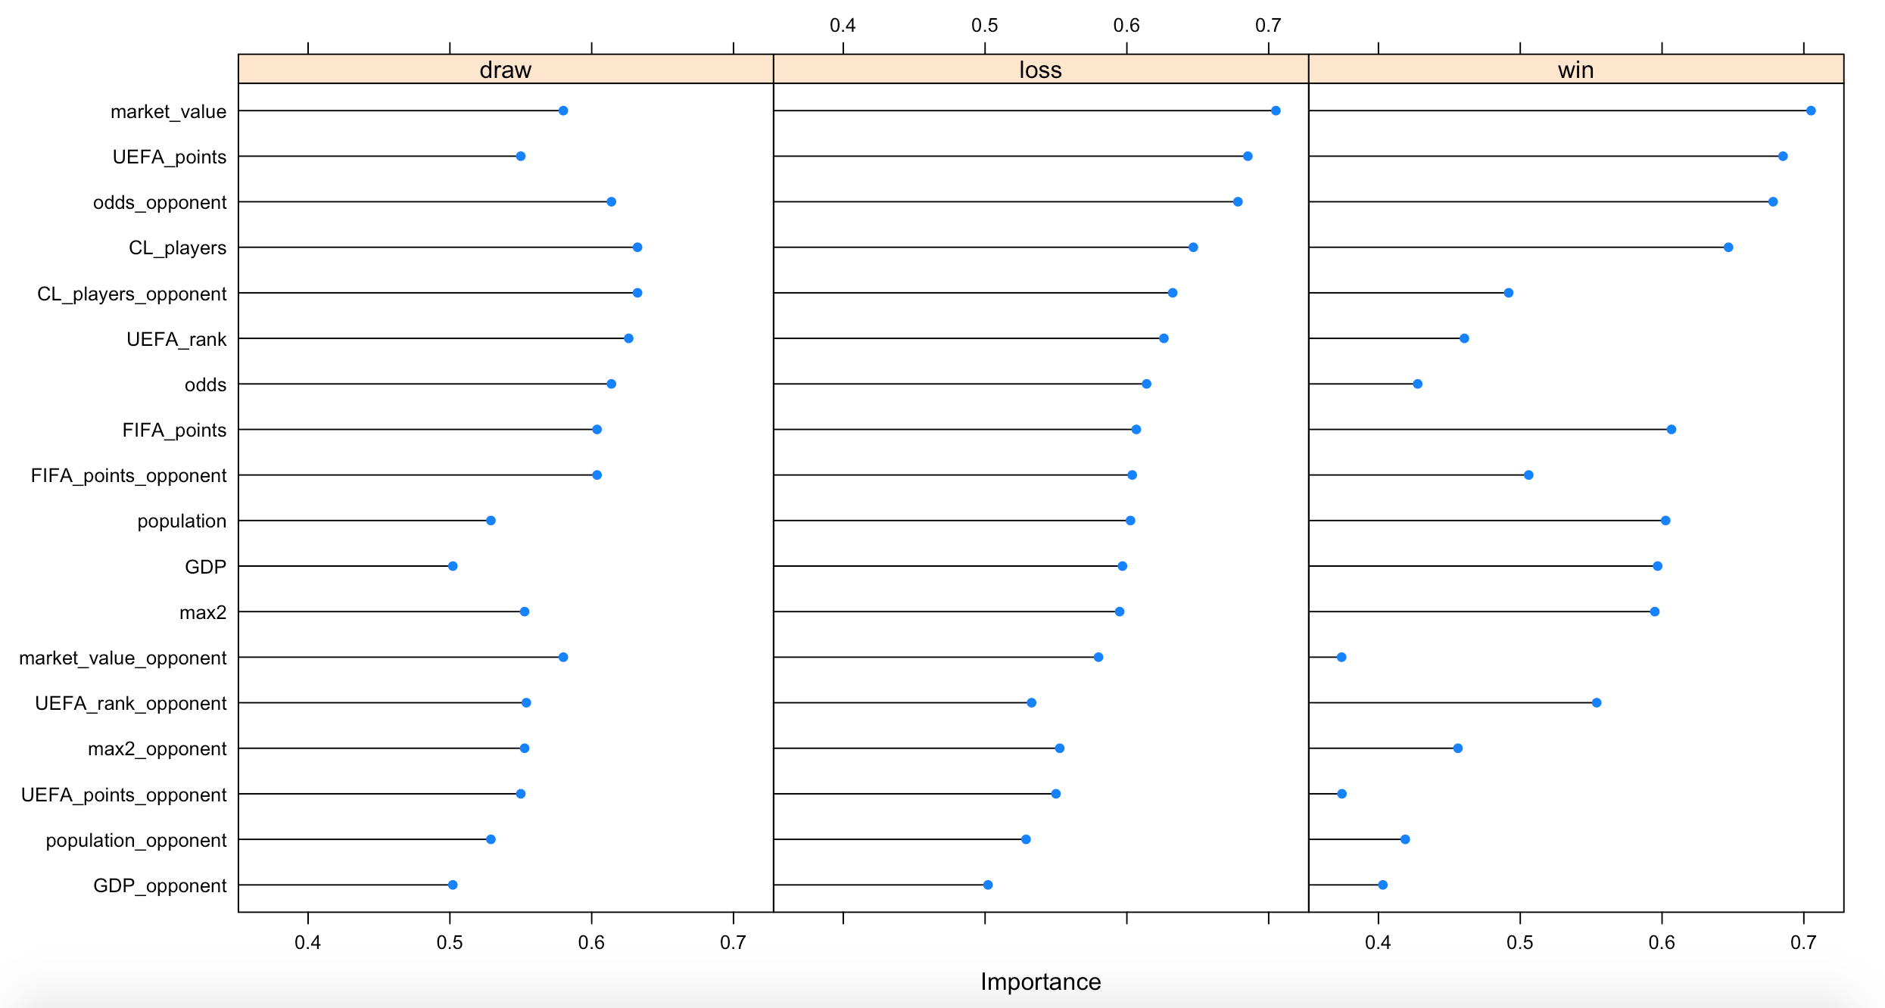
Feature Selection

Slide 10
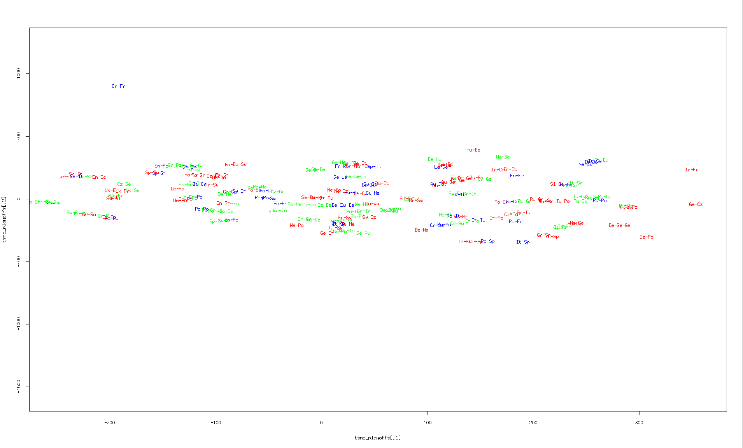
t-SNE on all games

Slide 11
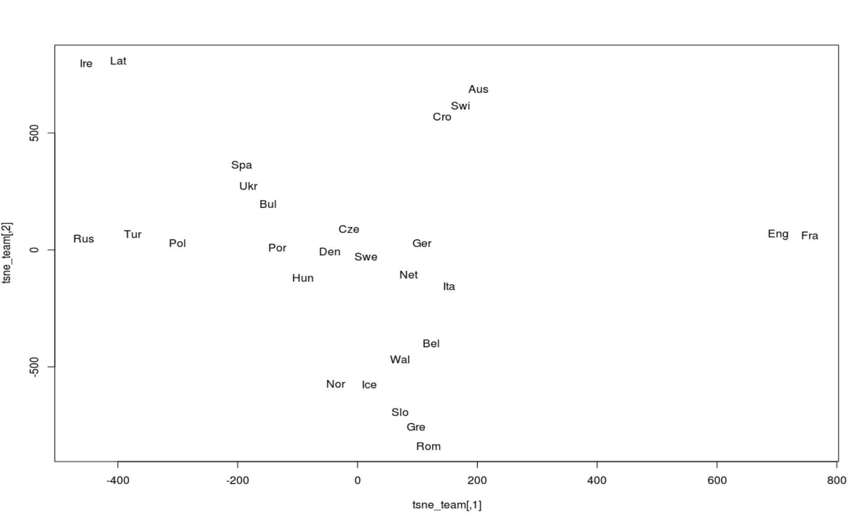
t-SNE on team data only

Slide 12
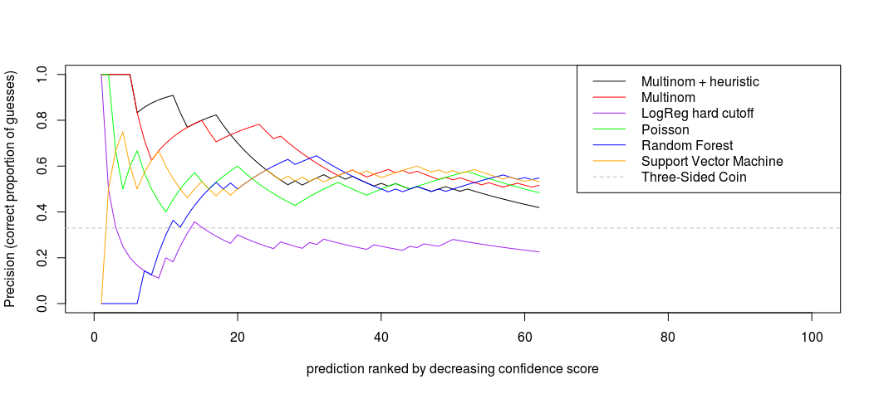
Evaluation and Model Selection

Slide 13
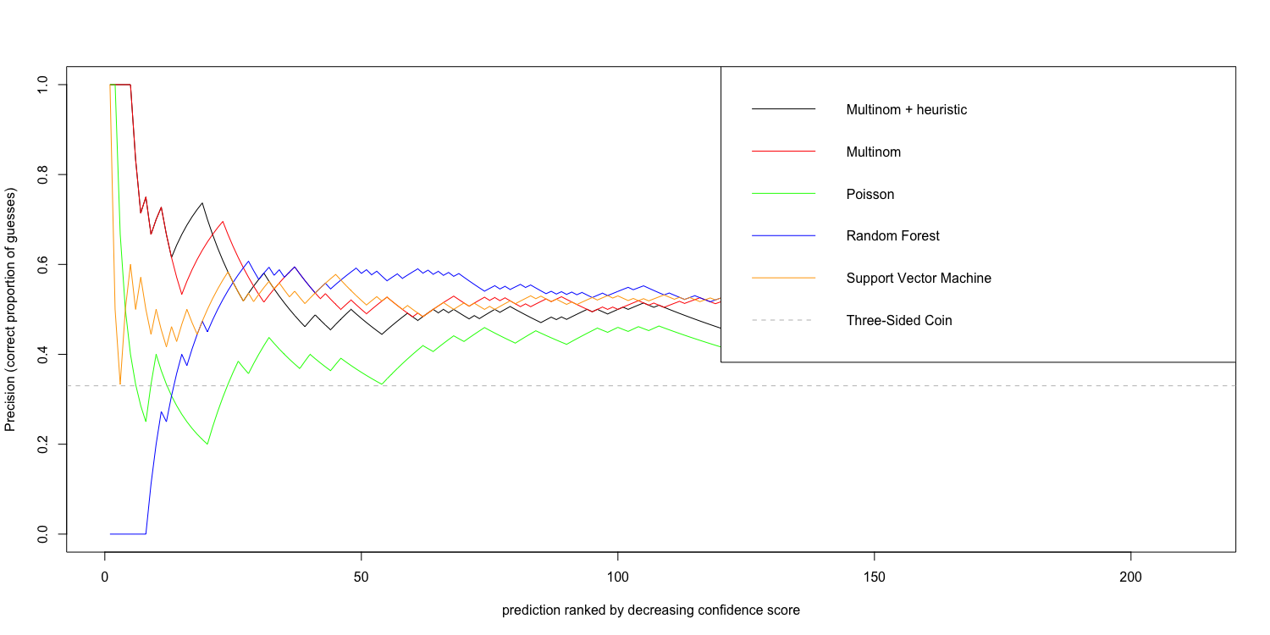
Evaluation and Model Selection

Slide 14
Conclusions
Probabilistic or not, models are similar in performance

Slide 15
Conclusions
Probabilistic or not, models are similar in performance
Modeling with Poisson, without additional features, throws away too much information

Slide 16
Conclusions
Probabilistic or not, models are similar in performance
Modeling with Poisson, without additional features, throws away way too much information
The lack of data decreases the confidence in our models' performance

