Slide 1

Proposal Defense
Team
Hafiz Mahir Saeed
Ahmed Anjum
Muhammad Taimor Ali khan

Slide 2

LOGO

Slide 3
Project Name/Title:
Petrol pump automization system
Supervisor(s):
Rizwan-ul-haq

Slide 4
Outline
Problem Statement
Motivation
Expected Outcome
Use
High Level Features
Related projects
Tools/Technologies/Environment
High Level System Diagram

Slide 5
Problem Statement
All manual readings and calculations of petrol are done on papers.
Human errors in calculations of petrol readings and daily sales cash.
Employee health hazards of inhaling petrol fumes when measuring the main fuel tanker causing Short-term effects include euphoria and excitement, dizziness and further more can cause vomiting, nausea and breathing difficulties.
Paper work is a hefty work for daily sales calculation
In case of emergency, quick measures are not available.
Opening Main tanker for measuring fuel is not safe due to stealing and frauds by personnel

Slide 6
Motivation
To automate the pump making the work flow more efficient and improving safety
To reduce the labor work

Slide 7
Expected Outcome
Automation of readings of main tanker and fuel dispenser
Automation of daily sales calculation of fuel and money.
Human error are reduced
Daily Sales can be viewed any time online
Certain level alert of a tanker
Camera live feed
Main tank is secured from frauds by employee
Notifying admin on Fire hazards
Employee working hours are maintained
Employee salary record is maintained

Slide 8
Use
Admin can easily manage information regarding employee
Admin can view the daily sales report of fuel dispensed from tanker and dispensers.
Admin can also generate sales reports and fuel reports from specific date to current dates
Admin can get information regarding working working employee
Employee can mark their attendance using fingerprint, when their working hours start

Slide 9
High Level Features
Check on fuel tanker theft.
Accurate Billing and Accounting of employees salary and daily sales.
Report generations of sales or fuel from specific date to current date.
Sales Management, An efficient Petrol Pump automation helps owners in effectively managing accounts, and sales operations
In case of emergency like fire a call will be made to fire department.
Making biometric attendance of employees for their working hours.

Slide 10



Tools/Technologies/Environment
We will be using following tools
Ultrasonic liquid level sensor for measuring fuel tanker
Fuel tanker door lock sensor
Controller like arduino or raspberry pi for sending fuel readings to back to system
Fire alarm sensors
Fingerprint attendance machine for marking employee attendance working hours
We will be using web technology including
react for font-end
node js as an API
Visual studio code
SQL database

Slide 11
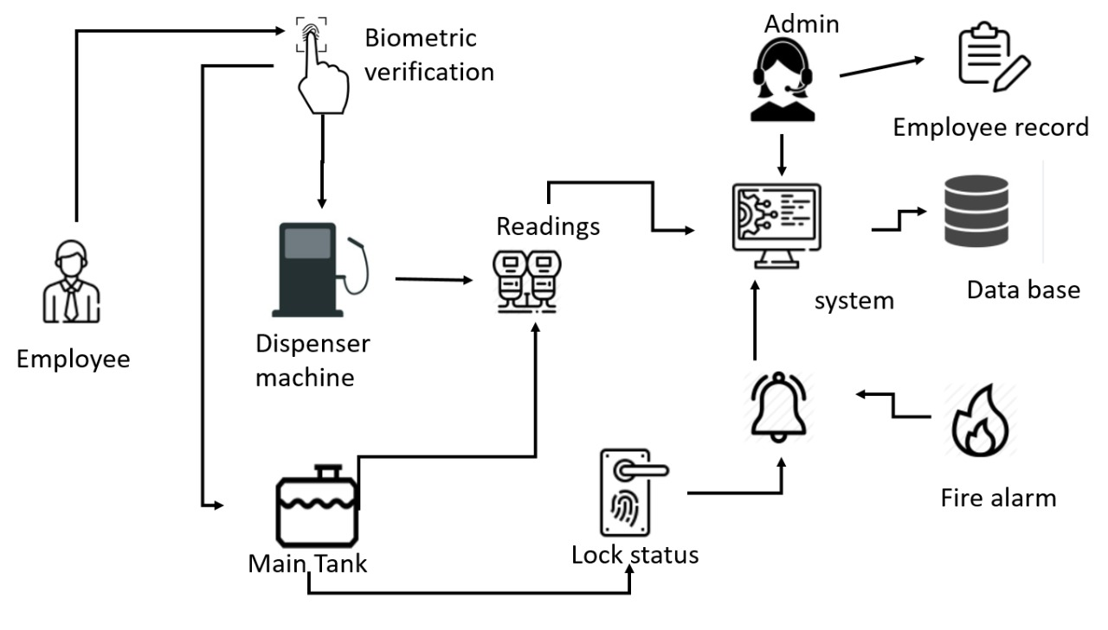
High Level System Diagram

