Slide 1

INVESTIGATING THE USE OF IMPEDANCE PLETHYSMOGRAPHY FOR DETECTING DECREASED BLOOD FLOW IN DIABETIC PATIENT LIMBS
Mirza Taimoor Sultan BAIG
Advisor: Assoc. Prof. Mustafa İlker Beyaz
JANUARY 2023

Slide 2
Outline
Introduction
Impedance Plethysmography
Motivation
Literature Review
Contribution
COMSOL Multiphysics 5.6
Geometrical Model
Theoretical Calculation
Tissue properties
Simulation Result
Circuit Diagram
Physical Implementation
Experimental Result
Conclusion

Slide 3
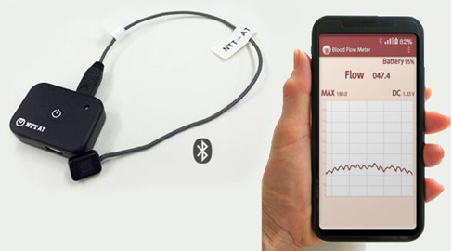
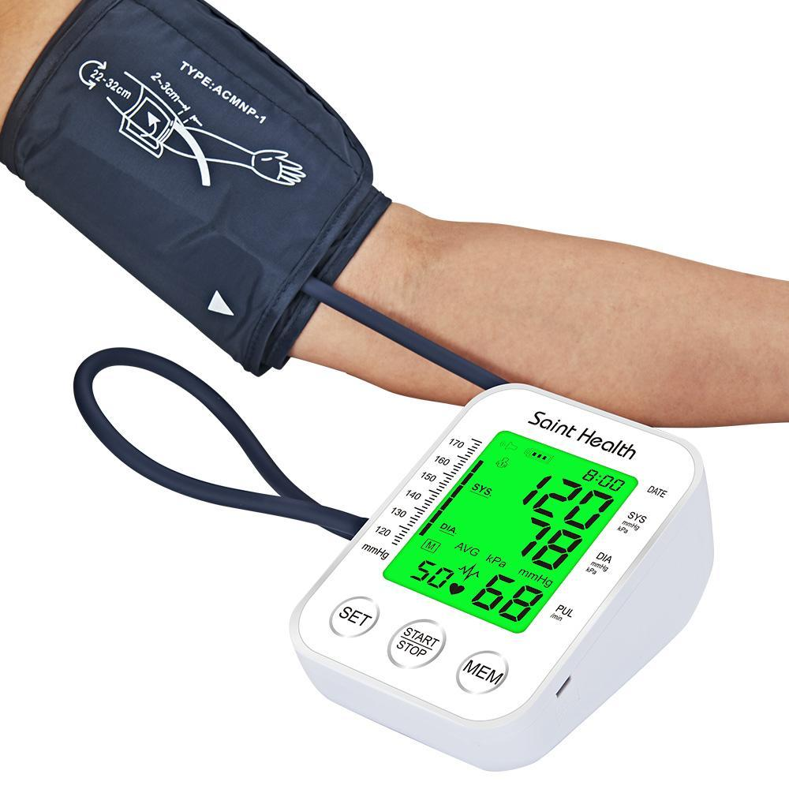

Modern Methods of Measuring Blood Flow
Ultrasound transducer
Source: (Wearable Compact Blood Flow Sensor _ MEMS_Microfabricated Products _ NTTAT Advanced Technology Product Introduction Site, n.d.)
Digital Sphygmomanometer
Source: (Buy Saint Health Arm Automatic Blood Pressure Monitor BP Sphygmomanometer Pressure Meter Tonometer for Measuring Arterial Pressure at Affordable Prices — Free Shipping, Real Reviews Wi, n.d.)
Sphygmomanometer
Source: (Aneroid Vérnyomásmérő És Sztetoszkópkészlet Egészségügyi Kézi Otthoni Vérnyomásmérő Széria Mandzsetta És Sztetoszkóp _ Wish, n.d.)
This system is made up of an app specifically designed for smartphones and a sensor gadget.
Visualizations such as animations of heartbeats or blood flow graphs are then generated by the smartphone based on this data.
It is a digital blood pressure monitor.
It is portable, easy to use, and rapidly and accurately detects blood pressure and pulse.
It is also called blood pressure cuffs.
Cuffs are used to stop blood flow in arteries by wrapping them around the upper arm and inflating them.

Slide 4
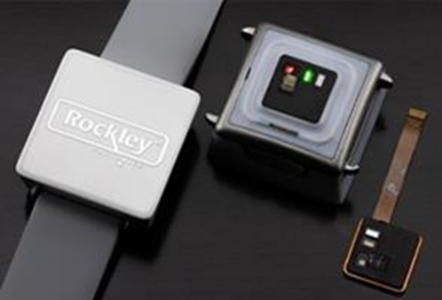
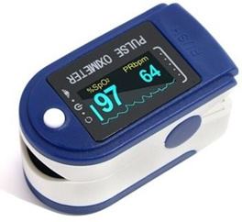
Modern Methods of Measuring Blood Flow
PPG Wristwatch
Source: Reader, R. (2022). Apple partner is developing a wearable to track blood sugar. In Fast Company. Retrieved from https://www.fastcompany.com/90730050/apple-partner-rockley-photonics-blood-sugar
Pulse Oximeter
Source: (SPO2 Finger Pulse Oximeter Fom a Reputed Online Medical Supply Store _ HealthConnection, n.d.)
A Non-Intrusive method for taking blood pressure using PPG Technique.
It can be worn on the wrist
Oximeters are tiny, non-invasive gadgets that may connect to a finger or toe.
It can tell how well the heart is supplying blood to the hands and feet.

Slide 5
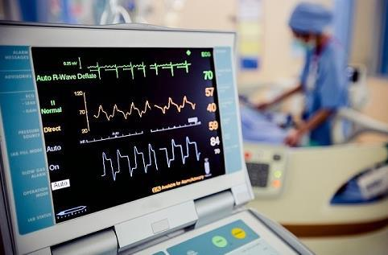
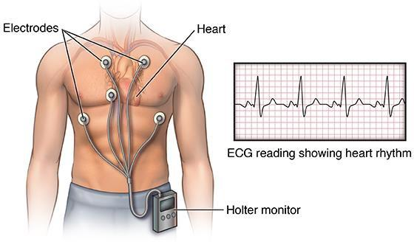
Modern Methods of Measuring Blood Flow
Electrocardiogram ECG
Source: (USA Medical and Surgical Supplies, 2018)
Holter Meter
Source: (Johns Hopkins Medicine, 2019)
At an early age of minor cardiovascular issues and signs of initial heart malfunction, an electrocardiogram or ECG is a simple, fast, and common test used to diagnose and catch an overview of the problem.
It is a safe procedure that captures the electrical activity of the heart.
A Holter blood pressure device is worn by the patient for twenty-four hours.
If the increase in blood pressure readings is to rule out or confirm the diagnosis of hypertension .

Slide 6
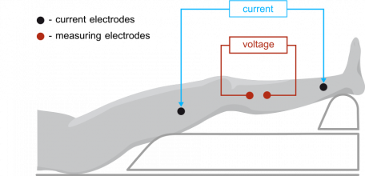
What is impedance plethysmography?
A method that can measure plethysmography and identify the arterial pulse waveform is called bioelectrical impedance. this technique is collectively known as impedance plethysmography.
By infusing a minute amount of AC into the body and then detecting the potential caused by blood flow, it gauges changes in blood volume.
Source: (Impedance Plethysmography (IPG) - Medis, n.d.)

Slide 7

Why Impedance Plethysmography?

Slide 8
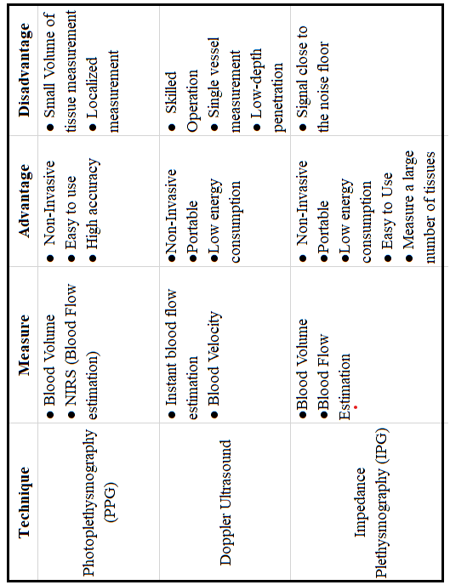
Source: Ansari, S. (2013). Motion artifact reduction in impedance plethysmography signal. ProQuest Dissertations and Theses, 116

Slide 9

Motivation
Monitoring the blood flow device is not affordable for everyone.
Expensive devices need to be precise and close to accuracy for the patient, however, it is directly proportional to the price they pay.
Everyone especially diabetic patients can measure their existence if the blood flow at home.
When the blood flow stops this device will give a signal that you should go to a doctor immediately.
To make a Portable and wearable device that everyone can afford easily.

Slide 10
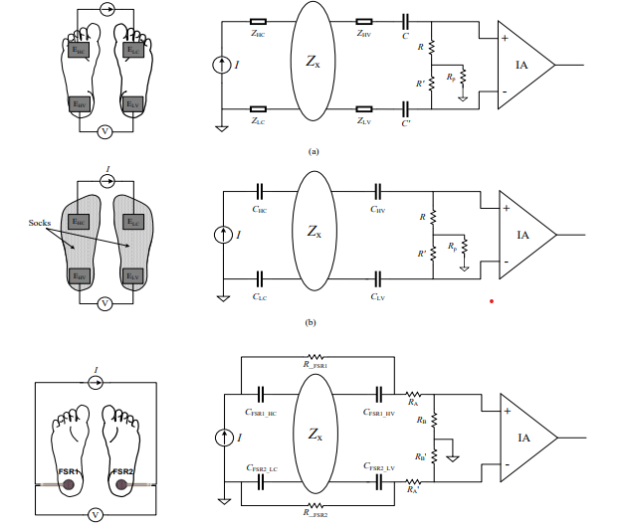
Literature Review
According to Isabel Morales’ research, the foot impedance plethysmography was carried out with two distinct kinds of electrodes, using 1mA/10kHz and finding the impedance of the foot.
In this study Piuzzi research is an ultimate technique selected that makes use of a current with a frequency of 50 kHz that is injected into the thorax of the subject using a couple of textile electrodes.
In this study of Ramkumar & Babu, blood flow was performed using a fuzzy logic toolbox with many different activities, measured before and after the 25 seconds of breath-holding activity. The plethysmographic waveform of forearm impedance can be used to analyze the changes in a heartbeat that are correlated with the changes in heart stroke volume.
Source: Morales, I., Gonzalez-Landaeta, R., & Simini, F. . Pressure sensors used as bioimpedance plantar electrodes: A feasibility study. 2021 IEEE International Symposium on Medical Measurements and Applications,

Slide 11
Contribution
In this work we are investigating using multiple electrodes to see the additional data going to make testing easier.
Our research is primarily focusing on the amount of blood flow through the finger of the upper limb for diabetic patients.

Slide 12

COMSOL Multiphysics 5.6
We are using COMSOL Model physics to investigate the tests.
The geometrical model of the test is on the 2D dimension.
In the COMSOL we are using electrical current physics and we are choosing the frequency domain.

Slide 13
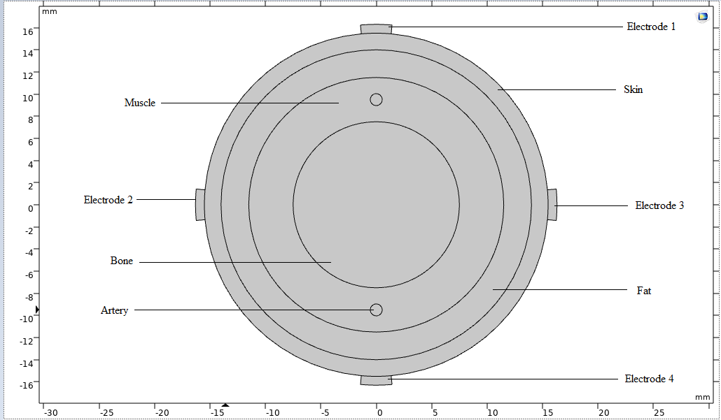
Geometrical Model
This geometry model was constructed to demonstrate the internal structure of the forefinger.
Electrodes numbering 1,2,3 and 4 are attached to the surface of the forefinger.
This way it is easier for our software to detect the best frequency penetrated across the layers.

Slide 14
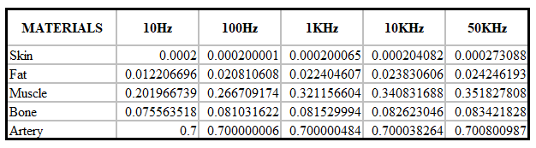
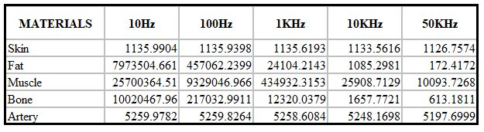
Frequency-Dependent Tissue Properties
The layers presented in the geometrical model namely:
skin, fat, muscle, bone, and artery will produce different values at different frequencies.
A theoretical view of these values is shown.
Depicting permittivity and conductivity.
The dielectric properties of tissues at different frequencies:
Electrical conductivity (S/m)
Electrical permittivity
Source: (Tissue Frequency Chart » IT’IS Foundation, n.d.)

Slide 15
Simulation Results
When the heart is diastolic condition.
When the heart is systolic condition.
Artery expands 15% of its original value, because when the heart pumps and supplies blood to the artery then the artery size will be expanded.

Slide 16
Simulation Results
The simulation result shows us that the output of electrodes 2 and 3 has given nearly the same values. Therefore, we would choose one out of electrodes 2 and 3.

Slide 17
Simulation Results
Finally, we took 100 Hz as the optimal frequency to get 1 as our result.

Slide 18
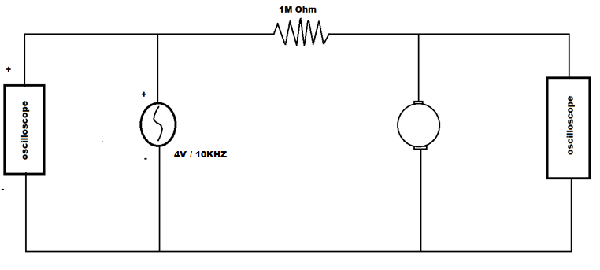
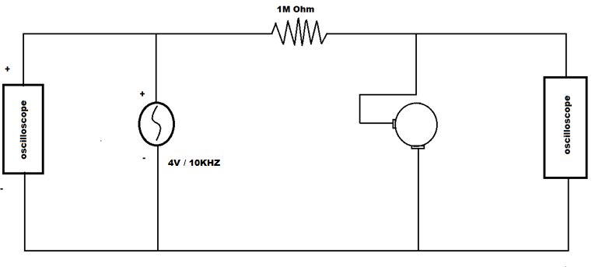
Circuit Diagram
Block Diagram of Position of electrodes top-bottom
Block Diagram of Position of electrodes Side-bottom
We are using 4Vpp with respect to frequency 100Hz /10KHz.
We try to look at the changes in peak-to-peak voltages.
Oscilloscope

Slide 19
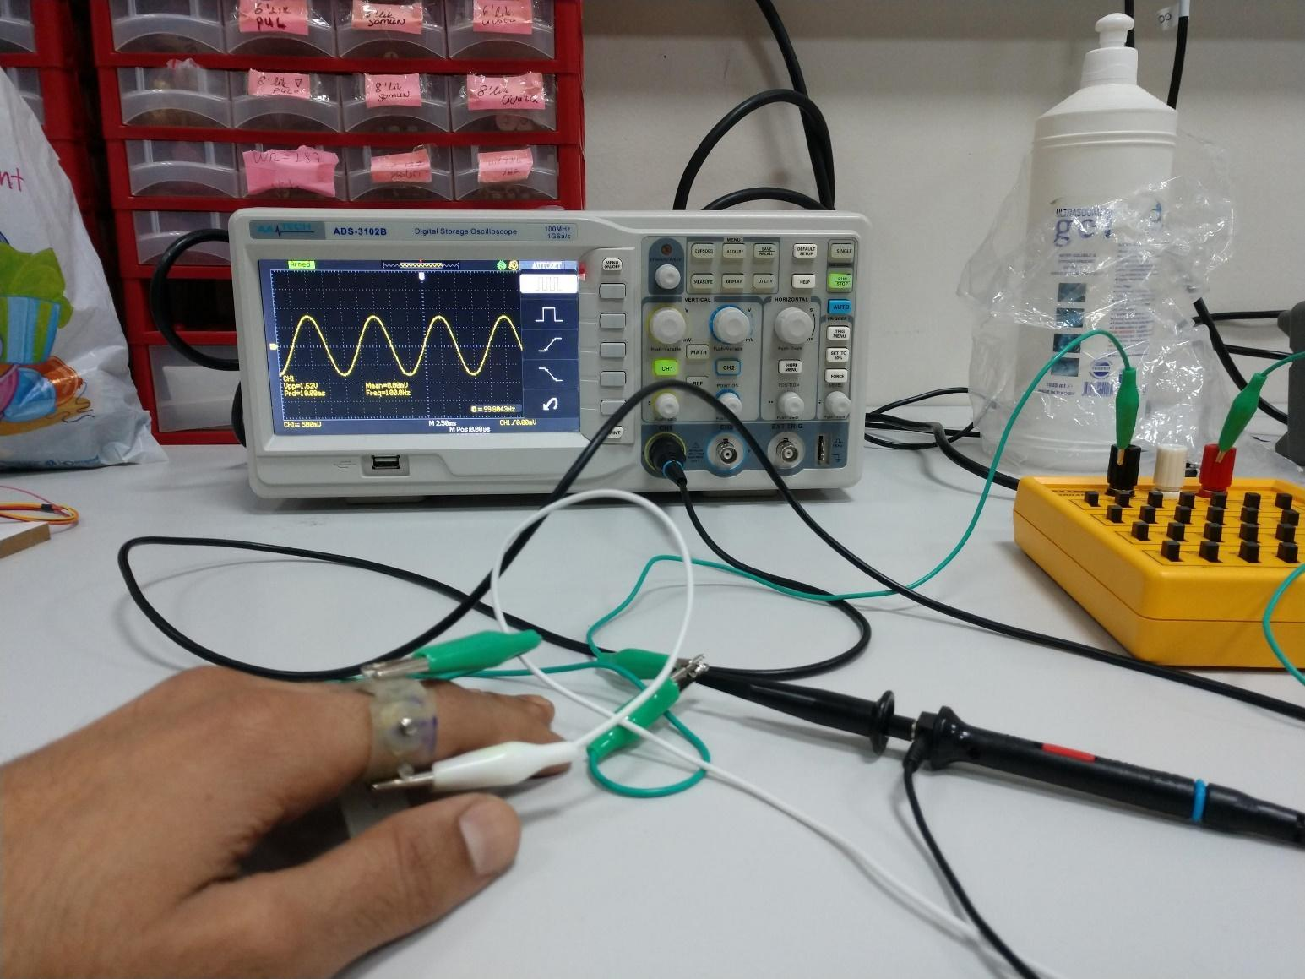
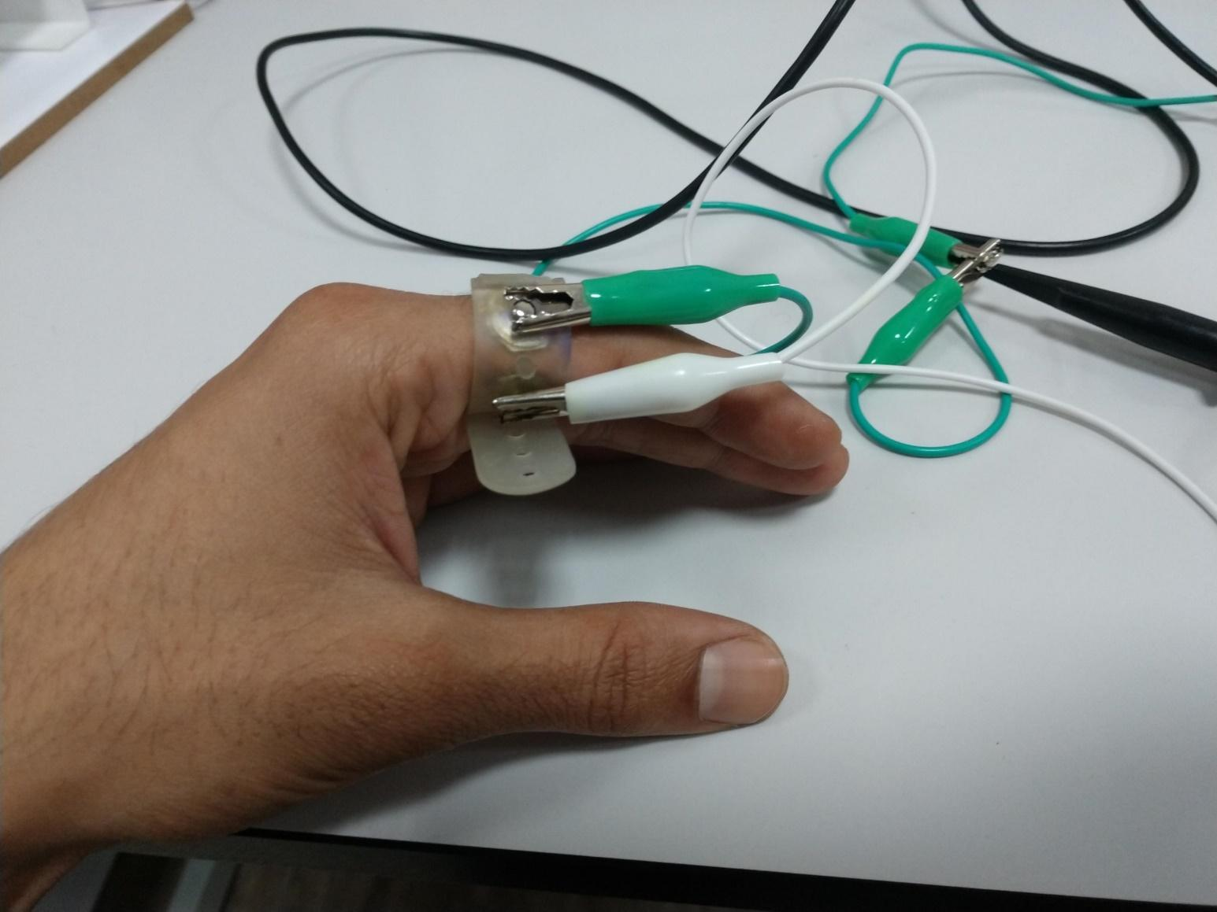
Physical Implementation
Visualization of the electrodes clipped on the forefinger.
Top Bottom
Side Bottom

Slide 20
Top-Bottom Results
Resulting graphs of the top bottom with 100Hz and 10KHz.
Using 100Hz Frequency
Using 10KHz Frequency

Slide 21
Side-Bottom Result
Resulting graphs of the side bottom with 100Hz and 10KHz.
Using 100Hz Frequency
Using 10KHz Frequency

Slide 22
Conclusion
The finger-simplified model was created in model geometry. A framework made up of five parts was used to build the finger. (i.e., skin, fat, artery, muscle, and bone)
The study includes COMSOL simulation results compared with experimental results to obtain the optimum parameters for this technique. The COMSOL simulation uses 4 electrodes in different positions with a current of 10mA giving the optimal frequency of 100Hz.
It was shown that multiple electrodes can be useful in obtaining impedance change.
This is useful because signals can not be obtained from one pair, or to further support the results.

Slide 23
Conclusion
The study was performed under normal resting conditions where an experimental procedure was set up to measure the impedance response from the finger.
Experiment results were not conclusive as more sensitive impedance analyzers are required.
This research will be helpful to find out the heartbeat using impedance plethysmography.

Slide 24
References of Literature Review
Morales, I., González-Landaeta, R., & Simini, F. (2021). Bioimpedance plethysmography with capacitive electrodes and sole force sensors: Comparative trial. Journal of Physics: Conference Series, 2008(1). https://doi.org/10.1088/1742-6596/2008/1/012018
Piuzzi, E., Pisa, S., Pittella, E., Podestà, L., & Sangiovanni, S. (2020). Wearable belt with built-in textile electrodes for cardio—respiratory monitoring. Sensors (Switzerland), 20(16), 1–15. https://doi.org/10.3390/s20164500
Ramkumar, M., & Babu, C. G. (2017). A Comprehensive Analysis of Forearm Impedance Plethysmography for the Maximally Non Invasive Monitoring and Measurement of Heart Pumping Function. SSRN Electronic Journal, 1(2), 178–184. https://doi.org/10.2139/ssrn.2942416

Slide 25
Thank you

