Slide 1


CSci 6971: Image Registration
Lecture 6: Getting Started with ITK
January 30, 2004
Prof. Chuck Stewart, RPI
Dr. Luis Ibanez, Kitware

Slide 2
Overview of Course Software
Insight Toolkit (ITK)
  NLM funded project to develop open-source medical image processing, segmentation and registration libraries
  Consortium of 3 companies and 3 universities with 6 more universities as subcontractors
VXL (Vision X Libraries), where X is a place-holder for names such as “image”, “numerics”
  Developed as volunteer effort by computer vision researchers at GE and several universities

Slide 3
CenSSIS Registration Tool Suite
Exploit ITK
  3D representations, processing algorithms, etc.
  Intensity-based registration
  Extensive examples and documentation
CenSSIS development currently using VXL
  Significant, novel feature-based algorithms developed using VXL
  Base library for robust estimation and other feature-based representations
Working together
  Some shared libraries already exist (numerics)
  Code can be compiled and linked, so that objects and functions from ITK and VXL can work together.
  BUT, do need to learn parts of two libraries

Slide 4
Moving Forward In This Course
CD distributed
  ITK, Cmake, VXL
  Does not yet contain the feature-based registration library
Lectures 6-10
  ITK and intensity-based registration
Lectures 11-15
  Rensselaer registration library will be delivered and used for feature-based registration
HW exercises will explore both toolkits
Either can be used for large programming project
  Choice should be individual and depend on the chosen project.

Slide 5
The Insight Toolkit
The Segmentation and
Registration Toolkit

Slide 6
What is ITK ?
Image Processing
Segmentation
Registration
No Graphical User Interface (GUI)
No Visualization

Slide 7









ITK Sponsors
The National
Institute for Dental and Craniofacial Research
The National
Science
Foundation
The National Institute of Neurological Disorders and Stroke

Slide 8














ITK Developers

Slide 9

ITK Developers
* indicates a subcontractor.

Slide 10
ITK by the Numbers
March 2000
  First code check-in
1000
  # of nightly builds
718
  tests run nightly
21
  # of platforms ( software + hardware )
700
  # of classes
1600
  # of files with code

Slide 11
ITK by the Numbers
400K
  # of lines of code
100K
  # of lines of test code
35K
  # of lines of examples
150K
  # of lines of Applications
160
  weekly t-cons
50
  unique developers

Slide 12
ITK by the Numbers
500
  # of users subscribed to the mailing-list
300
  # of emails posted monthly to the users-list
565
  # of pages in the Software Guide PDF document
1800
  # of monthly hits to the URL of the Software Guide PDF
1900
  # of monthly hits to the URL of the Tutorial PDF
2400
  # of monthly hits to the source code files (.zip + .tar.gz)

Slide 13
The Insight Toolkit
Starting with ITK

Slide 14
Integrating ITK in your application
C++ Glue Code
GUI
{MFC,Qt,
wxWin
FLTK}
ITK
Image
Processing
Visualization
{OpenGL, VTK}

Slide 15
What do I need ?
C++ Compiler
gcc 2.95 – 3.3
Visual C++ 6.0
Visual C++ 7.0
VC++ 7 2003
Intel 5.0
IRIX CC
Borland 5.0
Mac - gcc
CMake
www.cmake.org

Slide 16
Downloading ITK
Stability
Release tar
files
Live on the
Edge
CVS
http://www.itk.org
Insight.tgz
CVS anonymous

Slide 17

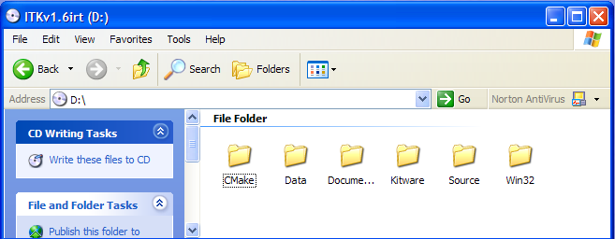
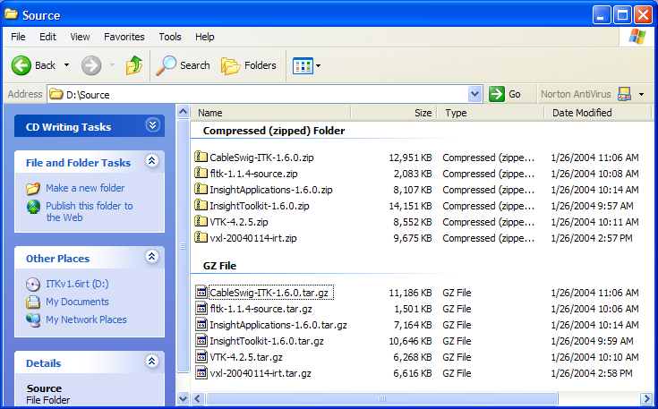
Copying ITK from the CD
/Source/
InsightToolkit-1.6.0.zip
InsightToolkit-1.6.0.tar.gz

Slide 18
Downloading CMake
Latest
CMake
Release
ITK
Requires
http://www.cmake.org
Install
Binaries
Get the
Binaries
1.8.3

Slide 19
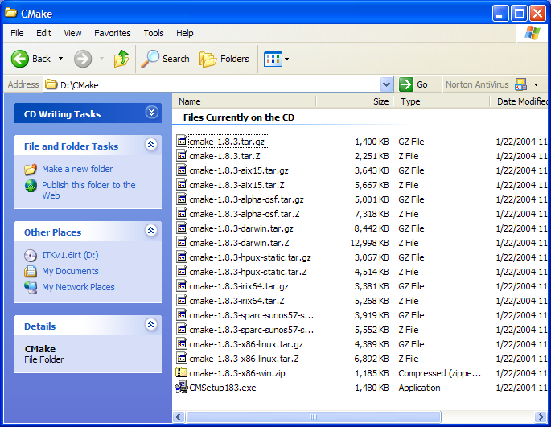
Installing CMake from the CD
/CMake/
cmake-1.8.3.tar.gz
cmake-1.8.3-x86-win.zip
cmake-1.8.3-x86-linux.tar.gz
CMakeSetup183.exe

Slide 20


Configuring ITK
Source Tree
Binary Tree
Out
Source Build
ITK
ITKb
Recommended !
Common
Common
Algorithms
Algorithms
BasicFilter
BasicFilter
Numerics
In
Source
Build
Numerics
IO
IO

Slide 21
Configuring ITK – MS-Windows
Run CMake
Select the SOURCE directory
Select the BINARY directory
Select your Compiler

Slide 22
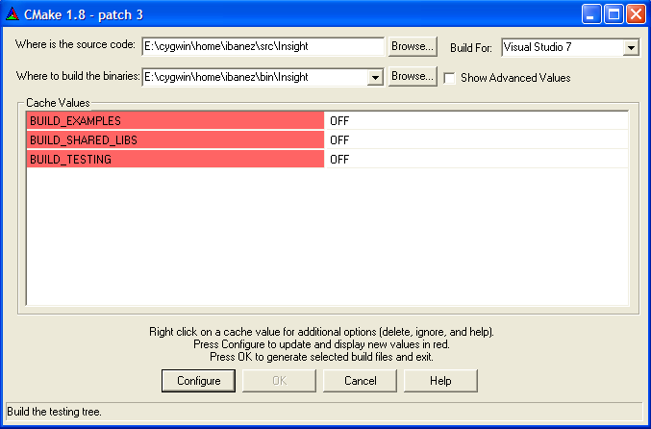
Configuring ITK – MS-Windows

Slide 23
Configuring ITK – MS-Windows
Disable BUILD_EXAMPLES
Disable BUILD_SHARED_LIBS
Disable BUILD_TESTING
Click “Configure” to configure
Click “OK” to generate project files

Slide 24
Configuring ITK – Unix
Create the BINARY directory (mkdir)
Change directory to the BINARY directory (cd)
Set the environment variables CC and CXX
setenv CC /usr/bin/gcc; setenv CXX /usr/bin/g++ OR
export CC=/usr/bin/gcc; export CXX=/usr/bin/g++
Type ccmake with argument the SOURCE directory

Slide 25
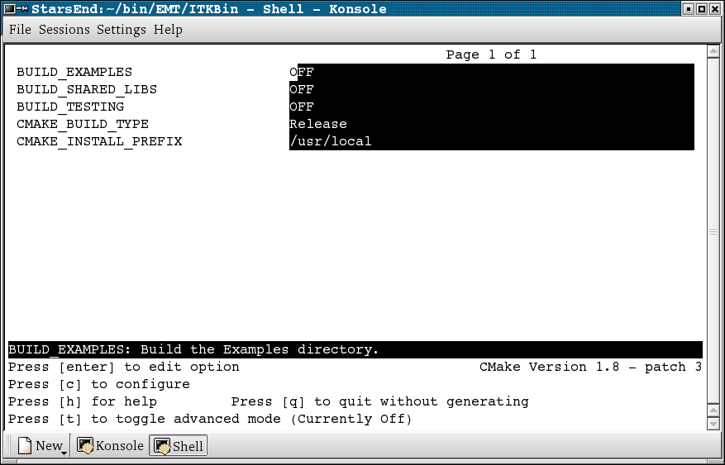
Configuring ITK – Unix

Slide 26
Configuring ITK – Unix
Disable BUILD_EXAMPLES
Disable BUILD_SHARED_LIBS
Disable BUILD_TESTING
Type “c” to configure
Type “g” to generate the Makefiles
Type “make” to start building

Slide 27
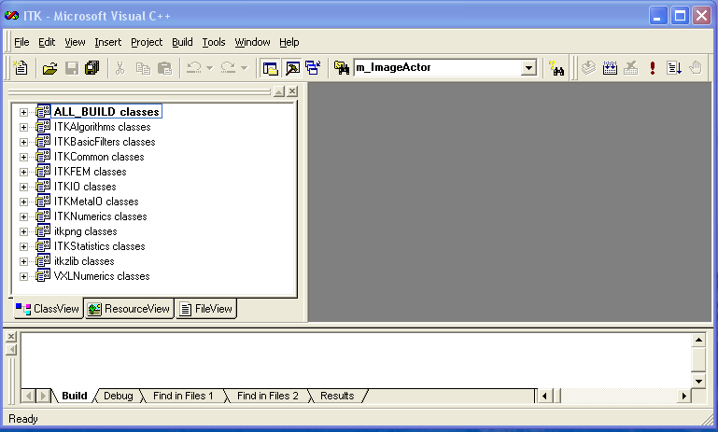
Building ITK

Slide 28
Building ITK
Open ITK.dsw in the Binary Directory
Select ALL_BUILD project
Build it
…It will take about 15 minutes …

Slide 29
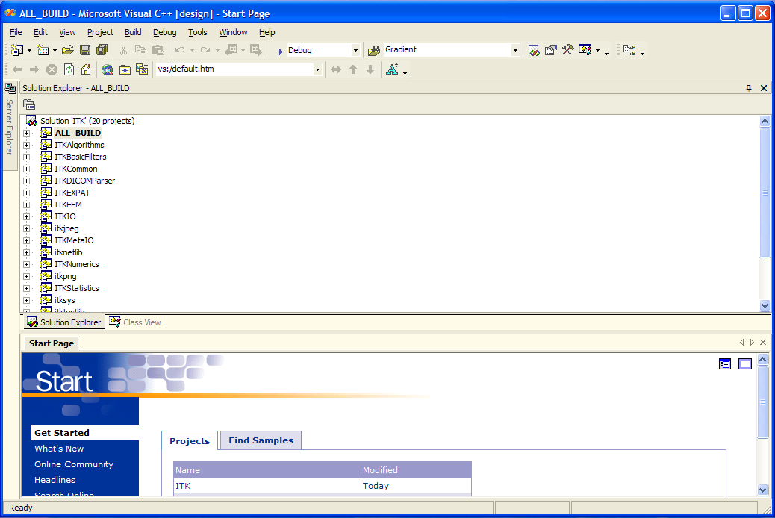
Building ITK

Slide 30
Building ITK
Open ITK.sln in the Binary Directory
Select ALL_BUILD project
Build it
…It will take about 15 minutes …

Slide 31
Building ITK
Most of ITK classes are C++ Templates
Basic libraries are small
they only contain non-templated classes
Basic libraries are built in about 15 min

Slide 32
Verifying the Built
Libraries will be found in
In MS-Windows
ITK_BINARY / bin / { Debug, Release }
In UNIX
ITK_BINARY / bin /

Slide 33
Verifying the Built
The following libraries should be there
ITKCommon
ITKBasicFilters
ITKAlgorithms
ITKNumerics
ITKFEM
ITKIO
ITKStatistics
ITKMetaIO
itkpng
itkzlib

Slide 34
Using ITK – Hello World
Copy
“HelloWorld.cxx”
“CMakeLists.txt”
from the
Examples/Installation
Directory
into another
directory
Run
CMake
Select Source Dir
Select Binary Dir

Slide 35
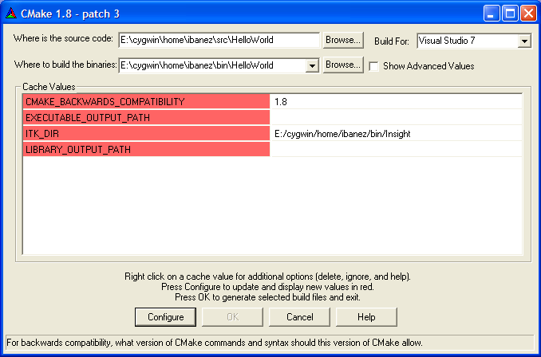
Using ITK – Hello World

Slide 36
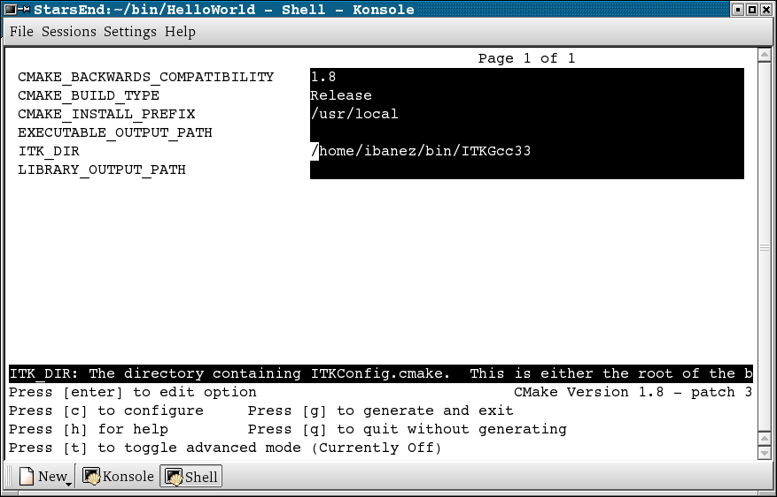
Using ITK – Hello World

Slide 37
Using ITK – Hello World
Accept the default in CMAKE_BACKBARD_COMPATIBILITY
Leave empty EXECUTABLE_OUTPUT_PATH
Leave empty LIBRARY_OUTPUT_PATH
Set ITK_DIR to the binary directory
where ITK was built

Slide 38
Building the HelloWorld Project
Open HelloWorld.dsw (or .sln)
generated by CMake
Select ALL_BUILD project
Build it
…It will take about 3 seconds …

Slide 39
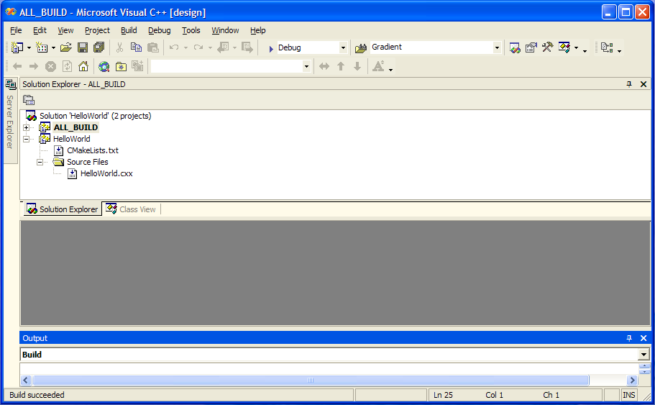
Using ITK – Hello World

Slide 40
Using ITK – Hello World
Locate the file HelloWorld.exe
Run it…
It should produce the message:
ITK Hello World !

Slide 41
Starting Your Own Project
Create a clean new directory
Write a CMakeLists.txt file
Write a simple .cxx file
Configure with CMake
Build
Run

Slide 42
Writing CMakeLists.txt
PROJECT( myProject )
FIND_PACKAGE ( ITK )
IF ( ITK_FOUND )
INCLUDE( ${USE_ITK_FILE} )
ENDIF( ITK_FOUND )
ADD_EXECUTABLE( myProject myProject.cxx )
TARGET_LINK_LIBRARIES ( myProject ITKCommon ITKIO)

Slide 43
Writing myProject.cxx
#include "itkImage.h"
#include "itkImageFileReader.h"
#include "itkGradientMagnitudeImageFilter.h"
int main( int argc, char **argv ) {
typedef itk::Image<unsigned short,2> ImageType;
typedef itk::ImageFileReader<ImageType> ReaderType;
typedef itk::GradientMagnitudeImageFilter<
ImageType,ImageType> FilterType;
ReaderType::Pointer reader = ReaderType::New();
FilterType::Pointer filter = FilterType::New();
reader->SetFileName( argv[1] );
filter->SetInput( reader->GetOutput() );
filter->Update();
return 0;
}

Slide 44
How to Find What Your Need
http://www.itk.org
http://www.itk.org/Doxygen/html/index.html
Follow the link Alphabetical List
Follow the link Groups
Post to the insight-users mailing list

Slide 45
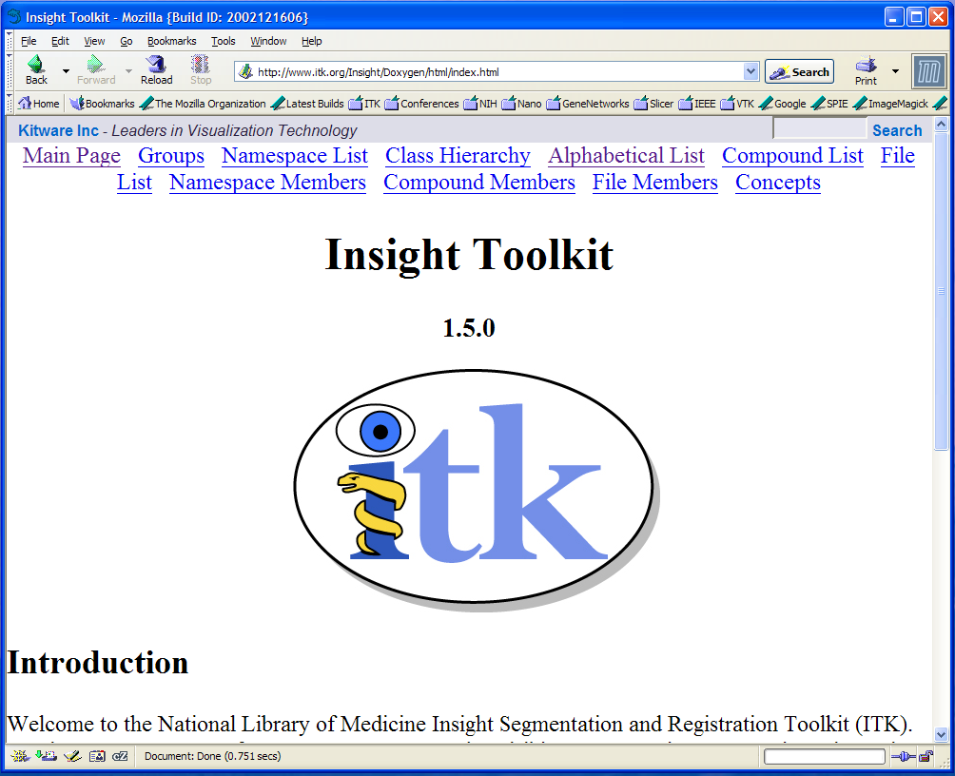
Doxygen Documentation

Slide 46
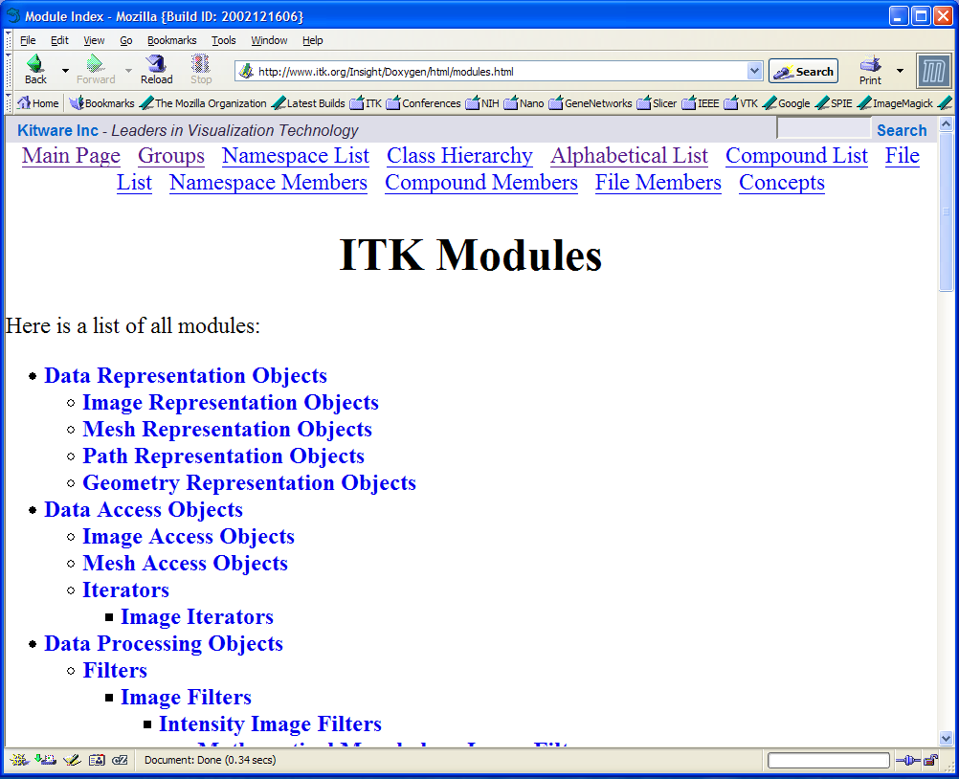
Doxygen Groups

Slide 47
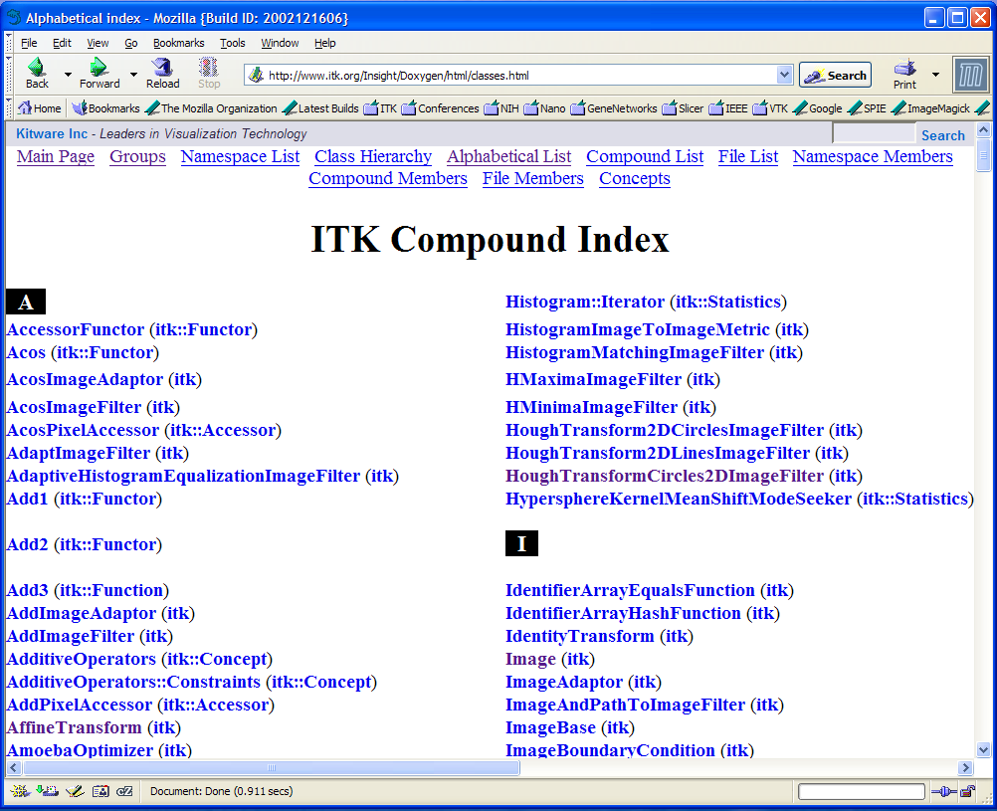
Doxygen Alphabetical List

Slide 48
ITK Architecture
ITK Architecture

Slide 49
ITK Basics
C++ Generic Programming
Data Pipeline
Multi-threading
Streaming
Exceptions
Events / Observers
Tcl and Python wrapping

Slide 50
Generic Programming
Example: STL Standard Template Library
Abstraction of Types and Behaviors
std::vector< T >
std::vector< int >
std::vector< double >
std::vector< char * >
std::vector< Point >
std::vector< Image >

Slide 51
ITK Image Class
itk::Image< PixelType , Dimension >
itk::Image< char , 2 >
itk::Image< char , 3 >
itk::Image< char , 4 >
itk::Image< float , 2 >
itk::Image< RGB , 3 >
itk::Image< unsigned short , 2 >
itk::Image< itk::Vector<float,2> , 2 >

Slide 52
C++ Namespaces
Avoid naming collisions
itk::
itk::Statistics::
itk::fem::
itk::fem::itpack
itk::bio
NEVER DO:
using namespace itk;
using namespace std;

Slide 53
ITK Most Common Keyword
typedef
typedef itk::Image< char , 2 > ImageType
typedef itk::ImageFilter< ImageType , ImageType > FilterType
otherwise...
itk::ImageFilter< Image< char , 2 > ,
Image< char , 2 > > FilterType

Slide 54
Smart Pointers
Smart
Pointer
Smart
Pointer
Smart
Pointer
Object
counter=0
counter=1
counter=2
counter=3
Self - Delete

Slide 55
Smart Pointers
typedef itk::Image< char , 2 > ImageType
typedef itk::ImageFilter< ImageType , ImageType > FilterType
FilterType::Pointer filter = FilterType::New();
ImageType::Pointer image = filter->GetOutput();
NO NEED FOR
filter->Delete();

Slide 56
Const Correctness
Knowing constancy is Insight.
Not knowing constancy leads to disaster.
Tao Te Ching, XVI. Lao Tsu

Slide 57
Const Smart Pointers
typedef itk::Image< char , 2 > ImageType
typedef itk::ImageFilter< ImageType , ImageType > FilterType
FilterType::Pointer filter = FilterType::New();
ImageType::ConstPointer image = filter->GetOutput();
Can only invoke “const” methods
image->GetSpacing ();
Compiler error for “non-const” methods
image->SetSpacing ( spacing );

Slide 58
Data Pipeline
Image
Filter
Image
Filter
Image
Image
Filter
Image

Slide 59
Image Regions
LargestPossibleRegion
BufferedRegion
RequestedRegion

Slide 60
Streaming
Processing Large Images
Input
Image
Output
Image
Filter

Slide 61
Simple Image IO
Image
File
ImageFileReader
Image
Filter
Image
File
ImageFileWriter
Image

Slide 62
Simple Image IO
Image
File
ImageFileReader
Image
PNGImageIO
MetaImageIO
AnalyzeImageIO
GIPLImageIO
VTKImageIO
DICOMImageIO
CustomImageIO
Loadable Factories

Slide 63
Simple Image IO
#include “itkImage.h”
#include “itkImageFileReader.h”
#include “itkImageFileWriter.h”
typedef itk::Image< char , 2 > ImageType;
typedef itk::ImageFileReader< ImageType > ReaderType;
typedef itk::ImageFileWriter< ImageType > WriterType;
ReaderType::Pointer reader = ReaderType::New();
WriterType::Pointer writer = WriterType::New();
reader->SetFileName( “inputImage.dcm” ); // DICOM
writer->SetFileName( “outputImage.hdr” ); // Analyze
writer->SetInput( reader->GetOutput() );
writer->Update();

Slide 64
Exceptions
Error Management
Application Layer
ITK Layer

Slide 65
Exceptions
try
{
filter->Update();
}
catch( itk::ExceptionObject & exp )
{
std::cerr << exp << std::endl;
}

Slide 66
Events and Commands/Observers
Itk::Command
Itk::Object
Event
itk::Command
Event
Event
itk::Command
Event
itk::Command
Event
itk::Command

Slide 67
Events
Common Events
AnyEvent()
StartEvent()
EndEvent()
ProgressEvent()
IterationEvent()

Slide 68
Events and Commands/Observers
Itk::Object
Itk::Command
Itk::ProcessObject
MyCommand
Execute()
Itk::FilterXY
AnyEvent
AddObserver( )
MyEvent

Slide 69
Events and Commands/Observers
Itk::Object
Itk::Command
Itk::SimpleMemberCommand
Itk::ProcessObject
AnyEvent
MyEvent
MyClass
Itk::FilterXY
MethodX()
AddObserver( )

Slide 70
GUI Communication
GUI Layer
Widget
Widget
Observer
Command
Callback
ITK Layer
FilterX
FilterX

Slide 71
End
Enjoy ITK !

