Slide 1


Wi-Fi controlled Robot
By Taimoor Tanweer
Research Associate at CASE

Slide 2
Contents
Specifications
System Design
Interfacing Joystick using C#
Implementation of client server architecture
Ethernet to Rs232 conversion
Ip Cam Functionalities

Slide 3
Specifications
Controlling Range ~ 1km
Speed ~ 6-7 km/hour
Battery ~ 12hour
Differential Drive
Night Vision Device
Live Video Streaming

Slide 4
System Design
Wi-Fi
Ip Cam
Live Streaming
Ethernet To UART
PC
Wi-Fi
Controller
Drive Circuit
Joystick
Server (PC)
Client
(Robot)

Slide 5
Interfacing Joystick using C#
Implementation of Joystick Class
Polling Functions
ButtonID+1
Pressed Or not
ButtonID
To Do

Slide 6
Interfacing Joystick using C#
Implementation of Joystick Class
Already Open source Classes are available
just like a <string> class in OOP.
Just know clearly what are you aiming for.

Slide 7
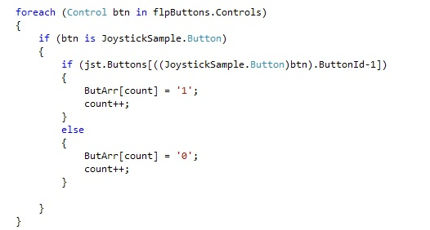
Interfacing Joystick using C#
Polling Functions

Slide 8
Implementation of Client-Server Architecture
What is Client Server architecture?
Benefits
Protocols
Future Improvements

Slide 9
Implementation of Client-Server Architecture
Client Server architecture
A Network Architecture
More than one client
A centralized single server

Slide 10
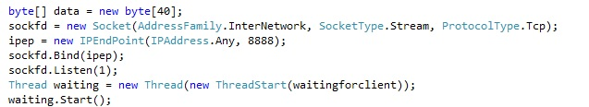
Implementation of Client-Server Architecture
Server

Slide 11
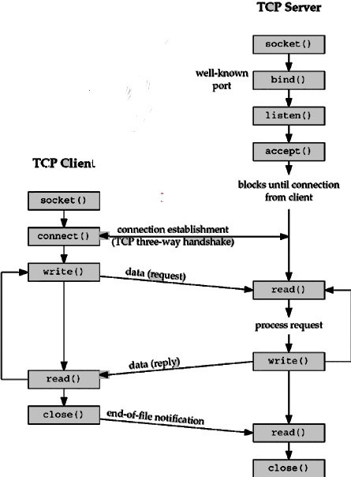
Implementation of Client-Server Architecture
How Client/Server Interacts ?

Slide 12

Implementation of Client-Server Architecture
Is robot a client or a server in this case ?

Slide 13
Implementation of Client-Server Architecture
Benefits
Frequent changes within the IT infrastructure i.e protocols
All users can utilize the resources on the server i.e office printers

Slide 14
Implementation of Client-Server Architecture
Protocol Used in Robotics
TCP - Requires Handshake
UDP – Doesn't Require Handshake

Slide 15
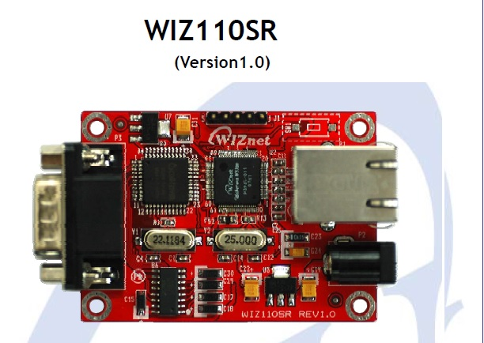
Ethernet to Uart conversion
Direct Connection to the Serial Device
Adding Network Function Simply and Quickly

Slide 16
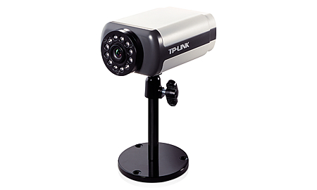
IP Camera Connectivity
Adding Static Camera IP
Get Live Streaming

Slide 17
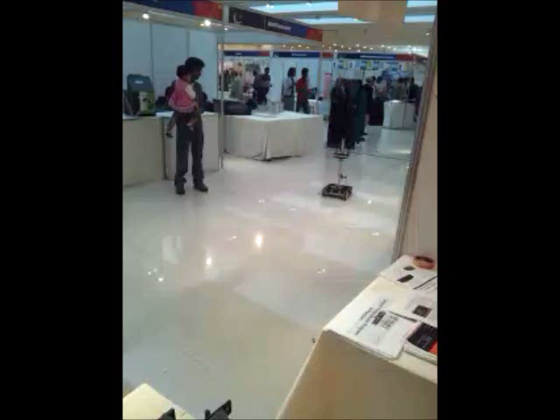
Demonstration

Slide 18
Thanks

