Slide 1


Slide 2
Final year Project
Project Title: Diagnoses of Appendicitis via Ultrasound Imaging

Slide 3
Project supervisor: Ms. Rabia Saqib
Group Members:
Maliha Aftab (023)
Mudassar Munir(077)
Jibran Mustafa(106)
Rehan Khan(120)

Slide 4
Previous Work
Center for Advanced Studies in Engineering
(CASE) (2013 – till date))
Proof-of-Concept of Prototype medical ultrasound imagers
Bringing obsolete Nemio-30 machine in working Condition
Working On Ultrasound Modules
Design and Development of Medical Ultrasound Imagers

Slide 6
Project Objectives
The overall objective of the project is to develop a software that differentiates between an appendix in normal condition and the infected one by the process image processing.

Slide 7
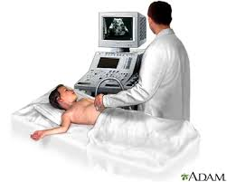
Introduction
WHAT IS ULTRASOUND?

Slide 8
Ultrasound
Ultrasound > starting range is 20kHz
Medical/Diagnostic Ultrasound 1-15 MHz
Sound spreads in all directions

Slide 9
WHAT IS APPENDICITIS??

Slide 10
TYPES OF APPENDICITIS
Acute appendicitis
Sub-acute appendicitis
Recurrent appendicitis
Chronic appendicitis

Slide 11
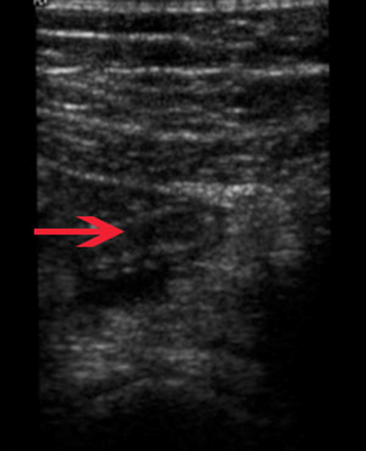
Ultra sound images

Slide 12
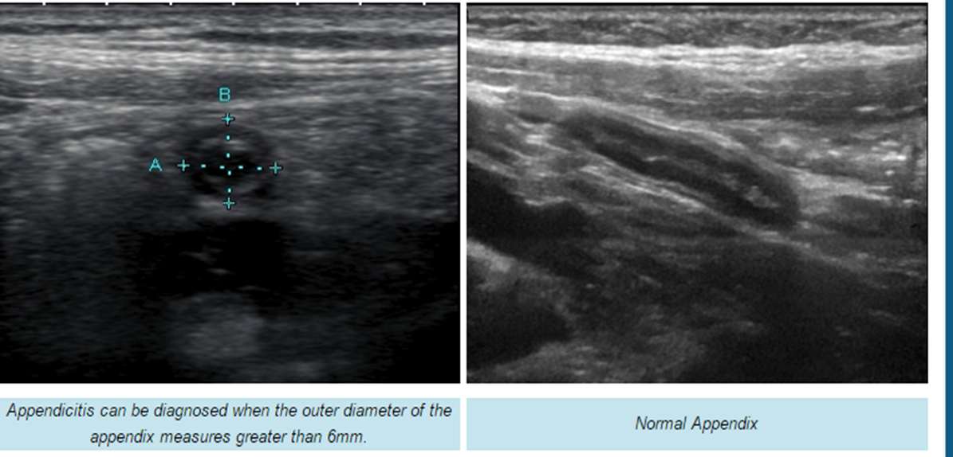
Continued……

Slide 13
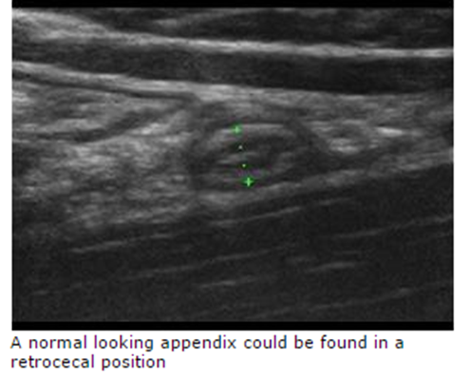
Continued………..

Slide 14
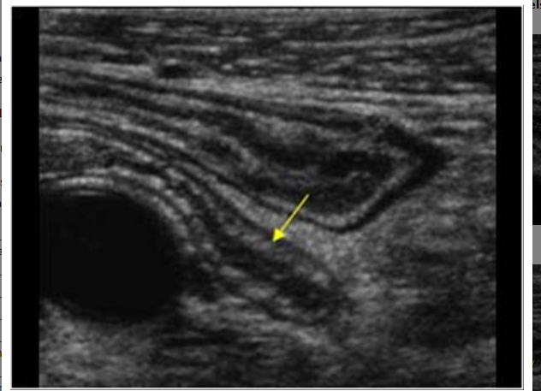
Normal Appendix

Slide 15
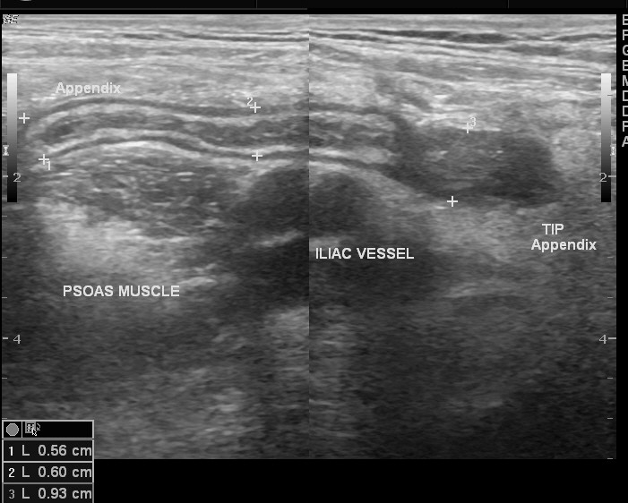
A person with Appendicitis

Slide 16
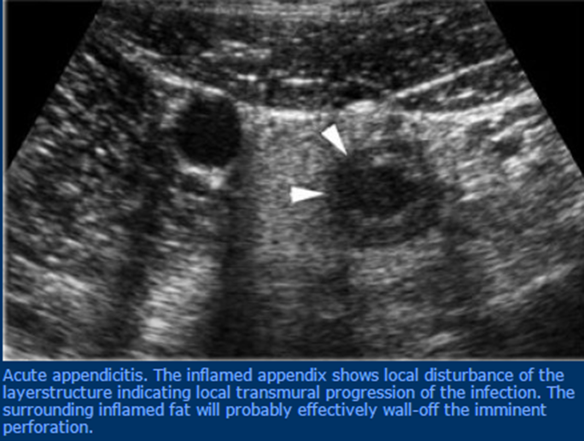
ACUTE APPENDICITIS

Slide 17
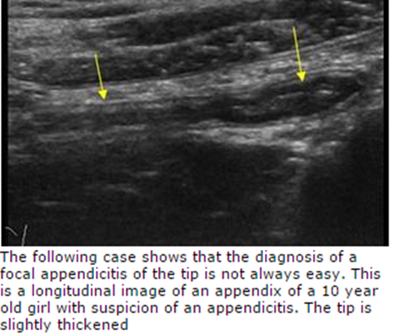
FOCAL APPENDICITIS

Slide 18
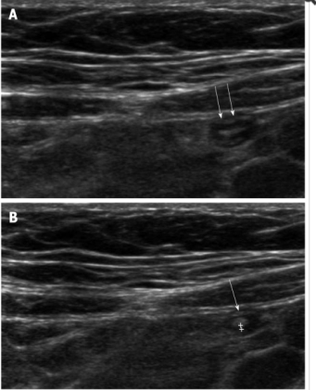
Basic Idea
Ultrasound Waves TX/RX
Human Body
Diagnosis Report
Image Produced
Digital image processing

Slide 19
Reasons for choosing the project
Interest in medical field
Appendicitis causes death if not diagnosed in time
Covers a lot of engineering concepts
(Signal and image processing, Electronics, Mathematical equations etc)

Slide 20
Scope
Research work
Improvement of images
Automated diagnosis report produced by an app
We will be working on two types of appendicitis
Acute appendicitis and Chronic appendicitis

Slide 21
What Motivated us??
There are no proper medical centers in our rural areas and villages for such diagnosis
To close the gap between engineering and medicine and make engineering science and medical science work together

Slide 22


