Slide 1
Implementation of a Neural Network-Based Perceptual Loss for Audio
Name = Taimur ul Islam
Matriculation number = 64955

Slide 2
Introduction
Objective:-
This project describe the perceptual loss between paired clean and noisy audio dataset.
Traditional metrics: MSE and SNR
Perceptual metric: VGGish embeddings with cosine distance.
Goal:-
Evaluate the difference between the results using given approaches

Slide 3
Objectives and Tasks
Implement perceptual loss function using VGGish
Compare with traditional metrics (MSE, SNR)
Tasks:
Set up embedding-based audio comparison
Compute traditional metrics
Analyze and visualize results

Slide 4
Literature Review
MSE & SNR measure distortion but may not align with human hearing
VGGish or OpenL3: Learn audio representations that track perception
Gap: Few works compare both methods on same dataset

Slide 5
Methodology
Load clean & noisy audio
Align and normalize
Compute MSE & SNR
Extract VGGish embeddings
Calculate cosine distance for perceptual loss
Compare results

Slide 6
Tools and Data
Tools:-
Python, NumPy, Pandas, Librosa, PyTorch/TF
Data:-
Clean files: 94 .wav
Noisy files: 101 .wav
Paired, resampled, trimmed, normalized

Slide 7
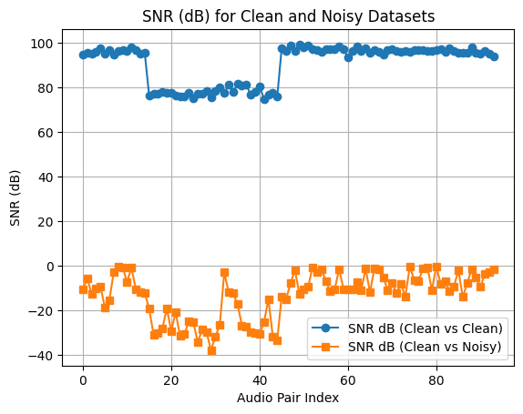
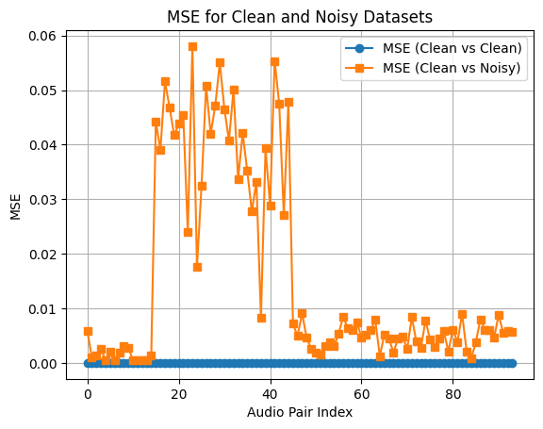
Results
MSE & SNR give numerical data
Perceptual loss more effective for complex noise

Slide 8
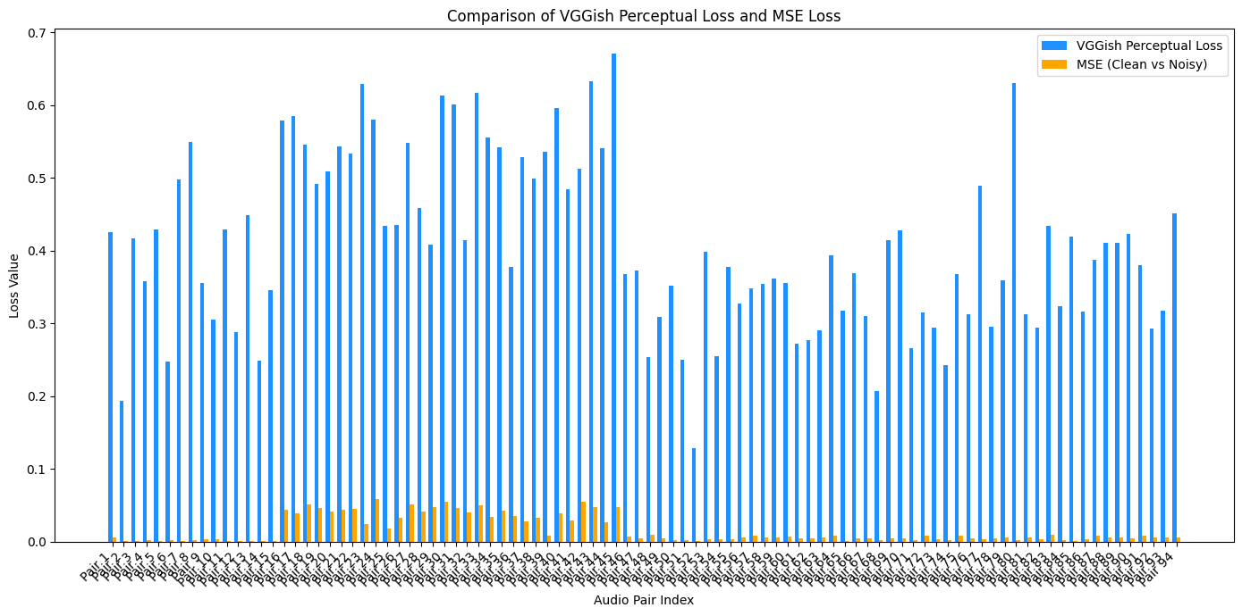
Conclusion
VGGish captures perceptual differences more effectively
VGGish-based loss better matches human perception
Useful for cases where human perception differs from basic metrics

Slide 9
Future Work
Test with real time audio
Compare with other models (OpenL3, PANNs)
Add subjective listening tests
Experiment with different noise types
Apply metrics to evaluate denoising algorithms

