Slide 1
Advanced Digital Techniques
Mr. Tai Nguyen
Email: taindp@viettel.com.vn

Slide 2
Content
Floating-point numbers:
Adders:
Basic Floating-point Algorithms:
Hardware for Floating-point Arithmetic:

Slide 3
1. Floating-point numbers:
A floating-point number comes with two signs:
Number sign, usually appears as a separate bit
Exponent sign, usually embedded in the biased exponent

Slide 4
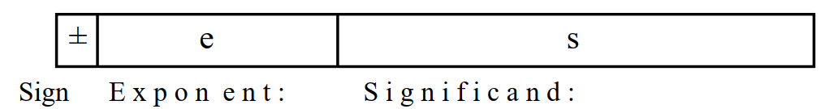
1. Floating-point numbers:
Typical Floating-point number format:

Slide 5
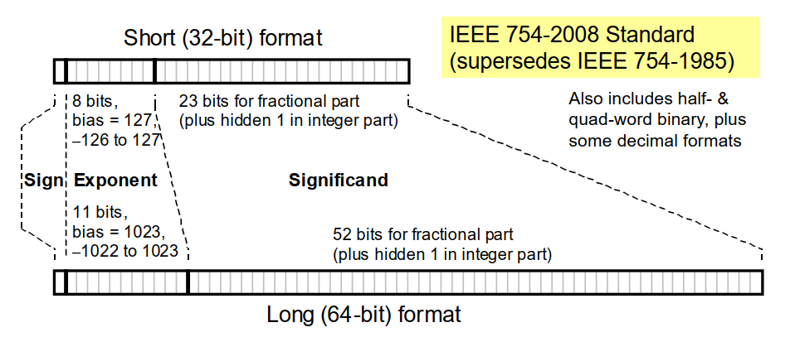
1. Floating-point numbers:
The IEEE Floating-point standard:

Slide 6
1. Floating-point numbers:
The values range Floating-point:
Minimum: exp = 00 00 00 01 & fraction = 23 bit 0
Maximum: exp =11 11 11 10 & fraction = 23 bit 1

Slide 7
1. Floating-point numbers:
The accuracy of Floating-point numbers:
Detect by numbers bit fraction.
Single FP: approximate 2⁻²³
Double FP: approximate 2⁻⁵²

Slide 8
1. Floating-point numbers:
Not a Number & Infinity Number:
NaN: exp = 11 11 11 11 & Fraction 23 bit ≠ 0
Inf: exp = 11 11 11 11 & Fraction = 23 bit 0

Slide 9
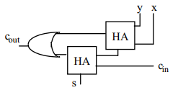
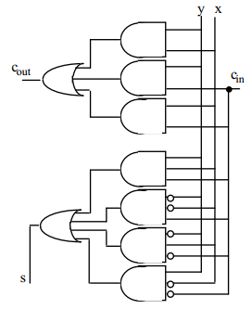
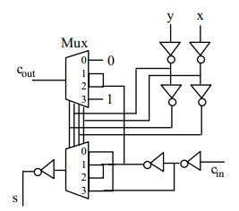
2. Adders:
Full-Adder:
Possible designs for a FA in terms of HA, logic gates and CMOS transmission gates

Slide 10
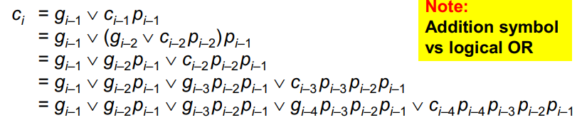
2. Adders:
Carry-Lookahead Adders:
Block generate and propagate signals:
g_{[i,i+3]}=g_{i+3}|(g_{i+2}&p_{i+3})|(g_{i+1}&p_{i+2}&p_{i+3})|(g_{i}&p_{i+1}&p_{i+2}&p_{i+3})
p_{[i,i+3]}=p_{i}&p_{i+1}&p_{i+2}&p_{i+3}

Slide 11
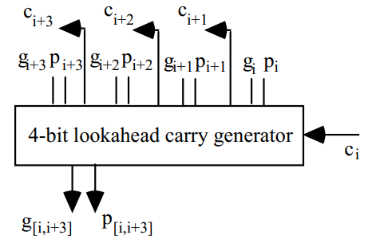
2. Adders:
Carry-Lookahead Adders:
Summarize:
g_{[ h , j ]} = g_{[ i + 1 , j ]} | p_{[ i + 1 , j ]} & g _{[ h , i ]}
p_{[ h , j ]} = p_{[ i + 1 , j ]} & p_{[ h , i ]}

Slide 12


3. Basic Floating-point Algorithm:
Addition/Subtraction:
Assume e1 $≥$ e2; alignment shift (preshift) is needed if e1 > e2

Slide 13
3. Basic Floating-point Algorithm:
Addition/Subtraction:
Step1: Check input number may zeros
Step2: Alignment exponent
Step3: Addition mantissa parts
Step4: Normalize result & Check special case

Slide 14
3. Basic Floating-point Algorithm:
Addition/ Subtraction:
Cases | Add Magnitude | Sub Magnitude
 |  | A > B | A < B | A = B
(+A)+(+B) | +(A+B)
(+A)+(-B) |  | +(A-B) | -(B-A) | +(A-B)
(-A)+(+B) |  | -(A-B) | +(B-A) | +(A-B)
(-A)+(-B) | -(A+B)
(+A)-(+B) |  | +(A-B) | -(B-A) | +(A-B)
(+A)-(-B) | +(A+B)
(-A)-(+B) | -(A+B)
(-A)-(-B) |  | -(A-B) | +(B-A) | +(A-B)

Slide 15
3. Basic Floating-point Algorithm:
Multiplication:
Step1: Addition exponent parts
Step2: Multiply coefficients
Step3: Normalize result & Check special case

Slide 16
3. Basic Floating-point Algorithm:
Division:
Step1: Subtraction exponent parts
Step2: Divide coefficients
Step3: Normalize result & Check special case

Slide 17


3. Basic Floating-point Algorithm:
Square-Rooting:
For e even:
For e odd:

Slide 18
3. Basic Floating-point Algorithm:
Exceptions in Floating-point Arithmetic:
Divide by zero
Overflow
Underflow

Slide 19
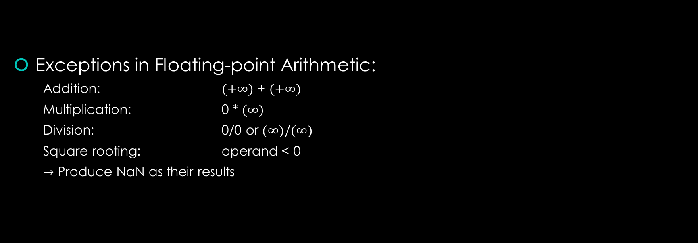
3. Basic Floating-point Algorithm:
Exceptions in Floating-point Arithmetic:
Addition: $(+∞)$ + $(+∞)$
Multiplication: 0 * $(∞)$
Division: 0/0 or $(∞)/(∞)$
Square-rooting: operand < 0
$→$ Produce NaN as their results

Slide 20
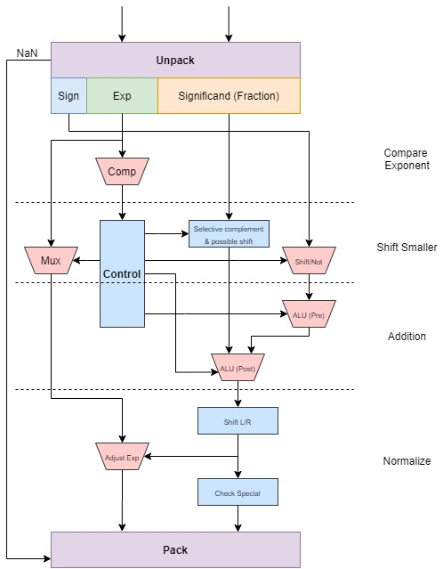
4. Hardware for Floating-Point Arithmetic:
FLP Add/Sub Hardware:
The Exp is too large to be represented in the Exp field (Overflow). The Exp is too small to be represented in the Exp field (Underflow).
OVF can occur only for normalizing right-shift.
UDF possible only with normalizing left-shift.
Exception involving NaN and invalid operations handled by unpacking and packing.

Slide 21
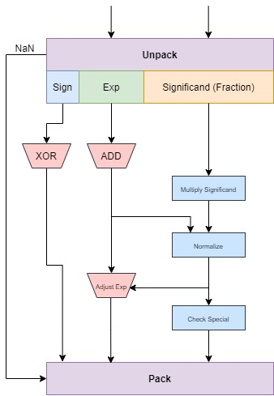

4. Hardware for Floating-point Arithmetic:
FLP Multiplier/Divider Hardware:
If add biased Exp, bias will be added twice. Therefore we need to subtract it once to compensate.

Slide 22
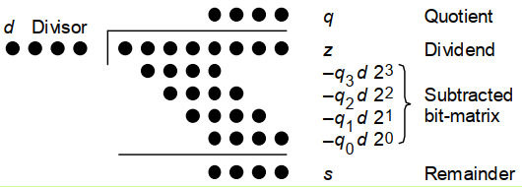
4. Hardware for Floating-point Arithmetic:
FLP Multiplier/Divider Hardware:
Shift/Subtract Division Algorithms:
z is Dividend
d is Divisor
q is Quotient
s is Remainder, z - (d*q)

Slide 23
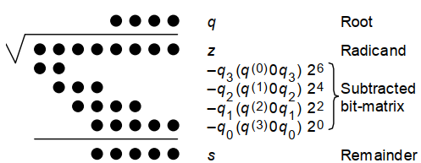
4. Hardware for Floating-point Arithmetic:
FLP Square-Rooting Hardware:
Binary SQR in dot notation
Restoring Shift/Subtract Algorithm

