Slide 1

Movie Data Exploratory analysis Tai ngoc Bui

Slide 2

Table of contents
Business Understanding
Objectives
Data Understanding
Exploratory Data Analysis and Recommendations
Q&A

Slide 3

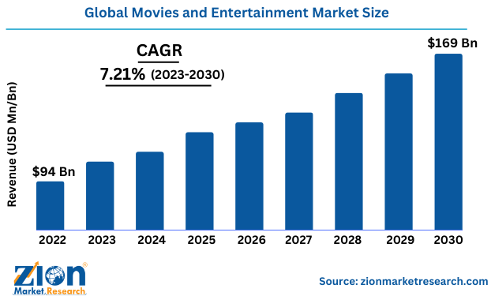
Business understanding

Slide 4

Objectives
Provide data-driven evidence to support the strategic investment
PROVIDE best strategies to minimize the overall investment risks
Notes:
To take advantage of such strong growth, this analysis report aims to provide

Slide 5



Data understanding
Major fields in these datasets
Quantitative data:
Production budget
Gross revenue
Average ratings
Categorical data:
Movie genres
Regions
Notes:
The data used in this analysis came from 3 different sources. The data fields include quantitative such as pro, revenue and average ratings, as well as categorical data fields such as

Slide 6
Exploratory analysis
Return on investment (ROI) as measurement used to determine a movie’s success
ROI = Gross revenue / Production Cost - 1
Strategies to reduce investment risks: Picking the right month, right genres and right directors

Slide 7
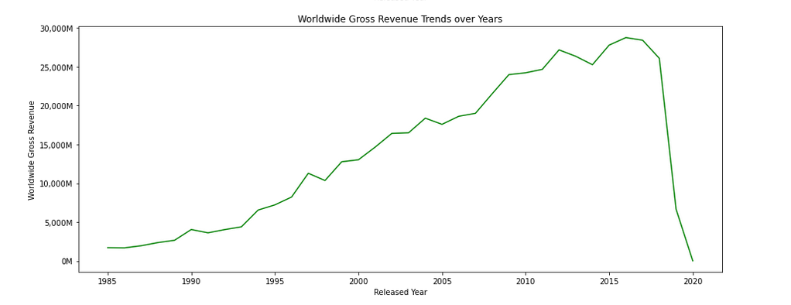

Overall trend
ROI removes bias factors such as inflation
ROI helps normalize the scale differences between blockbusters and smaller movies

Slide 8
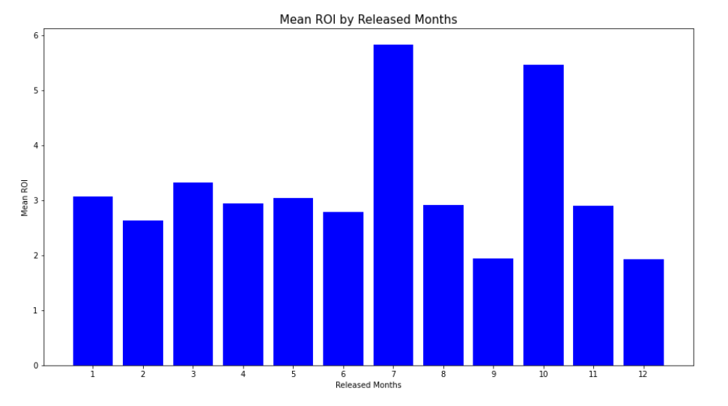
which month to release?
Releasing in October will avoid competition from blockbusters

Slide 9
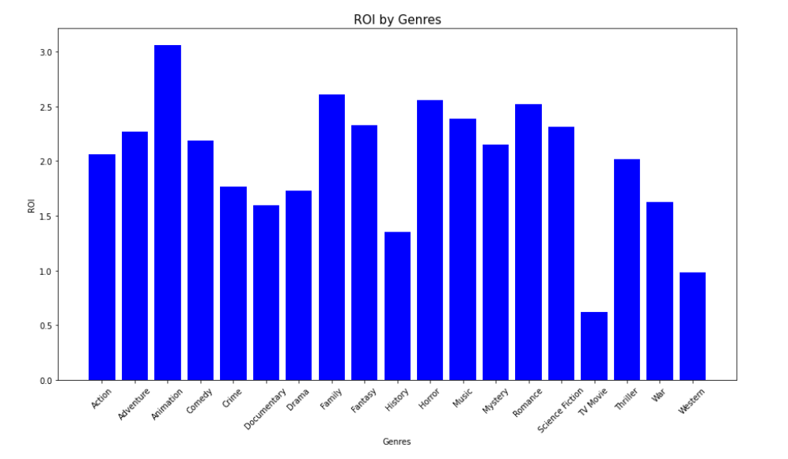
which movie genres to invest?
Animation, family, horror, and romance should be prioritized

Slide 10
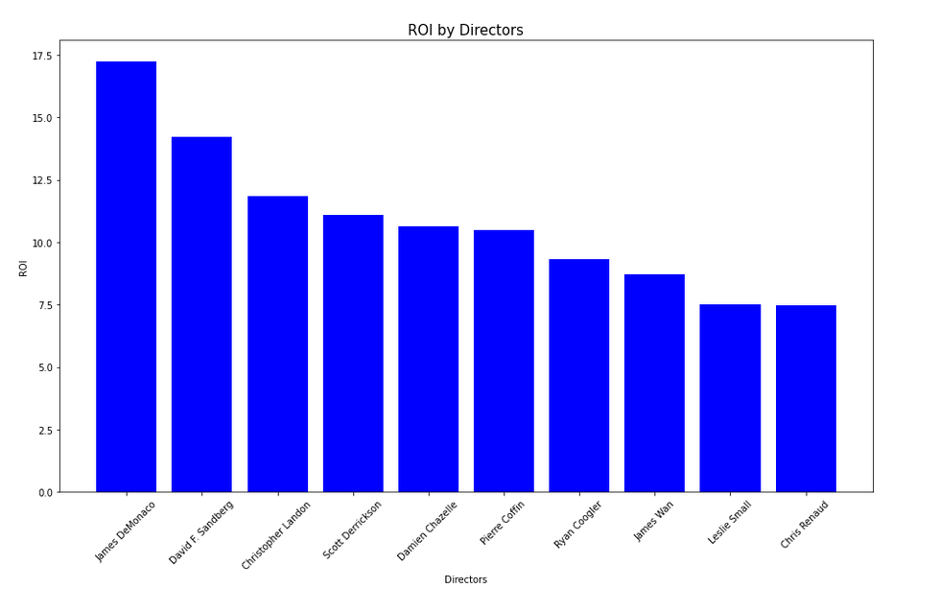
Blockbuster directors = success?
James Demonaco, Christopher Landon and Damien Chazelle should be prioritized

Slide 11

THANK YOU Q&A?
Tai Ngoc Bui
https://www.linkedin.com/in/tai-bui-ngoc/

