Slide 1

TypeScript
Tai Nguyen – DC 7
www.typescriptlang.org

Slide 2
TypeScript – www.typescriptlang.org
What is typescript
GOALS
Features
Basics
Advanced

Slide 3
TypeScript – www.typescriptlang.org
What is TypeScript
Is a free and open source programming language developed and maintained by Microsoft
Is a strict superset of Javascript
Supports static typing and class-based OOP
Offers support for the latest and evolving JS features
ECMAScripts 6
Async functions
Decorators
.....

Slide 4
TypeScript – www.typescriptlang.org
Goals
Is designed for developemt of large JS applications
Client – side
Server – side execution (Node.js)
Be a cross-platform development tool
Statically identify constructs that are likely to be errors
Provide a structuring mechanism for larger pieces of code

Slide 5
TypeScript – www.typescriptlang.org
Features
Basics
Advanced
Variable Declarations
Basic Types
Functions
Mixins
Declarations Merging
JSX
Classes
Interfaces
Generics
Iterators
Advanced Types
Writing Declaration File
Namespaces - Modules
Export - Import
Decorators
Typing for npm
Compile code

Slide 6
TypeScript – www.typescriptlang.org
Features – Basics – Variable Declarations
Two new types of variable declarations :
let : similar to var in some respects
const : prevents re-assignment
A variable declared using let or const cannot be used before its declarations
If we do not initialize our variable in let statement , value undefined will be automatically assigned
let foo : number = 123
Variable name
data type
value

Slide 7
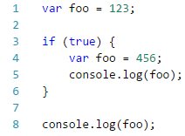
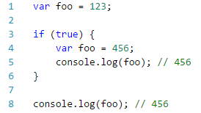
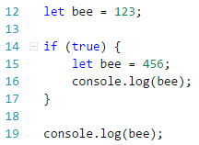
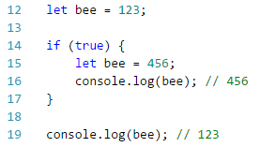
TypeScript – www.typescriptlang.org
Features – Basics – Variable Declarations (cont.) – Comparing let vs var

Slide 8



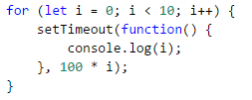
TypeScript – www.typescriptlang.org
Features – Basics – Variable Declarations (cont.) – Comparing let vs var (cont.)

Slide 9









TypeScript – www.typescriptlang.org
Features – Basics – Basic Types
boolean
void
number
Array
any
string
Tuple
enum

Slide 10
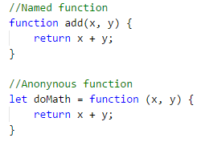
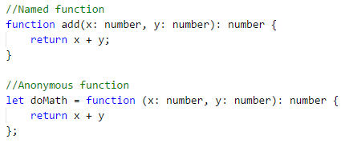

TypeScript – www.typescriptlang.org
Features – Basics – Functions – Typing the function
JavaScript
TypeScript
optional
equal
Arrow (Lambda) function

Slide 11


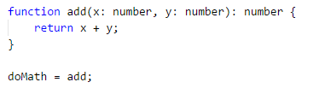
TypeScript – www.typescriptlang.org
Features – Basics – Functions – Writing the function type
mandatory

Slide 12


TypeScript – www.typescriptlang.org
Features – Basics – Functions – Arrow (Lambda) Function
(param1, param2, …, paramN) => { statements }
(param1, param2, …, paramN) => expression
Parentheses are optional when there's only one parameter
(singleParam) => { statements }
singleParam => { statements }
A function with no parameters requires parentheses
( ) => { statements }

Slide 13
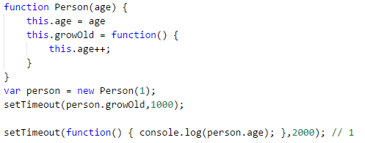
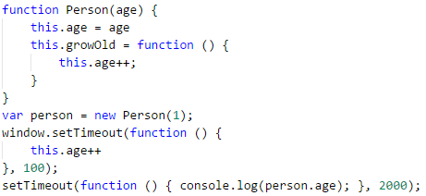
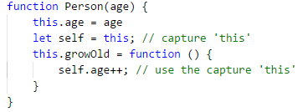
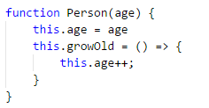
TypeScript – www.typescriptlang.org
Features – Basics – Functions – Arrow (Lambda) Function (Example)
replace
Capturing variable ‘this’
Transform to =>

Slide 14

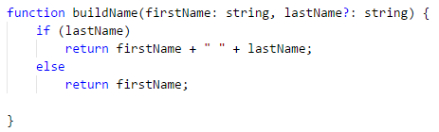

TypeScript – www.typescriptlang.org
Features – Basics – Functions – Optional and Default Parameters
Optional parameter
Default parameter
Notes:
In JavaScript, every parameter is optional, and users may leave them off as they see fit. When they do, their value is undefined

Slide 15
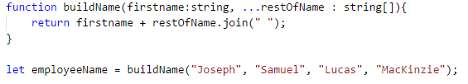
TypeScript – www.typescriptlang.org
Features – Basics – Functions – Rest Parameters
Denoted by …argumentName
Allow to accept multiple arguments in function and get them as array
firstname
restOfName
Notes:
In JavaScript, every parameter is optional, and users may leave them off as they see fit. When they do, their value is undefined

Slide 16
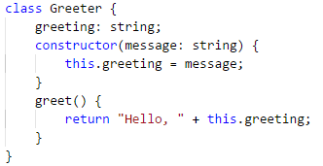
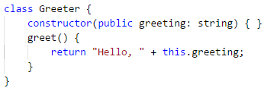
TypeScript – www.typescriptlang.org
Features – Basics – Classes
Three modifiers : public , private, protected
Private member cannot be accessed from outside of it containing class
Protected member can also be access from instances of deriving classes
Simple class-based
Parameter Properties

Slide 17
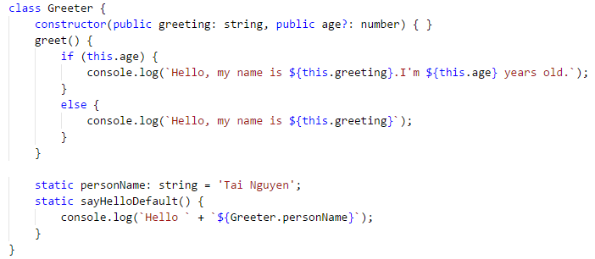
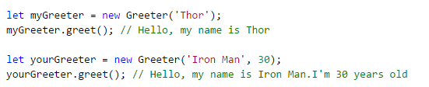

TypeScript – www.typescriptlang.org
Features – Basics – Classes – Static and Optional Members
optional properties
static properties
static function

Slide 18
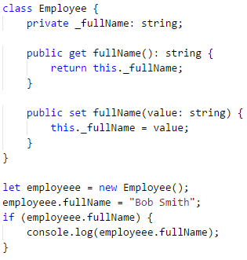
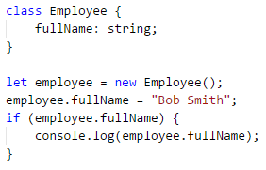
TypeScript – www.typescriptlang.org
Features – Basics – Classes - Assessors

Slide 19
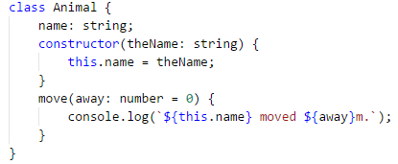
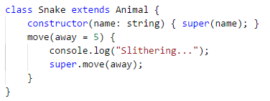
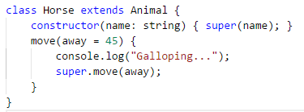
TypeScript – www.typescriptlang.org
Features – Basics – Classes - Inheritance
Use keyword extends
Derived class contain constructor function must call super()

Slide 20
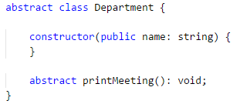
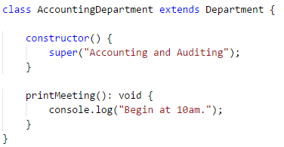
TypeScript – www.typescriptlang.org
Features – Basics – Classes – Abstract Classes
Are base classes from which others classes may be derived
Use keyword abstract
Methods are marked abstract do not contain implementation and must be implemented in derived classes

Slide 21
TypeScript – www.typescriptlang.org
Features – Basics – Interfaces
Are a powerful way to define contracts within code
Classes inherit interfaces by keyword implements
Four types :
Function
Indexable
Class
Hybrid
Can extend each other
Can extend classes
interface IMath {
x : number;
y : number;
Do() : number;
}
Interface name
properties

Slide 22

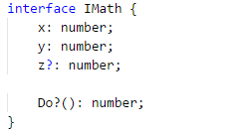
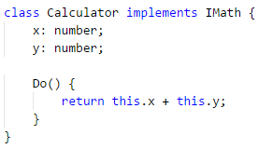
TypeScript – www.typescriptlang.org
Features – Basics – Interfaces – Optional Properties

Slide 23
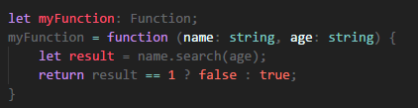
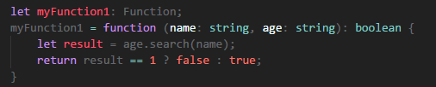

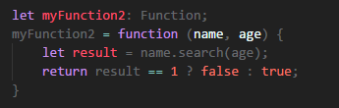
TypeScript – www.typescriptlang.org
Features – Basics – Interfaces – Function Type

Slide 24
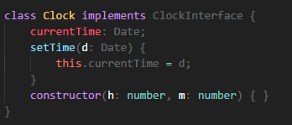

TypeScript – www.typescriptlang.org
Features – Basics – Interfaces – Class Type

Slide 25
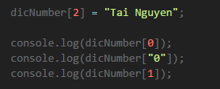


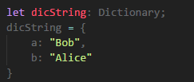

TypeScript – www.typescriptlang.org
Features – Basics – Interfaces – Indexable Type
Support two types of index signatures : string & number
Possible to support both types of indexers
The type returned from a number indexer must be a subtype of the type returned from string indexer
Notes:
/**
* There are two types of supported index signatures: string and number.
* It is possible to support both types of indexers,
* but the type returned from a numeric indexer must be a subtype of the type returned from the string indexer
*/

Slide 26
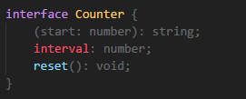
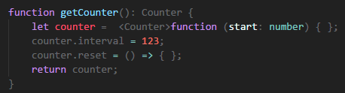

TypeScript – www.typescriptlang.org
Features – Basics – Interfaces – Hybrid Type
Notes:
When interacting with 3rd-party JavaScript, you may need to use patterns like the above to fully describe the shape of the type.

Slide 27





TypeScript – www.typescriptlang.org
Features – Basics – Generics
Are reusable components can work over a variety of types than a single one
Three types:
Functions
Interface
Class

Slide 28
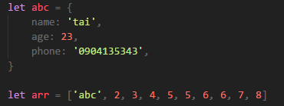
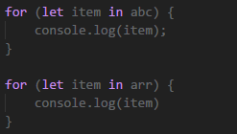
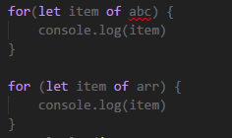
TypeScript – www.typescriptlang.org
Features – Basics – Iterators
For..in
For..of
name age phone
0 1 2 3 4 5 6 7 8 9
abc 2 3 4 5 5 6 6 7 8
Notes:
Both for..of and for..in statements iterate over lists; the values iterated on are different though, for..in returns a list of keys on the object being iterated,
whereas for..of returns a list of values of the numeric properties of the object being iterated.

Slide 29
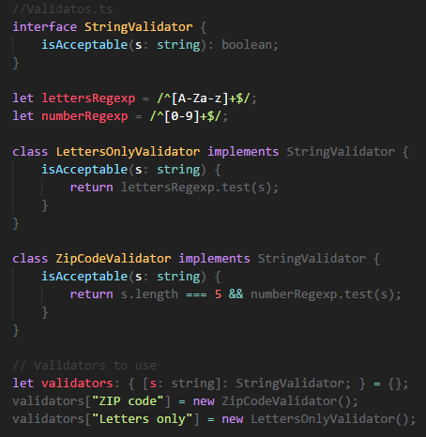
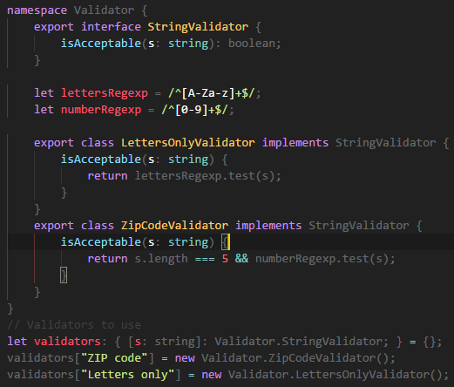
TypeScript – www.typescriptlang.org
Features – Basics – Namespaces
Notes:
Both for..of and for..in statements iterate over lists; the values iterated on are different though, for..in returns a list of keys on the object being iterated,
whereas for..of returns a list of values of the numeric properties of the object being iterated.

Slide 30





TypeScript – www.typescriptlang.org
Features – Basics – Export vs Import
Export
Import

Slide 31

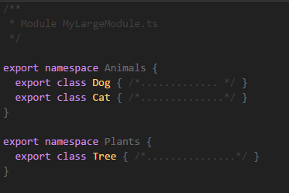

TypeScript – www.typescriptlang.org
Features – Basics – Export vs Import - Advises
Only exporting a single class or function , use export default
Exporting multiple objects, put them all at top-level
Exporting a large number of things, should use the module/namespace

Slide 32

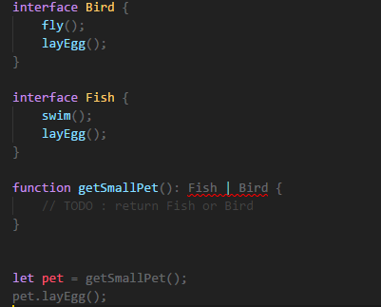
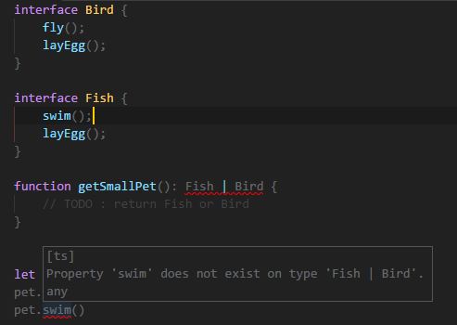
TypeScript – www.typescriptlang.org
Features – Advanced – Advanced Types – Union Types
Use the vertical bar ( | ) to separate each type
Can only access members are common to all types in the union

Slide 33
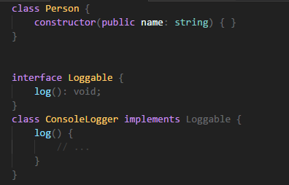
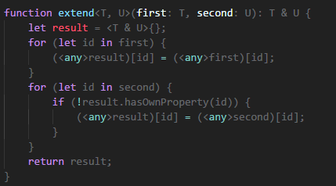

TypeScript – www.typescriptlang.org
Features – Advanced – Advanced Types – Intersection Types
Use & to intersect types
Object of intersected types will have all members of all others types

Slide 34
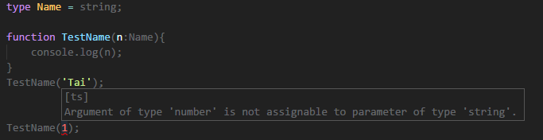
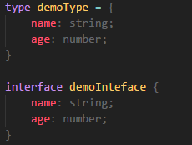
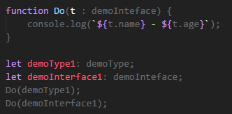
TypeScript – www.typescriptlang.org
Features – Advanced – Advanced Types – Alias Types
Create a new name to refer that type
Sometimes act sort like of interfaces
Notes:
One important difference is that type aliases cannot be extended or implemented from (nor can they extend/implement other types)
On the other hand, if you can’t express some shape with an interface and you need to use a union or tuple type, type aliases are usually the way to go.

Slide 35
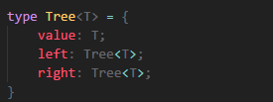
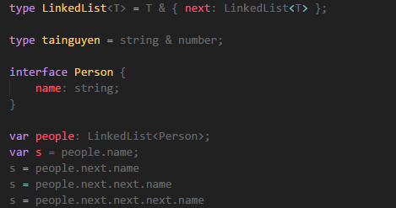
TypeScript – www.typescriptlang.org
Features – Advanced – Advanced Types – Alias Types (cont.)
Can be generic and refer to itself in a property
Cannot be extended or implemented
Notes:
On the other hand, if you can’t express some shape with an interface and you need to use a union or tuple type, type aliases are usually the way to go.

Slide 36
TypeScript – www.typescriptlang.org
Features – Advanced – Declaration Merging
Is a unique concept in Typescript
Mean that compiler merges two separation declarations with same name into a single one
Merged definition has the feature of the original declarations
Any number of declarations can be merged
Three groups:
Namespace
Type
Value
Notes:
In TypeScript, a declaration creates entities in at least one of three groups: namespace, type, or value. Namespace-creating declarations create a namespace, which contains names that are accessed using a dotted notation. Type-creating declarations do just that: they create a type that is visible with the declared shape and bound to the given name. Lastly, value-creating declarations create values that are visible in the output JavaScript.

Slide 37

TypeScript – www.typescriptlang.org
Features – Advanced – Declaration Merging (cont.)
Notes:
In TypeScript, a declaration creates entities in at least one of three groups: namespace, type, or value. Namespace-creating declarations create a namespace, which contains names that are accessed using a dotted notation. Type-creating declarations do just that: they create a type that is visible with the declared shape and bound to the given name. Lastly, value-creating declarations create values that are visible in the output JavaScript.

Slide 38


TypeScript – www.typescriptlang.org
Features – Advanced – Declaration Merging (cont.)
Merging Interfaces
Non-function members must be unique
Function members has same name is treated as an overload

Slide 39



TypeScript – www.typescriptlang.org
Features – Advanced – Declaration Merging (cont.)
Merging Namespaces
Non-exported members are only visible in the original (un-merged) namespace

Slide 40


TypeScript – www.typescriptlang.org
Features – Advanced – Declaration Merging (cont.)
Merging Namespaces with Classes
Merging Namespaces with Functions

Slide 41

TypeScript – www.typescriptlang.org
Features – Advanced – Declaration Merging (cont.)
Merging Namespaces with Enum

Slide 42


TypeScript – www.typescriptlang.org
Features – Advanced – Mixins
Is another popular way of building up classes from reusable components
Combine simpler partial classes

Slide 43



TypeScript – www.typescriptlang.org
Features – Advanced – Mixins (cont.)

