Slide 1
TypeScript
www.typescriptlang.org

Slide 2
TypeScript – www.typescriptlang.org
What is typescript
GOALS
Features
Basics
Advanced

Slide 3
TypeScript – www.typescriptlang.org
What is TypeScript
Is a free and open source programming language developed and maintained by Microsoft
Is a strict superset of Javascript
Supports static typing and class-based OOP
Offers support for the latest and evolving JS features
ECMAScripts 6
Async functions
Decorators
.....

Slide 4
TypeScript – www.typescriptlang.org
Goals
Is designed for developemt of large JS applications
Client – side
Server – side execution (Node.js)
Be a cross-platform development tool
Statically identify constructs that are likely to be errors
Provide a structuring mechanism for larger pieces of code

Slide 5
TypeScript – www.typescriptlang.org
Features
Basics
Basic Types
Interfaces
Classes
Generics
Iterators
Namespaces – Modules
Export vs Import
Advanced
Mixins
Declarations Merging
JSX
Writing Declaration Files
Typing for NPM packages

Slide 6








TypeScript – www.typescriptlang.org
Features – Basics – Basic Types
Boolean
Number
String
Array
Tuple
Type Assertion
Enum
Any
Void

Slide 7
TypeScript – www.typescriptlang.org
Features – Basics – Interfaces
Are a powerful way to define contracts within code
Can extend each other
Can extend classes
Inherits memers of the class but not their implementations
That interface type can only be implemented by that class or a subclass of it in case base class has private or protected member
Four types :
Function
Indexable
Class
Hybrid

Slide 8
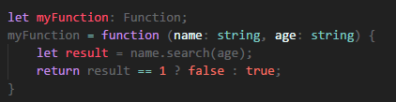
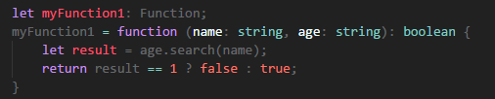

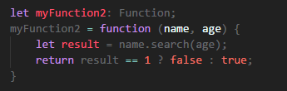
TypeScript – www.typescriptlang.org
Features – Basics – Interfaces – Function Type

Slide 9
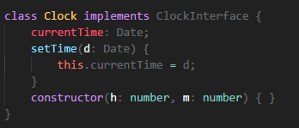

TypeScript – www.typescriptlang.org
Features – Basics – Interfaces – Class Type

Slide 10
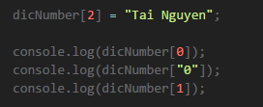


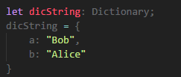

TypeScript – www.typescriptlang.org
Features – Basics – Interfaces – Indexable Type
Support two types of index signatures : string & number
Possible to support both types of indexers
The type returned from a number indexer must be a subtype of the type returned from string indexer
Notes:
/**
* There are two types of supported index signatures: string and number.
* It is possible to support both types of indexers,
* but the type returned from a numeric indexer must be a subtype of the type returned from the string indexer
*/

Slide 11
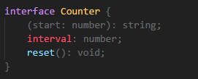
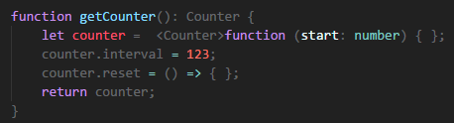

TypeScript – www.typescriptlang.org
Features – Basics – Interfaces – Hybrid Type
Notes:
When interacting with 3rd-party JavaScript, you may need to use patterns like the above to fully describe the shape of the type.

Slide 12
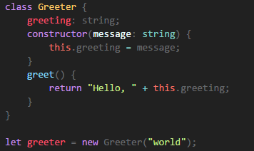
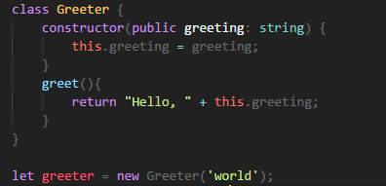
TypeScript – www.typescriptlang.org
Features – Basics – Classes
Simple class-based
Parameter Properties
Three modifiers : public , private, protected
Private member cannot be accessed from outside of it containing class
Protected member can also be access from instances of deriving classes

Slide 13
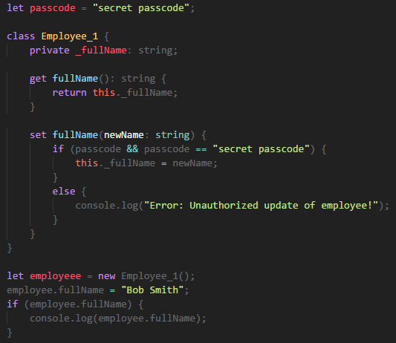
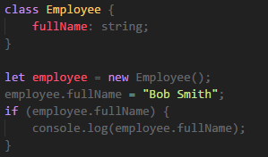
TypeScript – www.typescriptlang.org
Features – Basics – Classes - Assessors

Slide 14
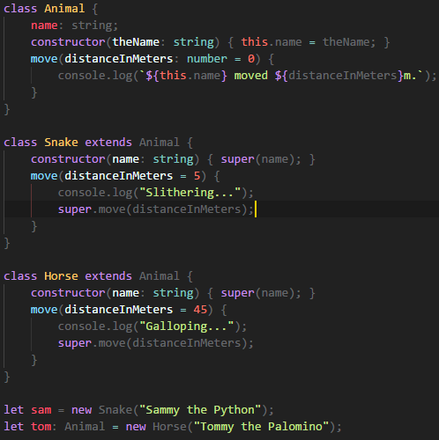
TypeScript – www.typescriptlang.org
Features – Basics – Classes - Inheritance
Use keyword extends
Derived class contain constructor function must call super()

Slide 15
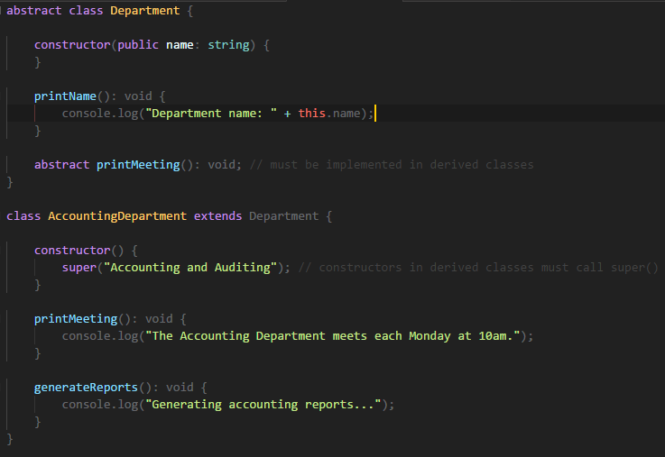
TypeScript – www.typescriptlang.org
Features – Basics – Classes - Abstract

Slide 16





TypeScript – www.typescriptlang.org
Features – Basics – Generics
Are reusable components can work over a variety of types than a single one
Three types:
Functions
Interface
Class

Slide 17
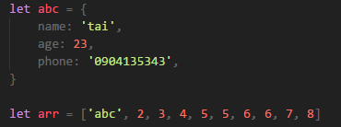
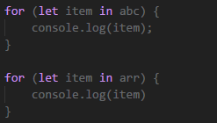
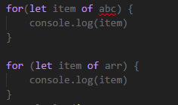
TypeScript – www.typescriptlang.org
Features – Basics – Iterators
For..in
For..of
name age phone
0 1 2 3 4 5 6 7 8 9
abc 2 3 4 5 5 6 6 7 8
Notes:
Both for..of and for..in statements iterate over lists; the values iterated on are different though, for..in returns a list of keys on the object being iterated,
whereas for..of returns a list of values of the numeric properties of the object being iterated.

Slide 18
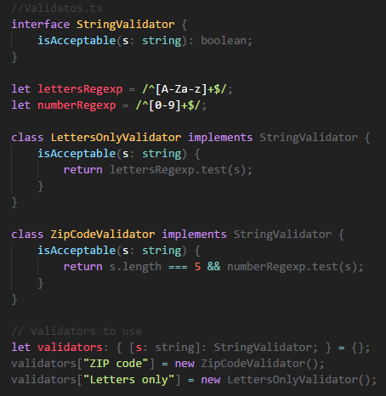
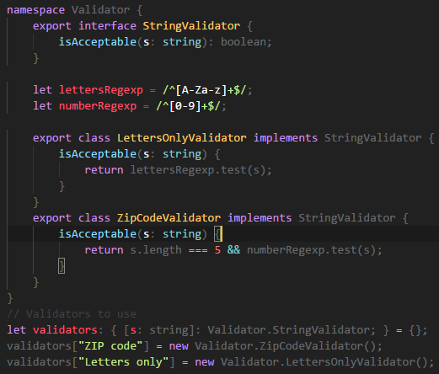
TypeScript – www.typescriptlang.org
Features – Basics – Namespaces
Notes:
Both for..of and for..in statements iterate over lists; the values iterated on are different though, for..in returns a list of keys on the object being iterated,
whereas for..of returns a list of values of the numeric properties of the object being iterated.

Slide 19





TypeScript – www.typescriptlang.org
Features – Basics – Export vs Import
Export
Import

Slide 20

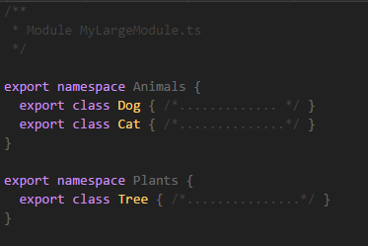

TypeScript – www.typescriptlang.org
Features – Basics – Export vs Import - Advises
Only exporting a single class or function , use export default
Exporting multiple objects, put them all at top-level
Exporting a large number of things, should use the module/namespace

Slide 21

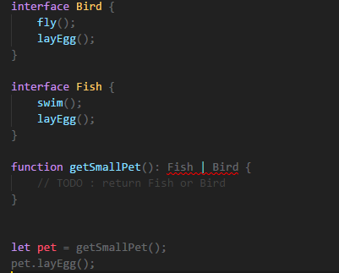
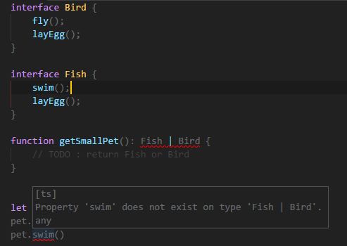
TypeScript – www.typescriptlang.org
Features – Advanced – Advanced Types – Union Types
Use the vertical bar ( | ) to separate each type
Can only access members are common to all types in the union

Slide 22
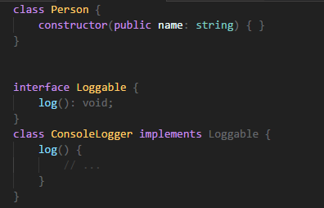
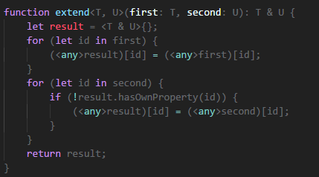

TypeScript – www.typescriptlang.org
Features – Advanced – Advanced Types – Intersection Types
Use & to intersect types
Object of intersected types will have all members of all others types

Slide 23
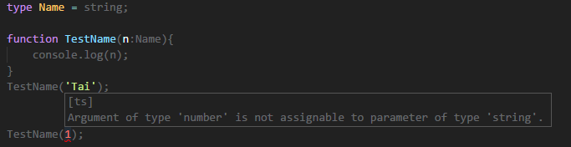
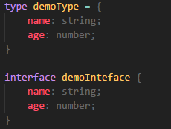
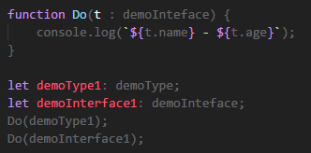
TypeScript – www.typescriptlang.org
Features – Advanced – Advanced Types – Alias Types
Create a new name to refer that type
Sometimes act sort like of interfaces
Notes:
One important difference is that type aliases cannot be extended or implemented from (nor can they extend/implement other types)
On the other hand, if you can’t express some shape with an interface and you need to use a union or tuple type, type aliases are usually the way to go.

Slide 24
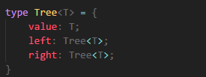
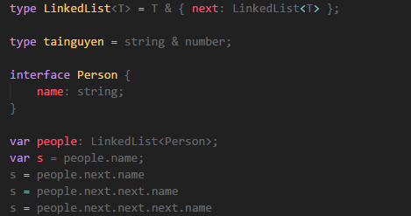
TypeScript – www.typescriptlang.org
Features – Advanced – Advanced Types – Alias Types (cont.)
Can be generic and refer to itself in a property
Cannot be extended or implemented
Notes:
On the other hand, if you can’t express some shape with an interface and you need to use a union or tuple type, type aliases are usually the way to go.

Slide 25
TypeScript – www.typescriptlang.org
Features – Advanced – Declaration Merging
Is a unique concept in Typescript
Mean that compiler merges two separation declarations with same name into a single one
Merged definition has the feature of the original declarations
Any number of declarations can be merged
Three groups:
Namespace
Type
Value
Notes:
In TypeScript, a declaration creates entities in at least one of three groups: namespace, type, or value. Namespace-creating declarations create a namespace, which contains names that are accessed using a dotted notation. Type-creating declarations do just that: they create a type that is visible with the declared shape and bound to the given name. Lastly, value-creating declarations create values that are visible in the output JavaScript.

Slide 26
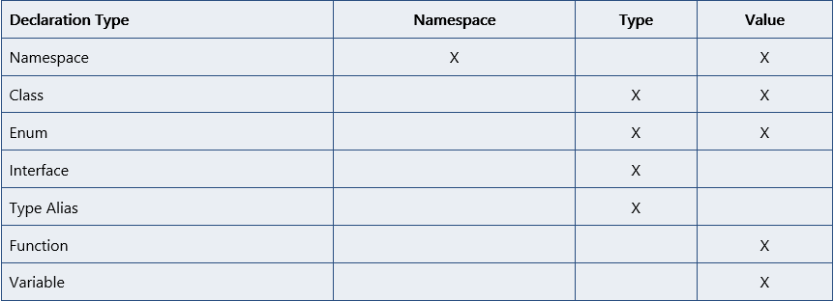
TypeScript – www.typescriptlang.org
Features – Advanced – Declaration Merging (cont.)
Notes:
In TypeScript, a declaration creates entities in at least one of three groups: namespace, type, or value. Namespace-creating declarations create a namespace, which contains names that are accessed using a dotted notation. Type-creating declarations do just that: they create a type that is visible with the declared shape and bound to the given name. Lastly, value-creating declarations create values that are visible in the output JavaScript.

Slide 27
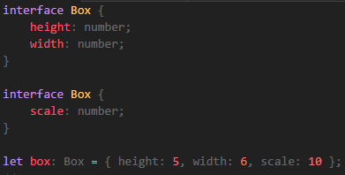
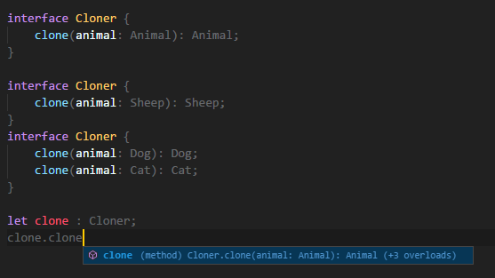
TypeScript – www.typescriptlang.org
Features – Advanced – Declaration Merging (cont.)
Merging Interfaces
Non-function members must be unique
Function members has same name is treated as an overload

Slide 28
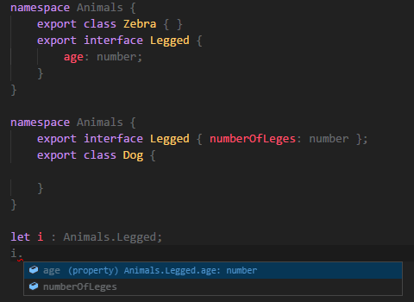
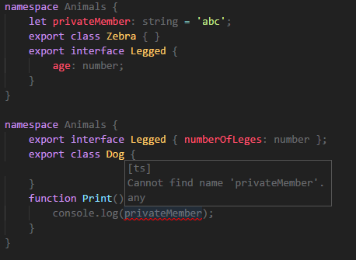
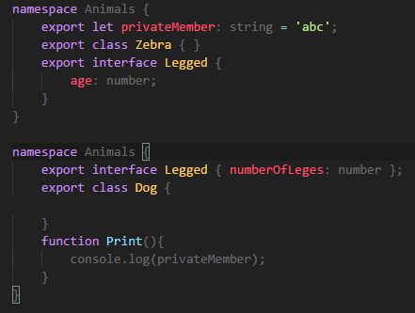
TypeScript – www.typescriptlang.org
Features – Advanced – Declaration Merging (cont.)
Merging Namespaces
Non-exported members are only visible in the original (un-merged) namespace

Slide 29
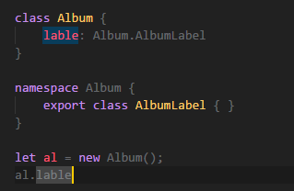
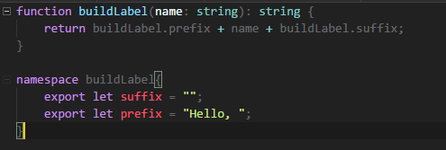
TypeScript – www.typescriptlang.org
Features – Advanced – Declaration Merging (cont.)
Merging Namespaces with Classes
Merging Namespaces with Functions

Slide 30
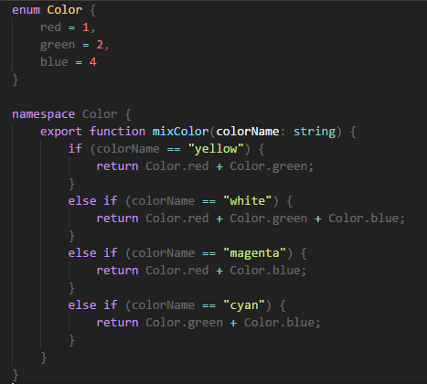
TypeScript – www.typescriptlang.org
Features – Advanced – Declaration Merging (cont.)
Merging Namespaces with Enum

Slide 31
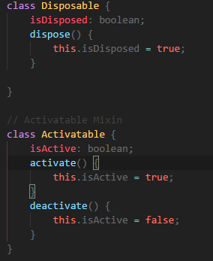
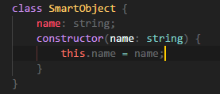
TypeScript – www.typescriptlang.org
Features – Advanced – Mixins
Is another popular way of building up classes from reusable components
Combine simpler partial classes

Slide 32
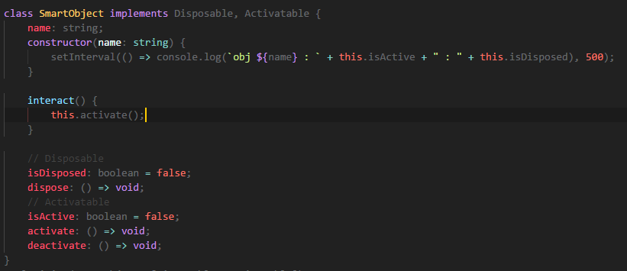
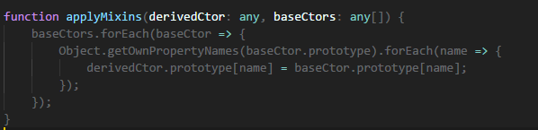

TypeScript – www.typescriptlang.org
Features – Advanced – Mixins (cont.)

