Slide 1
TypeScript
www.typescriptlang.org

Slide 2
TypeScript – www.typescriptlang.org
What is typescript?
Features
Basics
Advanced

Slide 3
TypeScript – www.typescriptlang.org
What is TypeScript ?
Is a free and open source programming language developed and maintained by Microsoft
Is a strict superset of Javascript
Supports static typing and class-based OOP
Offers support for the latest and evolving JS features
ECMAScripts 6
Async functions
Decorators
.....

Slide 4
TypeScript – www.typescriptlang.org
What is TypeScript - Goals
Is designed for developemt of large JS applications
Client – side
Server – side execution (Node.js)
Be a cross-platform development tool
Statically identify constructs that are likely to be errors
Provide a structuring mechanism for larger pieces of code

Slide 5
TypeScript – www.typescriptlang.org
Features
Basics
Basic Types
Interfaces
Classes
Namespaces – Modules
Generics
Integrating with Build Tools
Gulp
Grunt
Webpack
......
Advanced
Mixins
Declarations Merging
Type Inference
Type Compatibility
JSX
Writing Declaration Files
Typing for NPM packages

Slide 6








TypeScript – www.typescriptlang.org
Features – Basics – Basic Types
Boolean
Number
String
Array
Tuple
Type Assertion
Enum
Any
Void

Slide 7
TypeScript – www.typescriptlang.org
Features – Basics – Interfaces
Are a powerful way to define contracts within code
Can extend each other
Can extend classes
Inherits memers of the class but not their implementations
That interface type can only be implemented by that class or a subclass of it in case base class has private or protected member
Four types :
Function
Indexable
Class
Hybrid

Slide 8
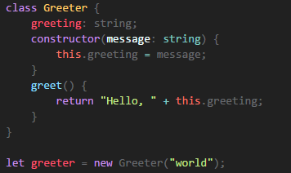
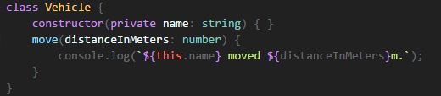
TypeScript – www.typescriptlang.org
Features – Basics – Classes
Parameter Properties

Slide 9
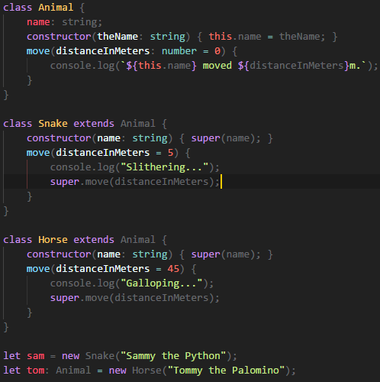
TypeScript – www.typescriptlang.org
Features – Basics – Classes
Inheritance

Slide 10
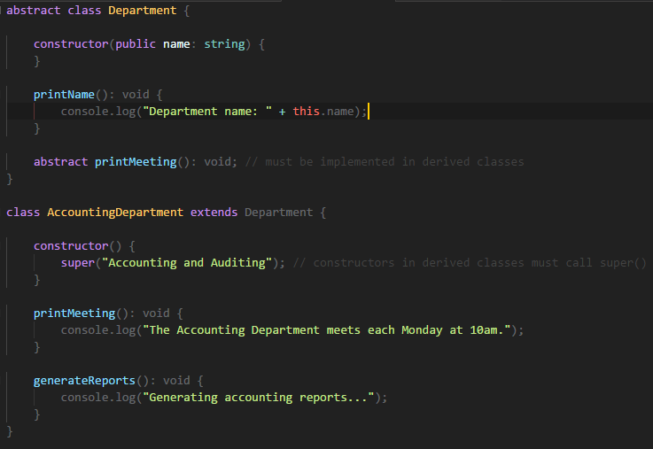
TypeScript – www.typescriptlang.org
Features – Basics – Classes
Abstract

Slide 11
TypeScript – www.typescriptlang.org
Features – Basics – Generics
Are reusable components can work over a variety of types than a single one
Three types:
Function
Interface
Class

Slide 12

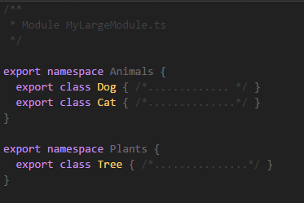

TypeScript – www.typescriptlang.org
Features – Basics – Modules - Namespaces
Only exporting a single class or function , use export default
Exporting multiple objects, put them all at top-level
Exporting a large number of things, should use the module/namespace

