Slide 1
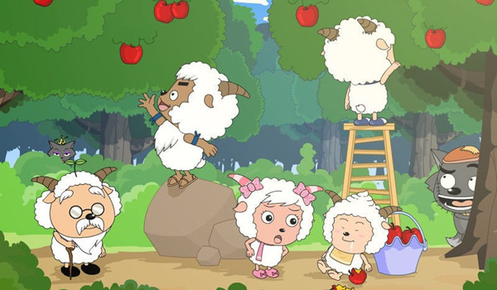
RNN
CNN
DNN
DBN
Theano

