Slide 1
Have a Taste of DNN on the shoulder of Theano
王泰青

Slide 2

Geoffrey E. Hinton
University of Toronto
New York University
Google
Yann LeCun
New York University
Facebook
Yoshua Bengio
Université de Montréal

Slide 3
Outline
Introduction to Theano
Softmax regression
Highlights of DNN
Neural network
Multiple layer perception
Forward propagation
Backward propagation
Sparse auto-encoder
Auto-encoder
Sparse auto-encoder
Building deep networks for classification
Model structure
Pre-training
Fine-tuning
Experimental results

Slide 4
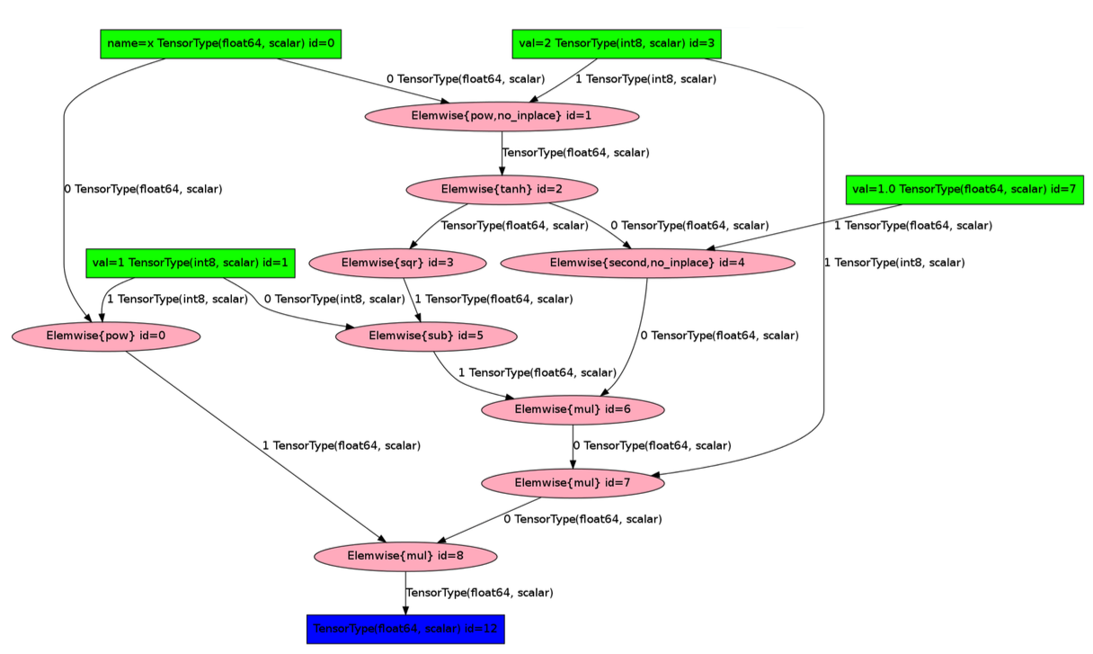
Introduction to Theano
Theano is Python library that allows you to define, evaluate and optimize math expressions.
Efficient symbolic differentiation
Efficient handling of matrices
Tight integration of NumPy
Dynamic C code generate
Transparent use of GPU
Symbolic programming

Slide 5
Introduction to Theano (cont.)
Machine learning libraries built on top of Theano
Pylearn2
great flexibility and a good choice for trying out ML ideas
PyMC3
Probabilistic programming; building statistical Bayesian models
Sklearn-theano
Easy-to-use deep learning tool
Lasagne
Lightweight library to build neural networks
Notes:
Pylearn2 differs from scikit-learn in that Pylearn2 aims to provide great flexibility and make it possible for a researcher to do almost anything, while scikit-learn aims to work as a “black box” that can produce good results even if the user does not understand the implementation.

Slide 6
Introduction to Theano (cont.)
Models that have been built with Theano
Neural networks
Convolutional Neural Networks (CNN)
Recurrent Neural Networks (RNN)
Lone Short Term Memory (LSTM)
Autoencoders
GoogLeNet
Overfeat
…

Slide 7
Introduction to Theano (cont.)
Symbolic variables in Theano
Variable (C, Java, Python, etc.)
A segment of physical storage in RAM
Operations are based on value passing between variables
Tensor (Theano)
A mathematical symbol
No physical storage in RAM to hold its value
Operations are actually building connections between tensors
Shared variable (Theano)
Hybrid of variable and tensor
Tensor with physical storage in RAM to hold its value

Slide 8
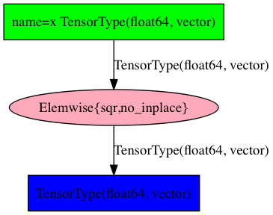
Introduction to Theano (cont.)
Symbolic variables in Theano
Variable node
import theano
import theano.tensor as T
x = T.dvector(name='x')
def f(x):
return x ** 2
y = f(x)
Operation node
Variable node

Slide 9
Introduction to Theano (cont.)
Symbolic variables in Theano
theano.function brings life to theano variables
input
import theano
import theano.tensor as T
import numpy as np
x = T.dvector(name='x')
def f(x):
return x ** 2
y = f(x)
pow2 = theano.function(inputs=[x],
outputs=y)
a = np.array([1,2,3],
dtype=theano.config.floatX)
b = pow2(a)
output
b is np.array([1.0, 4.0, 9.0])

Slide 10
Introduction to Theano (cont.)
Symbolic variables in Theano
theano.function brings life to theano variables
import theano
import theano.tensor as T
import numpy as np
x = T.dvector('x')
def f(x):
return x.sum()
y = f(x)
grad = T.grad(cost=y, wrt=[x])
grad_func = theano.function(inputs=[x],
outputs=grad)
a = np.array([1,2,3],
dtype=theano.config.floatX)
print grad_func(a)
[array([ 1., 1., 1.])]

Slide 11
Softmax Regression

