Slide 1

Design Considerations While Building the TAIR Database
NCGR
Dan Weems
TAIR Software Development Team Leader
NATIONAL CENTER FOR GENOME RESOURCES

Slide 2

Initial Problem
From an RDBMS Database Perspective
TAIR will provide access to a database of “all” publicly accessible Arabidopsis data
If the entire data domain was to be represented in a single table:
  Thousands of columns / attributes
  Millions of rows
  Duplicate values throughout
  Empty (null) values throughout
  Extremely slow and difficult to search

Slide 3
Classical Process
Logically break down the data into discrete units through collaboration with domain experts.
Insure that the data is normalized.

Slide 4
What is Normalization?
1st normal form
  there are no repeating groups
  all the key attributes are defined
  all attributes are dependent on the primary key
2nd normal form
  it includes no partial dependencies (where an attribute is dependent on only a part of a primary key).
3rd normal form
  it contains no transitive dependencies (where a non-key attribute is dependent on another non-key attribute).

Slide 5
Classical Approach:
Decomposition of data into multiple tables
Not Normalized
Normalized

Slide 6
Pros and Cons of Normalization
Advantages of a normalized relational database
  Number of columns per table minimized
  Number of rows per table minimized
  Redundancy within tables is minimized
  Null values are minimized
  Searches are faster and easier
Too much normalization can fragment a database resulting in slow searches because too many searches / joins must be performed to get a result
Balance is the objective

Slide 7
Example: Expression Data
ExpressionSet
ArrayDesign
HybDescription
LabeledSample
Spot
HybData
BioSample
ArrayElement
SummaryHybData

Slide 8
Object-Oriented Approach
Initial design specifications were intended to follow the guidelines recommended by the Object Management Group (OMG) for generating a object-oriented Genome Data Base (GDB).
An object-oriented programming language, Java, was selected as the Internet interface software platform
Developing the database in an object-oriented model would greatly facilitate Java web development.

Slide 9
Object-Oriented Table Design
Unlike classical normalization techniques, object-oriented table design starts with small objects and groups them into larger objects to establish patterns of inheritance.
Attributes shared by multiple small objects can be associated with the parent table (super class)

Slide 10
Example:
Person & Organization
Person
Organization
Person_id
Last_name
First_name
Middle_name
Login_name
Password
Email
Address
City
Region
Country
Postal_code
Phone
Organization_id
Name
Type
Login_name
Password
Email
Address
City
Region
Country
Postal_code
Phone

Slide 11
Object-oriented Community
Community
Address
Community_id
User_name
Password
Email
Community_type
Address
City
Region
Country
Postal_code
Address_type
Phone
Number
Phone_type
Person
Organization
Community_id
Person_id
Last_name
First_name
Middle_name
Community_id
Organization_id
Name
Org_type

Slide 12
TairObject
(In Part)
TairObject
Map
Germplasm
Clone
AASequence
Gene
NTSequence
GeneticMarker

Slide 13
Multiple Inheritance
MapElement
Map
Gene
Contig
Polymorphism
Clone
CloneEnd
GeneticMarker

Slide 14
Assignment
Assignment
MapElement
Map
Gene
Contig
Polymorphism
Clone
CloneEnd
GeneticMarker

Slide 15
Problems with Object-Oriented
Approach
One-to-one relationship between parent and child tables.
Number of rows in parent table is the sum of all rows in all child tables.
Queries must join the child table and the parent table to get all of the data.
As the size of the parent table increases, the time to search for data increases.

Slide 16
Hierarchical Relational
Approach
Move all attributes from the parent table to the child table.
Keep the parent / child relationship.
Significantly improves query performance because all attributes associated with a single object can be acquired through a single query.
Allows for collective attributes with built-in referential integrity.

Slide 17
Collective Attributes with Referential Integrity
Attribution
Alias
Reference
TairObject
Community
TairObject
Map
Germplasm
Clone
AASequence
Gene
NTSequence
GeneticMarker

Slide 18
High-Level Data
Segregation
TairObject
Community
Reference
Evidence

Slide 19
Keyword Associations
TairObject
Community
Keyword
Reference
BioSample

Slide 20
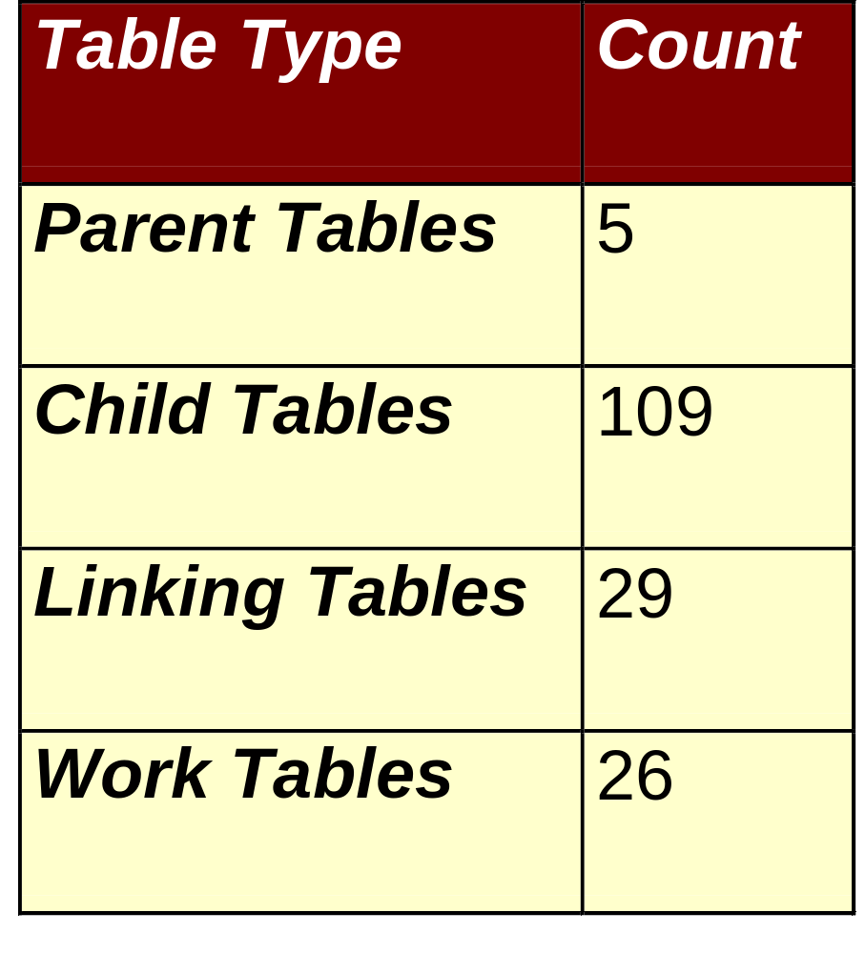
Breakdown of Table Types

Slide 21
Current Size of Some of TAIR’s Tables
TairObject
2,826,489
DomainMatch
230,096
Map
27
Reference
72,976
Contig
73
Publication
21,663
Clone
356,456
Community
17,909
CloneEnd
266,061
Person
12,854
Gene
43,665
Organization
5,006
DnaFragment
34,375
Evidence
230,096
GeneticMarker
3,740
ExpressionSet
115
Polymorphism
266,772
HybDescription
394
Germplasm
198,131
HybData
515
SpeciesVariant
880
SummaryHybData
5,948,096
Stock
383,911
Keyword
17,351
Orders
19,908
TairObject_Keyword
99,908
NucleotideSequence
655,666
Attribution
3,008,311
AASequence
33,874
Alias
543,528

Slide 22
Conclusions
TAIR implements a hierarchical relational approach
Which allows for efficient database design
Reducing the proliferation of tables
While adhering to classical database principles of data normalization.

Slide 23
Complete TAIR Schema at: www.arabidopsis.org/search/ERwin/Tair.htm

