Slide 1
The Public Face of TAIR
User Interface Design
Responsiveness to User Input

Slide 2
Different types of TAIR pages
Information pages (home page, external resource lists, conferences, jobs)
Search pages
Search result pages
Object detail pages
Tools
Help pages

Slide 3
User Interface Requirements
Fast, easy access for all researchers worldwide
Cross-platform compatibility (PC, Mac, Unix)
Works with older OS and browser versions

Slide 4
TAIR Interfaces 1999-2003
HTML pages (widest compatibility)
Light client/heavy server design
Avoidance of stand-alone Java applications, applets

Slide 5
2003 - Converted HTML to JSP
Easier incorporation of dynamic content
  headers change depending on login status
  custom home pages for individual users
  dynamic tutorials
Allows passing of parameters between applications
  link to BLAST page with sequence pre-filled
  search results linked to SeqViewer or other analysis tool

Slide 6
Design Considerations
Consistent look and feel
Balance between comprehensiveness and simplicity (ease of use)

Slide 7
Graphical Data Display
Providing visual clues
Avoiding information overload
  selective display of datasets
  selective display of details
  multiple views

Slide 8
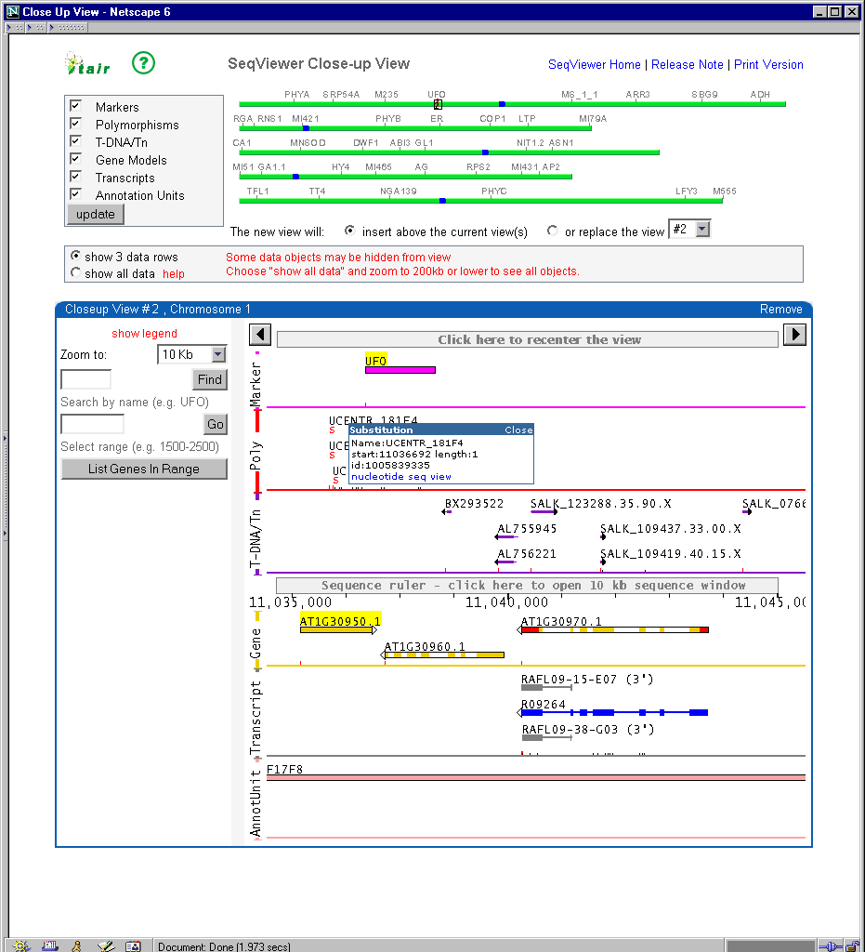

Slide 9
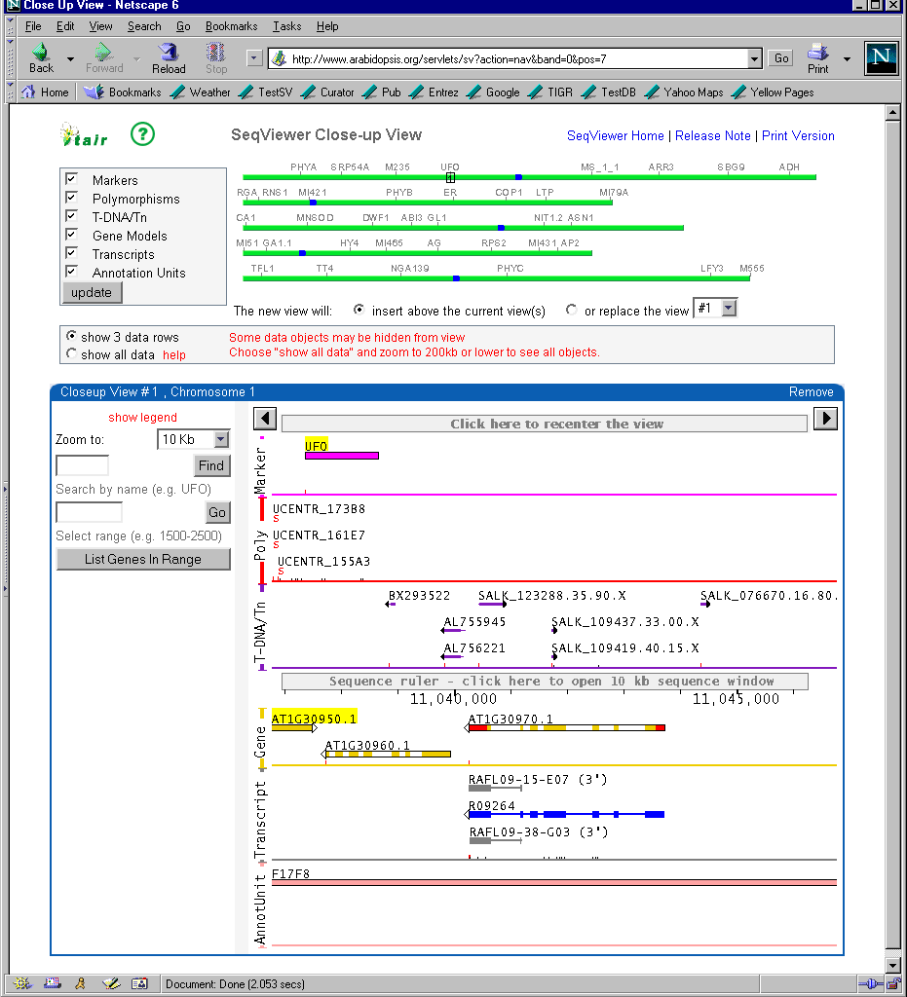
Providing Visual Clues
Orientation
Positional information
Indicating hidden information

Slide 10
Providing Visual Clues
Orientation
Positional information
Indicating hidden information

Slide 11
Providing Visual Clues
Orientation
Positional information
Indicating hidden information

Slide 12
Avoiding Information Overload
Selective display of datasets
  turn bands on/off
  show 3 rows/show all data
  zoom

Slide 13
Avoiding Information Overload
Selective display of datasets
  turn bands on/off
  show 3 rows/show all data
  zoom

Slide 14
Avoiding Information Overload
Selective display of datasets
  turn bands on/off
  show 3 rows/show all data
  zoom

Slide 15
Avoiding Information Overload
Selective display of details
  objects link to database detail pages
  popup information boxes

Slide 16
Avoiding Information Overload
Selective display of details
  objects link to database detail pages
  popup information boxes

Slide 17
Avoiding Information Overload
Multiple views for different types of data
  whole genome view
  closeup view
  nucleotide sequence view

Slide 18
Avoiding Information Overload
Multiple views for different types of data
  whole genome view
  closeup view
  nucleotide sequence view

Slide 19
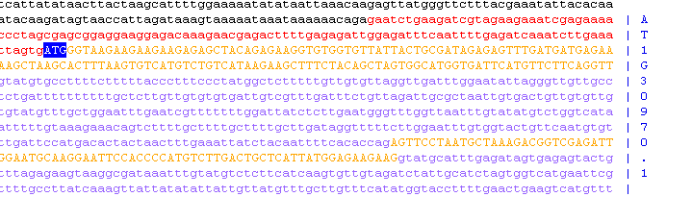
Avoiding Information Overload
Multiple views for different types of data
  whole genome view
  closeup view
  nucleotide sequence view

Slide 20
TAIR pages change over time
Why redesign?
  larger amounts of data
  more data types and interrelationships
  increased diversity of users
  advances in web technology
Examples
  Home page
  Gene search

Slide 21
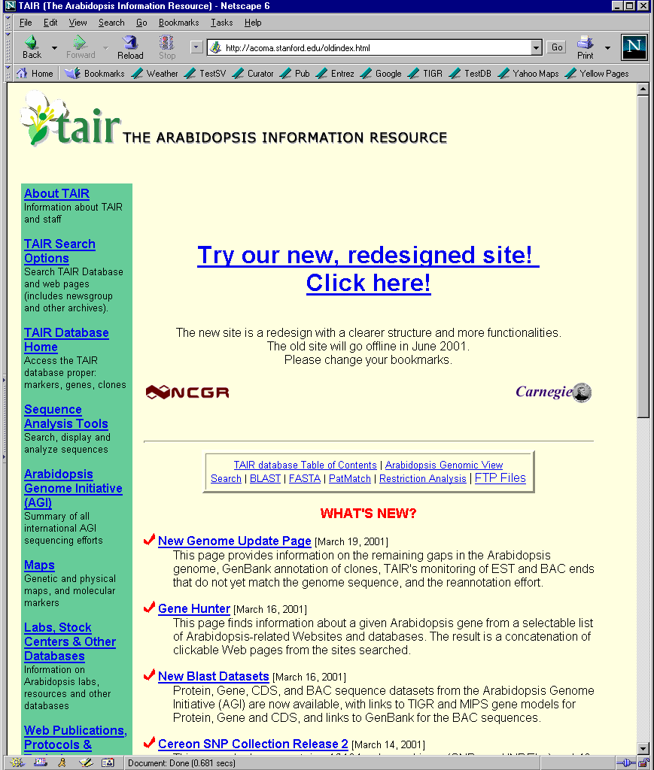
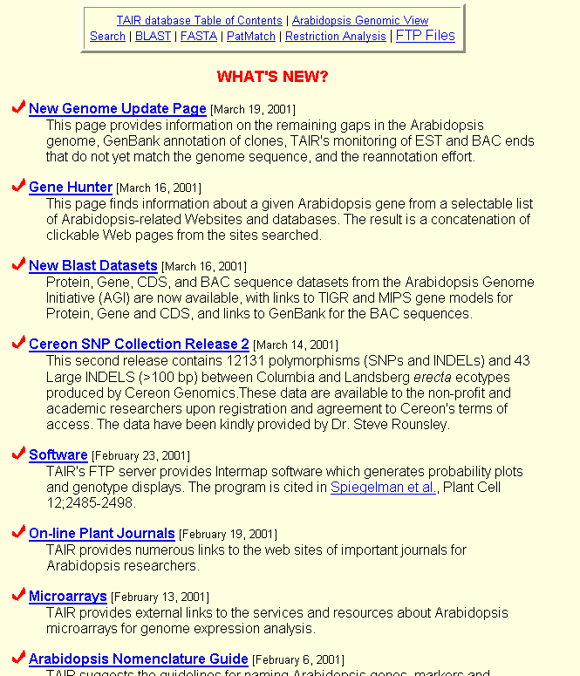
3/2001

Slide 22
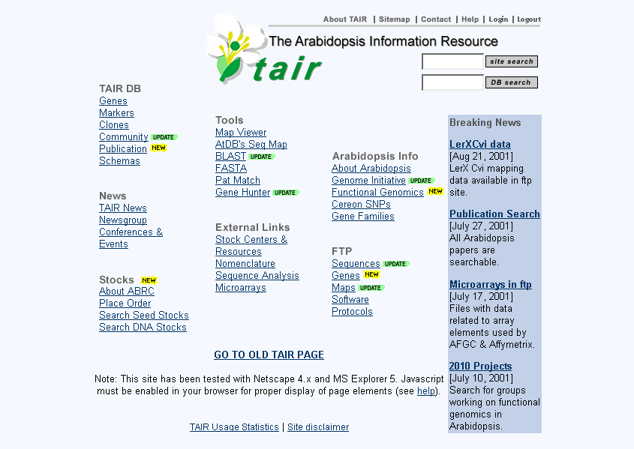
8/2001

Slide 23
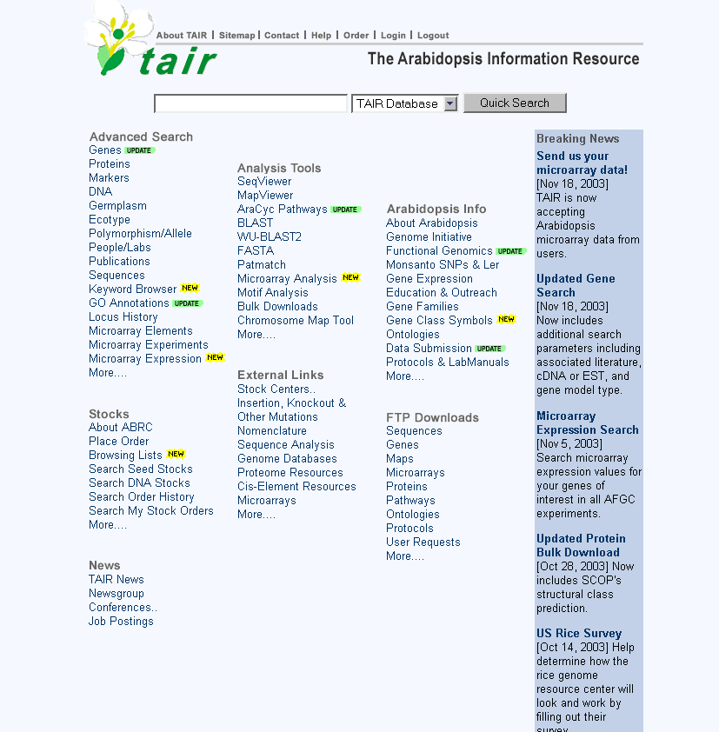
1/2004

Slide 24
1/2004

Slide 25
Current Home Page Design
Advantages
  all information is accessible
  users are familiar with this design
Disadvantages
  users experience information overload
  most important information is difficult to find
  home page resembles a site map

Slide 26
TAIR pages change over time
Search pages
  more search parameters added
  sophisticated queries now possible
  options are too complex for some users

Slide 27
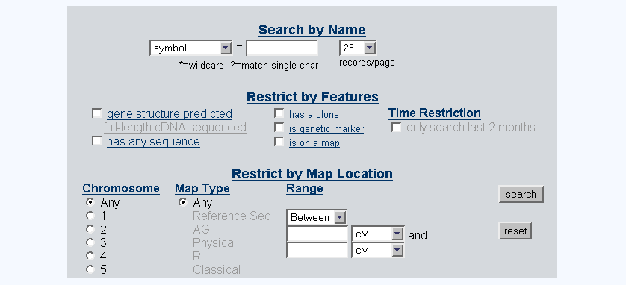
Gene Search
8/2001

Slide 28
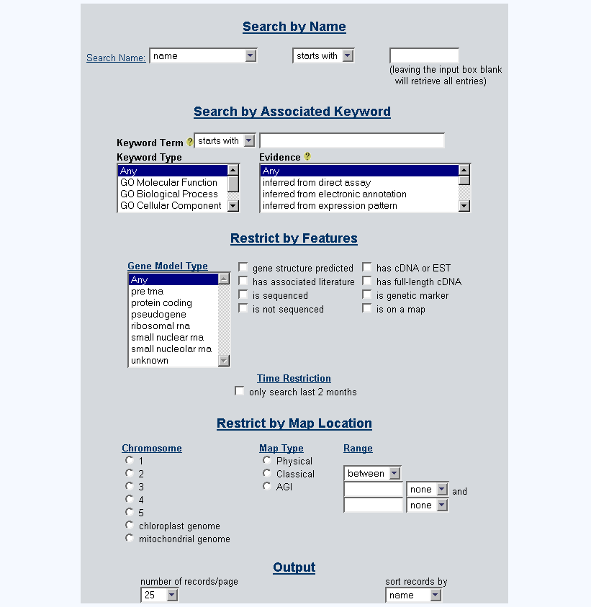
1/2004

Slide 29
New TAIR Design Planned
Inverted L for navigation
Simplify view by limiting visible information to essentials
Use show/hide to access more detail

Slide 30
The Public Face of TAIR
User Interface Design
Responsiveness to User Input

Slide 31
TAIR Community Interactions
Community feedback
Community data submission

Slide 32
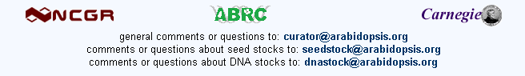
Community Feedback Sources
Email to curator@arabidopsis.org
User comments on detail pages

Slide 33
Community Feedback by email
TAIR uses Jitterbug to track user emails
Each email is assigned to a curator
Questions and replies are archived
Regular expression searching is possible
Answers are compiled into a FAQ

Slide 34
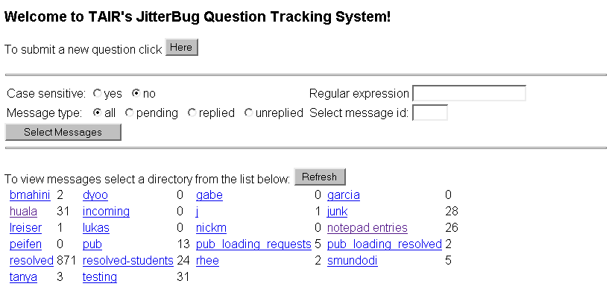
Jitterbug at TAIR

Slide 35
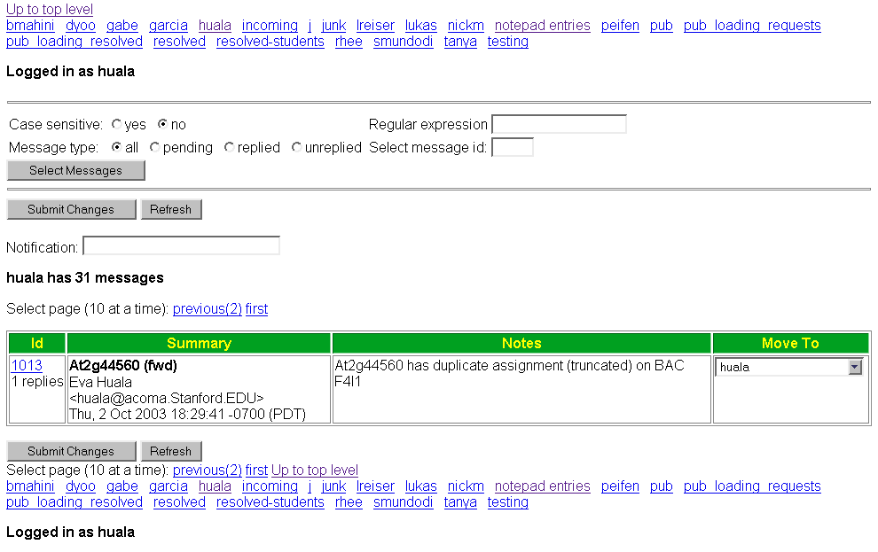
Jitterbug at TAIR

Slide 36
Typical User Emails
I want data
I don’t understand this tool/data
Please fix/improve this tool
Please update this annotation
I can’t find this info
Login/registration questions

Slide 37
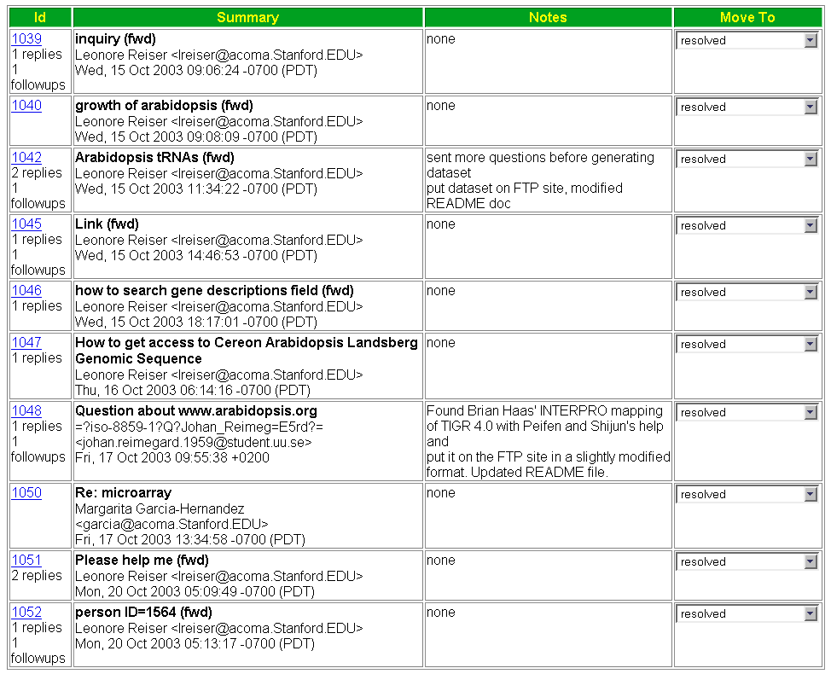

Slide 38
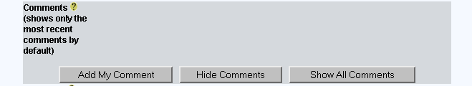
Community Feedback Sources
Email to curator@arabidopsis.org
User comments on detail pages

Slide 39
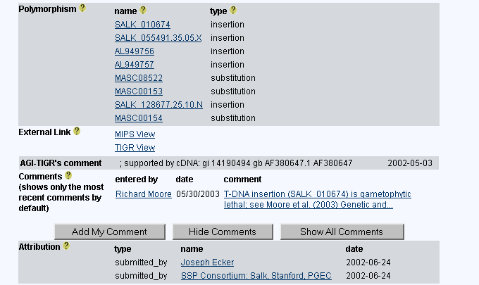
User comments on detail pages

Slide 40
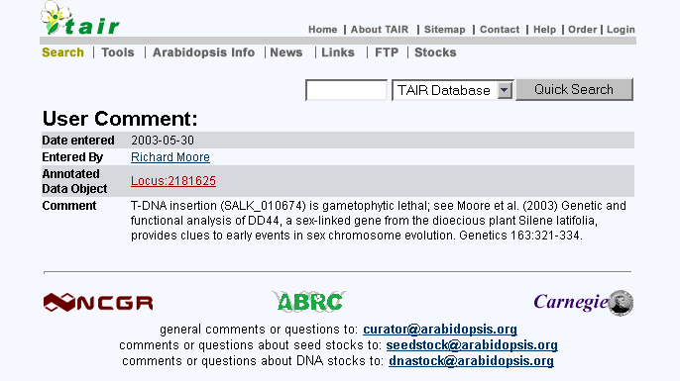
User comments on detail pages

Slide 41
TAIR Community Interactions
Community feedback
Community data submission

Slide 42
Community Data Submission
Gene Family
Gene class symbol
Person/Lab info
Seed and DNA stock info (through ABRC)
Microarray data
Gene structure/function
Marker data
2010 functional genomics projects

Slide 43
Data Submission Methods
Web forms (gene class symbol, person/lab)
Excel spreadsheets
Emails
User-defined formats (large datasets)

Slide 44
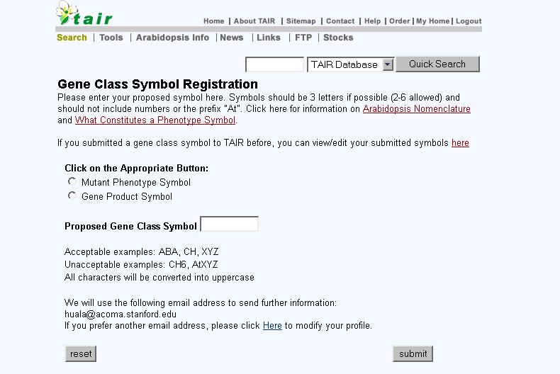
Gene Class Symbol Registration

Slide 45
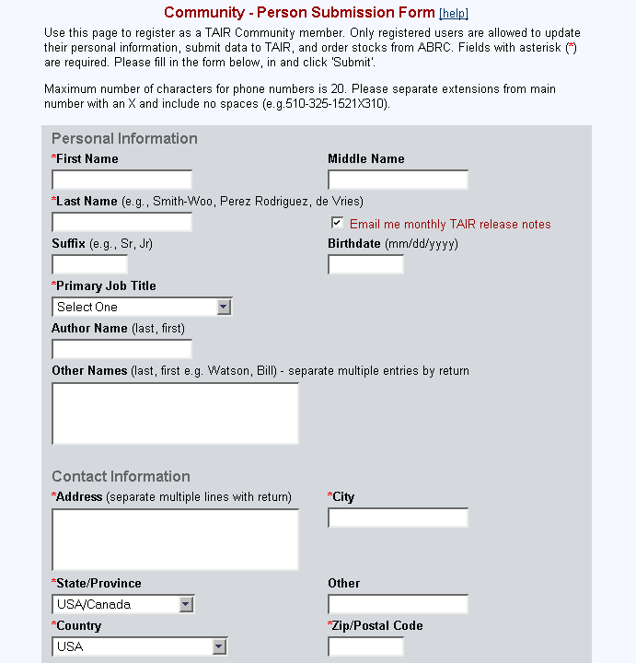

Slide 46
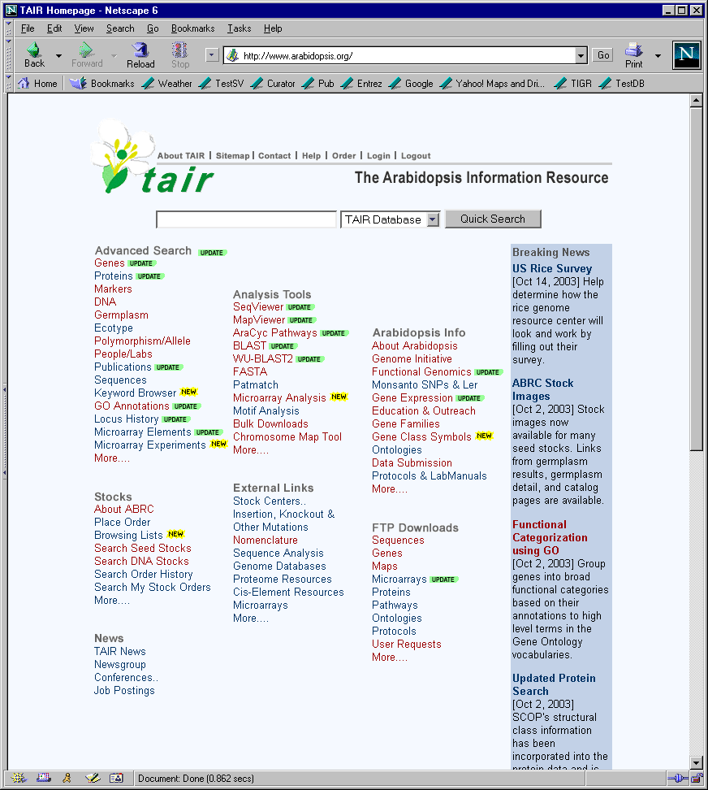
Other Data Submission

Slide 47
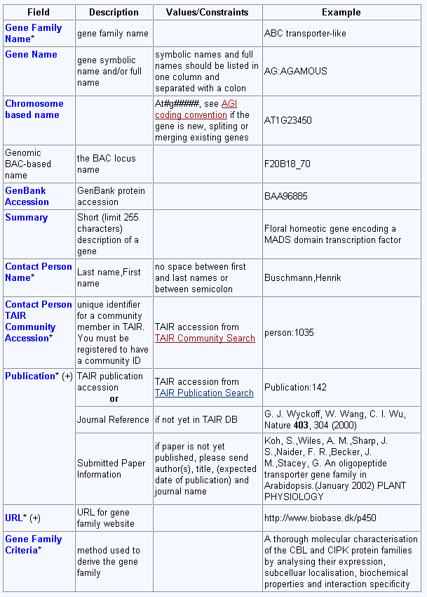

Slide 48
Conclusions
Strike a balance between complexity and ease of use
Expect design changes over time
User input is vital and comes in many forms

