Slide 1
1st The Arabidopsis Information Resource (TAIR) Workshop for Database/Web Resource Developers
(those currently developing or want to develop or interested in learning about developing biological databases)
Speaker 1: Sue Rhee, Carnegie Institution, Dept. Plant Biology
Speaker 2: Dan Weems, National Center for Genome Resources
Speaker 3: Neil Miller, National Center for Genome Resources
Speaker 4: Eva Huala, Carnegie Institution, Dept. Plant Biology
Speaker 5: Marga Garcia-Hernandez, Carnegie Institution, Dept. Plant Biology
January 10, 2004, Plant & Animal Genome XII

Slide 2
Goals of This Workshop
Introduce the TAIR project
Describe the system and human resources for developing/maintaining TAIR
Present the reasons and approaches we took to develop and maintain TAIR
Provide future directions for the main components of TAIR
Address specific questions from the audience
Panel discussion on general issues brought up by the audience

Slide 3
The Arabidopsis Information Resource
(TAIR) http://arabidopsis.org
Mission: An Arabidopsis community information management system to provide facile, unrestricted, and permanent access to accurate, up-to-date information about Arabidopsis biology
A collaboration between Carnegie Institution and National Center for Genome Resources (NCGR)
Started in 1999
Supported by NSF, NIH, Carnegie Institution, and NCGR

Slide 4
TAIR hosts first completed 2010 project (AFGC)
TAIR-ABRC-AIMS merged
Renewal
Genome sequence released !!!!
12,000
AGI- genome sequencing
(1996-2000)
2010 initiative
(2001-2010)
10,000
8000
Registered users
6000
4000
2000
1991
1993
1995
1997
1999
2000
2001
2002
2003
2004
FTEs
1 → 2 → 3 → 5→9 → 10 → 15 → 20 → 17
AAtDB
(Harvard/MIT)
AtDB
(Stanford)
TAIR
(Carnegie/NCGR)
A short history of Arabidopsis Databases

Slide 5
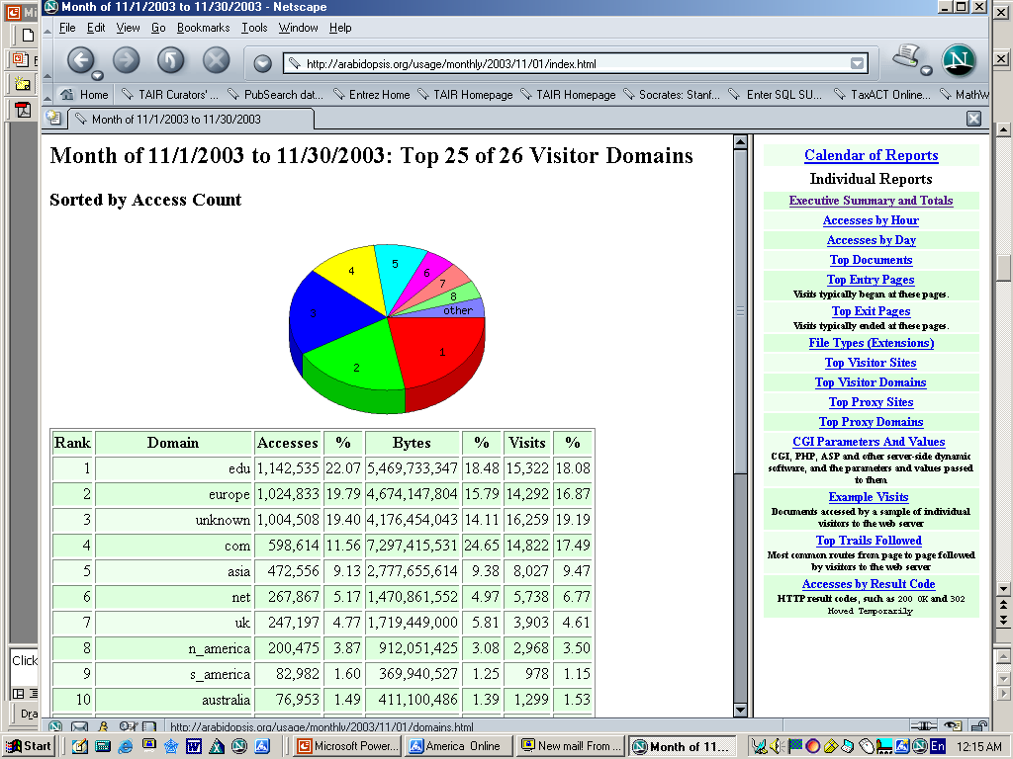
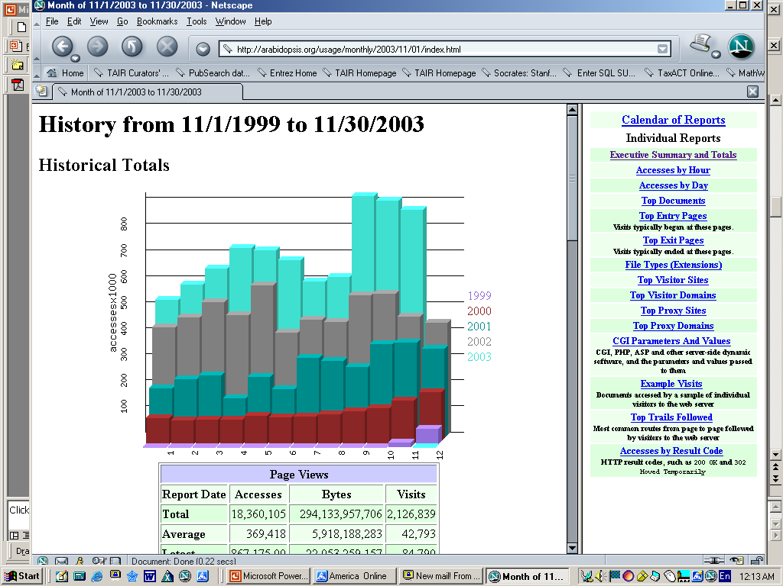
Usage Statistics
Monthly:
~900,000 page views
~30,000 IP addresses

Slide 6
Major Data Types
http://arabidopsis.org/jsp/tairjsp/pubDbStats.jsp
Data Types | Year 4
Alias | 535,994
Assignment | 476,933
FeatureAssignment | 1,153,647
Attribution | 2,916,590
Clone | 348,300
CloneEnd | 254,573
Communication | 30,478
GeneModel | 37,450
Locus | 31,212
GeneAlias | 81,607
GeneticMarker | 3,700
Comment | 257,352
Data Types | Year 4
ExternalLink | 132,062
Sequence | 597,105
Polymorphism | 244,664
Organization | 4,847
Person | 12,518
Journal | 1,028
Publication | 20,605
Protein | 32,225
ProteinDomain | 14,956
Stock | 383,348
StockOrders | 17,620
SpeciesVariant | 838

Slide 7
Examples of New Data Types Added in One Year
Data Types | Year 4
Germplasm | 197,688
Image | 1,390
Keyword | 16,945
Gene Annotation | 34,581
Taxon | 46
ExpressionSet | 115
Array Hybridizations | 515
ExpressionSummary | 5,948,096
And many more new data types we are currently adding and planning to add!

Slide 8
What do we do?
Identify sources of data, define data to curate, establish curation methods, and curate data
Communicate with data providers
Conceptual and logical design of data model
Physical implementation of the database structure
Design use cases, requirements, and specifications for software
(querying, visualizing, browsing, editing, importing, exporting, analyzing data)
Research into technologies, design the logic of software structure, implement software
Software documentation, maintenance, enhancement
User support
Attend meetings, provide workshops, write web content and publications

Slide 9
Organization structure and management
Hierarchical breakdown of goals → projects → tasks → subtasks
Establishment of project priority list and project leaders
Individual project team members meet ad-hoc or regularly
Establishment of 4-week cycle (breakdown goals to those that can
be accomplished in 4 weeks
follow-up once every two weeks
Quarterly in-person meeting for 2 full days to review/revise the
projects, priorities, and overall goals

Slide 10
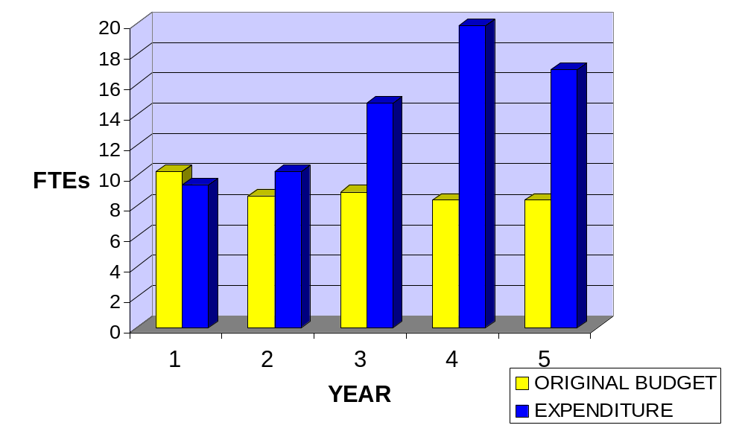
TAIR Budget versus Expenditure

Slide 11
Current Financial and Human Resources
GRANTS
7 active grants
Original TAIR budget (incl. Supplements): $3,901,561
Additional budget from 6 other grants: $1,501,693
Total Budget of active grants for 5 yrs: $5,403,254
Annual Budget (Direct Cost): $1,080,650
PEOPLE
Curators and assistants: 7.55 FTE
Programmers and DB developer: 6.4 FTE
Postdocs: 2 FTE
DBA &SysAD: 0.1 FTE
Web master: 0.7 FTE
Outreach coordinator: 0.5 FTE
Total: 17.25 FTE

Slide 12
Alliances, Collaborations, Outreach
Active participation in:
Gene Ontology Consortium: controlled vocabularies
GMOD (Generic Model Organism Database): software
Plant Ontology Consortium: controlled vocabularies
BioCurator: literature curation
Bay Area Database Curator Consortium: curation issues
Close Collaboration with:
TIGR: genome annotation
ABRC and NASC: stocks
Garnet (UK), Gent/VIB (Belgium), AtGenExpress (Germany): microarrays
MetaCyc: metabolic pathways, reactions, compounds
Cold Tolerance Project: microarrays, transcriptional regulation
Unknown GFP Localization Project: protein localization, unknown proteins
Workshops:
14th International Conference on Arabidopsis Research
American Society of Plant Biologists meeting
Plant & Animal Genome XII Conference (PAG XII)
Local workshops at Stanford and Berkeley

Slide 13
General Lessons Learned
1. Don’t underestimate the time for planning, researching available
technologies, knowledge, and people, conceptualizing and designing
(It takes more time and pain to ‘redo’ than start slow!)
2. Collaboration between program-illiterate biologist and biology-illiterate programmer is IDEAL. Make no assumptions.
3. While matrix organization (person *--* projects) is unavoidable, minimize the number of projects per person at a given time
4. Nothing is ever COMPLETED. Always leave room for maintenance and enhancement.
5. Find other groups that are dealing with similar goals and collaborate. Good ideas come from talking to others.

Slide 14
General Future Directions/Issues
-connection to other plant databases and other web resources
-data exchange formats (excel, xml)
-data presentation formats (xml, rdf)
-db connection methods (CORBA, SOAP, BioMoby)
-software sharing (Open Source, GMOD)
-community curation (unresolved)
-long-term sustainability (unresolved)

Slide 15
Current People Involved
TAIR-Carnegie
Director: Sue Rhee
Head curator: Eva Huala
Curators:
Tanya Berardini
Margarita Garcia-Hernandez
Nick Moseyko
Suparna Mundodi
Leonore Reiser
Peifen Zhang
Curator assistant:
Brandon Zoeckler
Programmers:
Behzad Mahini
Danny Yoo
Iris Xu
Jessie Zhang
Web master:
Julie Tacklind
Intern:
Thomas Yan (San Jose State U.)
TAIR-NCGR
Project leader and DB developer:
Dan Weems
Senior programmer:
Neil Miller
Programmer:
Mary Montoya
DB Administrator:
Faye Schilkey
Systems Administrator:
Forrest Black

Slide 16
Speakers
Speaker 2: Dan Weems, National Center for Genome Resources
“Design considerations while building the TAIR database ”
Speaker 3: Neil Miller, National Center for Genome Resources
“TAIR hardware and software architecture”
Speaker 4: Eva Huala, Carnegie Institution, Dept. Plant Biology
“Public face of TAIR: User interface design and incorporation of community feedback”
Speaker 5: Marga Garcia-Hernandez, Carnegie Institution, Dept. Plant Biology
“Data management and curation at TAIR”

Slide 17
Job Opportunity!
We are looking for a Programmer at Carnegie Institution, Stanford, CA to start immediately to participate in TAIR software development.
Tasks: Set up and maintain structural genome annotation pipeline using existing open-source software in collaboration with a curator. Development of TAIR’s curation and user web applications in collaboration with other developers and curators. Documentation of software. Presenting work at meetings.
Requirements: Solid skills and several years of experience with Perl, J2SE, J2EE, relational databases (we use Sybase, MySQL, PostGres), UNIX/Linux, and Apache. Excellent written and
verbal communication skills in English. A team-player.

Slide 18
History of the Arabidopsis Community Database
  1991-1993 AAtDB (Harvard/MIT) (1 FTEs)
  1991-2000 AIMS & ABRC (Ohio State, NSF)
  1993-1998 AAtDB becomes AtDB (Stanford, NSF) (2-5 FTEs)
    -300 community members in the beginning
  1999 TAIR transitions from AtDB (9 FTEs)
    -2000 community members in the beginning
  2001 TAIR merges with AIMS
    -7000 community members
  2002 TAIR hosts the first completed functional genomics projects (AFGC, 1999-2001, NSF)
  2004 TAIR assumes maintenance of Arabidopsis genome annotation (TIGR, 1996-2003, NSF)
  2004 TAIR up for a renewal for next five year (15 FTEs)
    -12,500 community members

