Slide 1
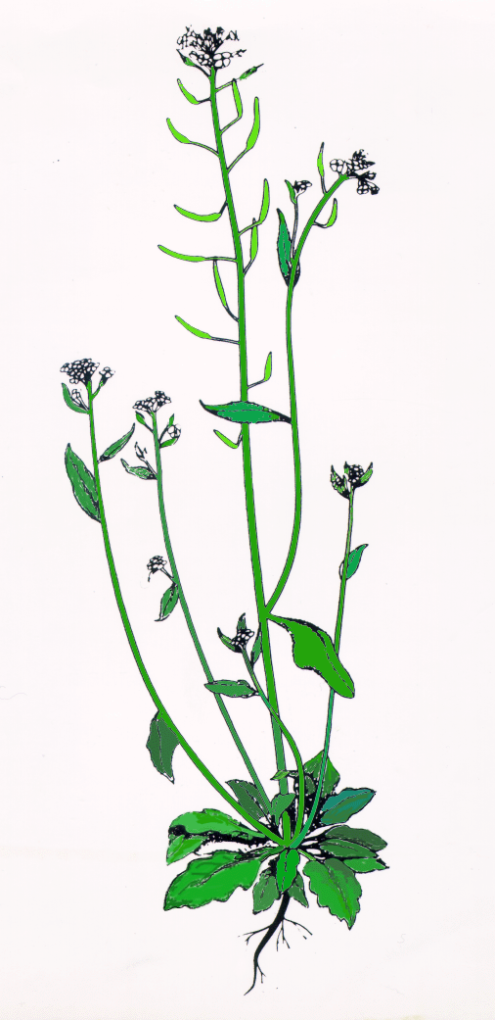



Arabidopsis Genomics in France

Slide 2

Systematic functional analysis:
from genome to function
All Arabidopsis genes
Full-length cDNAs, putative ORFs
Gène
ORFeome
FST
project
Molecular
function
Subcellular
location
2-hybrid...
Tagged proteins
AGRIKOLA
Expression
Cellular
function
Reverse genetics
microarrays
CATMA
Physiological
role
AraCORE

Slide 3
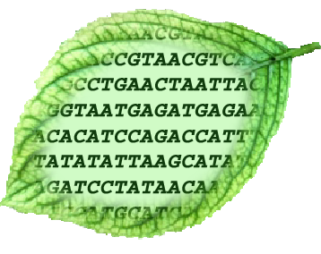
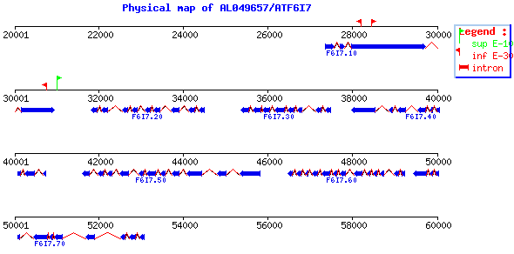
Unité de Recherche en Génomique Végétale
An Arabidopsis ORFeome
URGV
By RT-PCR, with the aid of genome sequence and gene predictions
From sequenced cDNA clones
INRA/Génoscope/Invitrogen
library
5000 ORFs
100 ORFs
25 000 – 30 000 genes
Génoplante-funded project in collaboration with Invitrogen

Slide 4
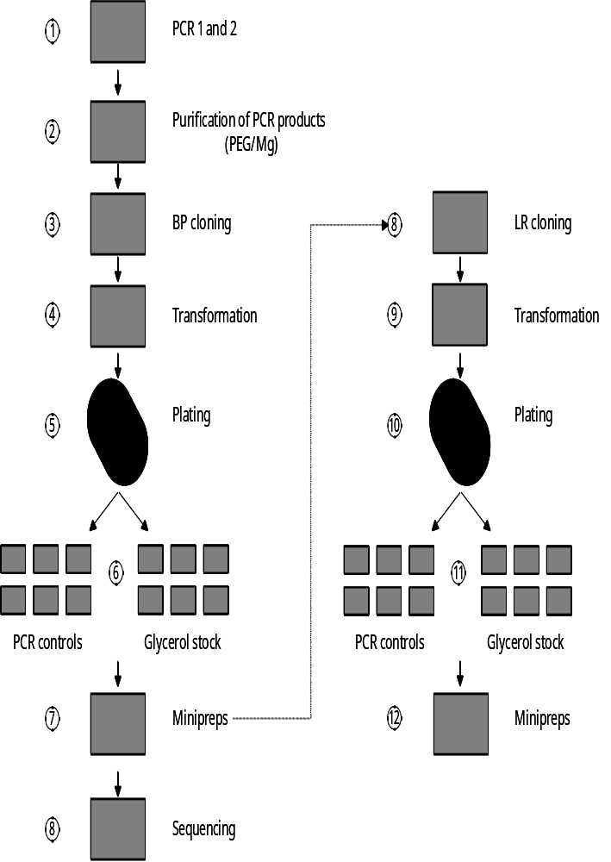
Unité de Recherche en Génomique Végétale
ORFeome construction
Poster 1-82
URGV
2-step
Protocol
5 cycles
10 cycles
Cloning efficiency:
90 % (128/144)
(from 1.2 to 3.5 kb)
Pfx error rate:
1 error / 3.1 kb (25/79kb)

Slide 5
Unité de Recherche en Génomique Végétale
URGV
Using an ORFeome…
Systematic functional analysis of large gene families
Genome-wide functional studies
1, 10 100 1000 n
ORFs
Subcellular localization
Protein-Protein interactions
Protein-RNA interactions
Structural genomics
Genetic analysis
Epitope tagging
…
Arabidopsis ORFeome
PPR
Poster 1-81

Slide 6
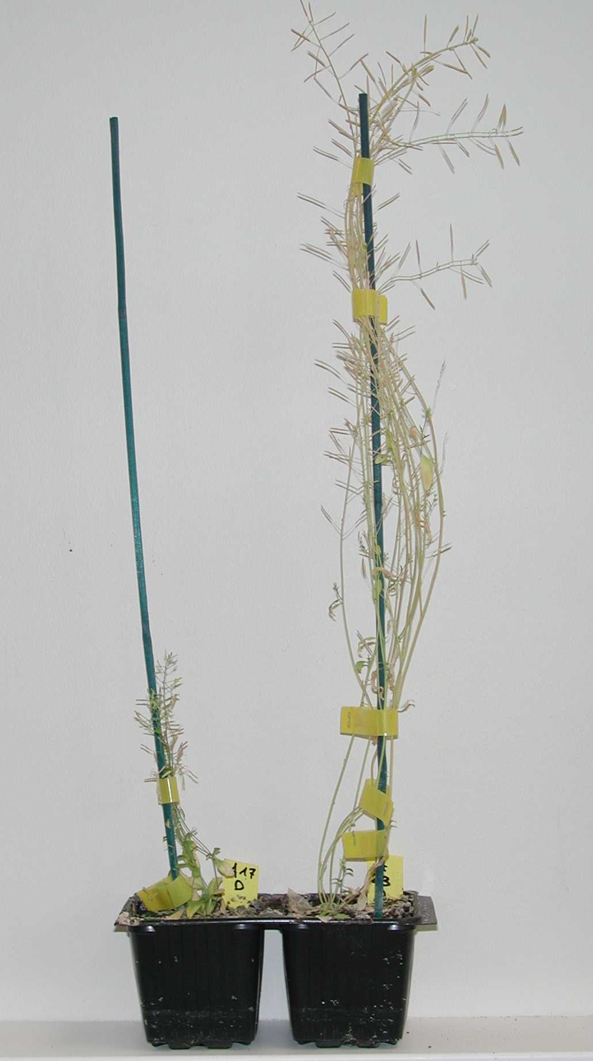
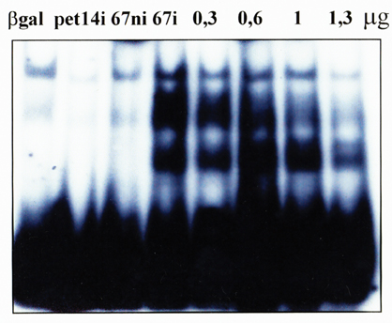
Unité de Recherche en Génomique Végétale
Functional analysis of PPR proteins with the help of a PPR ORFeome
URGV
Poster 1-81
Macromolecular interactions
(2-hybrid, 3-hybrid, tagged complexes)
Subcellular localisation
(GFP and RFP fusions)
Generation and complementation of mutants
(transgenic plants, RNAi)
Structural and biochemical characterization
(Expression in bacteria, purification…)

Slide 7
The Flanking Sequence Tag (FST) project
Poster 1-35
FST
FST
Genomic DNA
T-DNA
Genomic DNA
Via public FLAGdb/FST database (open July 2001) :
http://flagdb-genoplante-info.infobiogen.fr/projects/fst/
9108 FSTs are public, more than 12 000 more in the Génoplante database will become public over the next six months

Slide 8
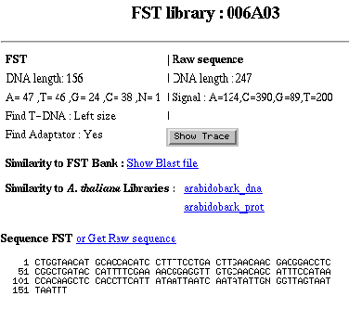
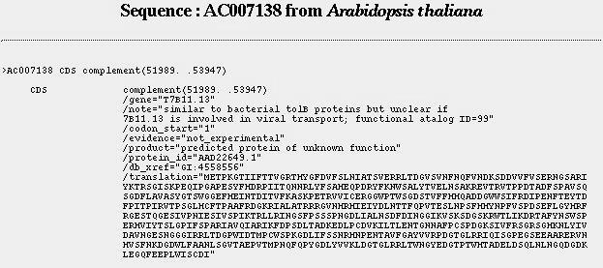
Linking FSTs to annotated sequences

Slide 9
Reverse genetics - advantages of RNAi
1. Targeted gene silencing - only a few transformants per gene required
2. Most mutants are not null mutants, so:
a range of plants with differing phenotypes can be obtained
silencing of essential genes can be studied using ‘leaky’ suppression or conditional silencing (tissue-specific or inducible)
3. Mutants can be easily obtained in a variety of genetic backgrounds or ecotypes without laborious backcrossing
4. Multiple genes can be targeted simultaneously

Slide 10
AGRIKOLA
Arabidopsis Genomic RNAi Knock-out Line Analysis
Poster 1-82
Objectives:
Provide a set of binary plasmids for constitutively or controllably triggering gene-silencing of at least 20000 Arabidopsis genes for which specific tags can be designed.
Transform Arabidopsis with a wide selection of these plasmids to obtain targeted mutants.
This project will provide plant scientists with the ability to generate mutants at will in almost any Arabidopsis gene for functional studies.

Slide 11
hpRNA plasmid construction
pHELLSGATE, Wesley et al. Plant J. 2001
Poster 1-17
Gateway cassette
Pdk Intron
Gateway cassette
ccdB
ccdB
35S
R1
R2
+
R2
R1
L1
L2
CATMA GST
Entry clone
Pdk Intron
GST
GST
35S
B1
B2
B2
B1

Slide 12
AraCore
Aims
  To study natural variation within Arabidopsis
  To provide resources for mapping and cloning QTLs
300-500 accessions, with an effort to cover new geographical areas
Core collection
Up to 10000 RIL (F6), 500 lines/population
SNP markers for c. 100 genes
Poster 10-12

Slide 13
Arabidopsis Genomics in France
CATMA
http://jic-bioinfo.bbsrc.ac.uk/CATMA/
ORFeome
  Claire Lurin lurin@evry.inra.fr
FST project
  http://flagdb-genoplante-info.infobiogen.fr/projects/fst/
AGRIKOLA
  Ian Small small@evry.inra.fr
AraCORE
  David Bouchez bouchez@versailles.inra.fr

