Slide 1
Plant Research Projects in Riken Institutes
Kiyotaka Okada
Minami Matsui
Motoaki Seki
Notes:
理研横浜

Slide 2
Plant Genomic Researches in Japan
Ministry of Education and Technology (MIXT)
National Universities
National Institutes NI for Basic Biology in Okazaki
NI of Genetics in Mishima
Riken Institutes
Plant Science Center
Genomics Science Center
Bioresource Center
Ministry of Agriculture
National Institute of Agrobiological Institute
providing funds to researchers at National Universities and Institutes
Ministry of Industry
providing funds to researchers at National Universities and Institutes
Regional Government
Chiba … Kazusa DNA Research Institute
Okayama … RIBS
Private Organization
private universities
companies
Rice genomics
Arabidopsis metabolome analysis, genomics of Lotus japonicus
Collection of Arabidopsis tagged lines,
Genome sequencing of Lotus japonicus
Notes:
理研横浜

Slide 3
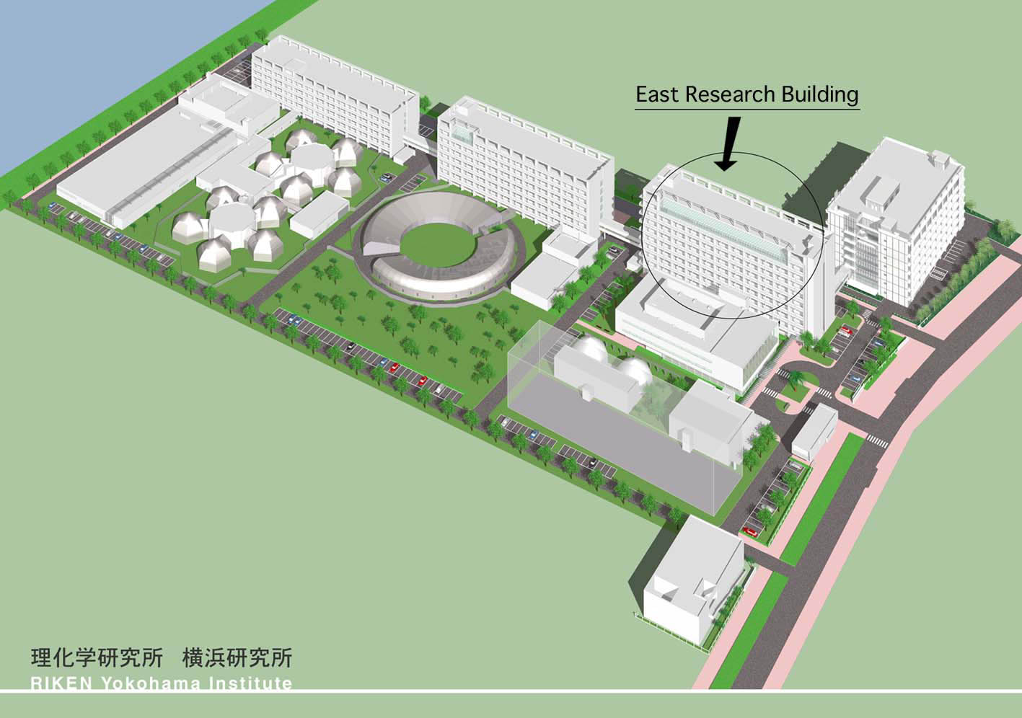
Plant Science Center
Genomics Science Center
NMR facilities
Riken Yokohama Campus
Notes:
理研横浜

Slide 4
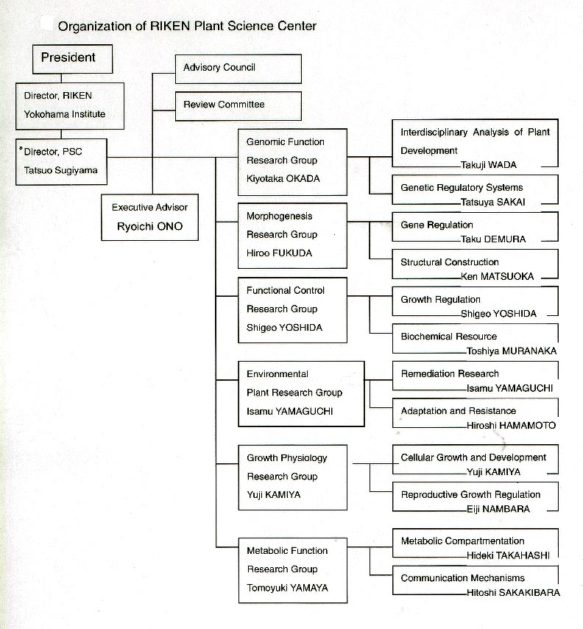
Notes:
理研横浜

Slide 5
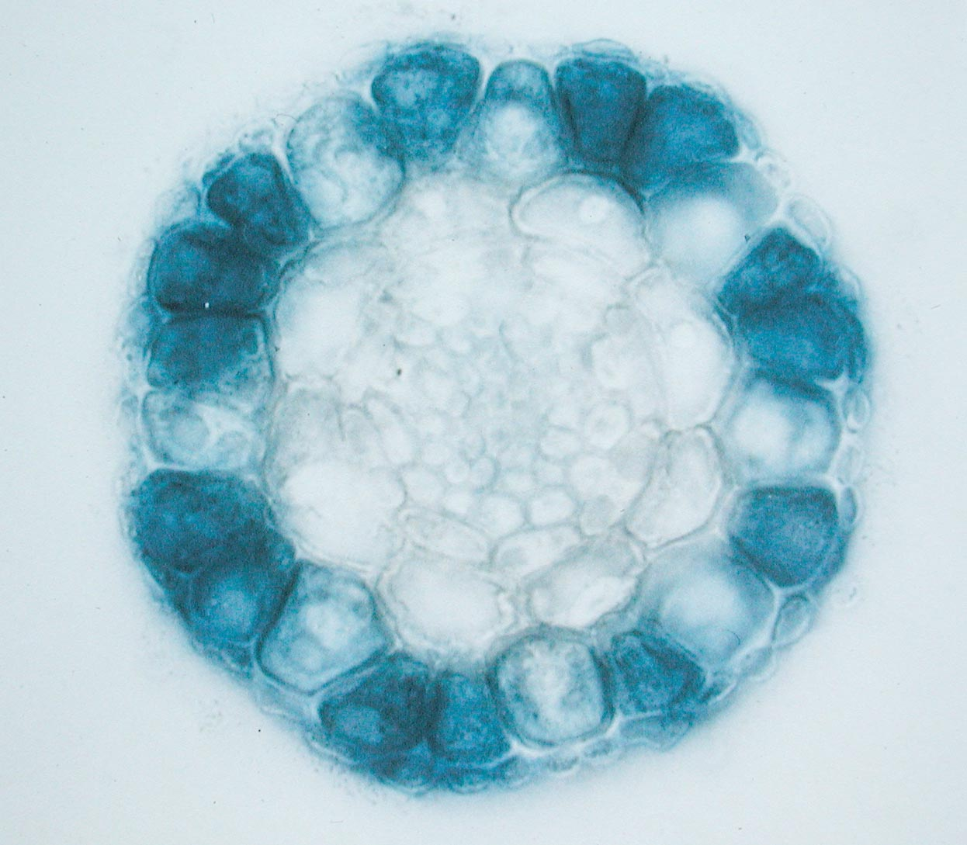
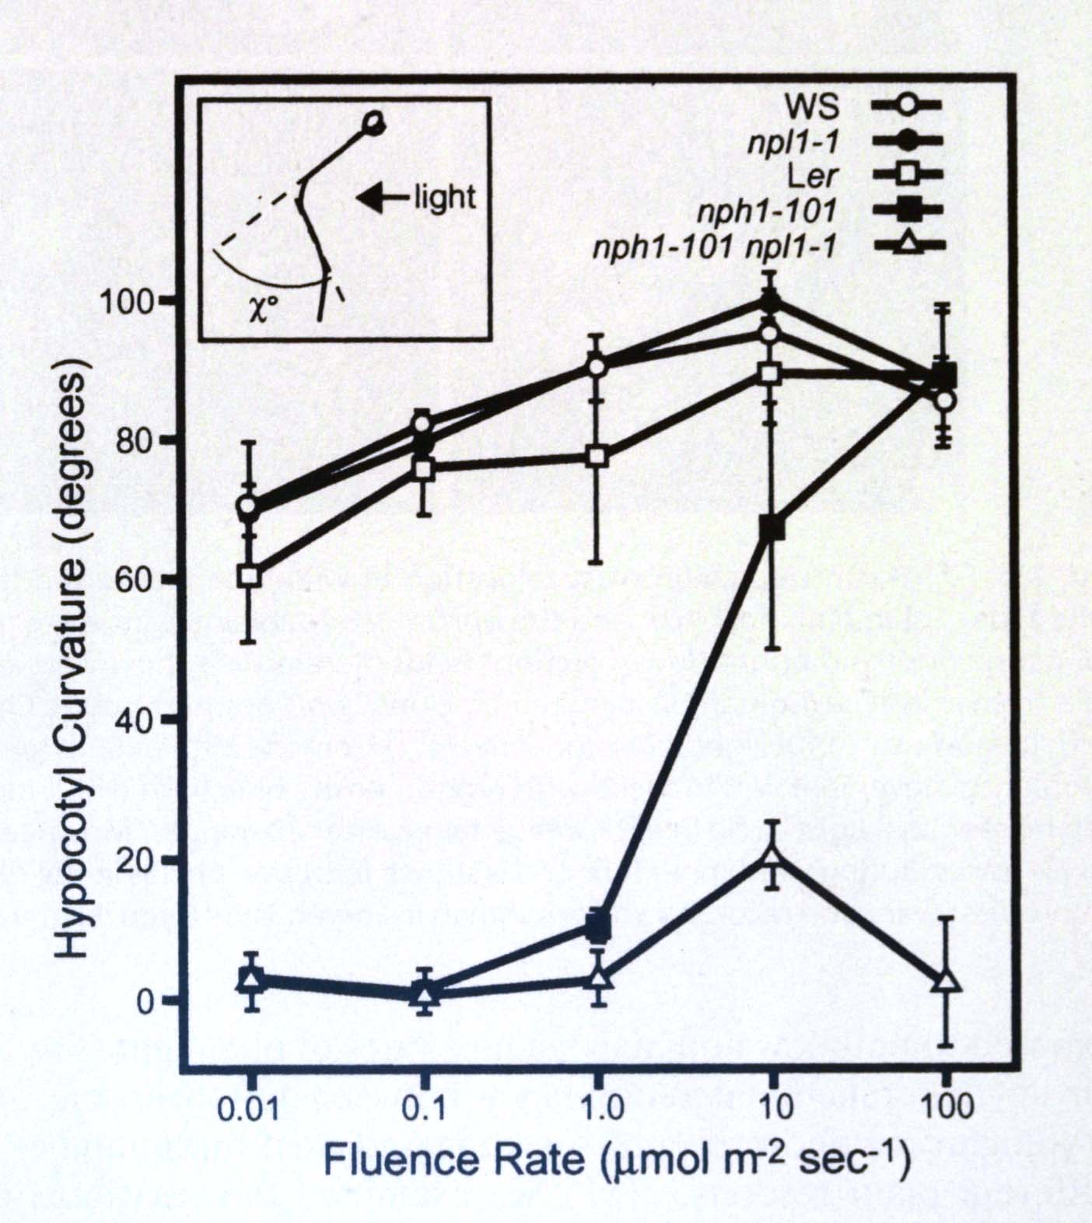
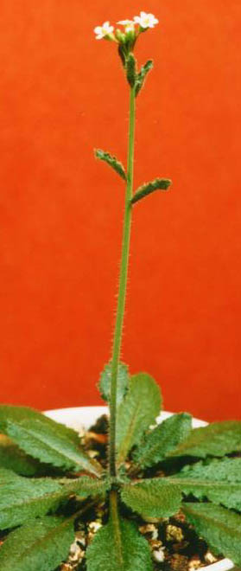
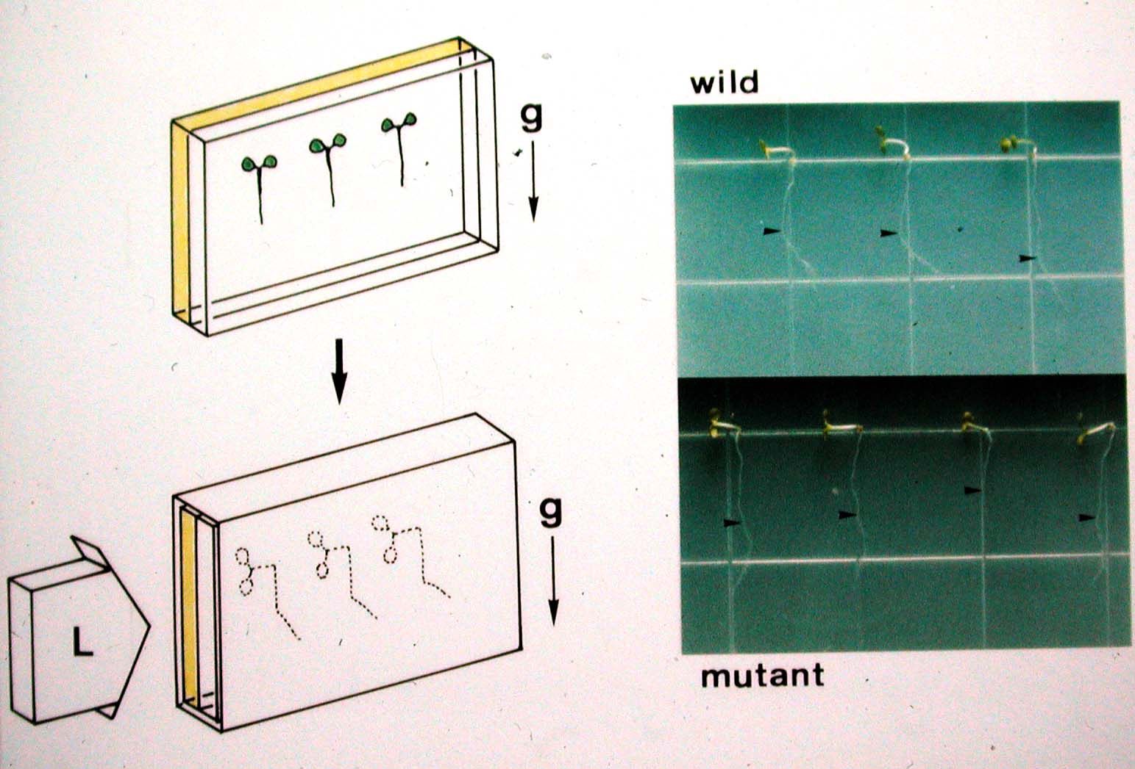
Genomic Function Research Group
Group director: Kiyotaka Okada (Kyoto Univ. and Riken PSC)
Forward genetics-based analyses of Arabidopsis
Laboratory for Interdisciplinary Analysis of Plant Development
  Team leader: Takuji Wada
Cell differentiation of epidermal cells … root hair development, trichome development, intercelllular signaling, etc.
Laboratory for Genetic Regulatory Systems
  Team leader: Tatsuya Sakai
Signaling mechanism by environmental cues … phototropism, chloroplast relocation, mechanosensing, etc.
Notes:
岡田グループ

Slide 6
Expressed Protein Catalog
Expressed Gene Catalog
Novel Culture Systems
Morphogenesis Research Group
Group director: Hiroo Fukuda
(Univ. Tokyo and Riken PSC)
Laboratory for Gene Regulation
  Team leader: Taku Demura
Analysis of gene expression network in differentiation, de-differentiation, and transdifferentiation of plant cells using Zinnia transdifferentiation culture system, Arabiopsis, …
Laboratory for Structural Construction
  Team leader: Ken Matsuoka
Analysis of intracellular membrane system and secretory system in plant cells.
Plant
Morphogenesis
Totipotency
Dedifferentiation
Cytodifferentiation
Cell Division
Gene Expression
Network
Intracellular
Communication
Microarrays
Genome Information
Reverse Genetics
Model Systems
Notes:
福田グループ

Slide 7
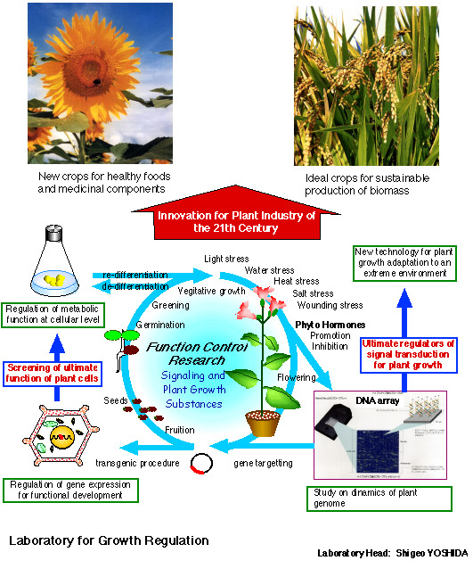
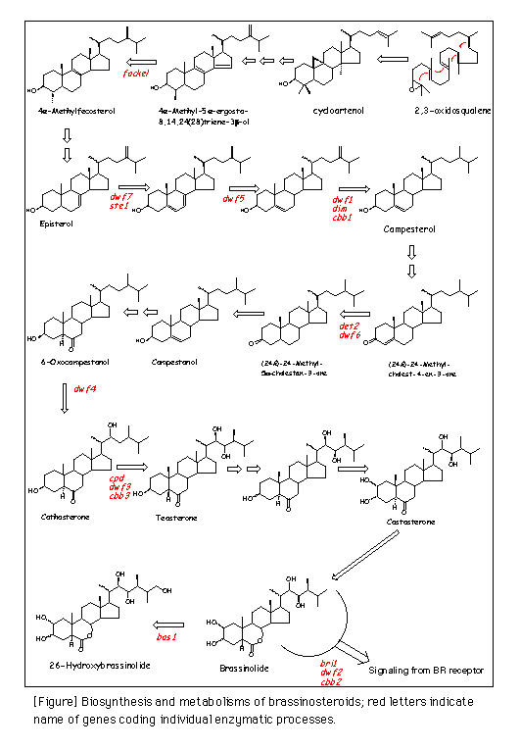
Function Control Research Group
Group director: Shigeo Yoshida
Laboratory for Growth Regulation
Team leader: Shigeo Yoshida
Laboratory for Biochemical Resource
Team leader: Toshiya Muranaka
Notes:
吉田グループ1

Slide 8
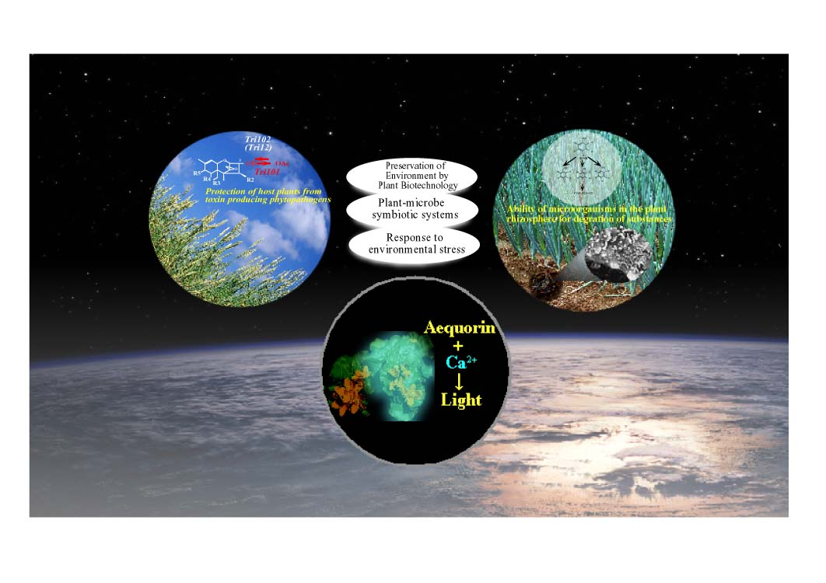
Environmental Plant Research Group
Group director: Isamu Yamaguchi
Laboratory for Remediation Research
Team leader: Isamu Yamaguchi
Laboratory for Adaptation and Resistance
Team leader: Hiroshi Hamamoto
Notes:
山口グループ

Slide 9
Lab. for Cellular Growth & Development
Growth Physiology Group
Team Leader: Yuji Kamiya
Group Director: Yuji Kamiya
Gibberellin Biosynthesis and Signaling
Regulation of Non-Mevalonate Pathway
Development of Seed Germination Technology
Time Break
1-1000 years
Seed Germination
Gibberellin
Seedling
Dormancy
Dormant Seed
Seed Development
Shoot Growth
Life Cycle of Plants
Lab. for Reproductive Growth
Flowering
Team Leader: Eiji Nambara
Flower Development
Regulation of Seed and Bud Dormancy
ABA Biosynthesis and Signaling
Accumulation of Secondary Metabolites in Seed
Abscisic Acid
Germinating Seed
Notes:
神谷グループ

Slide 10
Metabolic Function Research Group
Innovative Research for Plant Cell Metabolic Engineering: Comprehensive Analysis of Signaling and Regulation of Inorganic Nutrient Assimilation and Primary Metabolisms
Group Director:
Tomoyuki Yamaya
(Tohoku U. and Riken PSC)
C
CO₂
Compartmentation and Cross-talks of C, N, S metabolisms
Signal Transduction and Gene Expression Through Two-Component System
S
N
Lab for Metabolic Compartmentation
Lab for Communication Mechanisms
Team Leader:
Hideki Takahashi
Team Leader:
Hitoshi Sakakibara
Cell-to-Cell & Organ-to-Organ Signals
Uptake and Transport of Nitrate, Ammonia and Sulfate
Cytokinin as a Signal Transducer of Nitrogen Status
SO₄²⁻, NO₃⁻, NH₄⁺
Towards Improvement of Metabolic Function and Crop Productivity
Notes:
山谷グループ

Slide 11

RIKEN Genomic Sciences Center (GSC)
Plant Functional Genomics Group
Objectives
Saturated mutagenesis of Arabidopsis
T-DNA Tagging, Activation Tagging lines
miki@postman.riken.go.jp
Ac/Ds transposon Tagging lines
others
Mutant phenotype and gene function analysis
Mutant phenotype analysis
Gene knockout lines and identification of corresponding genes
Analyses of full-length cDNA
Inventory of full-length cDNAs
Construction of full-length cDNA microarray
Structural and functional analysis of plant proteins
http://www.gsc.riken.go.jp/Plant/index.html

Slide 12
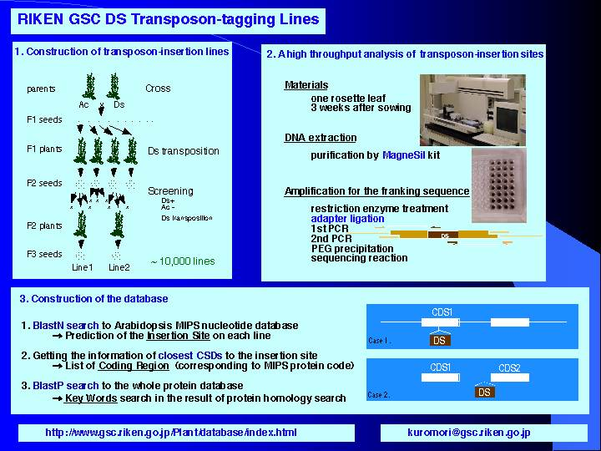

Slide 13
Database of mutant candidates from T1 generation of RIKEN activation tagging lines
Number of screened lines | 40,000 lines
Number of mutant candidates (adult morphology) | 1262 lines
Number of flanking sequences of T-DNA | 1065 sequences
Number of candidate genes | 1923 loci
miki@postman.riken.go.jp

Slide 14
The category of phenotypes that was observed at T1 generation
Rosette |  | Plant hight |  | Flower |  | Branching
pale green | 61 | dwarf | 190 | stigma | 0 | bushy |  | 133
dark green | 70 | semi-dwarf | 276 | petal | 16 | hyper APD |  | 16
anthocyanin | 18 | tall | 11 | pedicel | 5 | fasiation |  | 14
large leaves | 134 | Caulin leaves |  | filament | 1 | type of influorescence |  | 25
small leaves | 207 | no | 0 | sepal | 3 | short internode |  | 45
long petiole | 19 | small | 8 |  |  | long internode |  | 13
short petiole | 28 | large | 46 |  |  | Flowering
epinastic | 203 | many | 36 | Fertility |  | very early | 2
hyponastic | 12 | shape | 8 | Good | 6 | early | 21
shape | 98 | others | 0 | low | 217 | late | 31
round leaves | 156 |  |  | sterile | 164 | very late | 1
narrow leaves | 144 |  |  |  |  | never | 9
many leaves | 188
few leaves | 18
others | 42

Slide 15
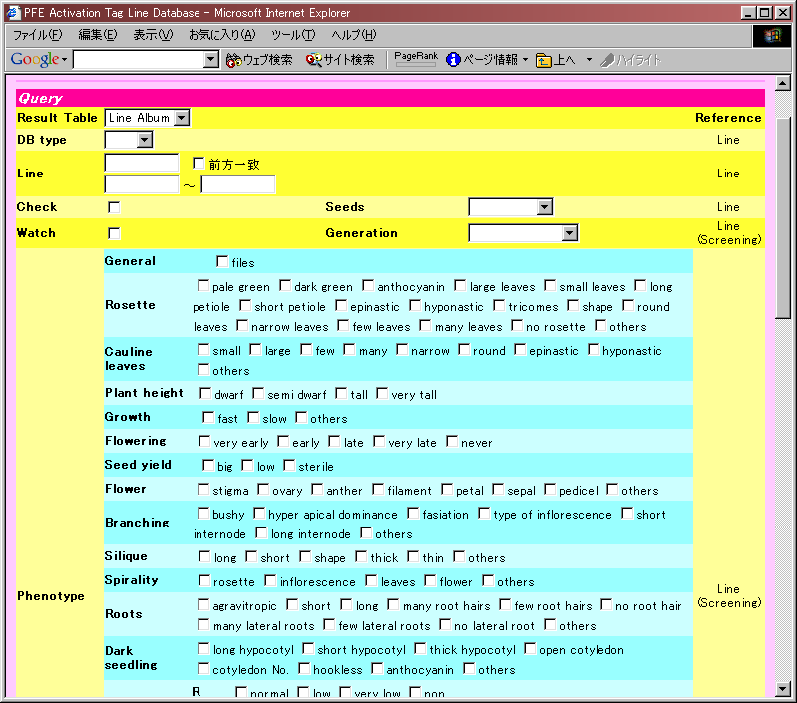
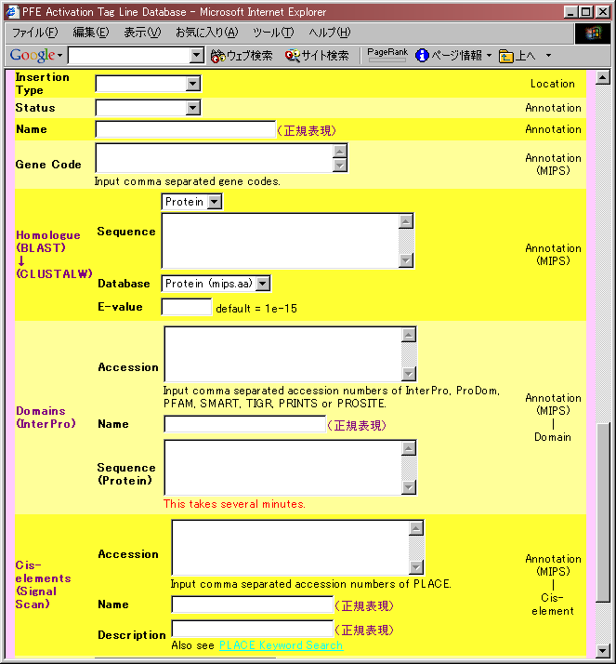

Slide 16
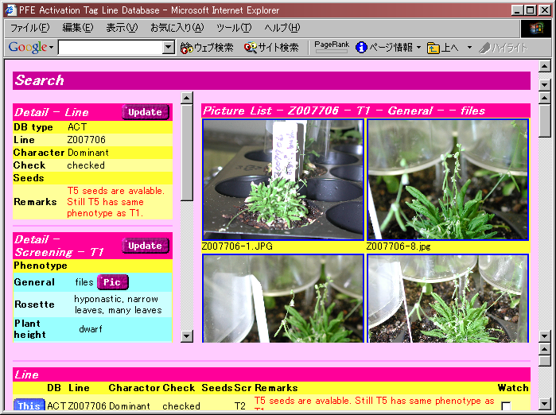
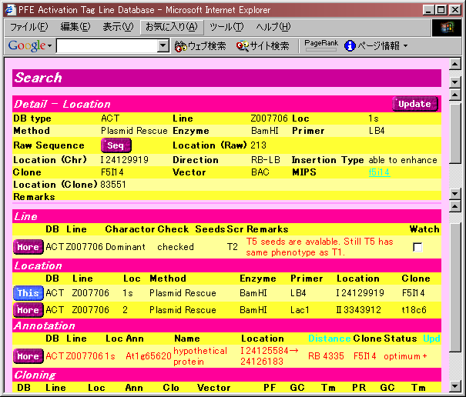
Database constructed
In collaboration with
NEC Soft. Ltd.
(mutou@mxu.nes.nec.co.jp)

Slide 17
Activation tag line insertion site map

Slide 18

RIKEN Genomic Sciences Center
Plant Functional Genomics Group
RIKEN
Bio Resources Center
Ac/Ds transposon lines
Activation tagging lines
Full-length
cDNAs
http://www.brc.riken.go.jp/lab/epd/Eng/index.html

Slide 20
Table 1. Summary of 3’-end single-pass sequencing of RAFL cDNA clones
isolated from A. thaliana full-length cDNA libraries
Seki et al. (2002) Science 296:141-145.
Library
Plant
Vector
Standard/
No. of cDNA
No. of
No.
Materials
Normalization
clones subjected
cDNA
Subtraction
to clustering
groups
RAFL1
Cold-treated leaves and stems
λZap
Standard
111
n.d.
RAFL2
Rosette plants
λZap
Standard
256
130
RAFL3
Dehydration-treated plants
λZap
Standard
223
115
RAFL4
Cold-treated plants
λZap
Standard
1029
862
RAFL5
Dehydration-treated plants
λZap
Standard
2030
1672
RAFL6
Plants at various developmental
λZap
Standard
6139
1461
stages and those treated
RAFL7
with dehydration and cold
λFLC-1-B
Standard
2591
751
RAFL8
Cold-treated plants
λFLC-1-B
Standard
2637
584
Dehydration-treated plants
3368
RAFL9
Plants at various developmental
λFLC-1-B
Standard
22929
stages and those treated
with dehydration and cold
RAFL11
Plants at various developmental
λFLC-1-B
Normalization
2242
339
stages and those subjected to
various stress (dry, cold, and
NaCl) and ABA treatments.
Plants grown under dark
RAFL12
conditions. Siliques.
λFLC-1-E
Subtraction
22
2
RAFL13
Cold-treated plants
72
5
Dehydration-treated plants
λFLC-1-E
Subtraction
RAFL14
Roots
λFLC-1-E
Standard
23302
1371
RAFL15
Siliques and flowers
λFLC-1-E
Standard
13661
816
RAFL16
Dark-grown plants
λFLC-1-E
Standard
25466
1227
RAFL17
Dehydration-treated plants.
λFLC-1-E
Subtraction
14035
452
Rehydration (After dry 10 hr)-
RAFL18
treated plants.
1213
41
RAFL19
Cold-treated plants
λFLC-1-E
Subtraction
24951
970
Siliques and flowers
λFLC-1-E
Subtraction
RAFL21
Plants that are treated with various
λFLC-1-E
Subtraction
12346
502
stress (heat and UV), hormones
(ABA,auxin,ethylene, SA, JA, GA,
and cytokinin) and BTH.
155,144 RAFL cDNA clones were
clustered by mapping of the 3’-end
>14,668 cDNA groups
single-pass-sequencing data on the
genomic sequence.

Slide 21
Identified genes:17,956
Predicted genes:26,285
predicted
unidentified: 9,286
non-
predicted
identified
: 837
3,288
11,394
2,437
17,119 identified
(16,999 predicted)
“Reported
EST or cDNA”
genes
“RAFL cDNA”
genes:14,668
(60% of all predicted
genes)
non-predicted
identified: 837
Seki et al. (2002) Science 296:141-145.

Slide 22
Full-Length cDNA Sequencing of RIKEN
Arabidopsis
Full-Length cDNA (RAFL cDNA)
1. Collaboration with the
Arabidopsis
SSP group of the USA
Salk Institute (PI: Dr. J.R. Ecker)
Stanford Genome Technology Center (PI: Dr. R.W. Davis)
Plant Gene Expression Center (PI: Dr. A. Theologis)
a. Full-length cDNA sequences of 8,554 RAFL cDNA clones
were determined as of March 25, 2002.
b. SSP and our groups are planning to do full-length cDNA
sequencing of ca. 12,000 RAFL cDNA clones.
2.
We are also planning to do full-length cDNA sequencing of
ca. 2,000 RAFL cDNA clones.
3. After determination of full-length cDNA sequences, the RAFL
cDNA clones will be distributed from RIKEN Bioresource center
and ABRC.

Slide 23
Expression profiling using full-length cDNA microarray
(Ver.2) containing ca. 7,000 full-length cDNA clones
Abiotic Stress (Drought, Cold, High-Salinity)
Biotic Stress (Pathogen Attack, SA, JA)
Light Conditions
Mutants, Transgenic Plants
Now, we are constructing a new full-length cDNA
microarray (Ver. 3) containing ca. 15,000 full-length
cDNA clones and will study expression profiles.

Slide 24
Studies on functions and structures of proteins:
1. Transgenic plants
2. Construction of protein catalogs using wheat germ
cell-free protein synthesis system (in collaboration with
Dr. Endo’s group)
3. X-ray crystallography and NMR spectroscopy
(in collaboration with Dr. Yokoyama’s group)

