Slide 1


The Nordic Arabidopsis Network http://www.arabidopsis.no
The use of Arabidopsis thaliana as a model for economically important plants
Funded by NorFA
Coordinator: Jaakko Kangasjärvi
jaakko.kangasjarvi@utu.fi
Department of Biology

Slide 2
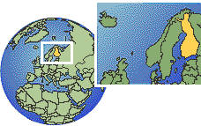
Nordic countries
Iceland
  pop 282 849
Norway
  pop 4.4 milj
Denmark (member of EU)
  pop 5.3 milj
Sweden (member of EU)
  pop. 8.9 milj
Finland (member of EU)
  Pop. 5.2 milj
Each country has its own scence funding organization
Nordic countries have high % of GNP for R&D funding
- e.g., Sweden 3.7%, Finland 3.1% (EU average 1.9%, US 2.8%)
- IT and telecommunications, in biological sciences ‘environmental’ research and trees/forest(ry) strong

Slide 3
The Nordic Academy for Advanced Study (NorFA) provides opportunities for exchange of ideas and human resources, and seeks to stimulate new developments and ideas in research training. A platform for analysis and dialogue for Nordic research training and research co-operation. NorFA is an organisation within the Nordic Council of Ministers.
Funding for:
  Research networks
  Research training courses
Norfa does NOT fund research ‘as such’

Slide 4
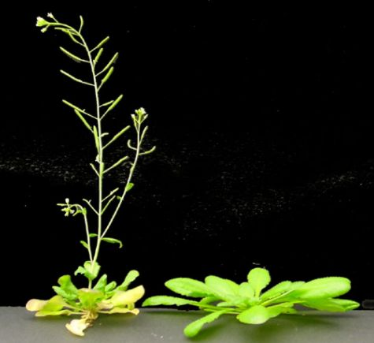
The Nordic Arabidopsis Network
Aim: to increase and promote contacts between the groups
The use of Arabidopsis thaliana as a model for economically important plants
  Open to all groups using Arabidopsis
  Most groups in the network use Arabidopsis as a model for trees, barley,…
NorFa Arabidopsis network 2001-2005
  Arranges annual workshops and symposia
  Promotes student exchange and visits within the network

Slide 5
The Nordic Arabidopsis Network
First workshop fall 2001 in Helsinki
  Attendance about 90
  Participation from about 20 groups from four countries
Scientist/student exchange program started
Second workshop fall 2002 in Sweden

Slide 6
Arabidopsis Functional Genomics in the Nordic countries
Norway: the FUGE program (FUGE= functional genomics)
  Starts 2003, funding decisions made
  Arabidopsis consortium gets 5 (?) year funding: proteomics, microarrays, strain/mutant collection
    Atle Bones, University of Trondheim coordinates
    Serves the Norwegian Plant Science Community
Sweden: The Wallenberg Foundation supports Functional genomics in two large "consortia”
  Within the "Consortium North" (Stockholm-Uppsala-Umeå) funding for a service facility for Arabidopsis transgenics/ mutants, and some funding for an Arabidopsis functional genomics network
  Foundation for strategic research: a 6 year "centre of excellence" in plant science - headed by Göran Sandberg Umeå. Mainly trees, but also Arabidopsis.

Slide 7
Arabidopsis Functional Genomics in the Nordic countries
Denmark: Will have a new genomics program DANGRO (contact: John Mundy at Copenhagen)
  normal competitive funding
  a few (3-4) institutions which work with At on specific problems
Finland: not yet specific genomics programs
  Normal competitive funding
  Proteomics, cDNA arrays used
    Stress acclimation, photosynthesis, developmental aspects
    A.th used as a model for trees in stress and developmental biology

Slide 8
In the future
More connections and collaboration between the Nordic Arabidopsis groups
  most of them still quite young
  Promotion of A.th and plant functional genomics for the funding agencies
Better/more integration with the European and US functional genomics programs

