Slide 1

Part II
SeqViewer
AraCyc
Help
Notes:
It is essential to understand that automatic annotation is not synonymous with gene prediction. Gene predictions are not gene annotations. In fact, ‘gene prediction’ is something of a misnomer—usually it’s just a single CDS (or, even, exon) of a protein-coding gene that is predicted; this is true even when the gene predictor makes use of homology, e.g. TWINSCAN (8). Likewise, simply aligning ESTs and full-length cDNAs to a genome does not produce gene annotations either. A gene annotation is a much more complex entity; it must include features such as alternative splicing & UTRs, and wrestle with issues such as locus assignment, pseudogenes, evidence trails, nomenclature issues, known vs. new gene, etc. Gene predictions and sequence alignments are the outputs of single executables and reside in flat-files; gene annotations, on the other hand, are complex objects that reside in databases and XML repositories. Gene annotations are versioned, graphically accessible, alterable, obsolete-able, and distributable. To create a gene annotation automatically is thus a very different task from gene prediction or aligning cDNAs to a genome.

Slide 2
SeqViewer: TAIR’s genome browser
Visualization of the whole Arabidopsis genome and its associated annotations
BAC, gene, transcript, polymorphism, T-DNA insertion, marker
Can go down to the individual nucleotide level

Slide 3
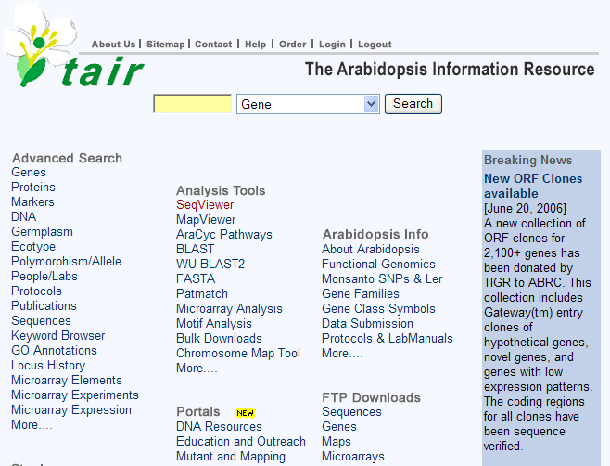
SeqViewer

Slide 4
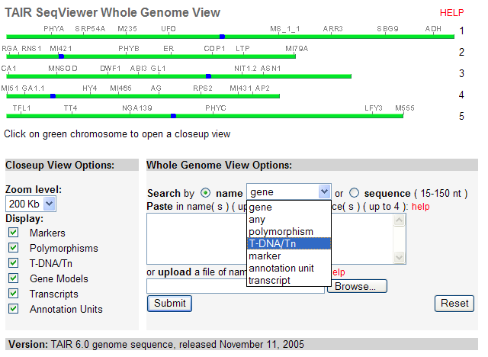
SeqViewer

Slide 5
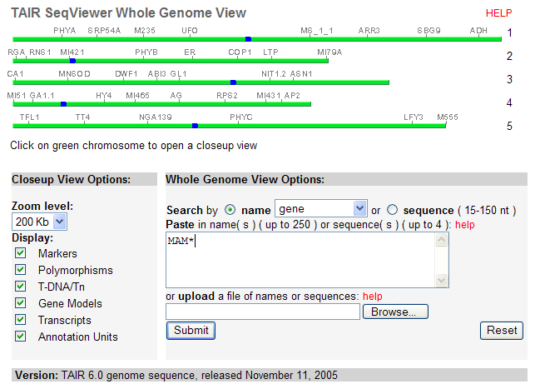
Search in SeqViewer

Slide 6
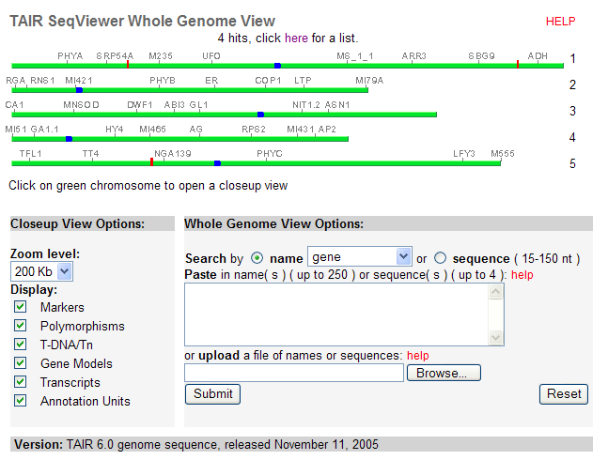
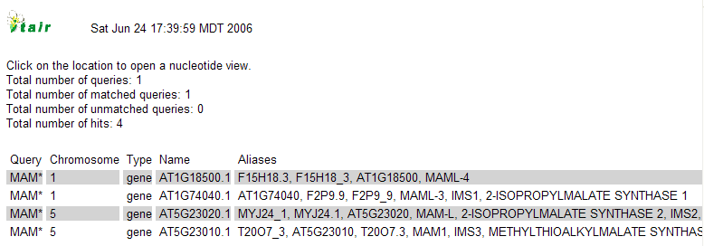
Search result

Slide 7
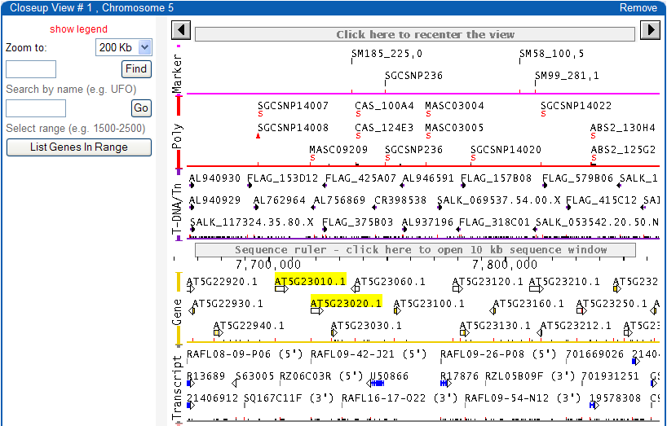

SeqViewer closeup view

Slide 8
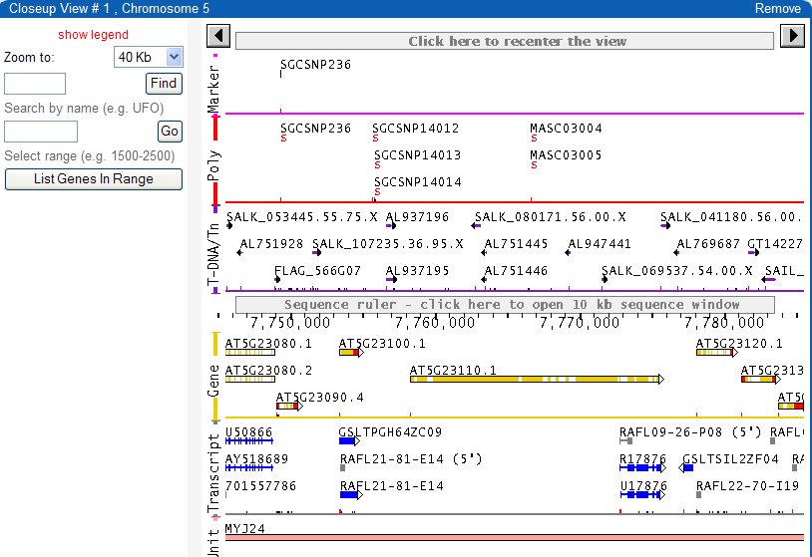

Slide 9
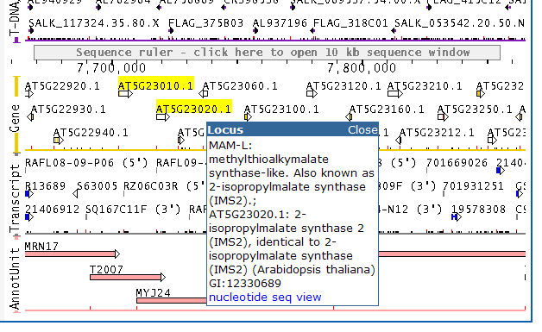
Seqviewer closeup view

Slide 10
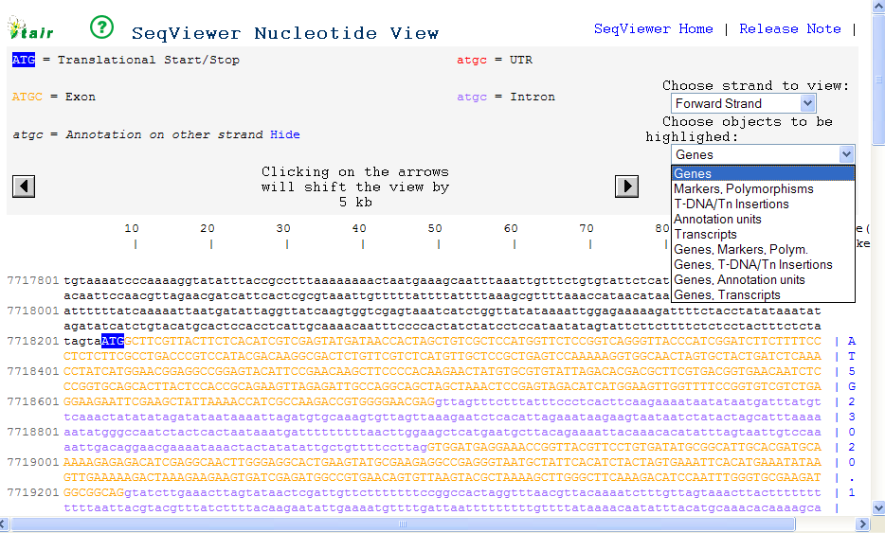
SeqViewer nucleotide view

Slide 11
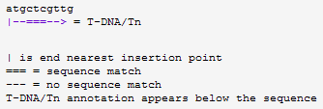
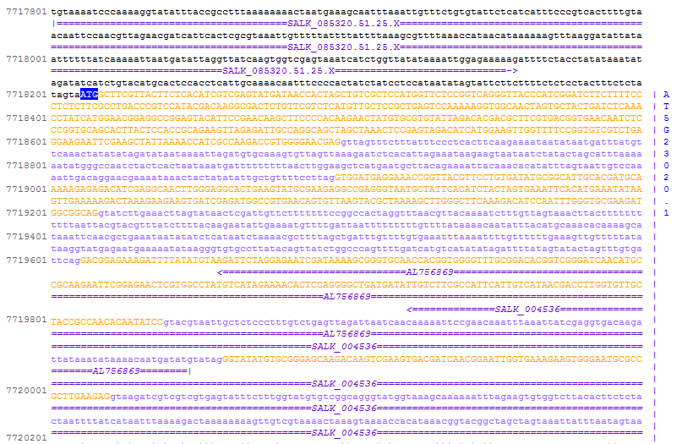
SeqViewer nucleotide view

Slide 12
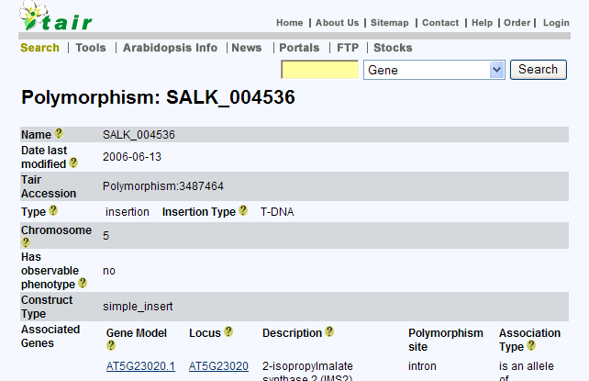
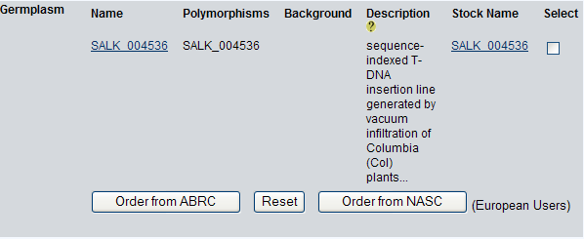

Slide 13
AraCyc: Biochemical pathways of Arabidopsis
Search, browse and visualize pathways, compounds, enzymes and genes
Overlay large scale Omics data on the metabolic pathway network

Slide 14
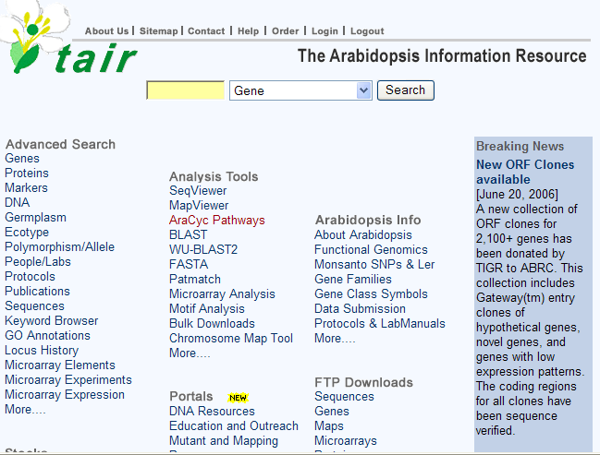
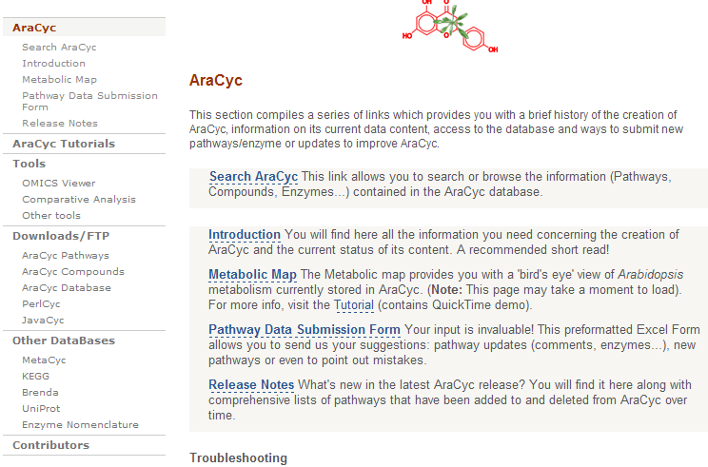
AraCyc

Slide 15
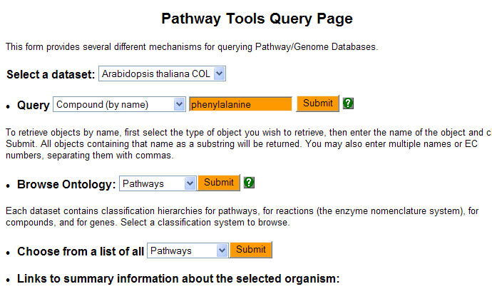
AraCyc: search by name

Slide 16
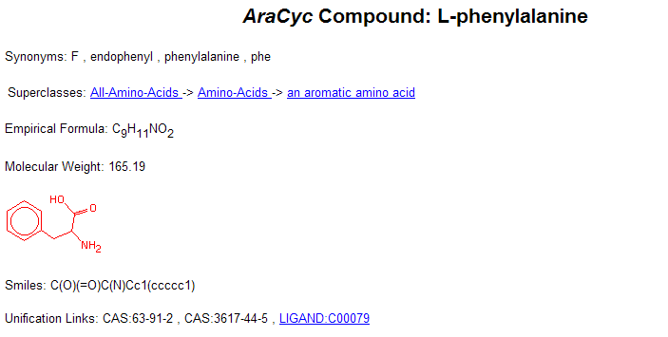
AraCyc: compound detail page

Slide 17
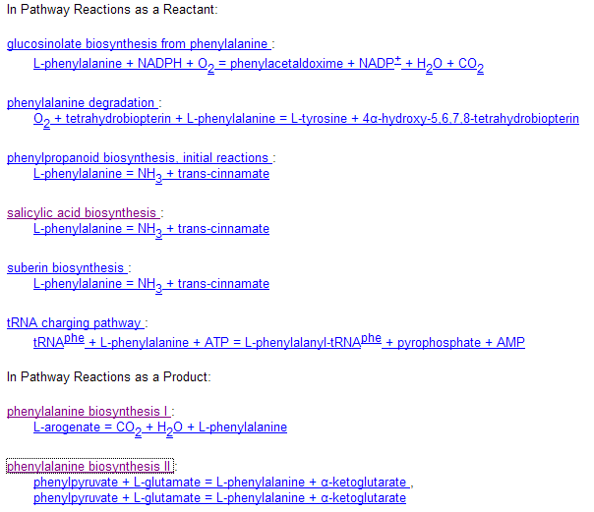
AraCyc: compound detail page (cont.)

Slide 18
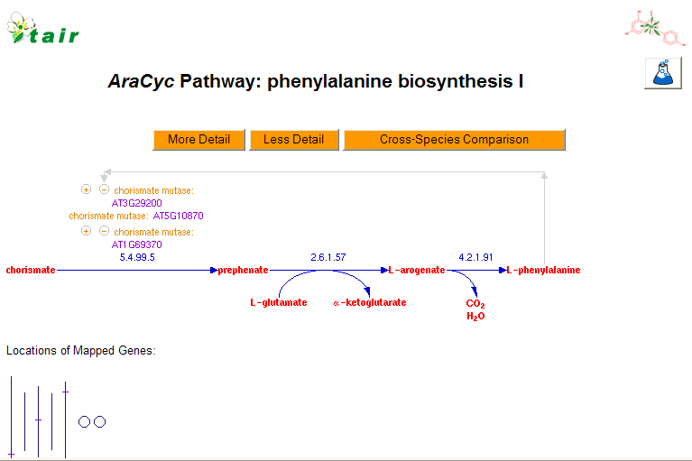

AraCyc: pathway detail page

Slide 19
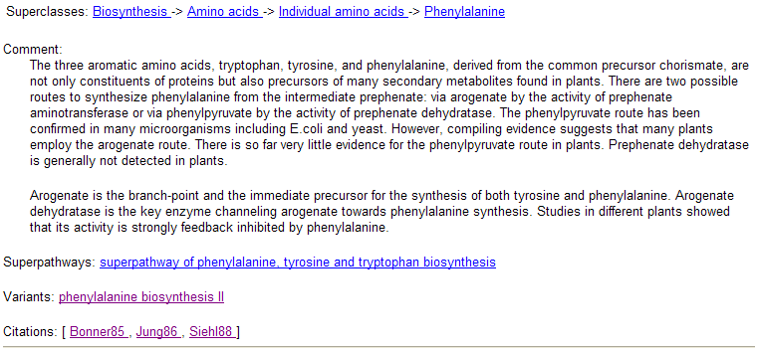
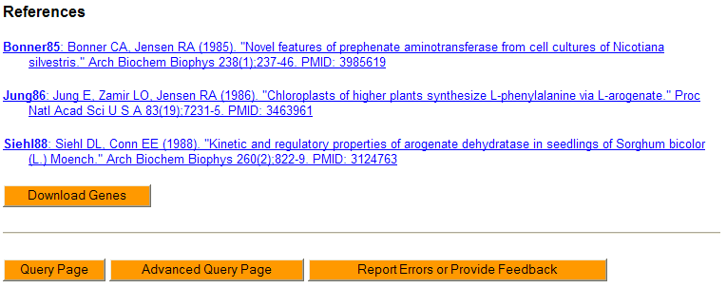

Slide 20

AraCyc: download genes of a pathway

Slide 21
AraCyc: pathway detail page

Slide 22
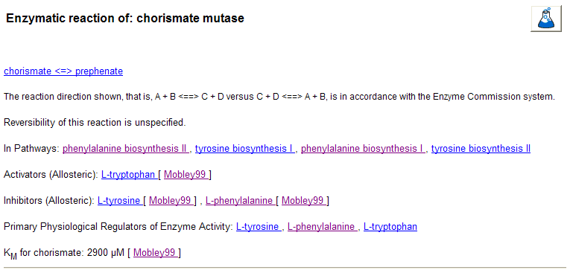
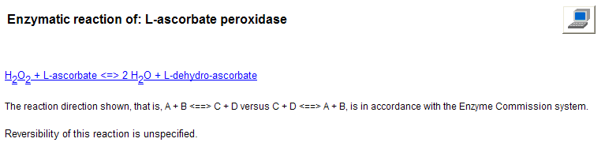
AraCyc: enzyme detail page

Slide 23
AraCyc: OmicsViewer
Overlay gene expression data
Overlay proteomics data
Overlay metabolite profiling data
and other experimental data

Slide 24
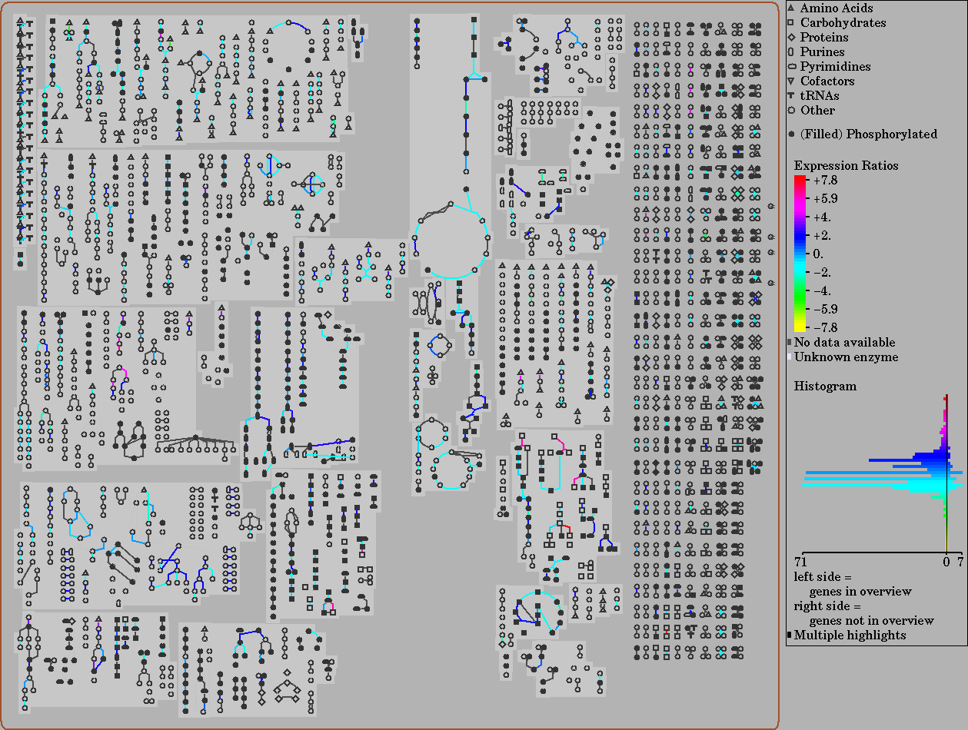

Slide 25
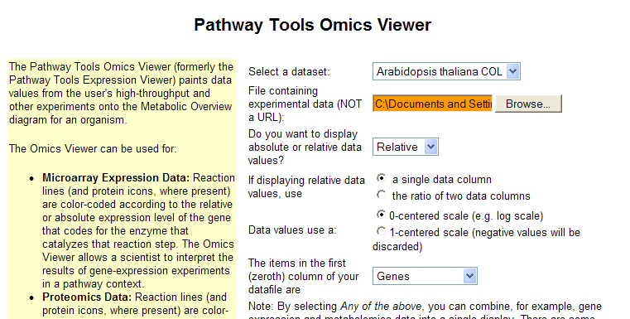
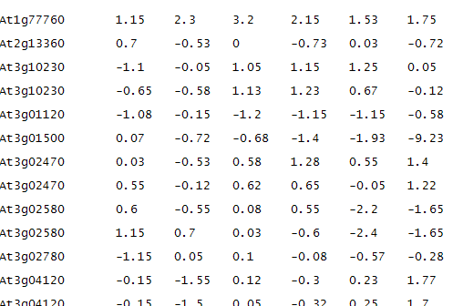
OmicsViewer submission page
Step 1
Step 2
Upload input file
tab-delimited text file

Slide 26
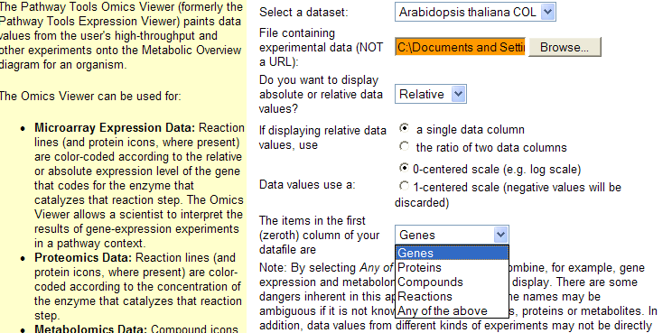
OmicsViewer submission page (cont.)
Step 3
Step 4
Step 5
Step 6

Slide 27
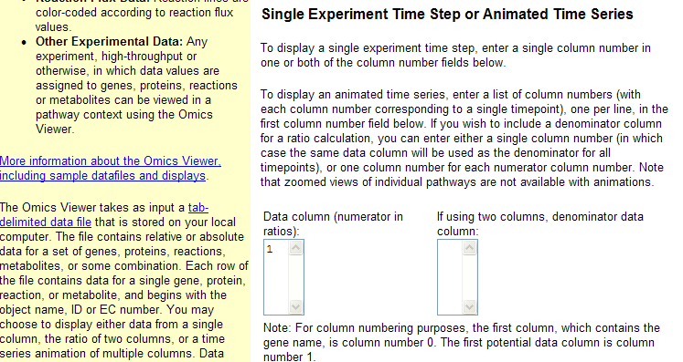
OmicsViewer submission page (cont.)
Step 7

Slide 28
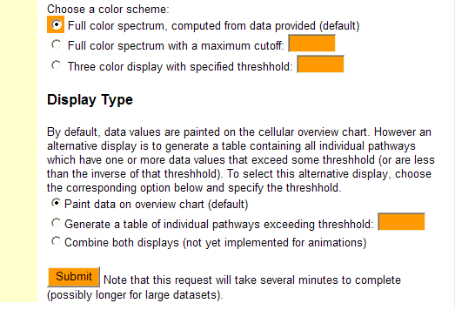
OmicsViewer submission page (cont.)
Step 8
Step 9

Slide 30
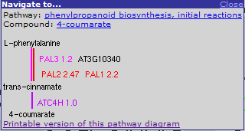
Zoom-in OmicsViewer results

Slide 31
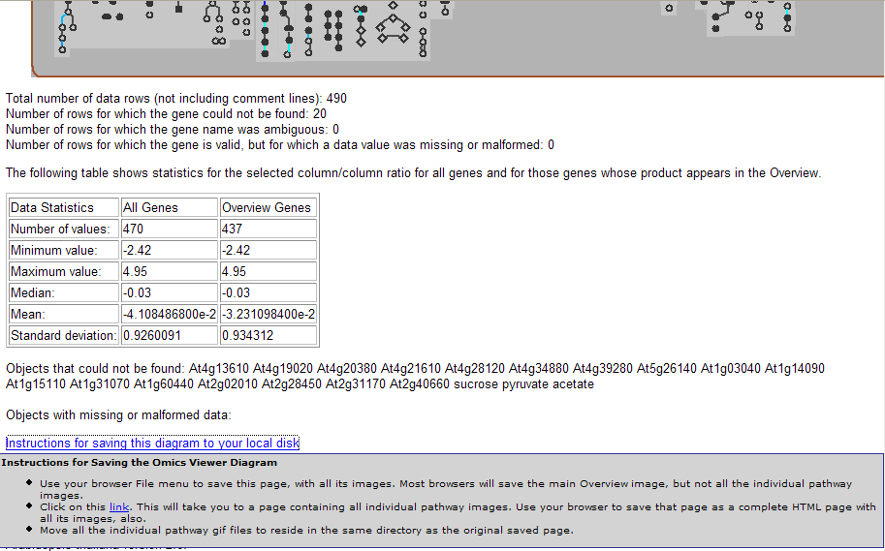
Saving results

Slide 32
Getting help using TAIR resource
Help Central
  Help for specific tools (e.g. searches, BLAST etc)
  Glossary of terms in TAIR
  FAQ
  Tutorials
Email support via curator@arabidopsis.org. We try to respond within 24 hours.
Special requests for data

Slide 33
Help central

Slide 34
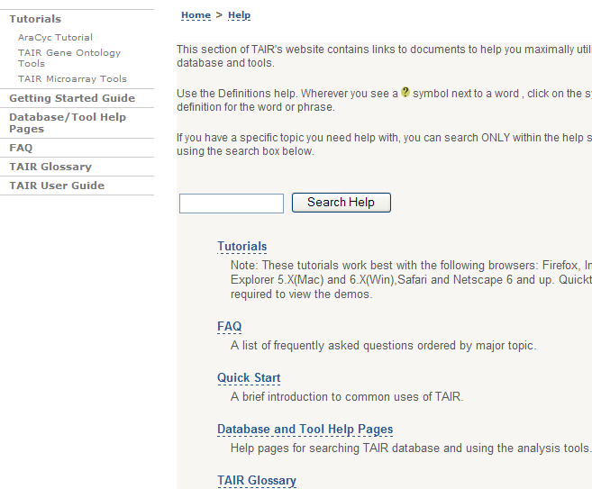
Help central

Slide 35
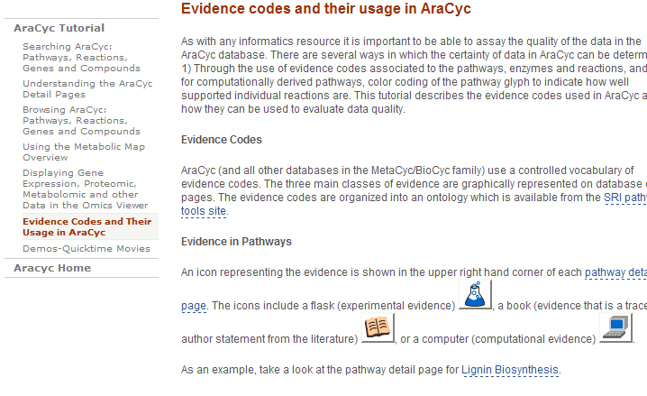
AraCyc tutorial

Slide 36
Help central

Slide 37
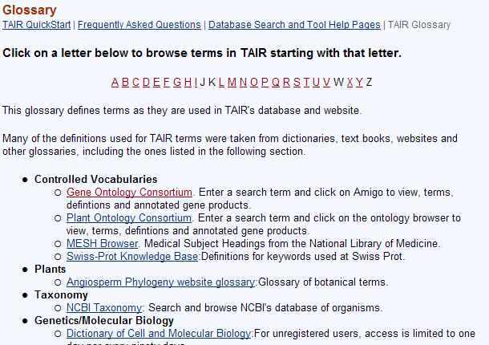
TAIR glossary

Slide 38
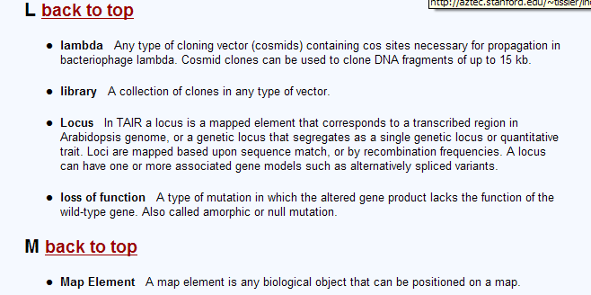
TAIR glossary

Slide 39
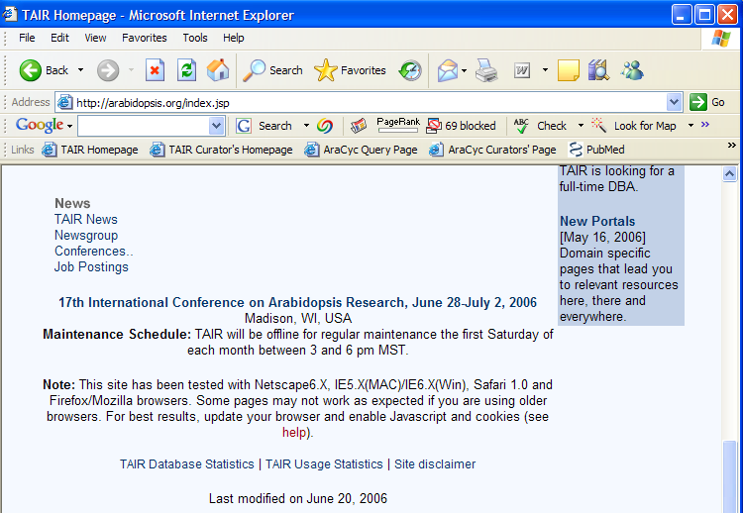

Contact us by email

Slide 40
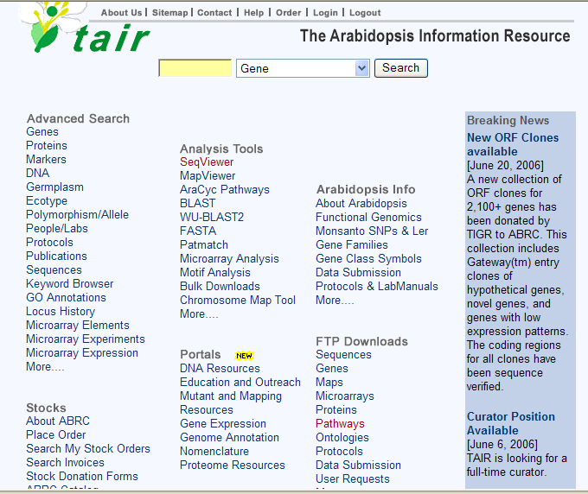
Special requests for data
All putative proteins
A list of loci with experimentally verified known functions
A list of gene name and alias
…

Slide 41


















