Slide 1
Arabidopsis Genome Annotation
TAIR7 Release

Slide 2
Arabidopsis Genome Annotation
Overview of releases
Current release (TAIR7)
Where to find TAIR7 release data
Preview of next release (TAIR8)

Slide 3
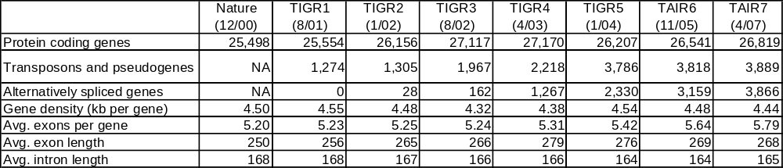
Overview of releases to date
26,819 protein coding genes
3,866 alternatively spliced
Notes:
Steady rise in number of splice variants, other aspects have changed only slightly

Slide 4
Average gene in TAIR7 release
2221 bp long
146 bp 268 bp 165 bp 233 bp
Avg 5’ UTR Avg Exon Avg Intron Avg 3’ UTR
1.16 splice variants per locus

Slide 5
What was done for TAIR7
681 new loci, 1774 new gene models
    211 Cysteine-rich peptides (CRPs) K. Silverstein, Univ. of Minnesota
    71 MicroRNAs Matt Jones-Rhoades, MIT/miRBASE
34 merges, 41 splits, 47 obsolete loci
797 models with CDS updates
10,792 models with UTR updates
One third of all TAIR6 loci (10,098 loci) were updated for TAIR7
Notes:
Scale of the update - nearly 800 cds updates, 10,000 genes updated overall

Slide 6
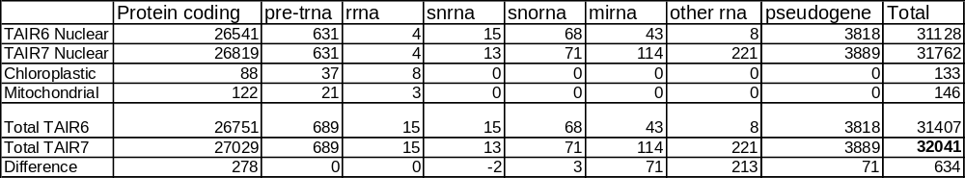
TAIR6 vs TAIR7 Release
All nuclear:
31,762
All genes:
32,041
Notes:
Comparison of 6 vs 7, new loci mainly small protein coding, miRNA, other RNA and pseudogene classes

Slide 7
Annotation pipeline and strategy
Gene updates
  New Arabidopsis cDNAs/ESTs incorporated via automated pipeline (PASA)
    Result: 1717 non-UTR updates
  Community updates (affecting 330 genes)
  Manual curation to identify potential errors (targeted approach)
  ~10% loci examined manually

Slide 8
Specific problems targeted
Small introns (65), long introns (89)
AT-AC splicing (55)
UTR errors (1098)
ncRNAs and small proteins (251)

Slide 9
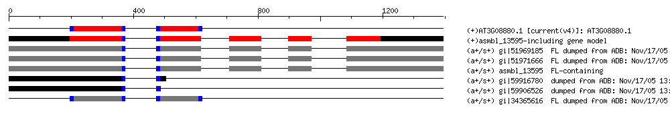
AT-AC splicing genes
55 Gene models updated
TAIR6 Model
AT-AC splice junction

Slide 10
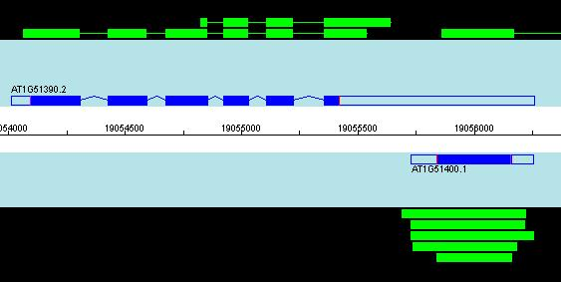
Manual updates – UTRs
UTRs overextended
  Identified 1051 gene pairs
  909 loci updated
Incorrectly extended by ESTs
Notes:
Identified targets by identifying loci which overlapped, had larger than avg UTR and where the UTR end was not supported by cDNA evidence
Causes problems in promoter predictions designing propes for arrays, or primers for cloning

Slide 11
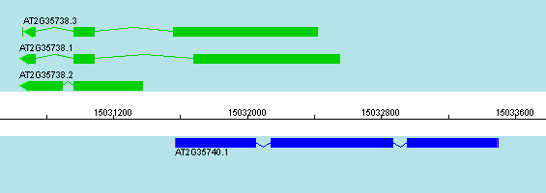
ncRNAs & small proteins
cDNAa not represented in TAIR6 gene set
    1260 cDNAs do not map to TAIR6 annotation (385 splice)
    947 separate cDNA clusters (“Loci”) (291 splice)
    251 new loci added TAIR7
1619 overlapping loci
1459 exon-exon overlaps
127 possible natural antisense genes
ncRNA

Slide 12
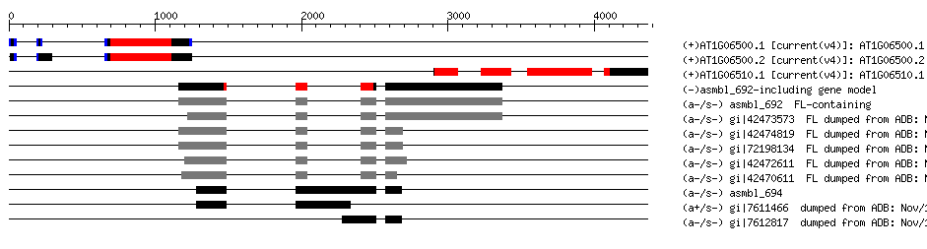
ncRNAs & small proteins
cDNAa not represented in TAIR6 gene set
    1260 cDNAs do not map to TAIR6 annotation (385 splice)
    947 separate cDNA clusters (“Loci”) (291 splice)
    251 new loci added TAIR7
Small protein

Slide 13
Computational descriptions
Updated all computational descriptions
  ANAC001 (Arabidopsis NAC domain containing protein 1); transcription factor; similar to ANAC069 (Arabidopsis NAC domain containing protein 69), transcription factor [Arabidopsis thaliana] (TAIR:AT4G01550.1); similar to putative NAC2 protein [Oryza sativa (japonica cultivar-group)] (GB:BAD09612.1); contains InterPro domain No apical meristem (NAM) protein; (InterPro:IPR003441).
~4000 loci have similarity only to uncharacterised proteins (i.e. hypothetical, predicted, unknown etc).
758 have no significant protein similarity to Genbank proteins
    286 also have no supporting EST/cDNA evidence

Slide 14
TAIR7 Summary
Chromosome sequence not changed
681 new loci
10,098 loci updated
~10% loci manually examined

Slide 15
Where to find TAIR7 data
TAIR:
  Genome Annotation Portal
  Bulk Download Tool (Sequences)
  SeqViewer (genome browser)
  FTP site
NCBI
  genomes section

Slide 16
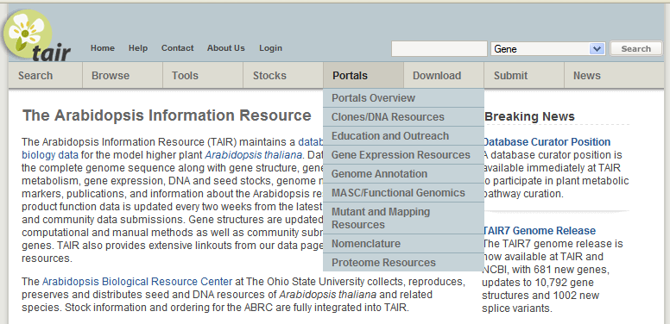
Genome Annotation Portal

Slide 17
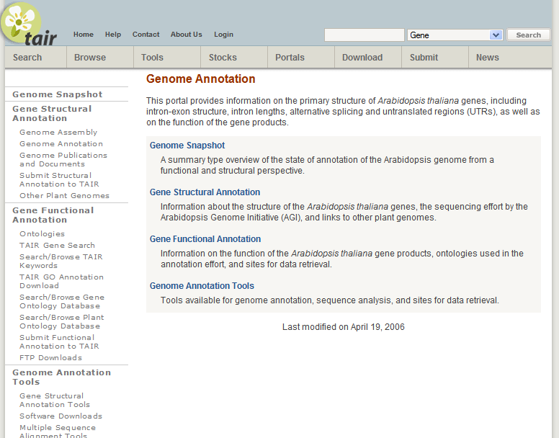

Slide 18
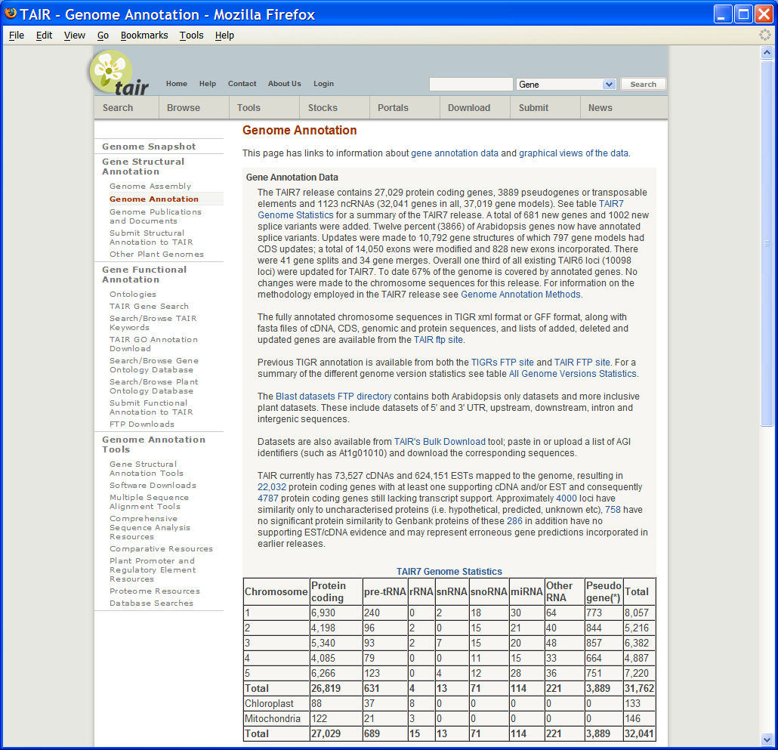

Slide 19
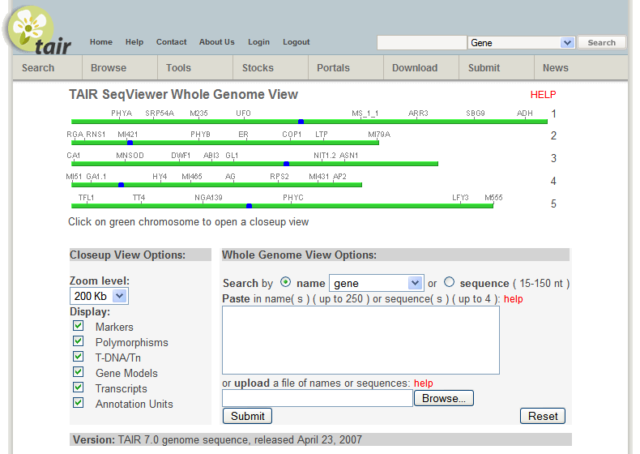
SeqViewer (Genome Browser)

Slide 20
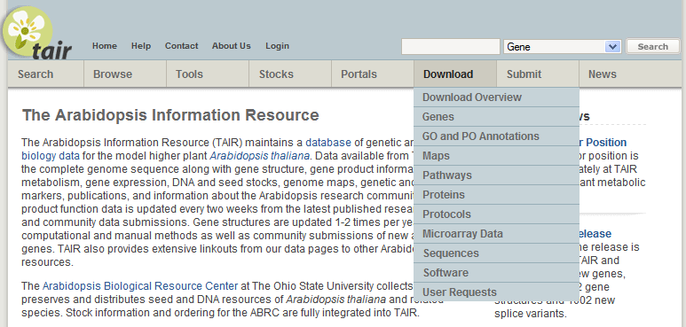
FTP download whole datasets

Slide 21
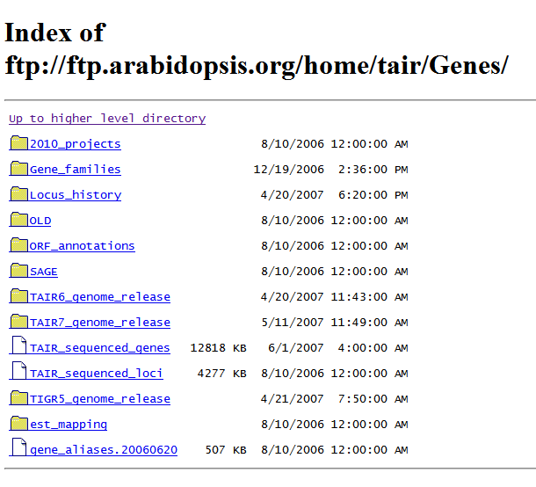

Slide 22
Preview of TAIR8 release
Genome assembly updates
Annotation maintenance
  Correct structural errors
  New transcript data
  Community submissions
Missing genes and splice variants
Improved transposon annotation

Slide 23
Missing genes and splice variants
Continued identification of missing genes
Alternative splicing
    8,264 alternative splicing events affecting 4,707 genes, (Brendel V et. al. Proc Natl Acad Sci 2006)
    16,252 events in 11665 models affecting 5,313 genes, (Buell 2006 Genomics)
    TAIR7 alternative splicing giving 8844 models affecting 3866 genes
Retained introns ~48% of alternatively spliced genes/loci

Slide 24
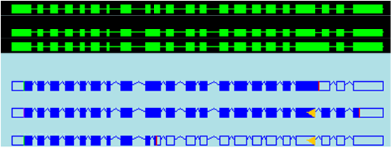
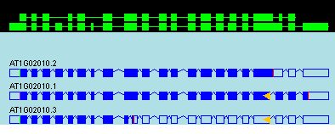
Missing genes and splice variants
Continued identification of missing genes
Alternative splicing
    8,264 alternative splicing events affecting 4,707 genes, (Brendel V et. al. Proc Natl Acad Sci 2006)
    16,252 events in 11665 models affecting 5,313 genes, (Buell 2006 Genomics)
    TAIR7 alternative splicing giving 8844 models affecting 3866 genes
Retained introns ~48% of alternatively spliced genes/loci
30% of time shorter splice variant prevalent
A
B
C
A
B
C
Notes:
30% of time shorter splice variant prevalent

Slide 25
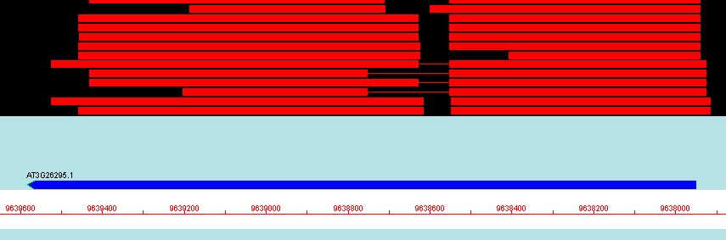
Transposons and pseudogenes
3889 “pseudogenes”
2490 transposons 1399 pseudogenes
~100 TEs not currently tagged as pseudo’s
Defined by a single pair of coordinates
At3g26295
Notes:
Processed pseudogenes are sometimes considered a special type of retrotransposon

Slide 26
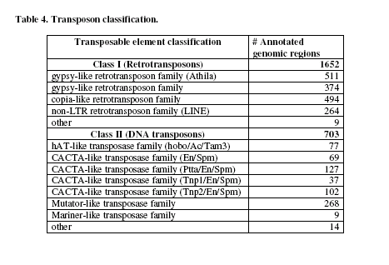
TIGR transposon classification
Searched against a curated database of protein-coding transposon sequences (TIGRs Transposon ORF Collection)
Classified into one of the major classes of transposable elements
Notes:
It should be noted that our transposon annotation has been restricted
to elements with protein coding potential. Assimilation of the smaller elements and other classes
of repeated sequences into the genome annotation remains a task for the future.

Slide 27
Who cares about TEs?
Efficient markers in gene tagging and phylogenetic studies.
Similarity with virus replication machinery and transcription factors
Role in heterochromatin formation
Involved in epigenetic gene regulation
Genome annotators

Slide 28
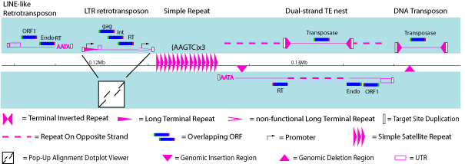
Transposon feature annotation
Diagram thanks to LBNL
Transposons can contain multiple genes
Four levels of data Genes>Transcripts>Exons>CDS_features
Repeat features
Notes:
transposons can contain multiple genes (these are genes
that relate specifically to the transposon), which each have transcripts, which in turn have
bona-fide exons and introns, the exons may also therefore have CDS features. Frequently
the transposon genes will be disrupted (i.e. pseudogenes) which is further information
which could be represented. This would essentially require four levels to represent the
data. In addition there are repeat features also associated to transposons

Slide 29
Beyond TAIR8
Mitochondrial and chloroplast gene reannotation
Comparative analysis using new genome sequences
Improved pseudogene annotation
Guide to supporting evidence for gene structure

