Slide 1
The Arabidopsis Information Resource (TAIR)
http://arabidopsis.org

Slide 2
TAIR workshop outline
Overview of the TAIR web site (Peifen Zhang)
TAIR 8 genome annotation (David Swarbreck)
Gene functional annotation from the literature (Donghui Li)

Slide 3
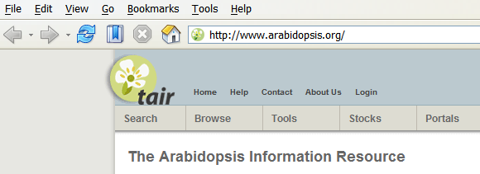
What is TAIR?
The US NSF-funded project begun in 1999
Web resource for Arabidopsis data and stocks
Literature-based manual annotation of gene function
Genome annotation (gene structure, computational gene function)

Slide 4
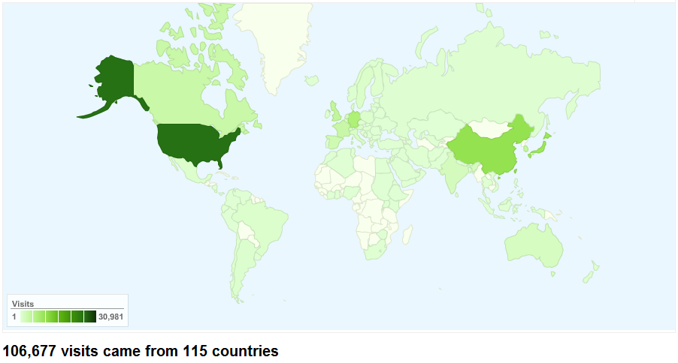
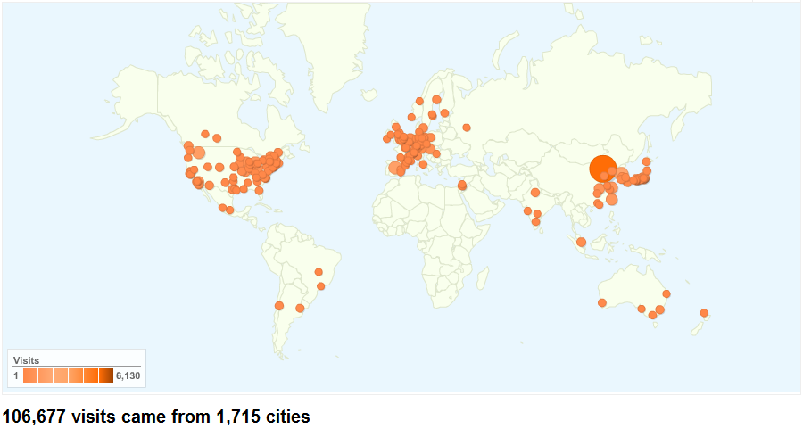
TAIR is used worldwide

Slide 5
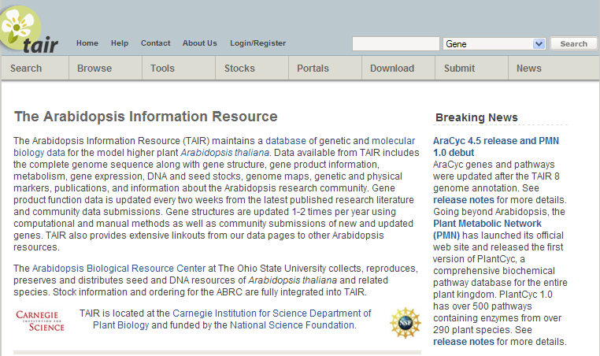
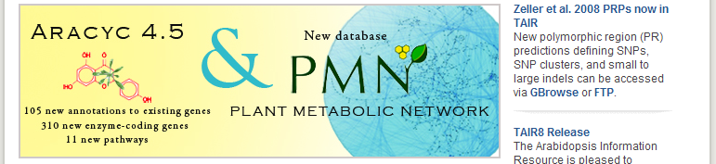
Introduction to TAIR
Quick Search
Advanced Search

Slide 6
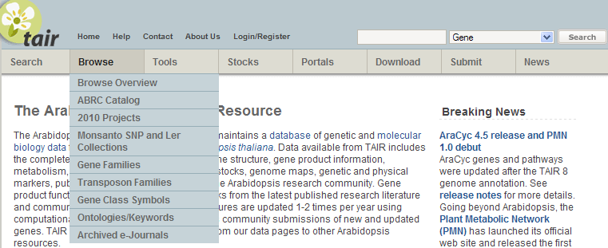
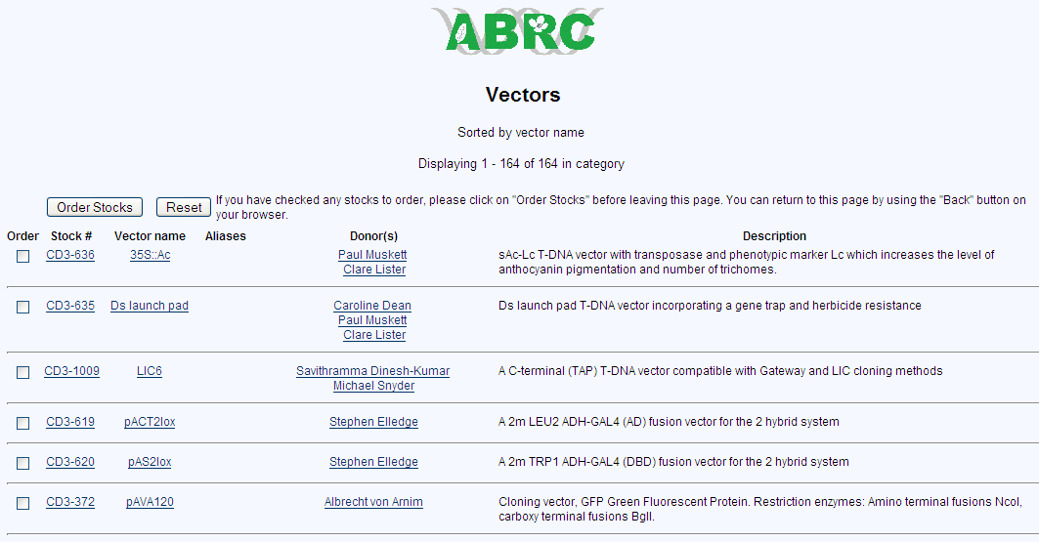

Slide 7
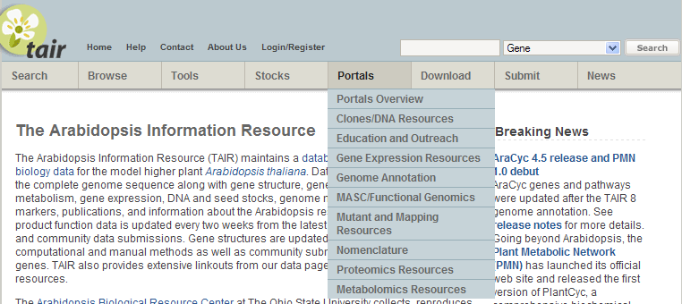
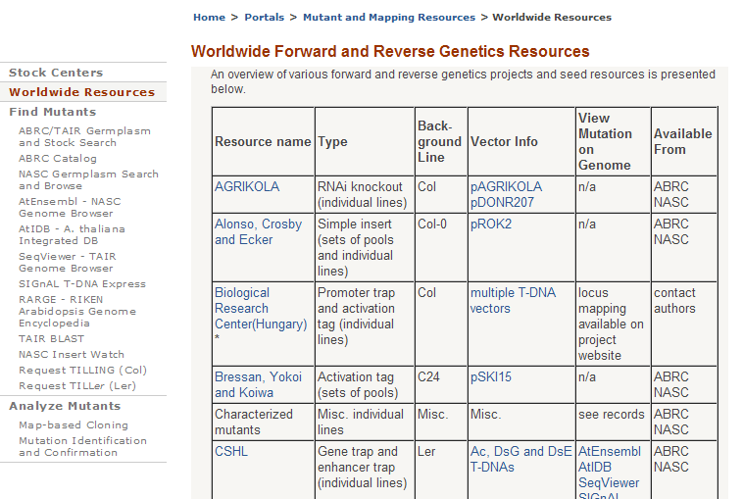

Slide 8
Searching TAIR
Notes:
It is essential to understand that automatic annotation is not synonymous with gene prediction. Gene predictions are not gene annotations. In fact, ‘gene prediction’ is something of a misnomer—usually it’s just a single CDS (or, even, exon) of a protein-coding gene that is predicted; this is true even when the gene predictor makes use of homology, e.g. TWINSCAN (8). Likewise, simply aligning ESTs and full-length cDNAs to a genome does not produce gene annotations either. A gene annotation is a much more complex entity; it must include features such as alternative splicing & UTRs, and wrestle with issues such as locus assignment, pseudogenes, evidence trails, nomenclature issues, known vs. new gene, etc. Gene predictions and sequence alignments are the outputs of single executables and reside in flat-files; gene annotations, on the other hand, are complex objects that reside in databases and XML repositories. Gene annotations are versioned, graphically accessible, alterable, obsolete-able, and distributable. To create a gene annotation automatically is thus a very different task from gene prediction or aligning cDNAs to a genome.

Slide 9
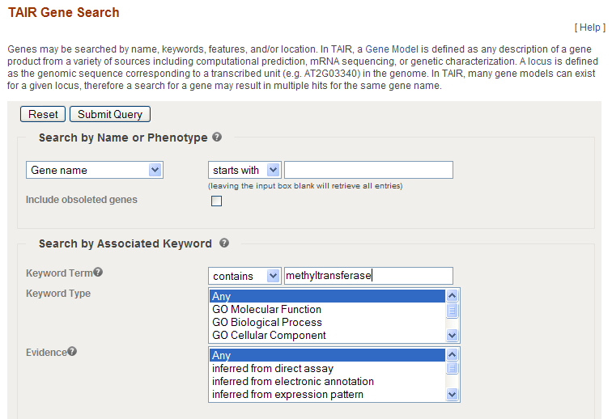

Slide 10
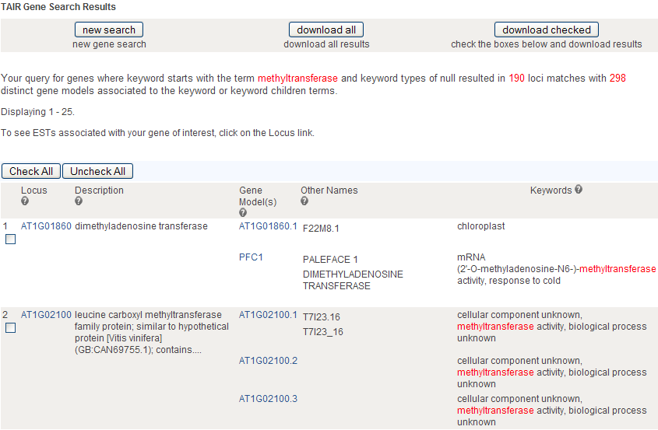
Locus ID

Slide 11
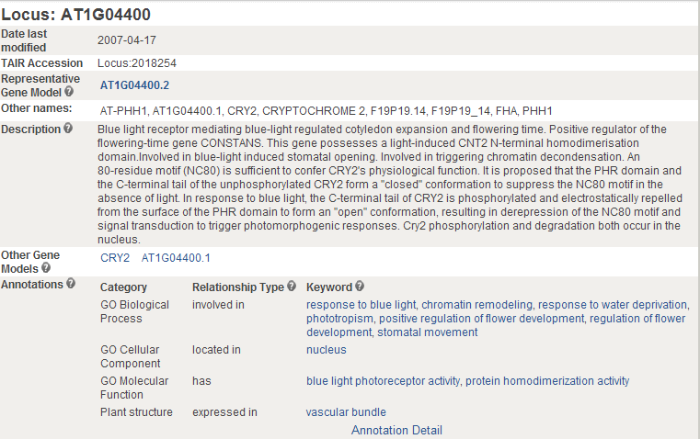
Locus detail page is your TAIR gateway
General functional info

Slide 12
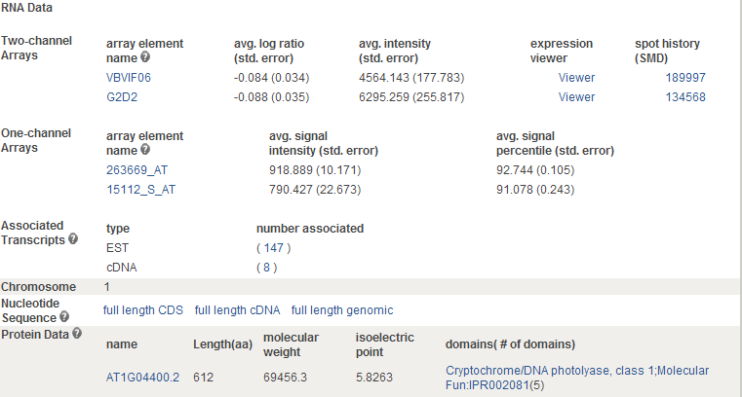
cDNA clones

Slide 13
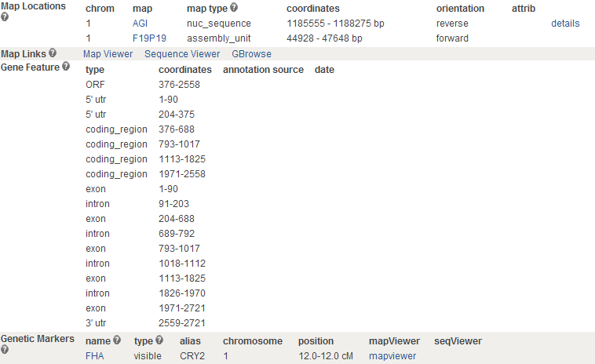

Slide 14

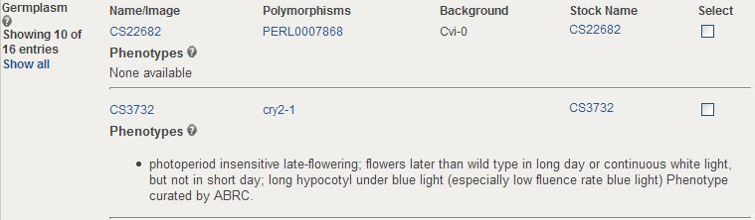
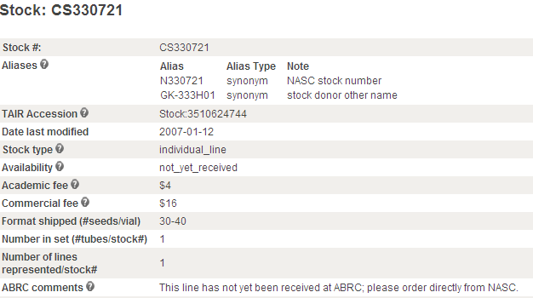
Associated seed stocks

Slide 15
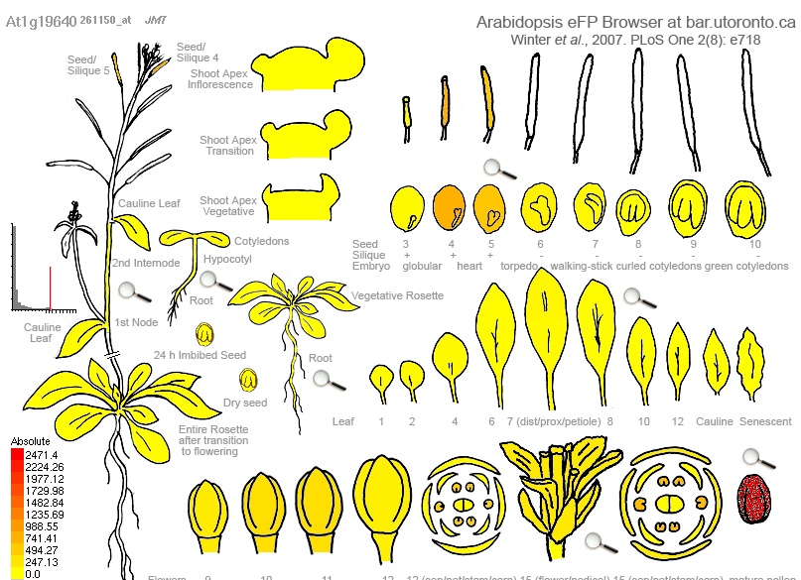
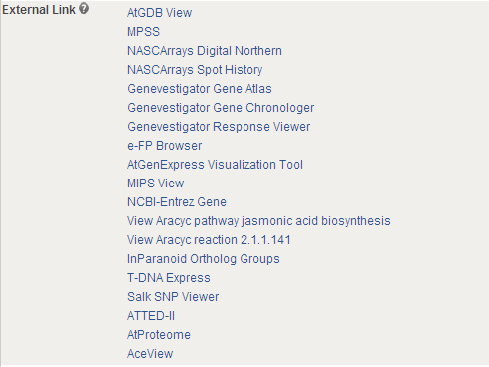
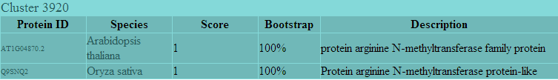
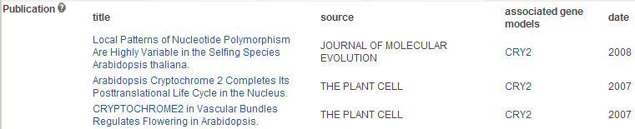

Slide 16
TAIR’s most popular visualization and analysis tools
Genome Browser
  SeqViewer
  GBrowse
AraCyc
BLAST

Slide 17
SeqViewer
Notes:
It is essential to understand that automatic annotation is not synonymous with gene prediction. Gene predictions are not gene annotations. In fact, ‘gene prediction’ is something of a misnomer—usually it’s just a single CDS (or, even, exon) of a protein-coding gene that is predicted; this is true even when the gene predictor makes use of homology, e.g. TWINSCAN (8). Likewise, simply aligning ESTs and full-length cDNAs to a genome does not produce gene annotations either. A gene annotation is a much more complex entity; it must include features such as alternative splicing & UTRs, and wrestle with issues such as locus assignment, pseudogenes, evidence trails, nomenclature issues, known vs. new gene, etc. Gene predictions and sequence alignments are the outputs of single executables and reside in flat-files; gene annotations, on the other hand, are complex objects that reside in databases and XML repositories. Gene annotations are versioned, graphically accessible, alterable, obsolete-able, and distributable. To create a gene annotation automatically is thus a very different task from gene prediction or aligning cDNAs to a genome.

Slide 18
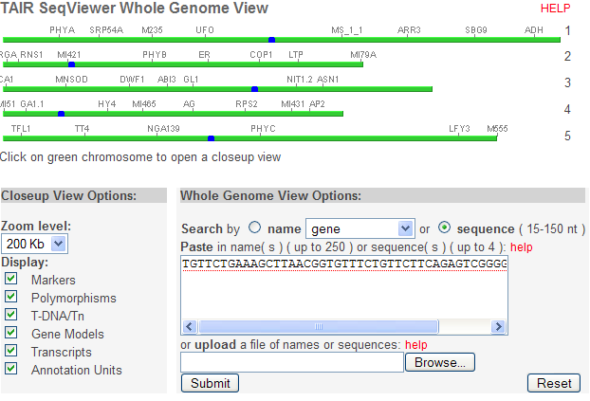
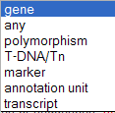

Slide 19
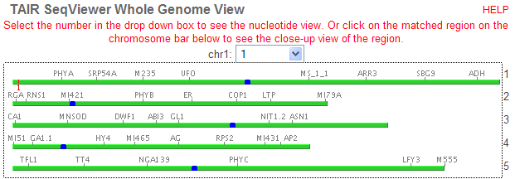
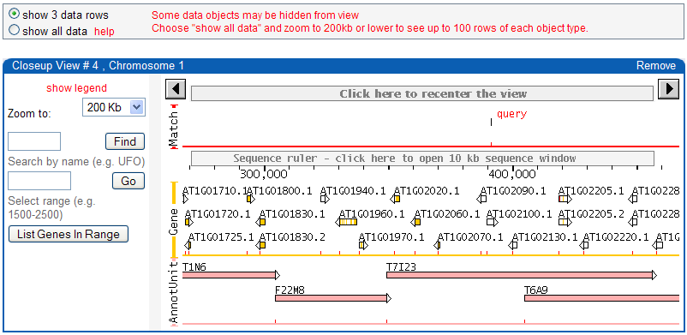

Slide 20
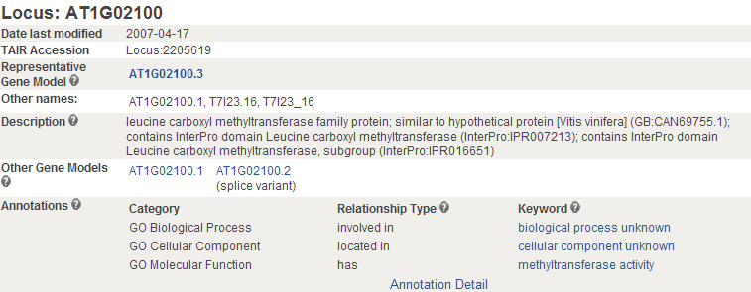
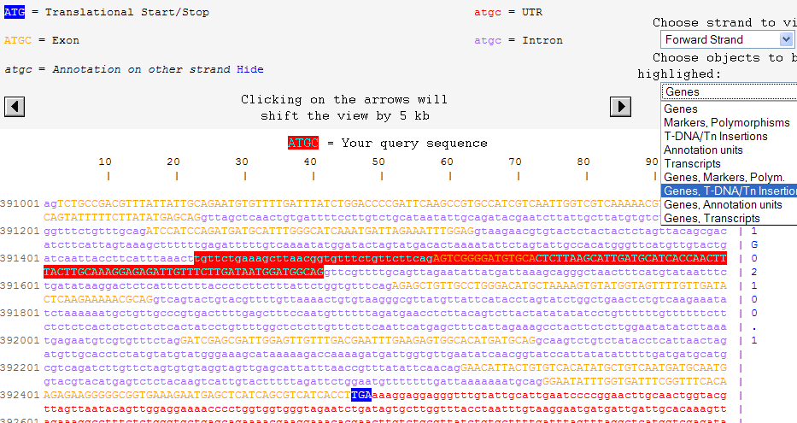

Slide 21
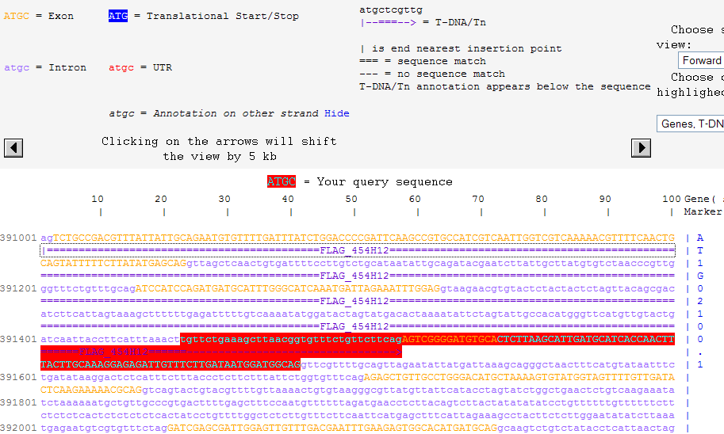
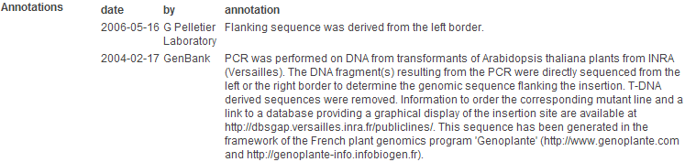

Slide 22
AraCyc
Visualization of Arabidopsis biochemical pathways, compounds and enzymes.

Slide 23
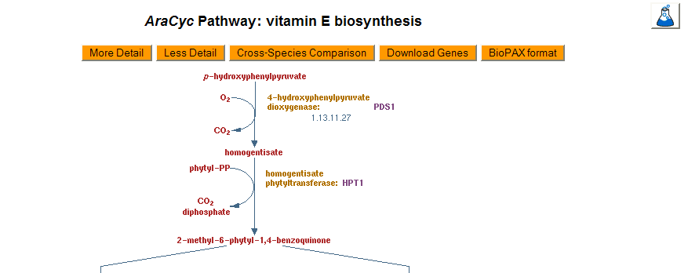
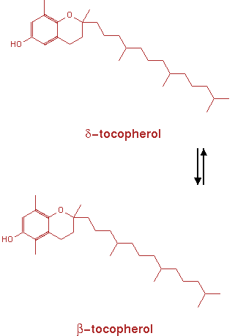
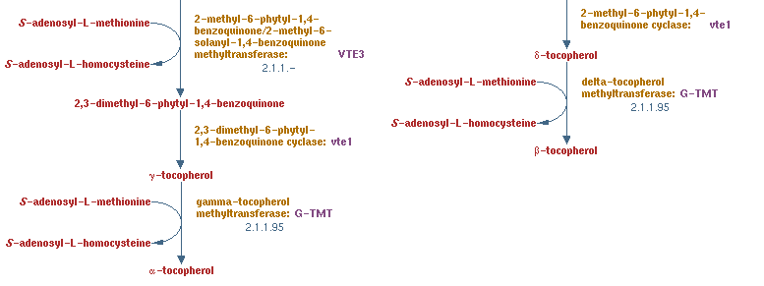
AraCyc pathway page example

Slide 24
AraCyc
Visualization of Arabidopsis biochemical pathways, compounds and enzymes.
Overlay of large-scale experimental data onto the Arabidopsis metabolic map using the Omics Viewer

Slide 25
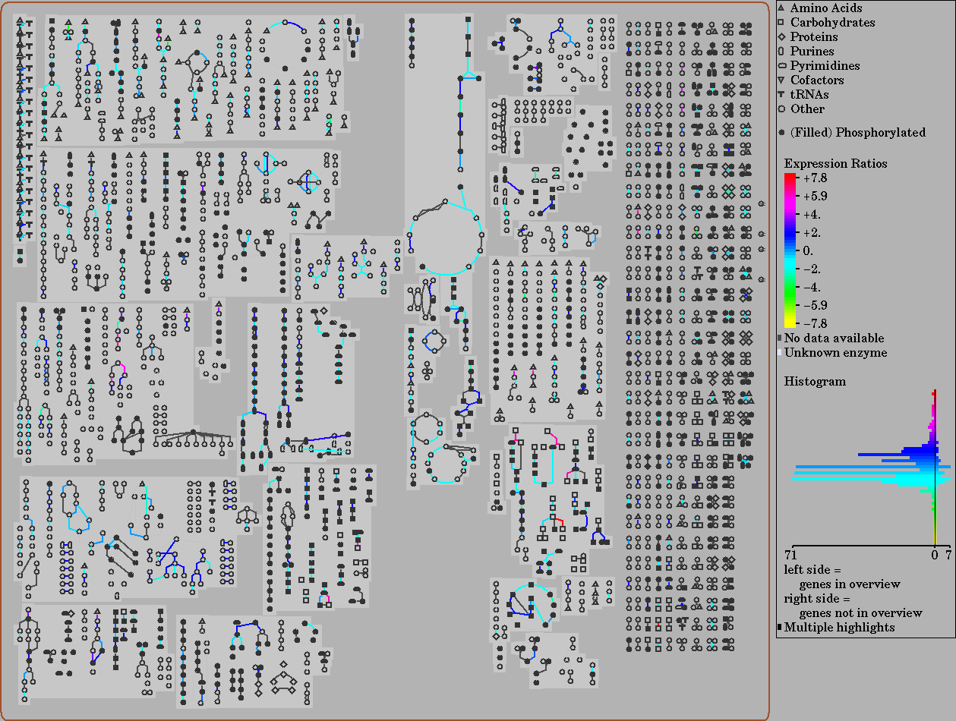
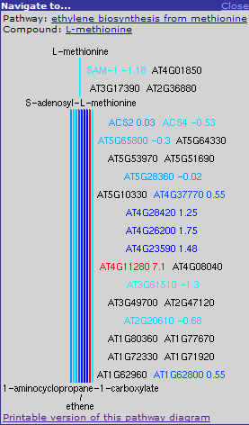
Overlay microarray data

Slide 26
PMN & SGN & Gramene Joint Workshop
on Metabolic Pathway Databases
Monday evening at 7:30

Slide 27
BLAST
Notes:
It is essential to understand that automatic annotation is not synonymous with gene prediction. Gene predictions are not gene annotations. In fact, ‘gene prediction’ is something of a misnomer—usually it’s just a single CDS (or, even, exon) of a protein-coding gene that is predicted; this is true even when the gene predictor makes use of homology, e.g. TWINSCAN (8). Likewise, simply aligning ESTs and full-length cDNAs to a genome does not produce gene annotations either. A gene annotation is a much more complex entity; it must include features such as alternative splicing & UTRs, and wrestle with issues such as locus assignment, pseudogenes, evidence trails, nomenclature issues, known vs. new gene, etc. Gene predictions and sequence alignments are the outputs of single executables and reside in flat-files; gene annotations, on the other hand, are complex objects that reside in databases and XML repositories. Gene annotations are versioned, graphically accessible, alterable, obsolete-able, and distributable. To create a gene annotation automatically is thus a very different task from gene prediction or aligning cDNAs to a genome.

Slide 28
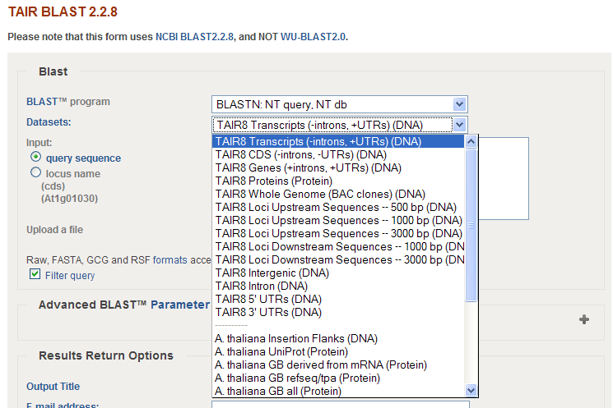
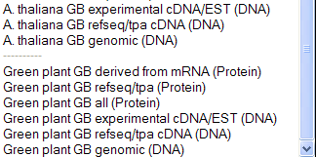
Customized datasets
TAIR genome release
Other Arabidopsis sequences
All plant sequences

Slide 29
Ordering DNA clones and seed stocks
Notes:
It is essential to understand that automatic annotation is not synonymous with gene prediction. Gene predictions are not gene annotations. In fact, ‘gene prediction’ is something of a misnomer—usually it’s just a single CDS (or, even, exon) of a protein-coding gene that is predicted; this is true even when the gene predictor makes use of homology, e.g. TWINSCAN (8). Likewise, simply aligning ESTs and full-length cDNAs to a genome does not produce gene annotations either. A gene annotation is a much more complex entity; it must include features such as alternative splicing & UTRs, and wrestle with issues such as locus assignment, pseudogenes, evidence trails, nomenclature issues, known vs. new gene, etc. Gene predictions and sequence alignments are the outputs of single executables and reside in flat-files; gene annotations, on the other hand, are complex objects that reside in databases and XML repositories. Gene annotations are versioned, graphically accessible, alterable, obsolete-able, and distributable. To create a gene annotation automatically is thus a very different task from gene prediction or aligning cDNAs to a genome.

Slide 30
Before you can put an order
Register yourself at TAIR
Associate yourself to a lab
Wait 1–2 days for account activation notice

Slide 31
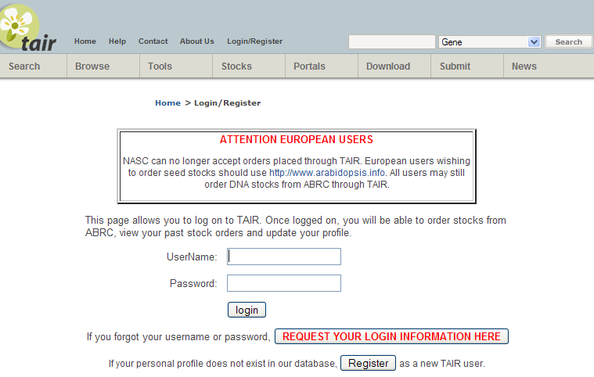

Slide 32
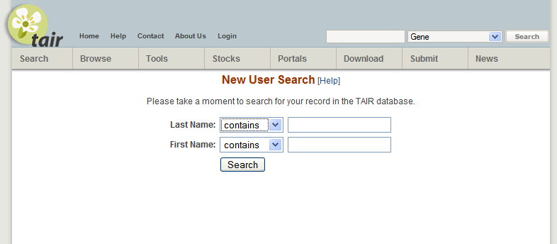
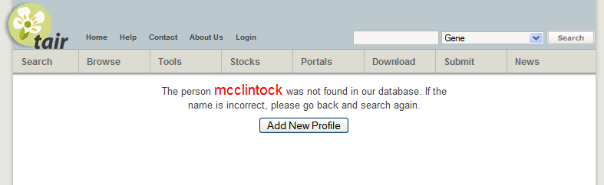
mcclintock

Slide 33
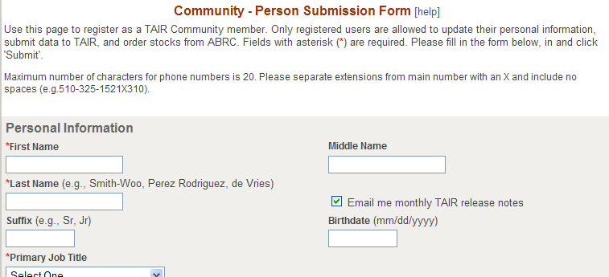
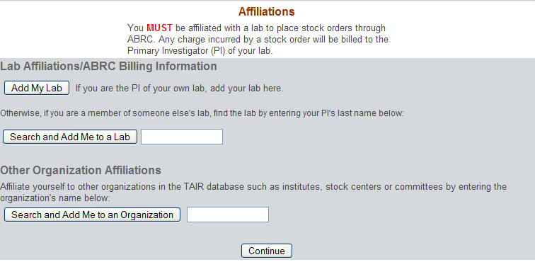

Slide 34
TAIR workshop outline
Overview of the TAIR web site (Peifen Zhang)
TAIR 8 genome annotation (David Swarbreck)
Gene functional annotation from the literature (Donghui Li)

Slide 35
Any questions for this session?

