Slide 1
How pathway databases were created and curated
Peifen Zhang
Plant Metabolic Network (PMN)

Slide 2
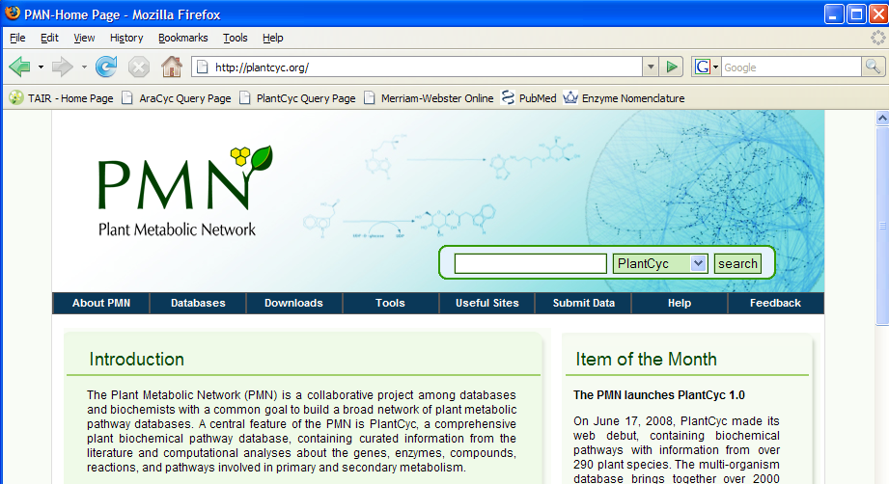
About PMN, http://plantcyc.org

Slide 3
PMN is
A network of plant metabolic pathway databases and database curation community
  A plant reference database, PlantCyc
    Genes, enzymes and pathways consolidated from all plant species
  A collection of single-species pathway databases
    Pathway Genome Databases (PGDB)
    Genes, enzymes and pathways in a particular species
  A community for data curation
    Curators at databases (PMN, Gramene, SGN etc)
    Researchers in the plant biochemistry field

Slide 4
Prediction of PGDBs, why
Huge sequence data are generated from genome and EST projects
Put individual genes into a metabolic network
Use the network to visualize and analyze large experimental data sets, discover missing enzymes, design metabolic engineering, conduct comparative and evolutionary studies

Slide 5
Creation of PGDBs, how
Manual extraction of pathways from the literature, assigning genes/enzymes to pathways
Computational assigning genes/enzymes to reference pathways, manual validation/correction and further curation

Slide 6
Prediction of PGDBs, how
Annotated sequences, molecular function
A reference database (such as MetaCyc and PlantCyc)
PathoLogic (Pathway Tools software)

Slide 7
ANNOTATED GENOME
MetaCyc
DNA sequences
Gene calls
AT1G69370
Gene functions
PathoLogic
chorismate mutase
chorismate mutase
prephenate aminotransferase
arogenate dehydratase
5.4.99.5
2.6.1.79
PGDB
4.2.1.91
chorismate
prephenate
L-arogenate
L-phenylalanine
chorismate mutase
AT1G69370

Slide 8
A snap shot of AraCyc
Arabidopsis genome
  27,235 protein coding genes
AraCyc
  6158 enzyme coding genes
  2733 genes are assigned to reactions
  1914 genes are assigned to pathways

Slide 9
Currently available PGDBs
Species | Database | Status
Arabidopsis | TAIR | Substantial curation
Rice | Gramene | Some curation
Sorghum | Gramene | No curation
Medicago | Noble Foundation | some curation
Tomato | SGN | some curation
Potato | SGN | No curation
Pepper | SGN | No curation
Tobacco | SGN | No curation
Petunia | SGN | No curation
Coffee | SGN | No curation

Slide 10
Prediction of new PGDBs by PMN
Prioritization
  Available sequences, economic impact
High priority
  Maize, Poplar, Soybean, Wheat
Second priority
  Cotton, Grape, Sugarcane, Sunflower, Switchgrass…

Slide 11
A quality database REQUIRES manual validation and curation

Slide 12
Validation: pruning false-positive predictions
Pathways not operating in plants or not in a target species
  glycogen biosynthesis
  C4 photosynthesis
  caffeine biosynthesis
Pathways operating via a different route
  Phenylalanine biosynthesis in bacteria v.s. in plants

Slide 13

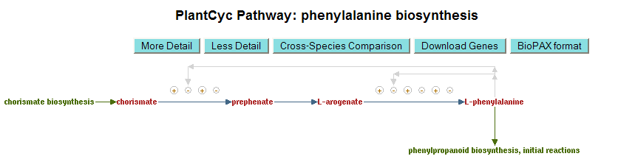

Slide 14
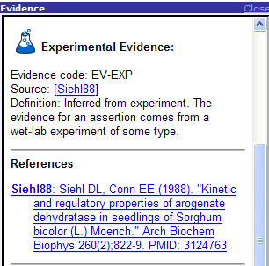
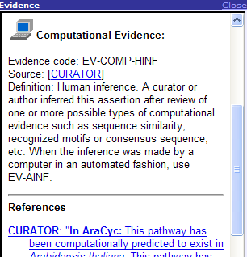
Validation: adding evidence and literature supports

Slide 15
Pathways are supported by different evidence
  Pathways supported by molecular data
    enzymes and genes
  Pathways based on radio tracer experiments
    no enzymes or genes
  Expert hypothesis (paper chemistry)
  Pure computational prediction
Notes:
Now in the last a couple of slides, I will give you an overview of a new project, sort of a continuation of AraCyc, but extended to a much larger scope to serve researchers of other plants. Blabla…

Slide 16
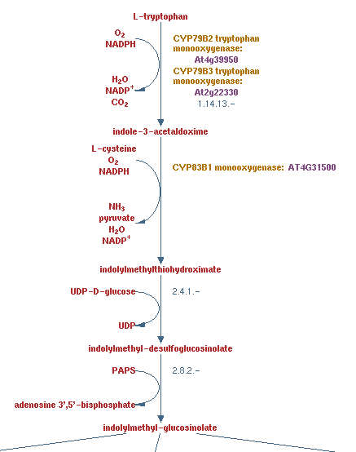
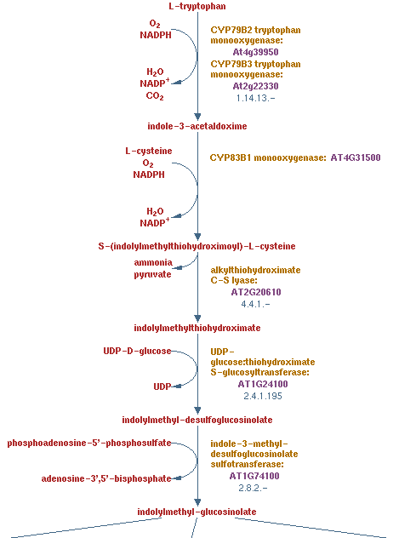
Correcting pathway diagrams

Slide 17
Curating missing pathways
What information are curated from the literature
  Pathway: diagram, summary, evidence, citations
  Reaction: co-substrates, EC number
  Compound: name and synonyms, structure
  Enzyme: coding gene, physical-/biochemical properties, evidence, comments, citations
Notes:
We extract information from the literature. For pathways….
Evidence code, experimental or computational, along with literature citations were assigned to allow users rapidly assess the reliability of the annotation.

Slide 18
Source of literature
PubMed, SciFinder
Special journals (i.e. phytochemistry),
Books in specialized field (i.e. alkaloids)

Slide 19


Curation workflow
reactions
species
draw pathway diagram
structure of substrates
EC number
enzymes
identify a pathway
find details of reactions
data entry
find details of enzymes
physical & chemical properties
coding gene

Slide 20
Current curation priority
Big economic impact
  Bio-energy production, i.e. cell wall components
  Industrial material, i.e. rubber
  Medicinal metabolites
Under-represented domains
  i.e. quinones, volatiles

Slide 21
The importance of community contribution, why we need your help
A mountain of information
  17 million citations in PubMed alone
  4208 citations in PlantCyc
Triage the most up-to-date and most relevant references
Synthesize and extract information from individual papers

Slide 22
The importance of community contribution, why we need your help
Limited human resource
  curator (3 at PMN, 1 at SGN, 1 at Gramene)
Limited expertise
  molecular biologist, may be familiar in one particular pathway, but certainly not all the pathways.

Slide 23
How you can help
Expedite data coverage
  Submitting a pathway, an enzyme, a bunch of compounds
Enhance data accuracy
  Reporting errors
Your idea/need of new features and functionalities

Slide 24
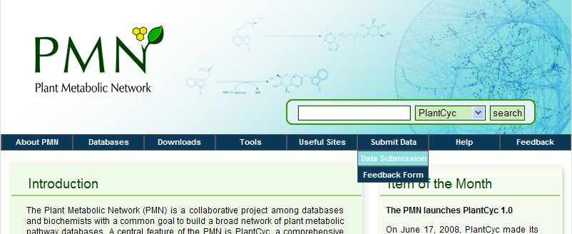
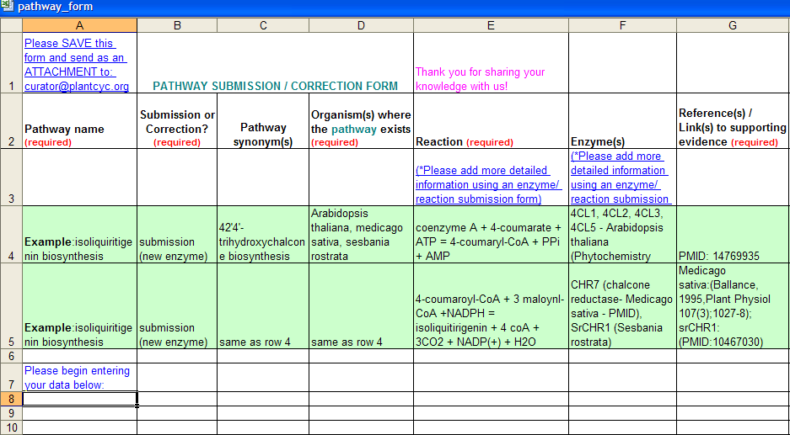
Data submission forms

Slide 25
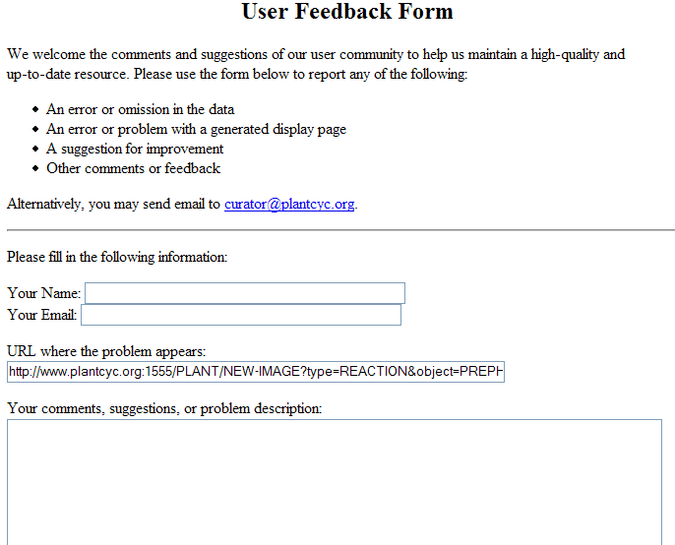
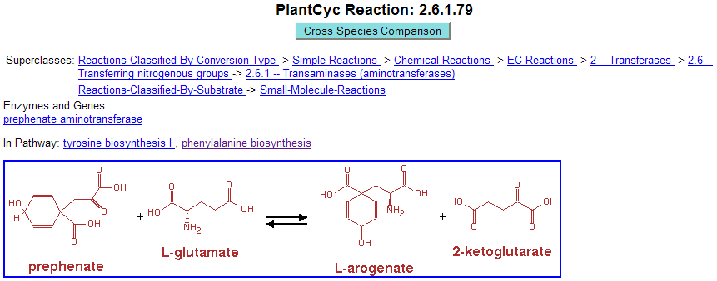

Reporting errors

Slide 26
Email to us
curator@plantcyc.org

Slide 27



The PMN project, us and you
medicago
tomato
rice
AraCyc
PlantCyc
MetaCyc
poplar
maize
wheat
sugarcane
other…
Notes:
‘At the center of the project is a new metabolic pathway database, plantcyc. It is an extensively curated database, contains metabolic pathways from all plant species. We will initiate the plantcyc database with the over 200 manually curated aracyc pathways. In addition, we will bring in over 100 secondary metabolic pathways, not found in Arabidopsis, but we have curated into the metacyc database during our collaboration with the metacyc project. Besides aracyc, there are three plant species-specific metabolic pathway databases created by other groups. These groups will collaborate with us in sharing curation and data. Manual curation of the three databases was at a much less extent compared to aracyc. Nonetheless, we will incorporate what they have curated to plantcyc.
Plantcyc will then serve as a reference database to predict pathway databases for other plant species.
There are at least 23 plant species which have enough sequence information, either from genomic DNA sequencing, or from EST/cDNA sequencing projects. These sequences are annotated at varies levels. To have a quality and uniform starting point for pathway prediction, we will setup a sequence annotation pipeline to annotate the sequences from the 23 species. Pathway databases will then be predicted for them in a similar fashion as we created aracyc. We have heard from the plant research community, and some groups already expressed interest in adopting the predicted pathway databases for further manual curation.
At the next level, as manual curation goes on at the different databases, we will coordinate and collaborate with other curators and experts, to form a curation community. This will help reduce redundant efforts and capitalize on each others’ expertise in a specific area of metabolism.
Finally, data exchange pipelines will be setup between plantcyc and the other individual databases. Direct curation to Plantcyc and data inflow from other PGDB, plantcyc will continue grow…

