Slide 1


Gene Structure Annotation
ASPB Plant Biology, June 29, 2008, Merida
David Swarbreck

Slide 2
Outline
Overview of TAIR8
  Data availability
  Assembly updates
  Transposable elements
Plans for TAIR9
  Gene confidence
  Alternative gene model
  Utilising Comparative, proteomic and transcriptome data
New GBrowse tracks

Slide 3
TAIR8 Release
33,282 total genes (38,963 gene models)
1291 new genes (2009 new gene models)
50 obsolete genes (65 deleted gene models)
Merge 41, Split 33
3811 updated structures, 625 CDS updates
23% (7380) TAIR7 genes updated
Source of updates
  Submission from community (reviewed by TAIR)
  Manual annotation in-house
  Computational pipeline (PASA)

Slide 4
TAIR8 Release
33,282 total genes (38,963 gene models)
1291 (681) new genes (2009 new gene models)
50 obsolete genes (65 deleted gene models)
Merge 41, Split 33
3811 updated structures, 625 CDS updates
23% (7380) (32% 10098) TAIR7 genes updated

Slide 5
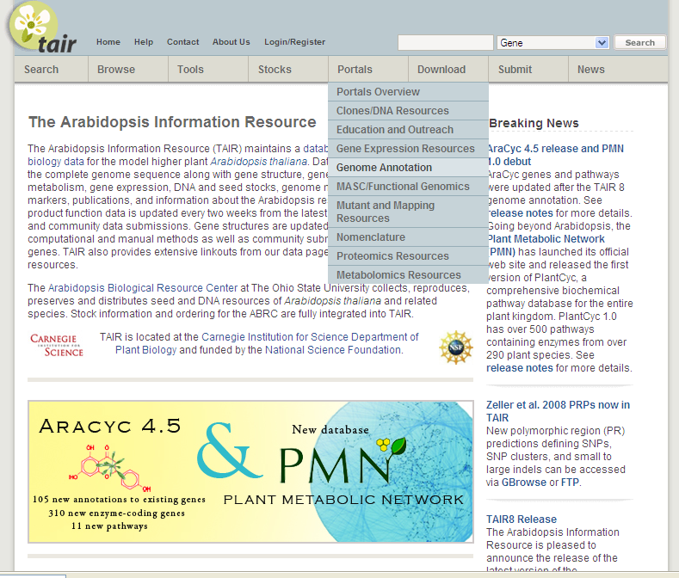
Genome Annotation Portal
http://www.arabidopsis.org/portals/genAnnotation/gene_structural_annotation/annotation_data.jsp

Slide 6
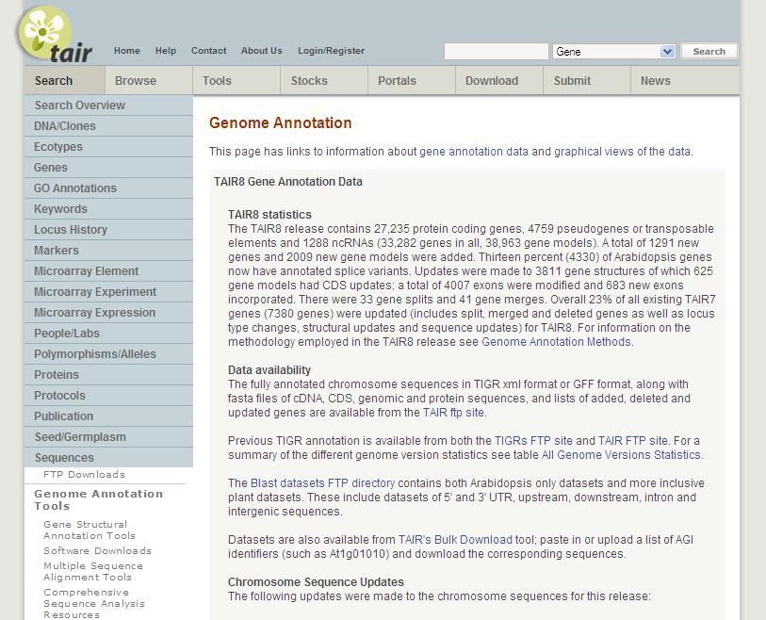
Genome Annotation Portal
http://www.arabidopsis.org/portals/genAnnotation/gene_structural_annotation/annotation_data.jsp

Slide 7
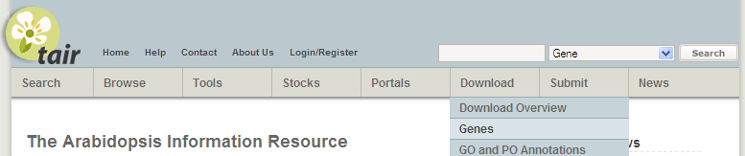
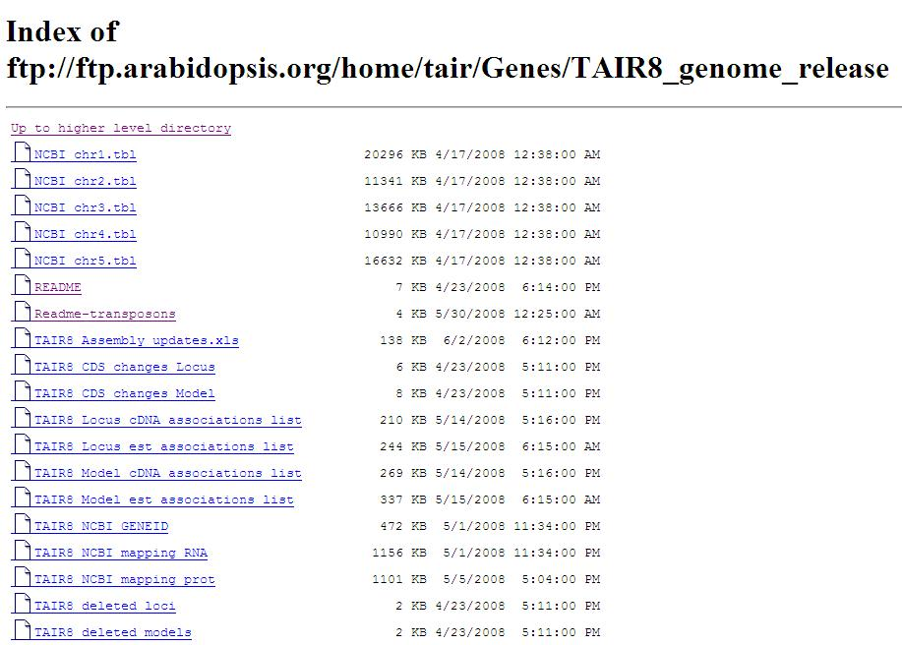
Sequences and information, TAIR FTP
ftp://ftp.arabidopsis.org/home/tair/Genes/TAIR8_genome_release/
Sequences
GFF/XML/NCBI .tbl
Updates
Conversion files
Associations

Slide 8
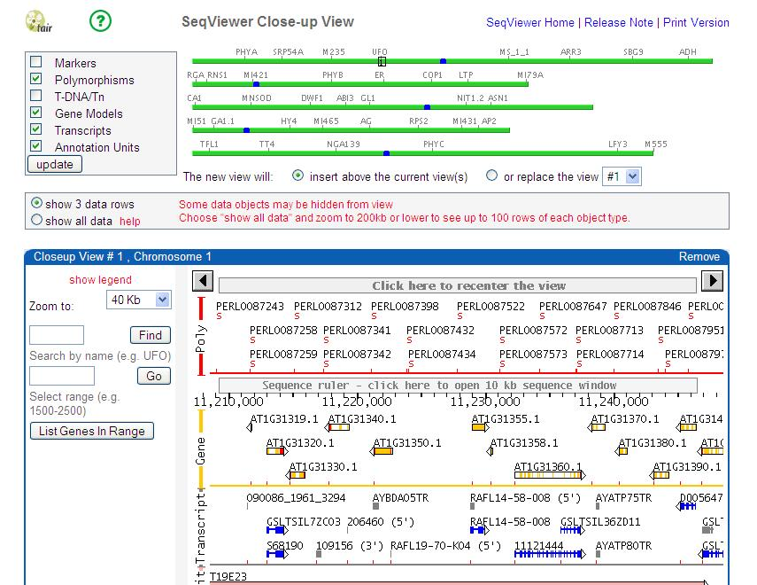
Browse the genome
Seqviewer
Data types

Slide 9
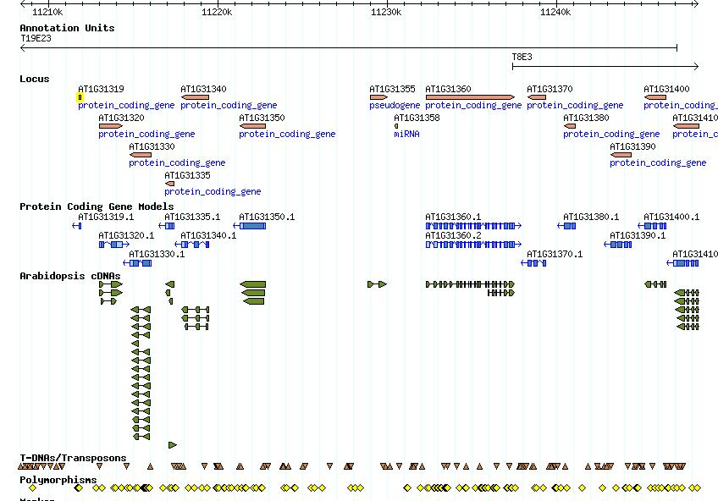
Browse the genome
GBrowse
Data types >50 tracks

Slide 10
Changes made for TAIR8
Assembly updates
  Remove sequence contamination
  Single base pair errors
Addition of Transposable elements

Slide 11
Assembly updates
Genome assembly unchanged since TIGR5 (prior to TAIR8)
Remove sequence contamination
  Vector = NCBI VecScreen, Webcutter 2.0
  Ecoli = Megablast v Ecoli(nr)
  Rice = Community
    Vector/Ecoli = 12 regions
    Rice = 2 regions
    Equivalent #Ns substituted
    8 genes set to obsolete, 2 modified

Slide 12
Assembly updates
Single base pair errors
  Solexa read data (Columbia) supplied by Joe Ecker’s Lab (Salk institute)
    1425 bases changed
      called 2 or greater, % of time consensus base is called is >=75%)
      no minority read support/no ler support
      Confirmed base changes where overlap current annotation

Slide 13
Assembly updates
Single base pair errors
  1425 bases changed
    157 gene model protein sequences updated
    518 had either protein/CDS,mRNA or genomic sequence updated

Slide 14
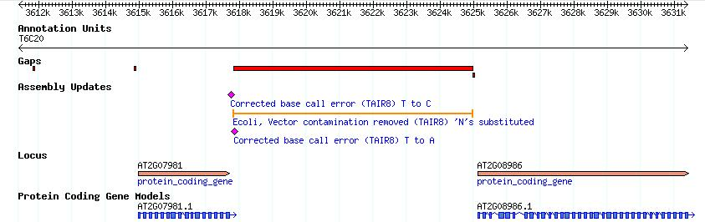
Assembly updates - GBrowse
Gaps

Slide 15
Transposable Elements (TE) & TE-genes
31,060 elements, 339 families, 17 superfamilies Hadi Quesneville Institut Jacques Monod (Buisine et al. Genomics, 2008)
Combines evidence from multiple homology-based predictions
TE-gene annotation
  gene encoded within a transposable element e.g. helicase, transposase etc
  TAIR7, No defined type (ncRNA, protein coding, pseudogene)
  TAIR7, Not all TE-genes have TE descriptions

Slide 16
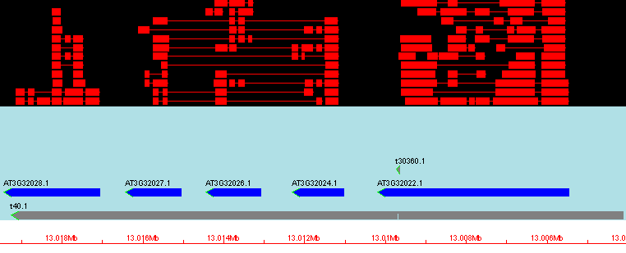
Overlapping TEs
Protein alignments
Unknown pseudogenes
Transposable Element
HELITRON4 family DNA transposon

Slide 17
Identifying TE-genes
Categorization as TE-gene
  By % Overlap with TE (100, >70, >50, below 50)
  Similarity to set of Known TE-proteins
  Manual review
  Additional checks (description, GO terms, publications, transcript evidence)
  3900 AGI genes were reclassified (720 previously classed as protein coding)

Slide 18
Associating TE to TE-genes
Overlap single TE >75%
2940 TE-genes associated
960 TE-genes unassociated

Slide 19
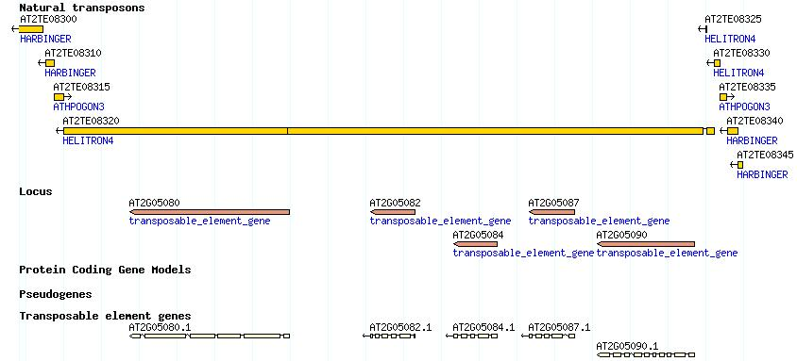
Transposons & TAIR
TE given ID
  AT2TE08320
31,189 TEs, 3900 TE-genes

Slide 20
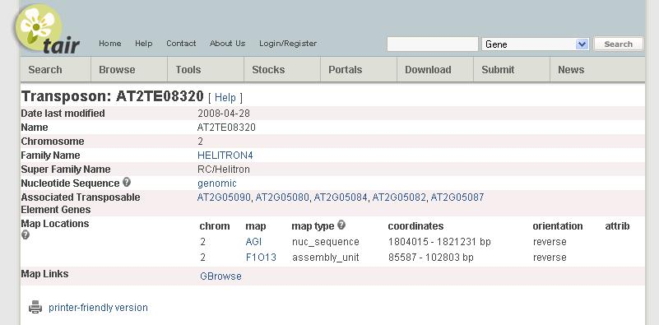
Transposons & TAIR

Slide 21
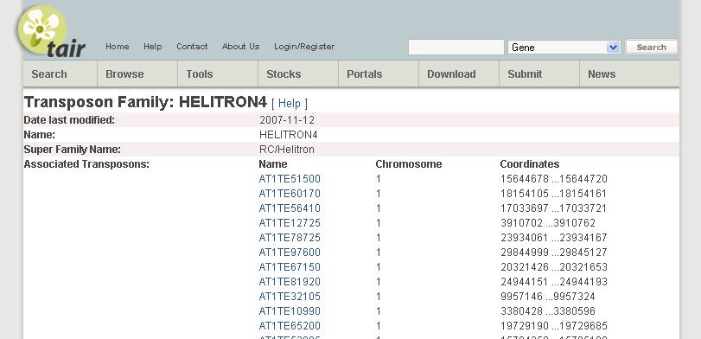
Transposons & TAIR

Slide 22
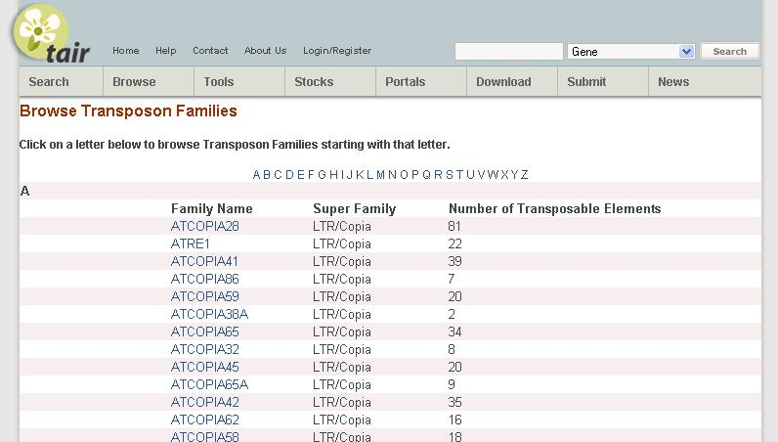
Transposons & TAIR

Slide 23
Plans for TAIR9

Slide 24
Gene confidence score
Why assign a confidence score?
  Differentiates well supported, partially supported and non-supported models
    Allows TAIR users to target particular categories
      For further experimentation
      For use as a reference set
      For computational analysis
    Allows TAIR to target partially supported genes
    Provides a measure with which to monitor improvement

Slide 25
Gene confidence outline
Categories of evidence
  Transcript (cDNA/EST)
  Protein
  Conservation
  Proteomic data
  Transcriptome data (MPSS etc)
Rankings within category
Assign confidence score/rank to model + exons

Slide 26
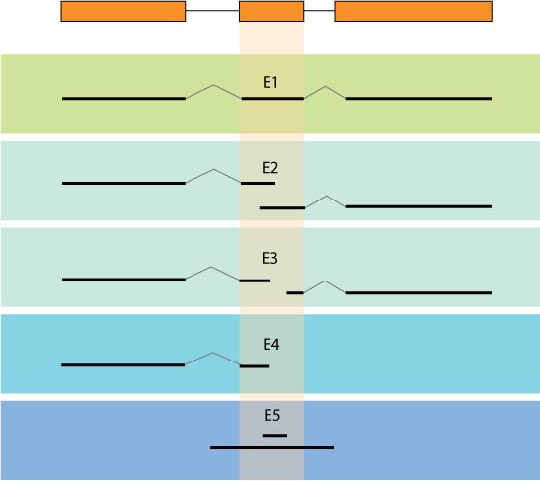
Transcript exon rankings - internal
Splice sites confirmed by transcript
Intermediates
Transcript only overlaps exon

Slide 27
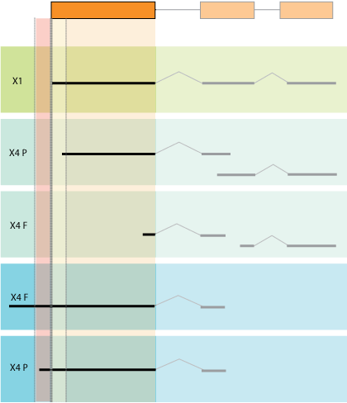
Transcript exon rankings - external

Slide 28
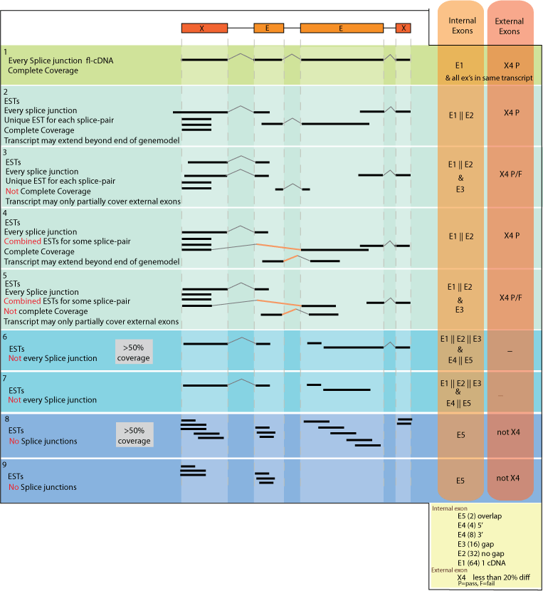
Transcript Model rankings
Intermediates
Intermediates

Slide 29
Gene confidence outline
Rank
Provide evidence ranks on web pages/GFF
  Transcript (cDNA/EST) 7
  Protein 2
  Conservation 2
  Proteomic data 0
  Transcriptome data (MPSS etc) 0
  Include overall rank (incorporating all evidence)
    Associate general description to each overall rank
      e.g. Confirmed, partially confirmed or Platinum, Gold, Silver etc
    Exon ranks included in GFF file

Slide 30

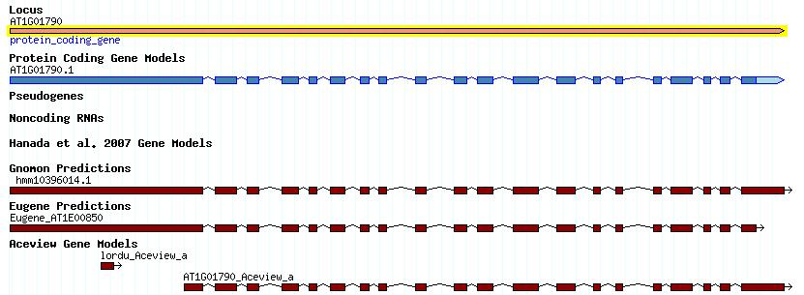
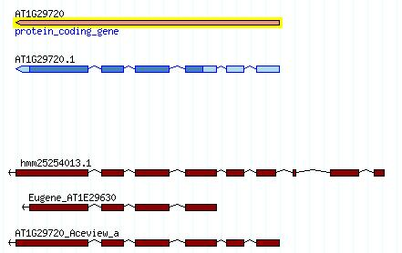
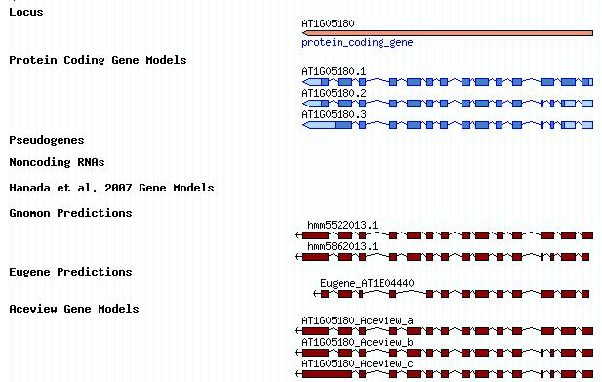
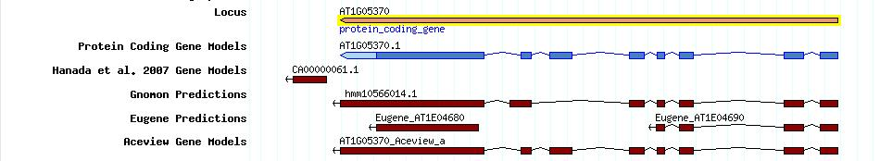
Alternative gene annotations
Eugene (transcript, proteins +) Thierry-Mieg (NCBI)
Gnomon (transcript, proteins) Souvorov (NCBI)
Aceview (transcript) Sebastien Aubourg
Hanada et al 2007 (3633 predicted genes)
Identify possible corrections

Slide 31
Utilising Comparative, proteomic and transcriptome data
Existing annotation ab initio + transcript
Advancements in sequencing technology
  Proteomic data (mass spec)
  Comparative data
  Transcriptome data (MPSS, SAGE)

Slide 32
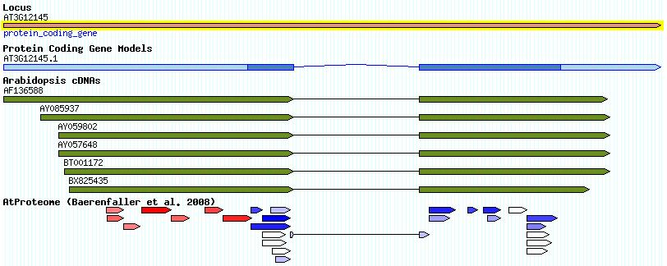
Proteomic Data
Incorrect start codon
High-density Arabidopsis proteome map (Baerenfaller. 2008)
Verification of gene structure at the level of translation
Not all transcripts expressed at protein level
  Transcribed pseudogenes
  NMD targets
Aid locus classification
Help identify
  missing genes/exons
  coding exons
  TSS

Slide 33
Comparative data
Cross spp transcript/peptide alignments
Genomic alignments (LBL)
  Populus trichocarpa
  Oryza sativa
  Medicago truncatula
  Physcomitrella patens
  Selaginella moellendorfii

Slide 34
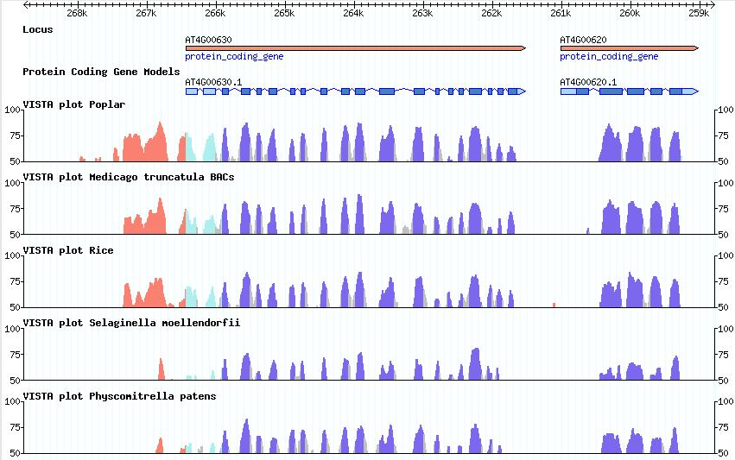
VISTA plot Gbrowse track

Slide 35
Transcriptome data
Sequence based signature methods
  MPSS
  SAGE
  etc
Identify intergenic expression
Alternative exons
Anti-sense expression

Slide 36
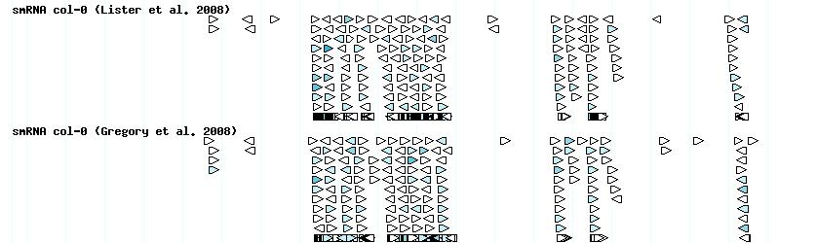
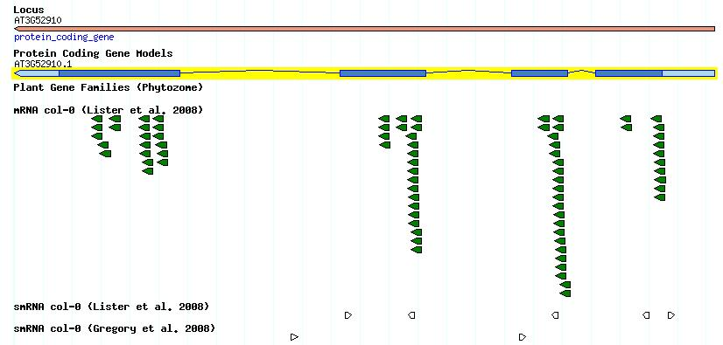
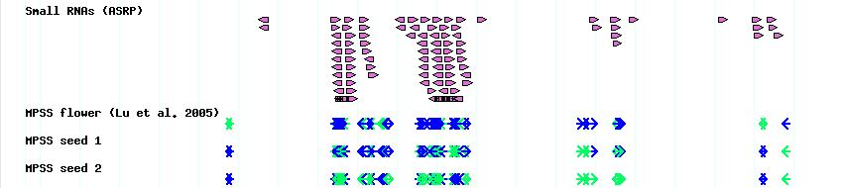
Transcriptome data

Slide 37
A collective approach
Utilise alt. gene predictions, comparative alignments, transcriptome and proteomic data
complements individual strategies
Gene confidence, identify weakly supported genes
Comparing across data types
  Identifies potential gene updates
  Allows us to prioritize updates
Combined manual and computational approach

Slide 38
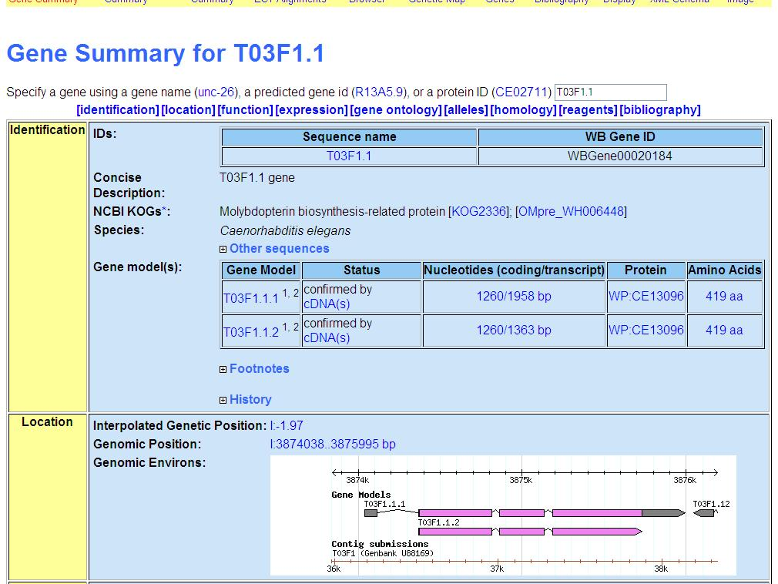
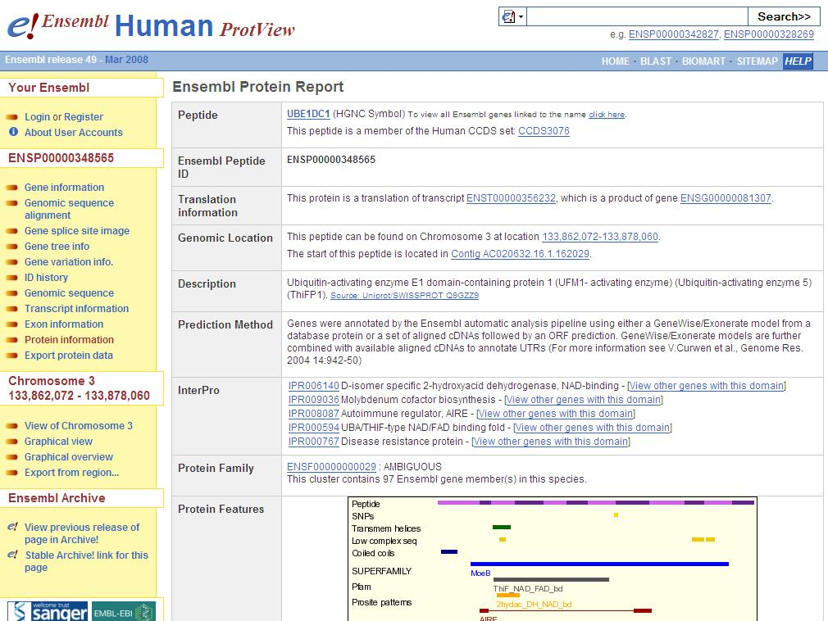
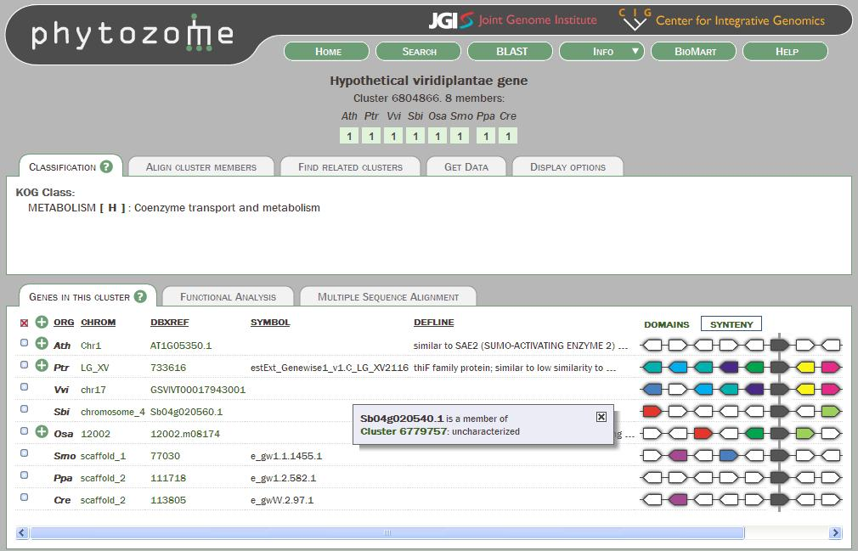
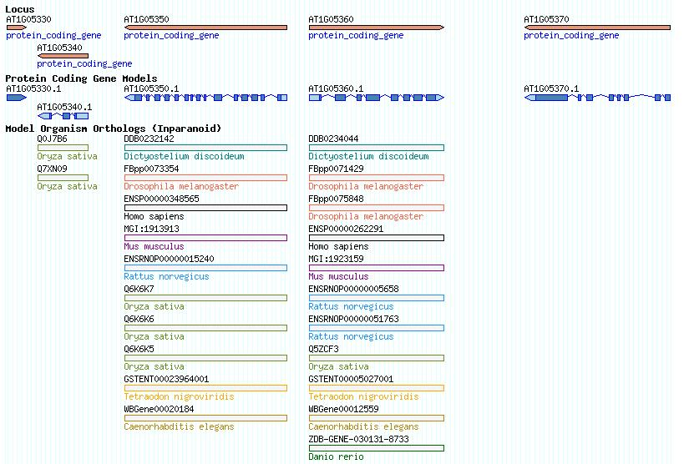
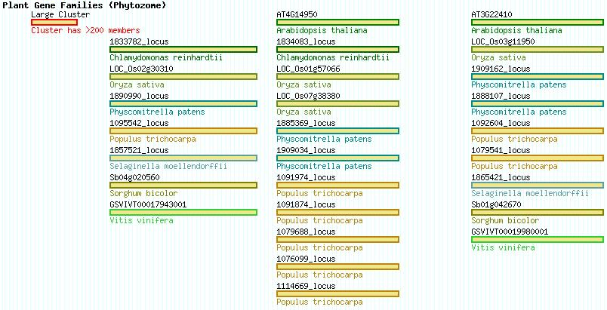
Orthologs and Gene Families

Slide 39
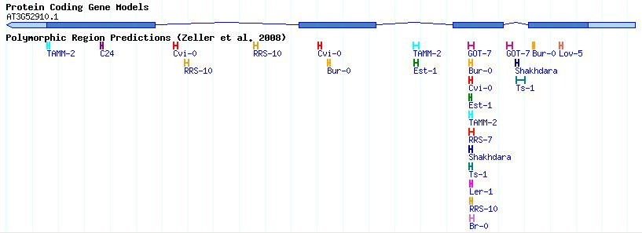
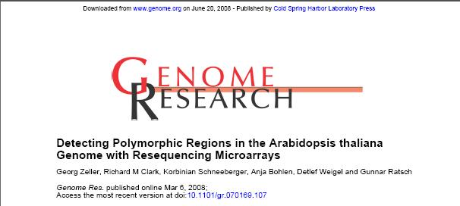
Variation

Slide 40
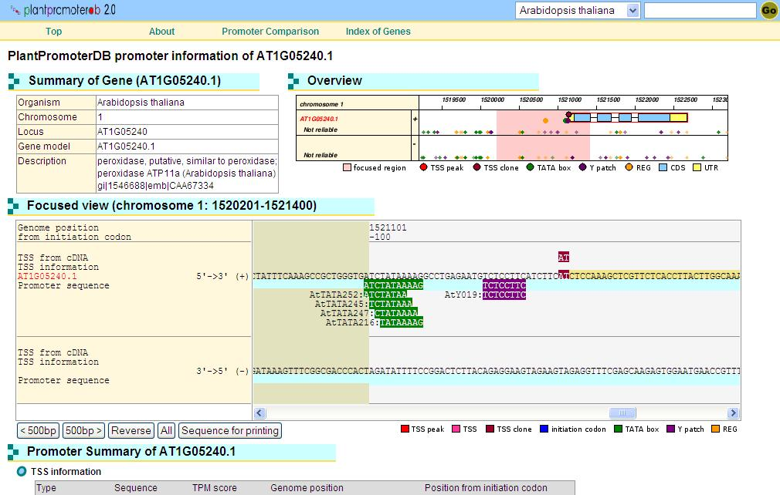
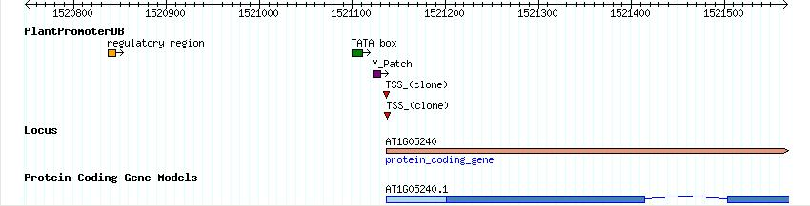
Promoter Elements

Slide 41
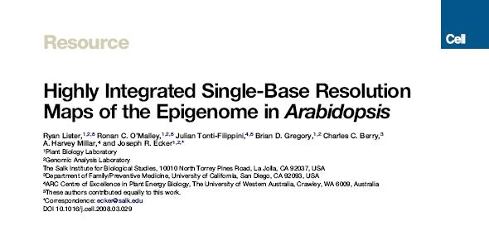
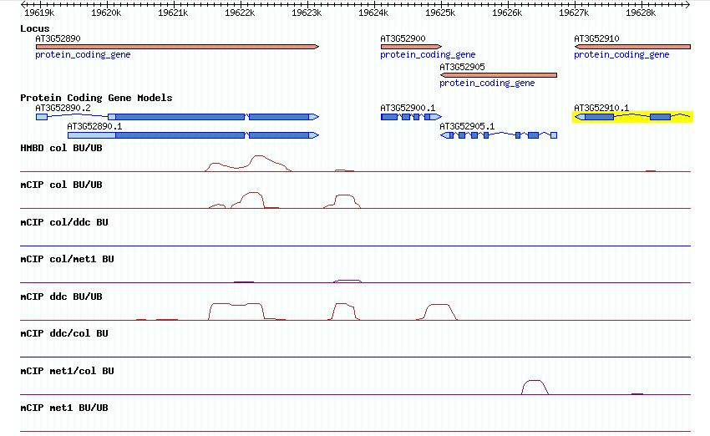
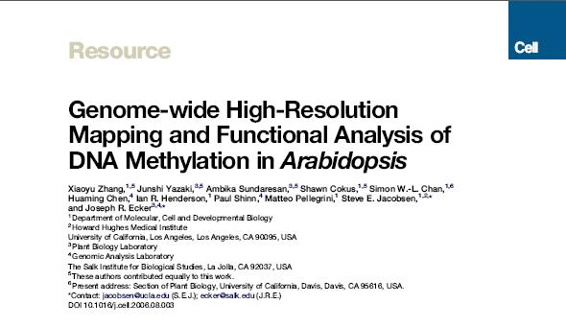
Methylation

Slide 42
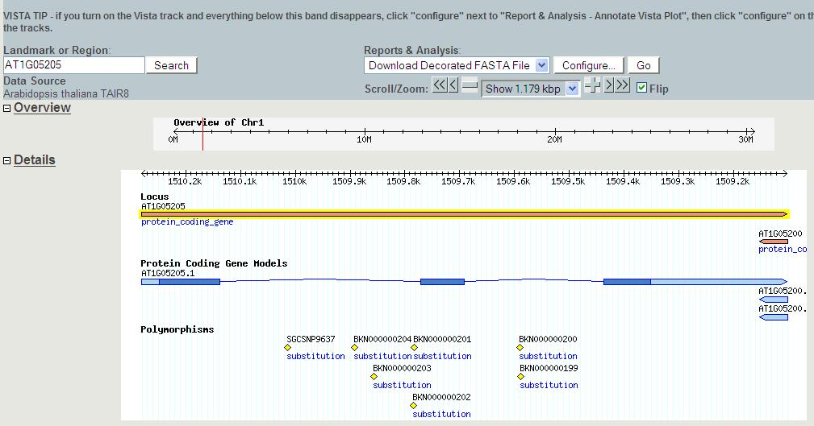
Decorated Fasta file

Slide 43
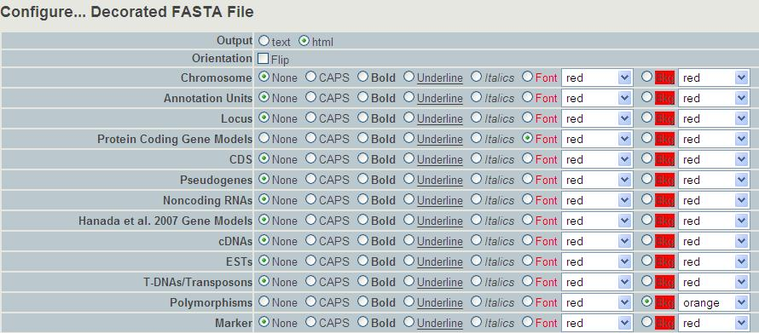
Decorated Fasta file

Slide 44
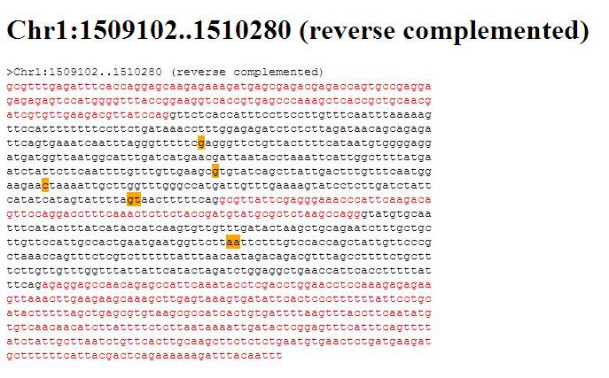
Decorated Fasta file

