Slide 1


Arabidopsis as a model for plant development
Eva Huala

Slide 2


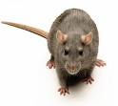

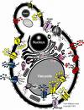
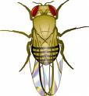

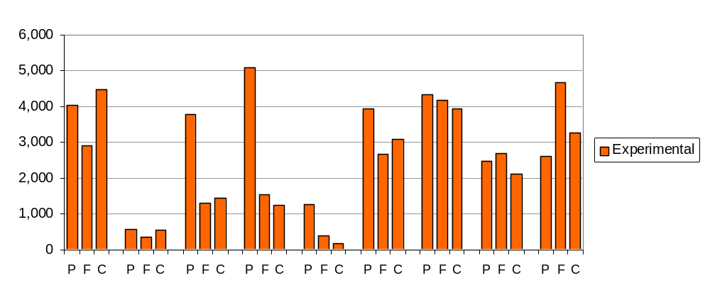

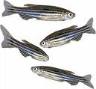
Genes with experimental GO annotations by species
Gene products
P = biological
process
F = molecular
function
C = subcellular
component
S. cer.
(yeast)
D. disc.
(slime
mold)
D. mel.
(fly)
C. eleg.
(worm)
A. thal.
(plant)
D. rer.
(fish)
M. mus.
(mouse)
R. nor.
(rat)
H. sap.
(human)

Slide 3
Genes with experimental GO annotations by species
2
4
1
3
Rank
Gene products
P = biological
process
F = molecular
function
C = subcellular
component
S. cer.
(yeast)
D. disc.
(slime
mold)
D. mel.
(fly)
C. eleg.
(worm)
A. thal.
(plant)
D. rer.
(fish)
M. mus.
(mouse)
R. nor.
(rat)
H. sap.
(human)

Slide 4
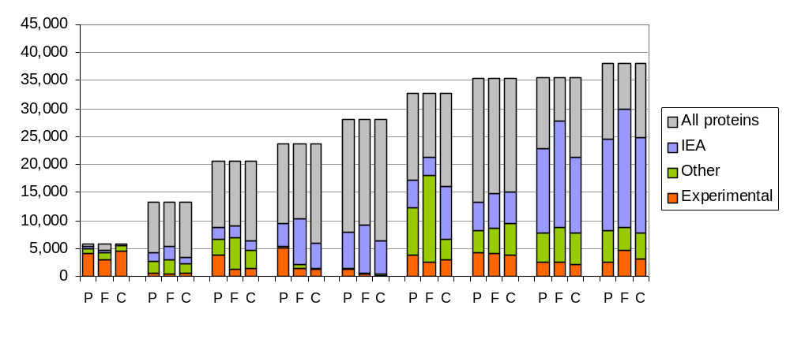
Genes with GO annotations by evidence and species
% gene products with exp GO annotations
65%
4%
11%
11%
2%
10%
12%
7%
9%
Gene products
S. cer.
(yeast)
D. disc.
(slime
mold)
D. mel.
(fly)
C. eleg.
(worm)
A. thal.
(plant)
D. rer.
(fish)
M. mus.
(mouse)
R. nor.
(rat)
H. sap.
(human)

Slide 5
Arabidopsis as a model plant
What is the role of Arabidopsis now that we have lots of plant genome sequences?
  Original reasons for using Arabidopsis still hold true
  New genomes make it easier to apply results from Arabidopsis to other plants
  More knowledge and tools More useful

Slide 6
Arabidopsis as a model plant
What is the role of Arabidopsis now that we have lots of plant genome sequences?
  Original reasons for using Arabidopsis still hold true
  New genomes make it easier to apply results from Arabidopsis to other plants
  More knowledge and tools More useful
The era of genome-hopping is upon us

Slide 7






Medicago
(clover)
Populus
(cottonwood)
Oryza
(rice)
Selaginella
(lycophyte)
Physcomitrella
(moss)
Arabidopsis
Eurosids II
92
Dicots
160
Seed plants
400
Vascular plants
450
Land plants

Slide 8
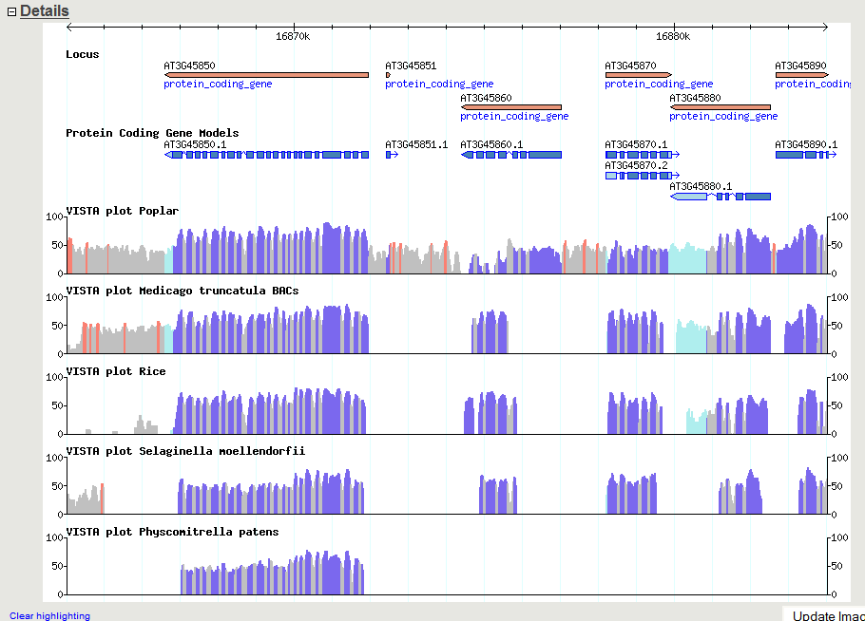
Nucleotide conservation across large evolutionary time spans
Arabidopsis
Populus (92 Mya)
Medicago (92 Mya)
Oryza (160 Mya)
Selaginella (400 Mya)
Physcomitrella (450 Mya)
TAIR GBrowse: http://arabidopsis.org/cgi-bin/gbrowse/arabidopsis/

Slide 9
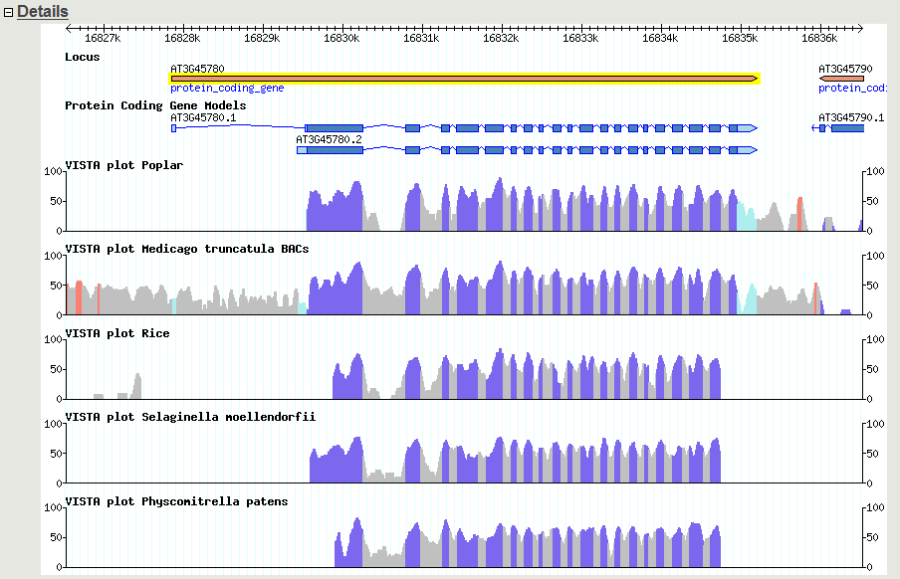
Nucleotide conservation across large evolutionary time spans
Arabidopsis
Phot1 blue light photoreceptor
Populus (92 Mya)
Medicago (92 Mya)
Oryza (160 Mya)
Selaginella (400 Mya)
Physcomitrella (450 Mya)
TAIR GBrowse: http://arabidopsis.org/cgi-bin/gbrowse/arabidopsis/

Slide 10
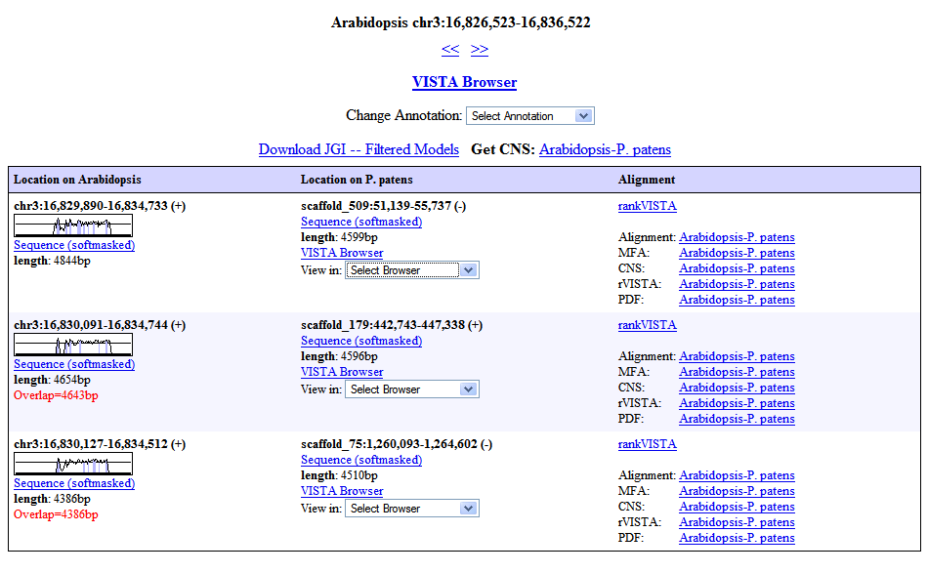
LBL: http://pipeline.lbl.gov/cgi-bin/textBrowser2?act=hits&run=74-&base=174&pos=chr3:16826523-16836522

Slide 11
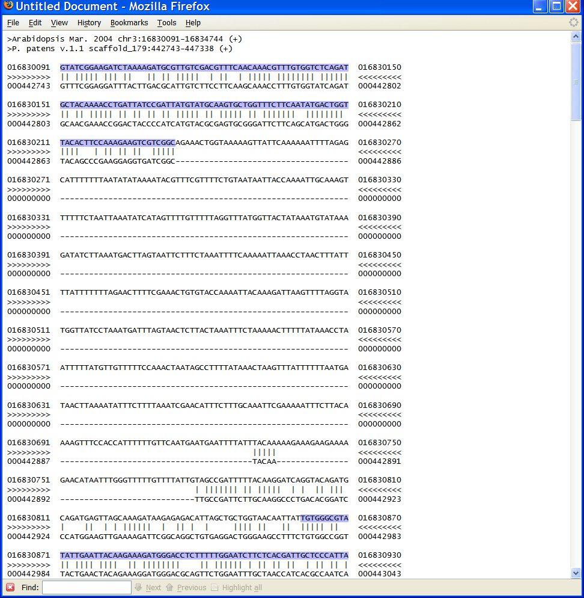

Slide 12
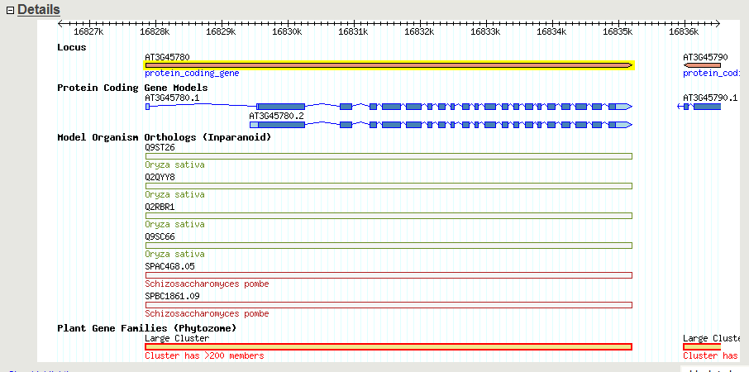
Other ways to navigate between genomes: Orthologs and gene families
TAIR GBrowse: http://arabidopsis.org/cgi-bin/gbrowse/arabidopsis/

Slide 13
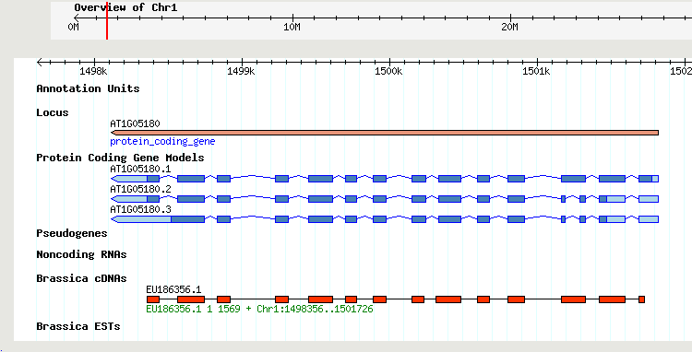
Other ways to navigate between genomes: Brassica and radish sequences
Brassica - 840,000 ESTs, 2100 cDNAs
Raphanus - 287,000 ESTs
Nucleotide alignments to Arabidopsis using CAT (Cross-species Alignment Tool, Li et al 2007)
TAIR GBrowse

Slide 14
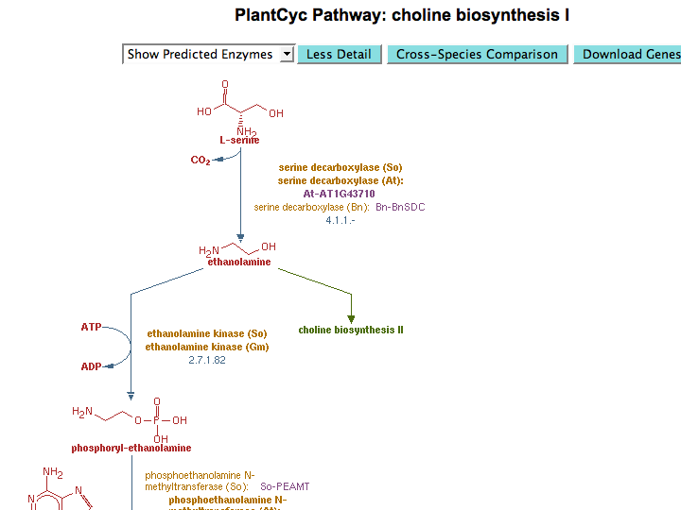
Spinacia oleracea
Arabidopsis thaliana
Brassica napus
Spinacia oleracea
Glycine max
www.plantcyc.org

Slide 15
Medicago
(clover)
Populus
(cottonwood)
Oryza
(rice)
Selaginella
(lycophyte)
Physcomitrella
(moss)
Arabidopsis
Eurosids II
92
Dicots
160
Seed plants
400
Vascular plants
450
Land plants

Slide 16


Medicago
(clover)
Populus
(cottonwood)
Oryza
(rice)
Selaginella
(lycophyte)
Physcomitrella
(moss)
Arabidopsis
A. lyrata
C. rubella
Eurosids II
92
Dicots
160
Seed plants
400
Vascular plants
450
Land plants

Slide 17

Medicago
(clover)
Populus
(cottonwood)
Oryza
(rice)
Selaginella
(lycophyte)
Physcomitrella
(moss)
Arabidopsis
A. lyrata
C. rubella
Eurosids II
92
Chlamydomonas
(green alga)
Dicots
160
Seed plants
400
Vascular plants
450
Land plants
475

Slide 18
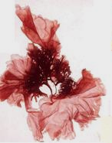
Medicago
(clover)
Populus
(cottonwood)
Oryza
(rice)
Selaginella
(lycophyte)
Physcomitrella
(moss)
Arabidopsis
A. lyrata
C. rubella
Eurosids II
92
Chlamydomonas
(green alga)
Dicots
160
Seed plants
400
Vascular plants
Porphyra purpurea
(red alga)
450
Land plants
475

Slide 19
Medicago
(clover)
Populus
(cottonwood)
Oryza
(rice)
Selaginella
(lycophyte)
Physcomitrella
(moss)
Arabidopsis
A. lyrata
C. rubella
Eurosids II
92
Chlamydomonas
(green alga)
Dicots
160
Others from JGI:
Cassava,
Brachypodium,
Pine, Eucalyptus,
Monkey flower,
Millet, Soybean,
Switchgrass,
Sorghum, Cotton
Seed plants
400
Vascular plants
Porphyra purpurea
(red alga)
450
Land plants
475

Slide 20


















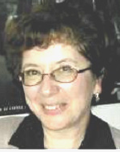
NAASC
Acknowledgements
Genome Annotation:
Gene Function/GO:
Metabolic Pathways:
David Swarbreck
Philippe Lamesch
Chris Wilks
Tanya Berardini
Donghui Li
Debbie Alexander
Peifen Zhang
Kate Dreher
A.S. Karthikeyan
Sue Rhee
TAIR Technical Staff:
LBL/JGI
Bob Muller
Shanker Singh
Larry Ploetz
Cynthia Lee
Tom Meyer
Vanessa Kirkup
Raymond Chetty
Anjo Chi
Inna Dubchak

