Slide 1


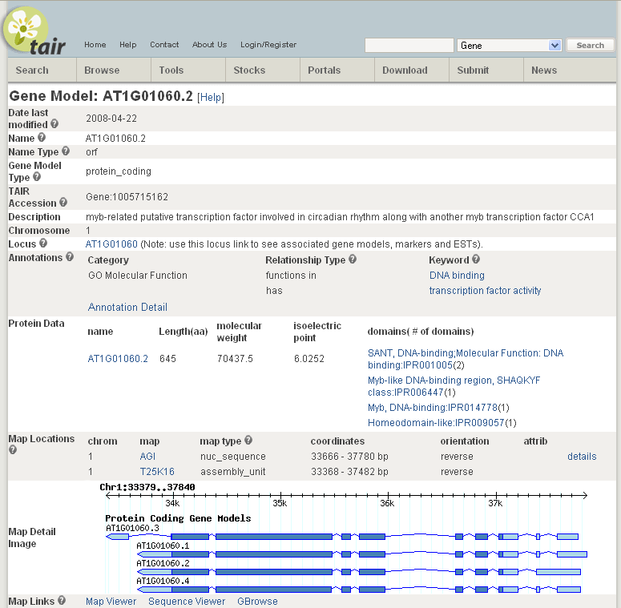
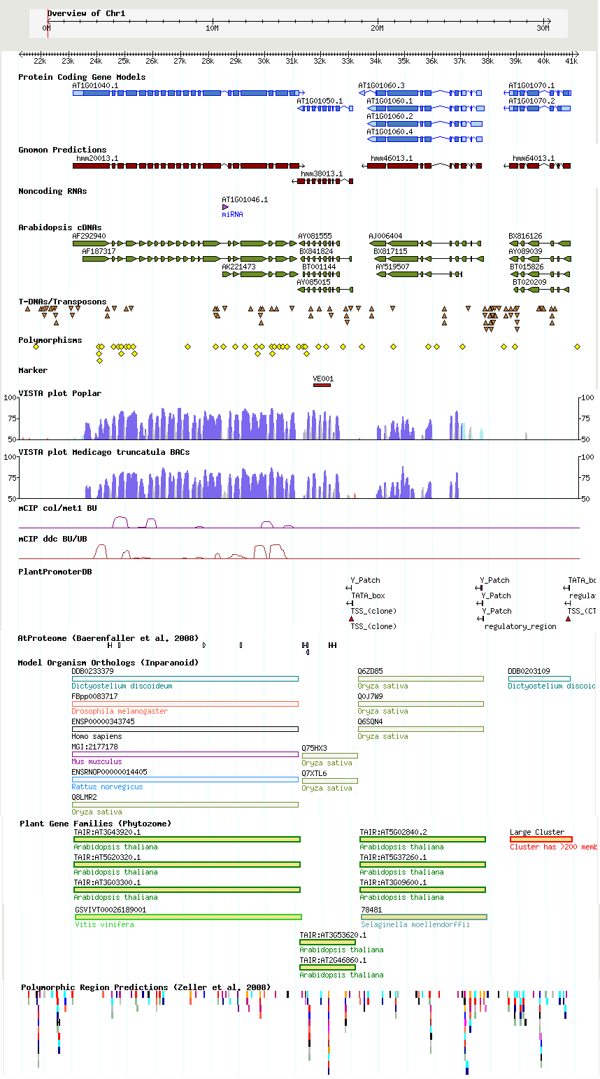
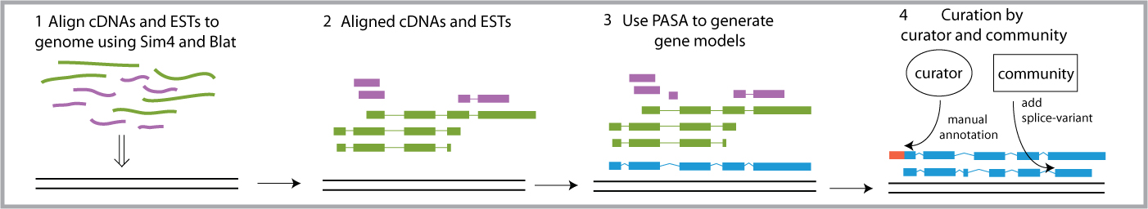
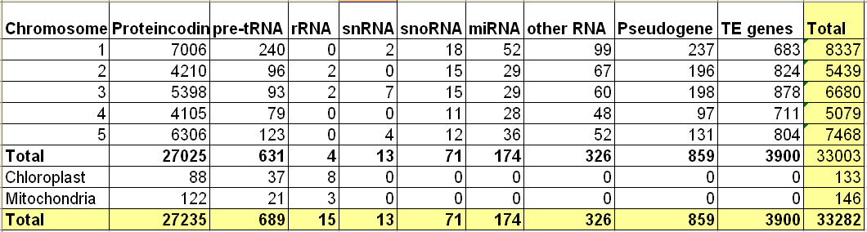
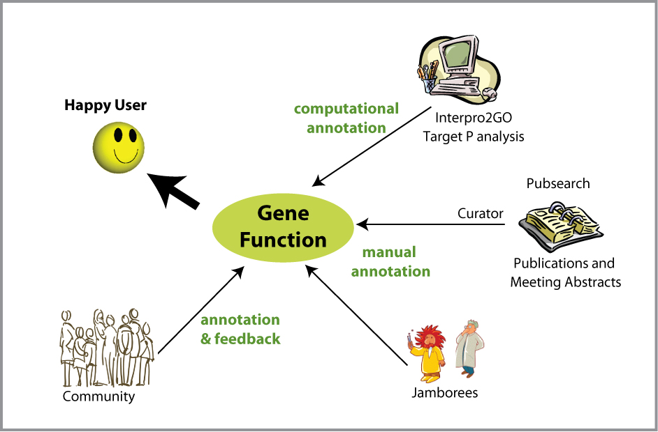
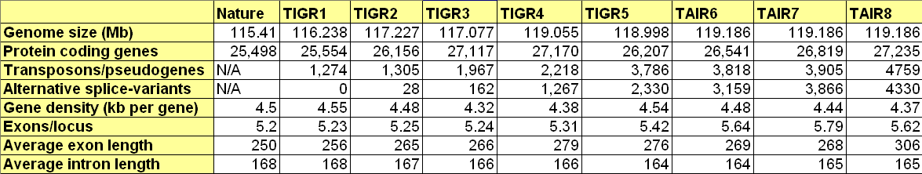
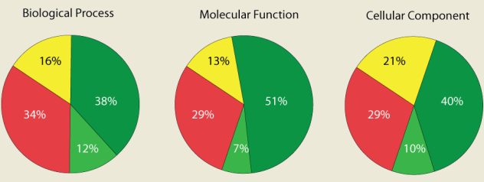

Gene structure and function annotation at TAIR
Philippe E. Lamesch, Donghui Li, David Swarbreck, Kate Dreher, Debbie Alexander, Tanya Z. Berardini, Peifen Zhang, Chris Wilks, Robert Muller, Cynthia Lee, Raymond Chetty, Tom Meyer, A.S. Karthikeyan, Vanessa Kirkup, Shanker Singh, Larry Ploetz, Anjo Chi, Margarita Garcia-Hernandez, Leonore Reiser, Christophe Tissier, Eva Huala
Department of Plant Biology, Carnegie Institution, 260 Panama St., Stanford, CA, 94305, USA
Introducing TAIR
TAIR website
Gene model page
It is eight years since the Arabidopsis genome sequence was completed. In the intervening period the genome annotation has undergone significant refinement. Primary responsibility for updating the Arabidopsis annotation in North America has now been assumed by TAIR. As the foremost model organism in plant biology, improvements to Arabidopsis gene structure and function annotation benefit not only Arabidopsis researchers but will aid gene annotation and understanding across all plant species.
TAIR analysis tools
The Gene Model detail page provides a portal to both internal and external resources. For each annotated gene model this page contains information on nucleotide and protein sequence, protein function, map location, map links, germplasm, polymorphisms, publications and more. Since July ’08, this page also displays an image representing the exon-intron structure of the gene model and all associated splice-variants.
TAIR hosts a variety of analysis tools useful to Arabidopsis researchers. Tools available at TAIR include Blast alignment tools, Restriction and Motif analysis tools, the AraCyc metabolic pathway tool, Bulk data retrieval tool, Omics viewer, Patmatch and Genome browsers (image of GBrowse below).
Gene structure annotation at TAIR
Computational and manual genome annotation at TAIR. For each TAIR release, all Arabidopsis ESTs and cDNAs are extracted from Genbank and are aligned to the A. thaliana genome using the alignment programs Sim4 and Blat. We use PASA (Program to Assemble Spliced Alignments) to assemble spliced alignments into gene models and compare them to existing models. TAIR curators correct structural artifacts of computationally annotated genes, annotate genes with discrepancies between prediction and transcript assembly, curate special types of genes such as pseudogenes or transposable element genes, and update gene structures based on community feedback.
Functional Annotation at TAIR
Our latest genome release: TAIR8
How does TAIR curate gene function?
In addition to gene structure annotation, another major focus of TAIR is to make gene function annotation using Gene Ontology (GO) and Plant Ontology (PO) controlled vocabularies. The major sources for functional annotation at TAIR include manual curation of research literature, computational analysis, and submissions from the community.
The TAIR8 release contains 27,235 protein coding genes. A total of 1291 new genes and 2009 new gene models were added. Updates were made to 3811 gene structures of which 625 gene models had CDS updates. There were 33 gene splits and 41 gene merges. Overall 23% of all existing TAIR7 genes (7380 genes) were updated (includes split, merged and deleted genes as well as locus type changes, structural updates and sequence updates) for TAIR8.
Chromosome updates: 14 genomic regions were identified as either vector, E.coli or rice contamination; in all cases the existing sequence was substituted with the equivalent number of IUPAC ambiguity code ‘N’s. Consequently there is no resulting change in chromosome length. 1425 single nucleotide substitutions were made to the assembly sequence based on high confidence Solexa read data using the Columbia ecotype supplied by Joe Ecker
Current state of GO annotations of Arabidopsis genes
The pie charts below represent the state of functional annotation of the A. thaliana genome (excluding pseudogenes) based on links to terms in the three GO ontologies: molecular function, biological process, cellular process. The pie charts for GO ontologies are based on annotation data as of May 3, 2008.
GBrowse, developed by the Generic Model Organism Database (GMOD) project, is now available at TAIR. Search or Browse a map of the Arabidopsis genome (including genes, cDNAs and ESTs, insertion mutants, SNPs, markers and BACs, orthologs, methylation sites, VISTA sequence conservation plots, plant promoter elements, proteomics data, alternative gene models and more) or upload your own annotation track. Tracks can be easily customized by turning on and off specific data types or collapsing and expanding tracks.
A. thaliana genome annotation releases. The initial annotation was carried out by the Arabidopsis genome initiative (AGI). Subsequent updates have been carried out by TIGR, MIPs and latterly TAIR.
Unknown
Known (experimental)
Unannotated
Known (other)

