Slide 1


Arabidopsis as a model for plant development
Eva Huala
Notes:
Start this talk with a couple of slides showing the position Arabidopsis occupies in the pantheon of model organisms, then go on to talk about what all these new genomes might mean for Arabidopsis research and show you some ways you can already begin to make use of all the new plant genome sequences at TAIR.
Where are we in the big picture?
What do all these new genomes mean to us? How can the average plant researcher begin to make use of them?

Slide 2




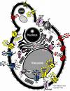
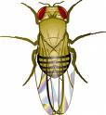

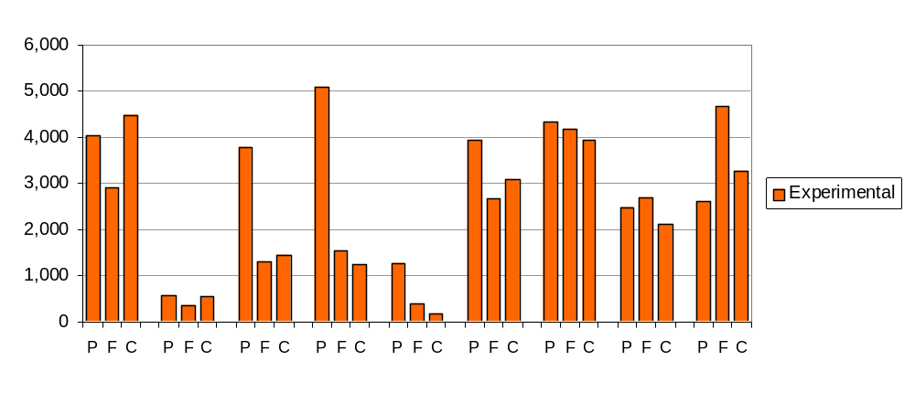

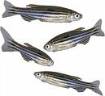
Genes with experimental GO annotations by species
Gene products
P = biological
process
F = molecular
function
C = subcellular
component
S. cer.
(yeast)
D. disc.
(slime
mold)
D. mel.
(fly)
C. eleg.
(worm)
A. thal.
(plant)
D. rer.
(fish)
M. mus.
(mouse)
R. nor.
(rat)
H. sap.
(human)
Notes:
This is one way to represent our current knowledge about our model system and compare it with others.
Gold standard data that has been converted to the most comparable, versatile and useful form of gene function knowledge
2. Arab. is in the hall of fame / pantheon of all-time great reference organisms
3. the challenge of experimentally characterizing all genes is huge.
As director of TAIR I may be one of the few people in this room who looks at this type of data regularly.
It’s important for everyone to understand that Arabidopsis is a major reference organism for all of biology, not just for plants.
This underscores not only how successful Arab. Is as a reference organism but also the hugeness of the challenge. Look at where we are for mouse and human, where the resources are comparatively enormous.
Here is where Arabidopsis stands relative to other major model orgs (all are slight underestimates due to curation bottleneck)
EXP GO annotations = measure of gold standard knowledge easily mined and applied to other species
Arabidopsis ranks 4th overall in this group
There is no other plant model anywhere near this level of knowledge
Component incl. SUBA is 4900 (adds about 1800)

Slide 3
Genes with experimental GO annotations by species
2
4
1
3
Rank
Gene products
P = biological
process
F = molecular
function
C = subcellular
component
S. cer.
(yeast)
D. disc.
(slime
mold)
D. mel.
(fly)
C. eleg.
(worm)
A. thal.
(plant)
D. rer.
(fish)
M. mus.
(mouse)
R. nor.
(rat)
H. sap.
(human)
Notes:
This is one way to represent our current knowledge about our model system and compare it with others.
Gold standard data that has been converted to the most comparable, versatile and useful form of gene function knowledge
2. Arab. is in the hall of fame / pantheon of all-time great reference organisms
3. the challenge of experimentally characterizing all genes is huge.
As director of TAIR I may be one of the few people in this room who looks at this type of data regularly.
It’s important for everyone to understand that Arabidopsis is a major reference organism for all of biology, not just for plants.
This underscores not only how successful Arab. Is as a reference organism but also the hugeness of the challenge. Look at where we are for mouse and human, where the resources are comparatively enormous.
Here is where Arabidopsis stands relative to other major model orgs (all are slight underestimates due to curation bottleneck)
EXP GO annotations = measure of gold standard knowledge easily mined and applied to other species
Arabidopsis ranks 4th overall in this group
There is no other plant model anywhere near this level of knowledge
Component incl. SUBA is 4900 (adds about 1800)

Slide 4
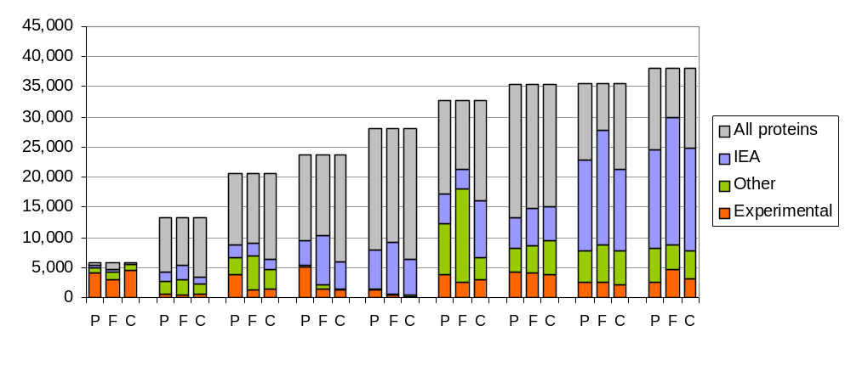
Genes with GO annotations by evidence and species
% gene products with exp GO annotations
65%
4%
11%
11%
2%
10%
12%
7%
9%
Gene products
S. cer.
(yeast)
D. disc.
(slime
mold)
D. mel.
(fly)
C. eleg.
(worm)
A. thal.
(plant)
D. rer.
(fish)
M. mus.
(mouse)
R. nor.
(rat)
H. sap.
(human)
Notes:
Shows the same data in the context of the whole genome and includes other types of annotations
Genome size worked in our favor when the project was sequencing, but we have just as many genes as these other orgs.
As a percentage of total number of predicted proteins we’re well below yeast but similar to other large genomes in overall percentage with exp annotation

Slide 5
Arabidopsis as a model plant
What is the role of Arabidopsis now that we have lots of plant genome sequences?
  Original reasons for using Arabidopsis still hold true
  New genomes make it easier to apply results from Arabidopsis to other plants
  More knowledge and tools More useful
Notes:
Due to positive feedback loop value of Arabidopsis as a reference org is increasing
Prediction – Arabidopsis will become even more dominant as the primary plant model for basic research
So how will we use all these new plant genomes?

Slide 6
Arabidopsis as a model plant
What is the role of Arabidopsis now that we have lots of plant genome sequences?
  Original reasons for using Arabidopsis still hold true
  New genomes make it easier to apply results from Arabidopsis to other plants
  More knowledge and tools More useful
The era of genome-hopping is upon us
Notes:
Due to positive feedback loop value of Arabidopsis as a reference org is increasing
Prediction – Arabidopsis will become even more dominant as the primary plant model for basic research
So how will we use all these new plant genomes?

Slide 7






Medicago
(clover)
Populus
(cottonwood)
Oryza
(rice)
Selaginella
(lycophyte)
Physcomitrella
(moss)
Arabidopsis
Eurosids II
92
Dicots
160
Seed plants
400
Vascular plants
450
Land plants
Notes:
A sampling of the many plants that now have sequenced genomes with their approximate divergence times in millions of years. These happen to be available from TAIR via JGI

Slide 8
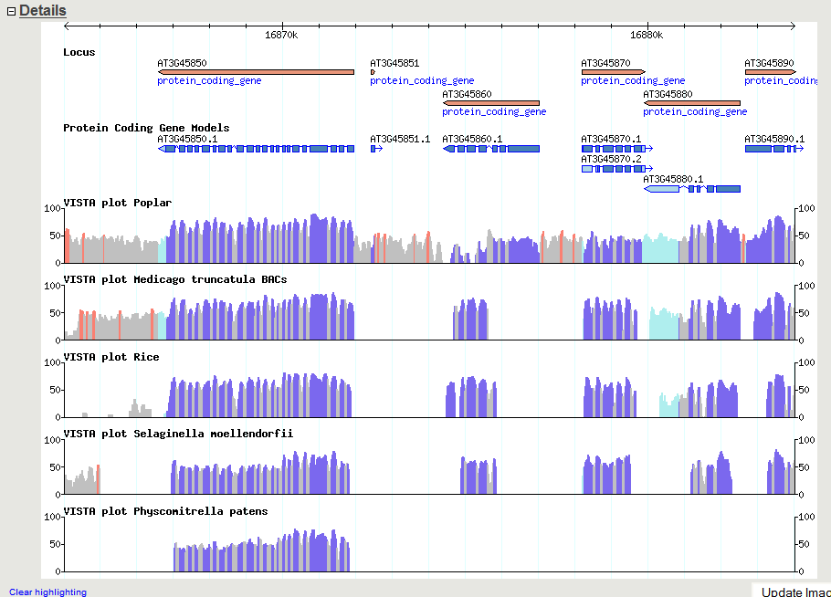
Nucleotide conservation across large evolutionary time spans
Arabidopsis
Populus (92 Mya)
Medicago (92 Mya)
Oryza (160 Mya)
Selaginella (400 Mya)
Physcomitrella (450 Mya)
TAIR GBrowse: http://arabidopsis.org/cgi-bin/gbrowse/arabidopsis/
Notes:
Shows nucleotide sequence conservation tracks generated by JGI and hosted at TAIR within our Gbrowse.
Shocking degree of conservation within coding regions at the nucleotide level
One major advantage of nucleotide alignments is that annotation quality becomes irrelevant

Slide 9
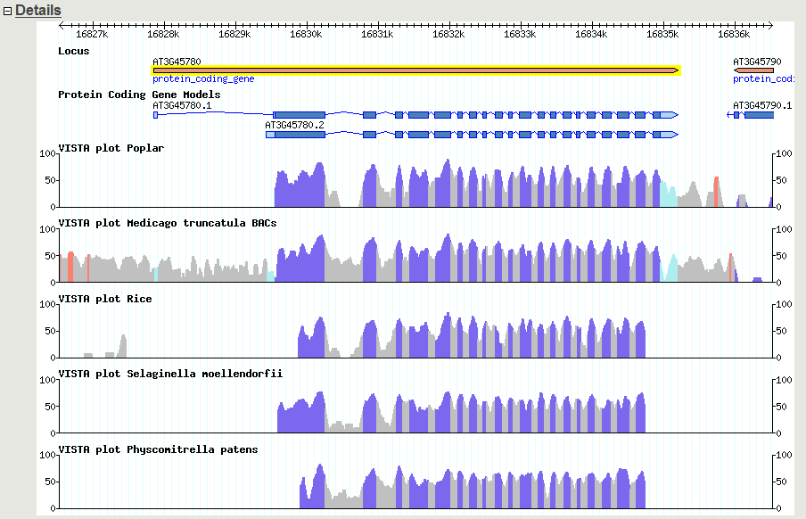
Nucleotide conservation across large evolutionary time spans
Arabidopsis
Phot1 blue light photoreceptor
Populus (92 Mya)
Medicago (92 Mya)
Oryza (160 Mya)
Selaginella (400 Mya)
Physcomitrella (450 Mya)
TAIR GBrowse: http://arabidopsis.org/cgi-bin/gbrowse/arabidopsis/
Notes:
Visualize conservation with your favorite gene
Conserved regions with all these plant sequences are now available in TAIR’s gbrowse.
Click on curve…

Slide 10
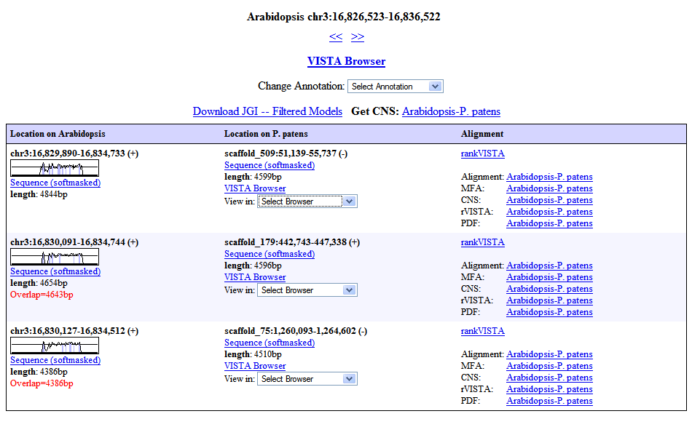
LBL: http://pipeline.lbl.gov/cgi-bin/textBrowser2?act=hits&run=74-&base=174&pos=chr3:16826523-16836522

Slide 11
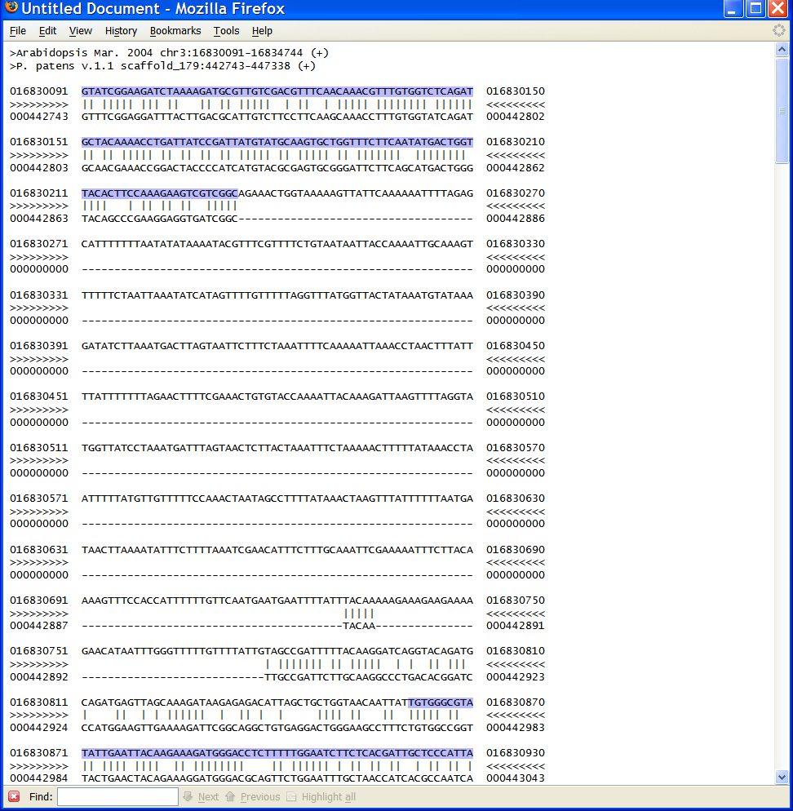

Slide 12
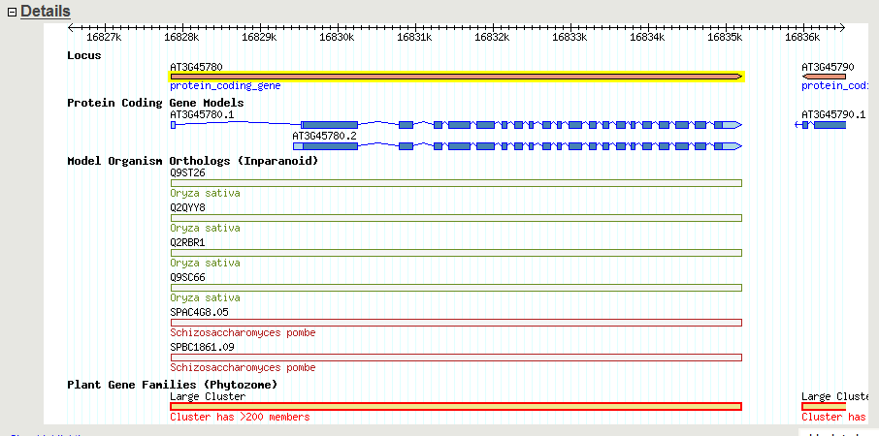
Other ways to navigate between genomes: Orthologs and gene families
TAIR GBrowse: http://arabidopsis.org/cgi-bin/gbrowse/arabidopsis/
Notes:
Clicking on these orthologs can lead to additional information

Slide 13
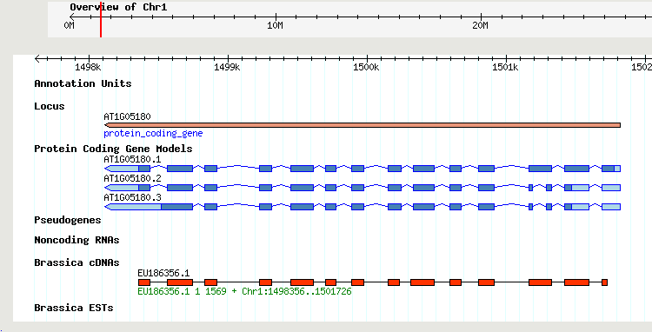
Other ways to navigate between genomes: Brassica and radish sequences
Brassica - 840,000 ESTs, 2100 cDNAs
Raphanus - 287,000 ESTs
Nucleotide alignments to Arabidopsis using CAT (Cross-species Alignment Tool, Li et al 2007)
TAIR GBrowse

Slide 14
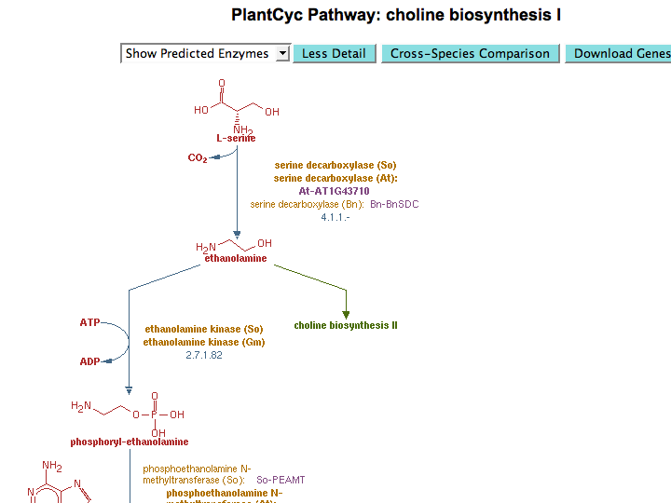
Spinacia oleracea
Arabidopsis thaliana
Brassica napus
Spinacia oleracea
Glycine max
www.plantcyc.org

Slide 15
Medicago
(clover)
Populus
(cottonwood)
Oryza
(rice)
Selaginella
(lycophyte)
Physcomitrella
(moss)
Arabidopsis
Eurosids II
92
Dicots
160
Seed plants
400
Vascular plants
450
Land plants
Notes:
What will this look like in the future?

Slide 16


Medicago
(clover)
Populus
(cottonwood)
Oryza
(rice)
Selaginella
(lycophyte)
Physcomitrella
(moss)
Arabidopsis
A. lyrata
C. rubella
Eurosids II
92
Dicots
160
Seed plants
400
Vascular plants
450
Land plants
Notes:
More close relatives

Slide 17

Medicago
(clover)
Populus
(cottonwood)
Oryza
(rice)
Selaginella
(lycophyte)
Physcomitrella
(moss)
Arabidopsis
A. lyrata
C. rubella
Eurosids II
92
Chlamydomonas
(green alga)
Dicots
160
Seed plants
400
Vascular plants
450
Land plants
475
Notes:
And more distant relatives

Slide 18
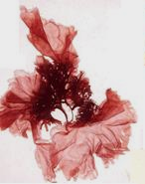
Medicago
(clover)
Populus
(cottonwood)
Oryza
(rice)
Selaginella
(lycophyte)
Physcomitrella
(moss)
Arabidopsis
A. lyrata
C. rubella
Eurosids II
92
Chlamydomonas
(green alga)
Dicots
160
Seed plants
400
Vascular plants
Porphyra purpurea
(red alga)
450
Land plants
475
Notes:
And even more distant relatives

Slide 19
Medicago
(clover)
Populus
(cottonwood)
Oryza
(rice)
Selaginella
(lycophyte)
Physcomitrella
(moss)
Arabidopsis
A. lyrata
C. rubella
Eurosids II
92
Chlamydomonas
(green alga)
Dicots
160
Others from JGI:
Cassava,
Brachypodium,
Pine, Eucalyptus,
Monkey flower,
Millet, Soybean,
Switchgrass,
Sorghum, Cotton
Seed plants
400
Vascular plants
Porphyra purpurea
(red alga)
450
Land plants
475
Notes:
And lots in between

Slide 20


















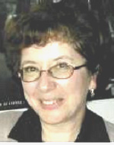
NAASC
Acknowledgements
Genome Annotation:
Gene Function/GO:
Metabolic Pathways:
David Swarbreck
Philippe Lamesch
Chris Wilks
Tanya Berardini
Donghui Li
Debbie Alexander
Peifen Zhang
Kate Dreher
A.S. Karthikeyan
Sue Rhee
TAIR Technical Staff:
LBL/JGI
Bob Muller
Shanker Singh
Larry Ploetz
Cynthia Lee
Tom Meyer
Vanessa Kirkup
Raymond Chetty
Anjo Chi
Inna Dubchak

