Slide 1
Model Organism Databases and Community Annotation
Gene Structure
Annotation at TAIR
Philippe Lamesch
curator@arabidopsis.org

Slide 2



Curator-User collaborations in various databases
Karen Yook
Issak Yosief Tecle
Donghui Li
Philippe Lamesch

Slide 3


TAIR
ESTs, cDNAs
TAIR
User
submissions
curators
New
release
Gene annotation
pipeline
TAIR web
curators

Slide 4
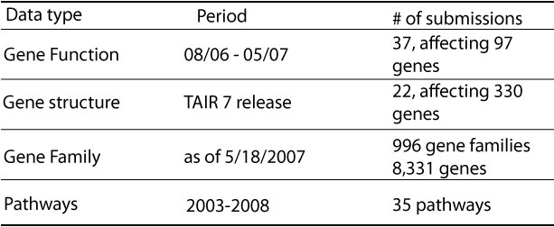
Statistics on various data submissions
30, affecting
>1,500 genes
Novel
Sequence
Exon-Intron Structure
UTRs
Splice-variants
Gene type (protein coding, RNA gene, pseudogene)
Notes:
Btw TAIR6 and TAIR8 about 30 datasets regarding gene structures or novel genes were submitted to TAIR, affecting about 1200 genes

Slide 5
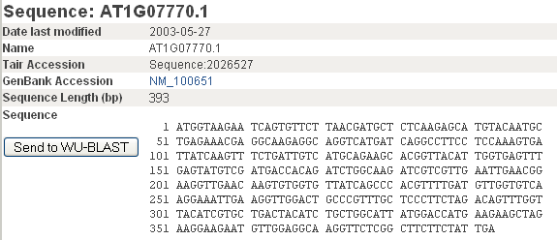
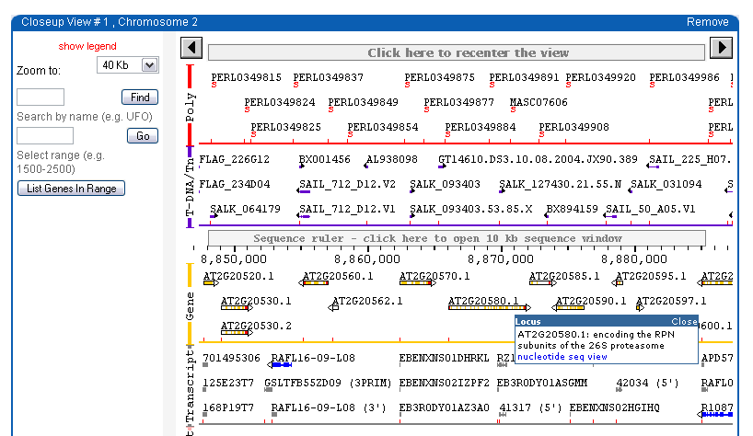
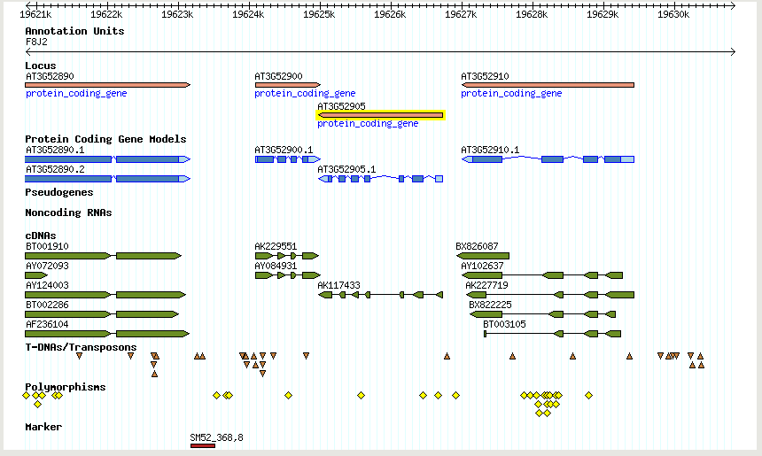
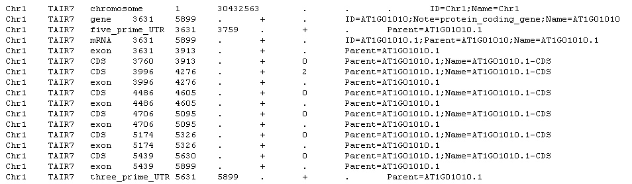
Gene structure & sequence info at TAIR
Gene Model Page: Fasta seq
Genome Browsers:
Seqview & Gbrowse
GFF file: exon/intron data

Slide 6

2 types of data submission
Small sets: mostly gene structure update
Genome-wide lists

Slide 7
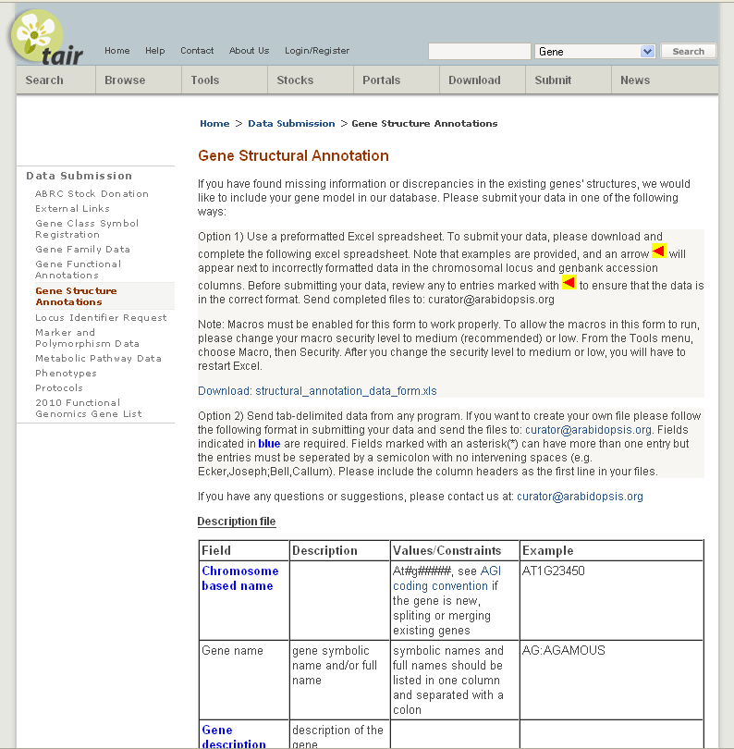
Submitting Gene structure data to TAIR
Download submission form
Gene reannotation submission form:
Chromosome
Gene Name
Gene Description
cDNA Sequence
Protein Sequence
Genbank entry
Contact Information
Method Description
Publication
http://www.arabidopsis.org/submit/gene_annotation.submission.jsp

Slide 8
Submitting Gene structure data to TAIR
Submit tab delimited or gff file (especially for large data sets)
http://www.arabidopsis.org/submit/gene_annotation.submission.jsp

Slide 9
2 types of data submission
Small sets: mostly gene structure update
Genome-wide lists

Slide 10
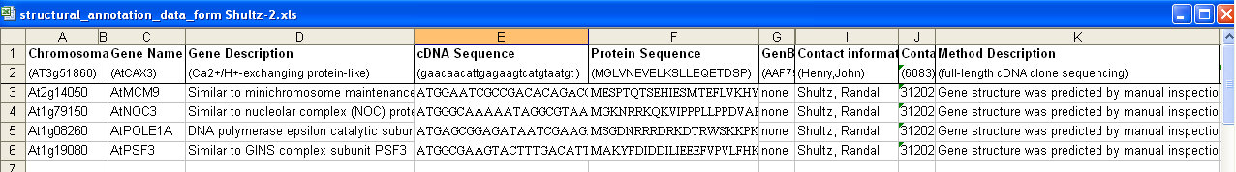
Gene Annotation Submission
Example (1) of small dataset
Randall Shultz:
Reannotation of 4 genes coding for core DNA replication proteins
AT1G19080

Slide 11
Gene Annotation Submission
Complex gene structure
Have a look at the current structure of that gene
Identify the suggested structure difference
Analyze evidence supporting the structure update
Update the gene structure

Slide 12
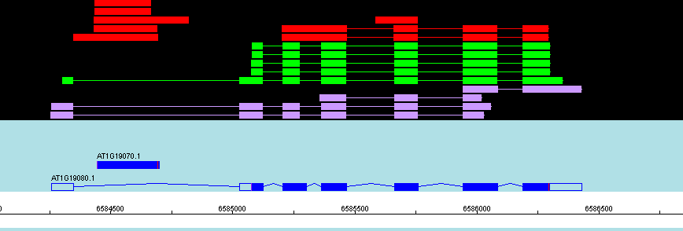
Gene Annotation Submission
Example of small dataset
Have a look at the current structure of that gene
Apollo software interface
Protein similarity
ESTs
Intronless gene
Multi-exon gene

Slide 13
Gene Annotation Submission
Example of small dataset
Have a look at the current structure of that gene
Identify the suggested structure difference
Seq 1
Blast2Seq
TAIR7 gene extends
at position 115
Seq 2

Slide 14
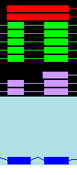
Gene Annotation Submission
Example of small dataset
Have a look at the current structure of that gene
Identify the suggested structure difference
Analyze evidence supporting the structure update
ESTs and cDNAs confirm R.S.’s gene structure reannotation

Slide 15
Gene Annotation Submission
Example of small dataset
AT1G08260

Slide 16
Gene Annotation Submission
Example of small dataset
Have a look at the current structure of that gene
Identify the suggested structure difference
Analyze evidence supporting the structure update
Update the gene structure

Slide 17
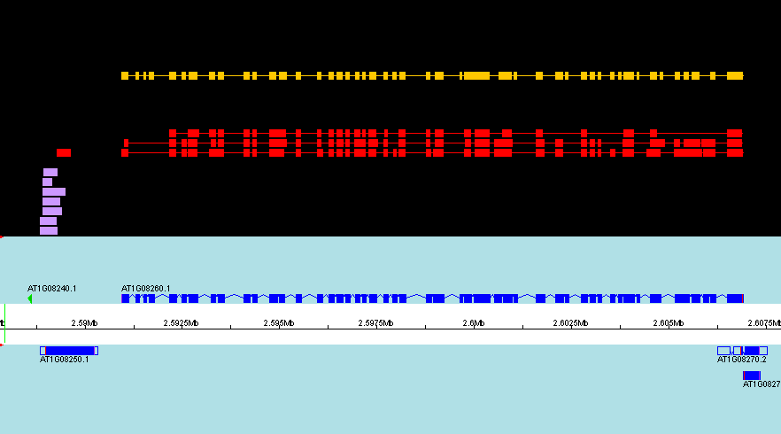
Complex gene structure

Slide 18
Gene Annotation Submission
Complex gene structure
Have a look at the current structure of that gene
Identify the suggested structure difference
Analyze evidence supporting the structure update
Update the gene structure

Slide 19
Gene Annotation Submission
Complex gene structure
Have a look at the current structure of that gene
Identify the suggested structure difference
Analyze evidence supporting the structure update
Update the gene structure

Slide 20
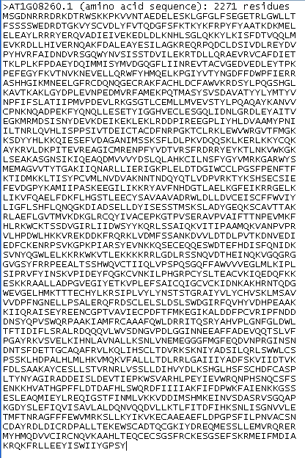
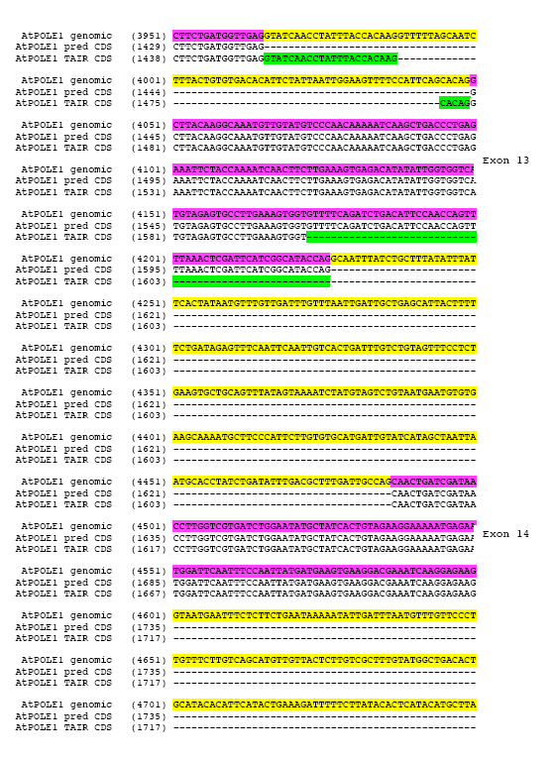
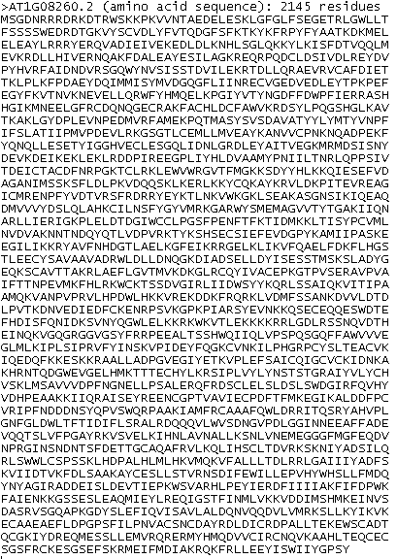
With a little help from the submitter…
Sequence
alignment

Slide 21
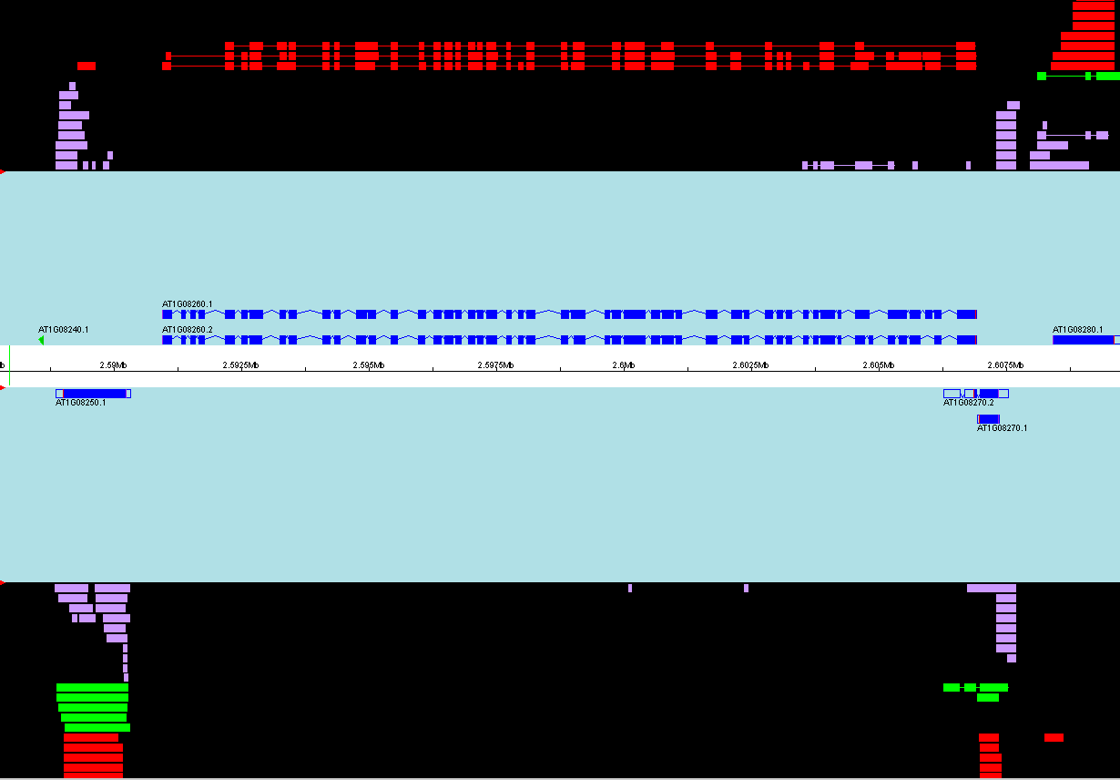

Slide 22
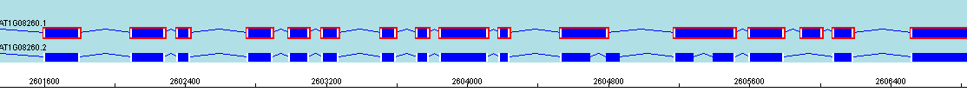

Slide 23
Gene Annotation Submission
Large datasets
Dataset name
# of genes
Dataset type
Ceres
26
Large set
Brendel
25
Large set
Rhoades
23
Specific gene type
miRNA
58
Specific gene type
uORFs
64
Specific gene type
Hanada
687
Specific genen type
Gnomon
326
Genome wide predictions
Eugene
34
Genome wide predictions

Slide 24
Integrating large gene structure datasets into the TAIR annotation
An active process
Gather evidence supporting the gene update
Read publication(s) if existing
Categorize genes based on strength of evidence
Load gene structures into Apollo
Decide which genes will be integrated into the TAIR annotation and which will be shown as track in Gbrowse

Slide 25
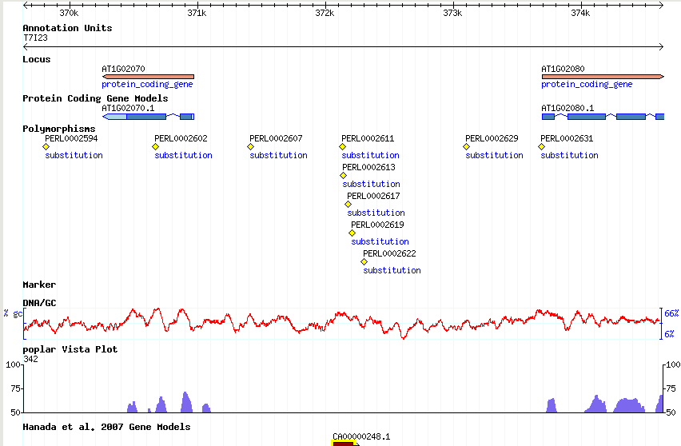
Example: Hanada et al 2007

Slide 26
Hanada et al 2007
  Constrained or Expressed 3633
  Constrained and Expressed 934
  overlap TAIR7 844
  overlap TE coordinates 768
  cluster within 350 bp 662

Slide 27
Hanada et al 2007
Conclusion
Of the 7159 genes
- 687 have been integrated into TAIR8
- 2946 are not integrated but are shown in a special Gbrowse track

Slide 28
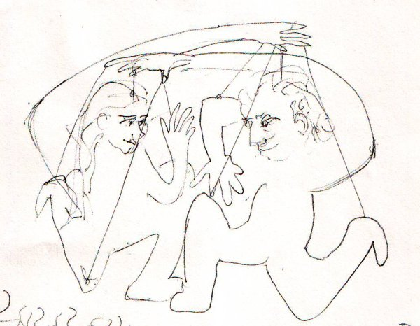
How to improve the user submission process
Encourage users to use submission forms
Improved gene structure submission form with additional columns for information regarding the structure update
Encourage users to use gff3 format, especially for large datasets
Encourage users to provide as much supporting evidence as possible along with their structural dataset
One-on-one sessions for scientists and curators at science conferences

Slide 29
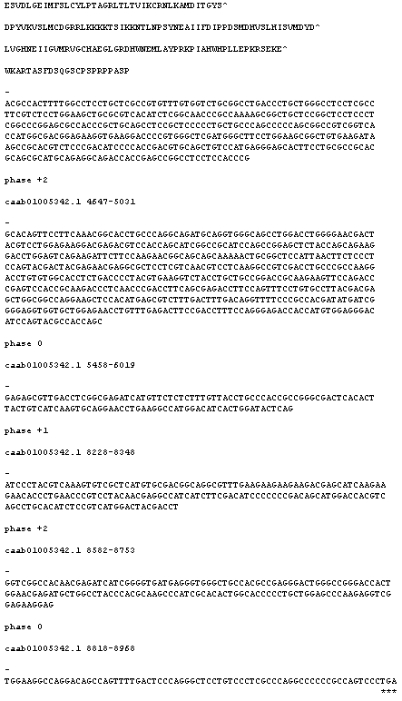
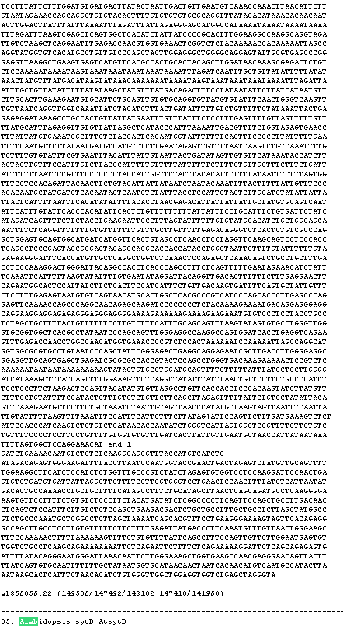
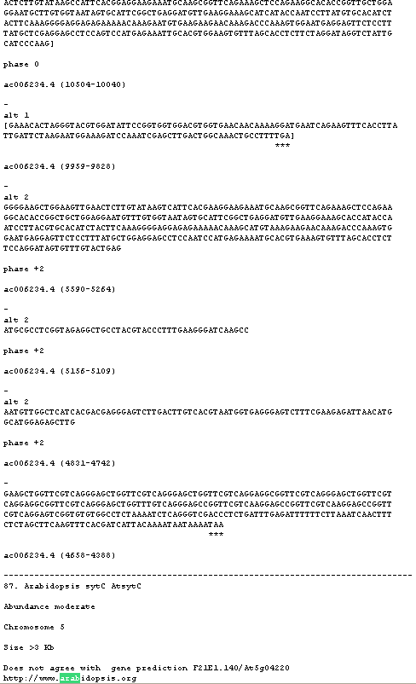
Non-formatted submissions

