Slide 1

GBrowse at TAIR
Philippe Lamesch
TAIR curator

Slide 2
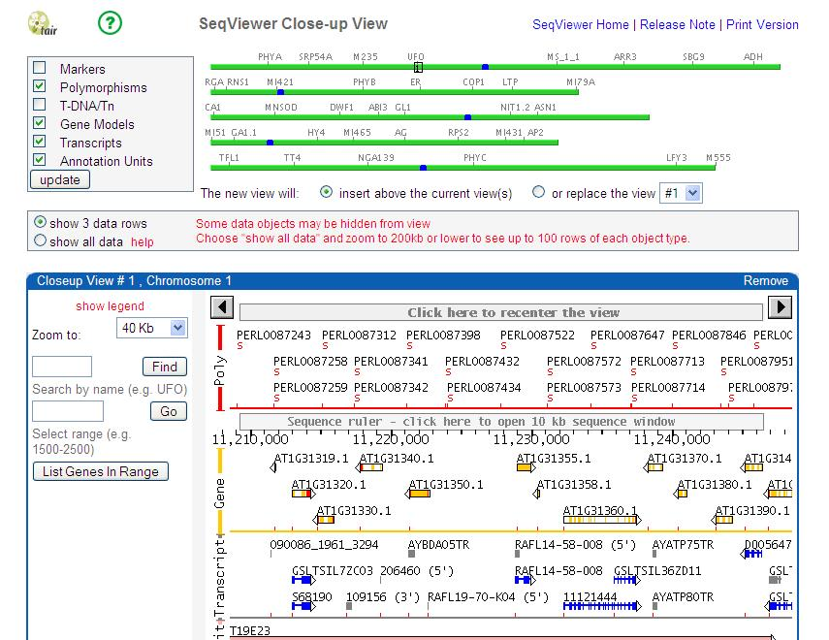
Seqviewer

Slide 3
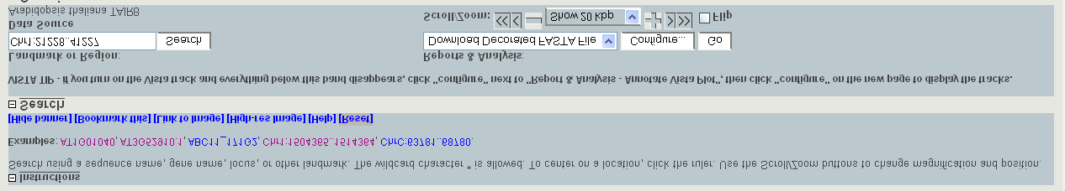
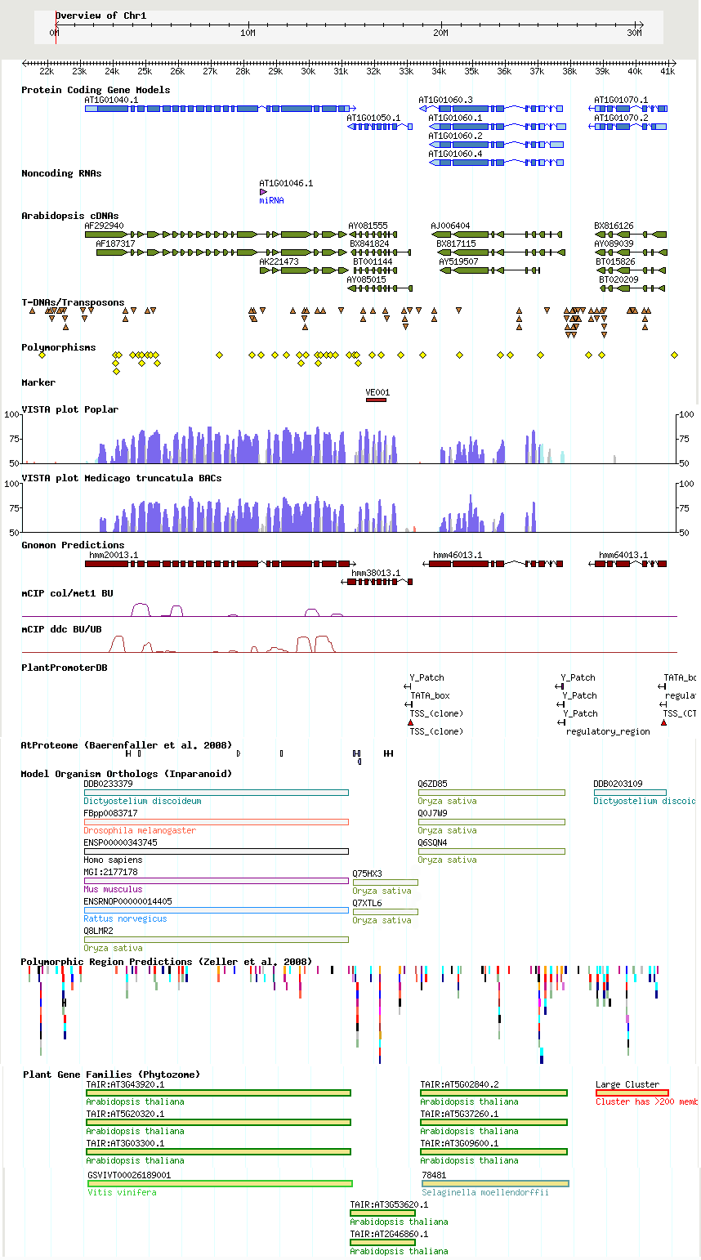
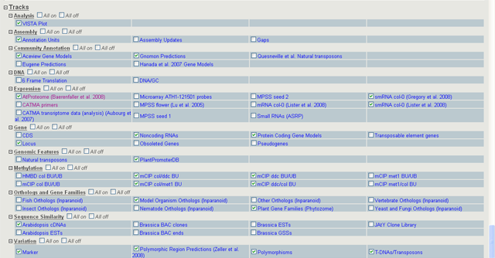
GBrowse
Header
Main Browser Window
Track Menu

Slide 4
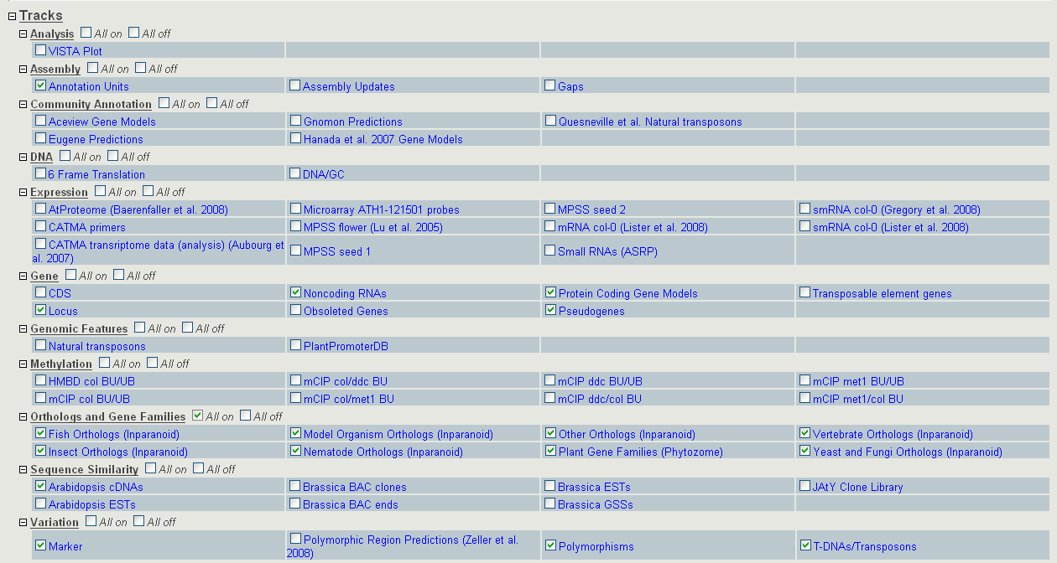
Track menu

Slide 5
TAIR GBrowse tracks
Gene
DNA
Community annotations
Sequence similarity
Assembly
Proteomics
Analysis
Expression
Orthologs & Gene Families
Variation
Genomic Features
Methylation

Slide 6
TAIR GBrowse tracks
Gene
DNA
Community annotations
Sequence similarity
Assembly
Proteomics
Analysis
Expression
Orthologs & Gene Families
Variation
Genomic Features
Methylation

Slide 7
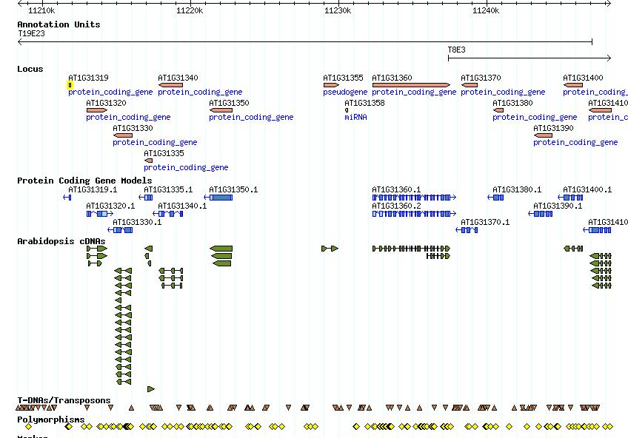
Genes

Slide 8
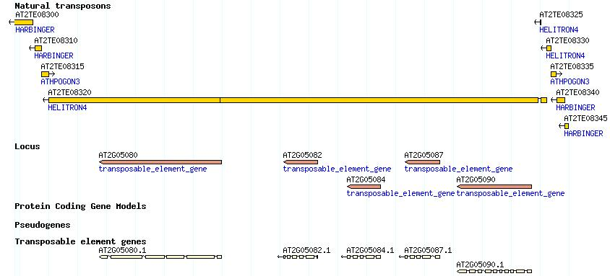
Transposon element genes

Slide 9
TAIR GBrowse tracks
Gene
DNA
Community annotations
Sequence similarity
Assembly
Proteomics
Analysis
Expression
Orthologs & Gene Families
Variation
Genomic Features
Methylation

Slide 10

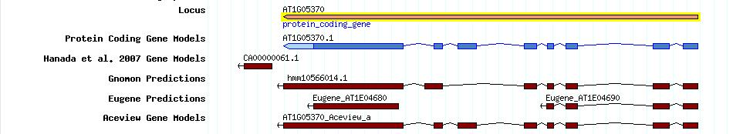
Alternative gene annotations
Eugene (transcript, proteins +) Sebastien Aubourg
Gnomon (transcript, proteins) Souvorov (NCBI)
Aceview (transcript) Thierry-Mieg (NCBI)
Hanada et al 2007 (3633 predicted genes)

Slide 11
TAIR GBrowse tracks
Gene
DNA
Community annotations
Sequence similarity
Assembly
Proteomics
Analysis
Expression
Orthologs & Gene Families
Variation
Genomic Features
Methylation

Slide 12
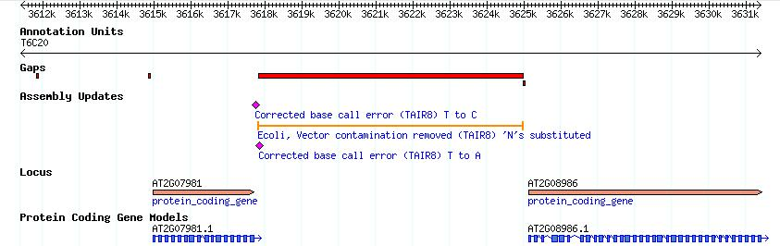
Assembly updates - GBrowse
Gaps

Slide 13
TAIR GBrowse tracks
Gene
DNA
Community annotations
Sequence similarity
Assembly
Proteomics
Analysis
Expression
Orthologs & Gene Families
Variation
Genomic Features
Methylation

Slide 14
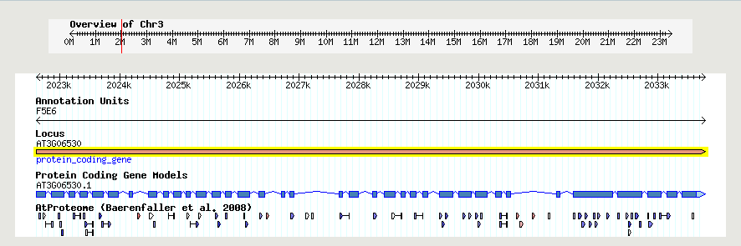
Proteomics Data
High-density Arabidopsis proteome map (Baerenfaller. 2008)

Slide 15
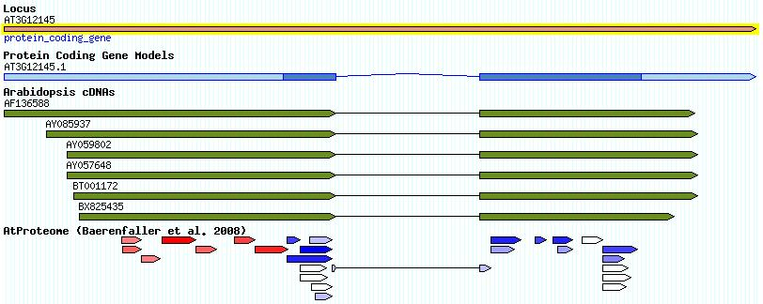
Proteomics Data

Slide 16
TAIR GBrowse tracks
Gene
DNA
Community annotations
Sequence similarity
Assembly
Proteomics
Analysis (Comparative)
Expression
Orthologs & Gene Families
Variation
Genomic Features
Methylation

Slide 17
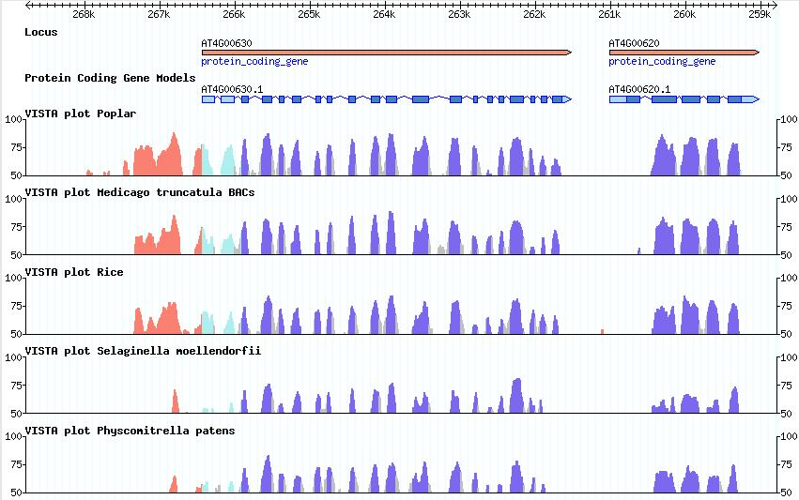
VISTA plot Gbrowse track
Dubchak et al

Slide 18
TAIR GBrowse tracks
Gene
DNA
Community annotations
Sequence similarity
Assembly
Proteomics
Analysis (Comparative)
Expression
Orthologs & Gene Families
Variation
Genomic Features
Methylation

Slide 19
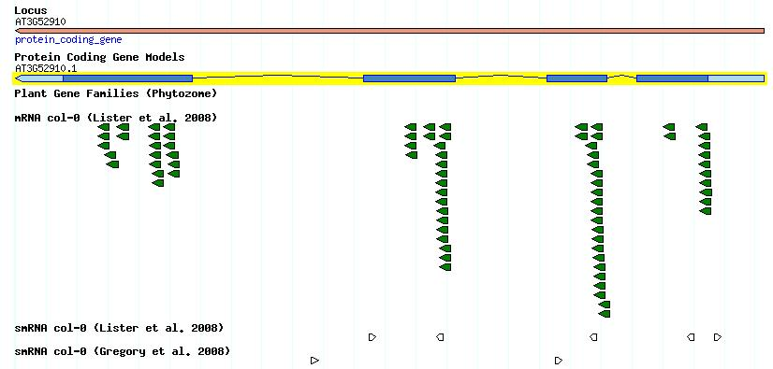
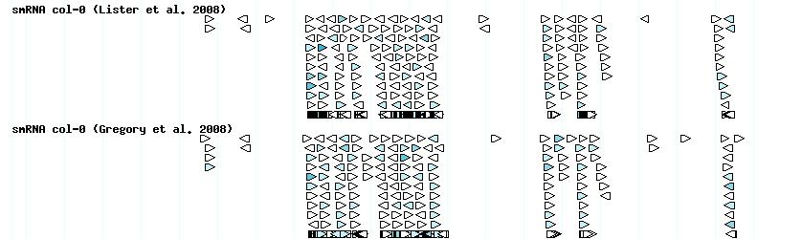
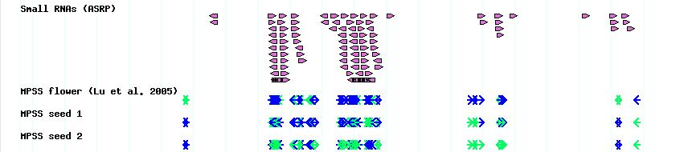
Transcriptome data

Slide 20
TAIR GBrowse tracks
Gene
DNA
Community annotations
Sequence similarity
Assembly
Proteomics
Analysis (Comparative)
Expression
Orthologs & Gene Families
Variation
Genomic Features
Methylation

Slide 21
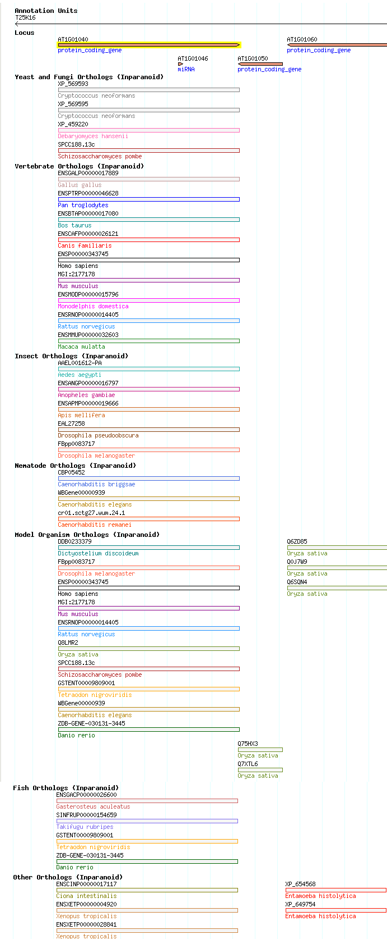
Orthologs and Gene Families
INSECTS
Aedes aegypti (Yellow fever mosquito)
Anopheles gambiae (Malaria mosquito)
Apis mellifera (Western honeybee)
Drosophila melanogster (Fly)
Drosophila pseudoobscura (Fly)
MAMMALS
Bos taurus (Cow)
Canis familiaris (Dog)
Homo sapiens (human)
Mus Musculus (mouse)
Gallus gallus (Chicken)
Macaca mulatta (Rhesus Macaque)
Monodelphis domestica (Opossum)
Pan troglodytes (Chimpanzee)
Rattus norvegicus (Rat)
YEAST
Candida gablata (Haploid yeast)
Cryptococcus neoformans (Yeast-like fungus)
Debaryomyces hansenii (Yeast)
Kluyveromyces lactis (Yeast)
Yarrowia lipolytica (yeast)
Schizosaccharomyces pombe (Fission yeast)
Saccharomyces cerevisiae (Budding yeast)
FISH
Takifugu rubripes (Pufferfish/Fugu)
Tetraodon nigroviridis (Pufferfish/Green-spotted)
Gasterosteus aculeatus (Stickleback)
Danio rerio (Zebrafish)
NEMATODES
Caenorhabditis elegans (Nematode)
Caenorhabditis briggsae (Nematode)
Caenorhabditis remanei (Nematode)
PLANTS
Oryza sative (rice)
OTHER
Xenopus tropicalis (Frog)
Ciona intestinalis (Sea squirt)
Entamoeba histolytica (Amoebozoa)
Dictyostelium discoideum (Slime mold)

Slide 22
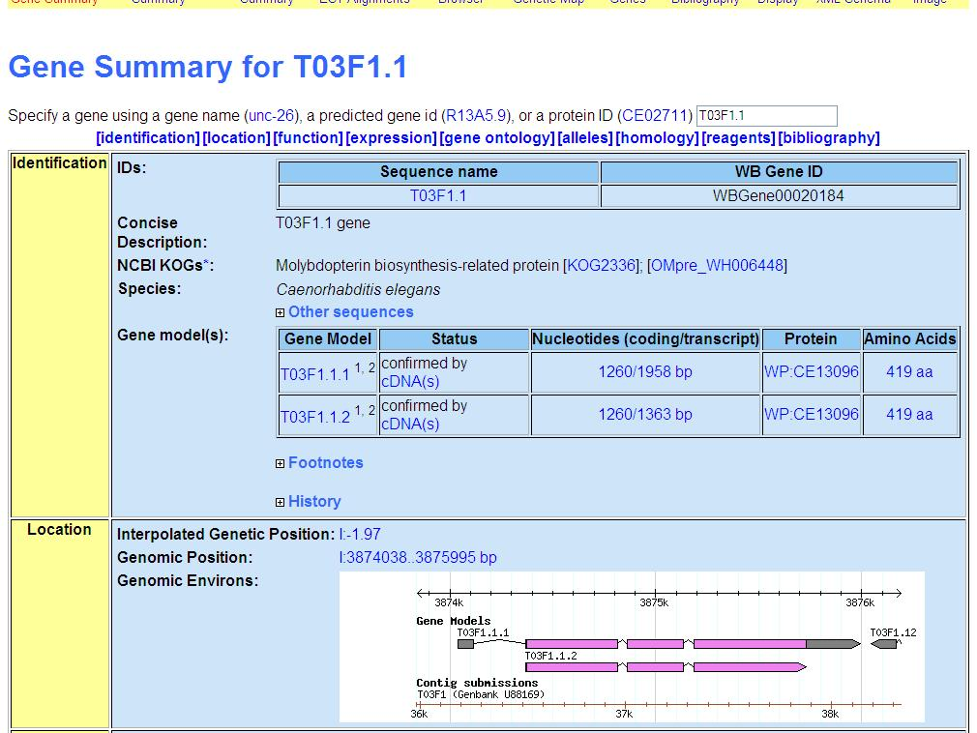
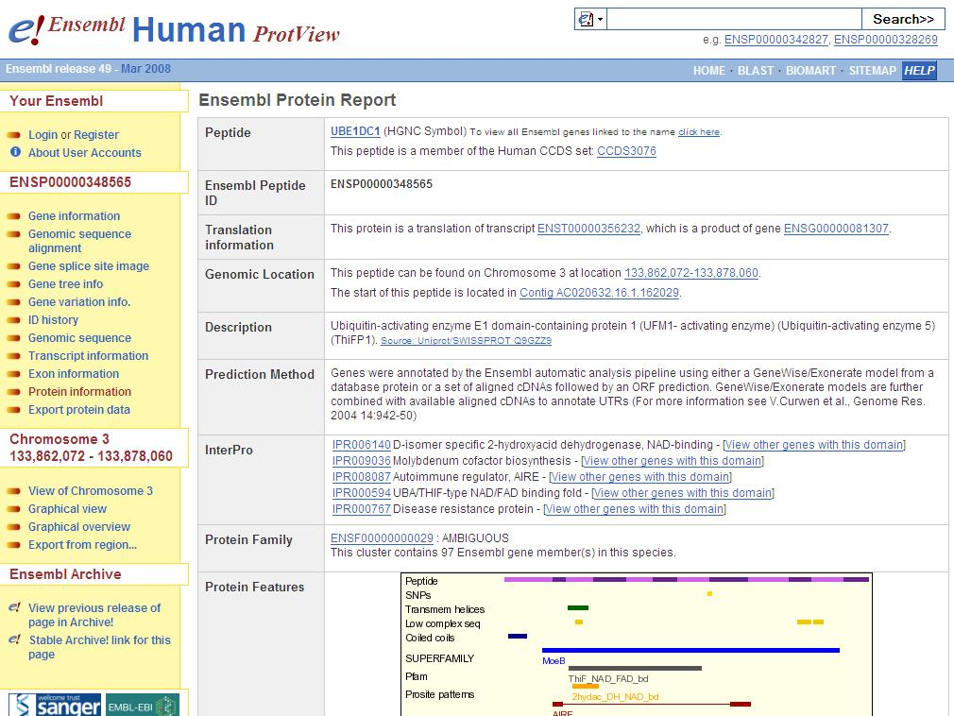
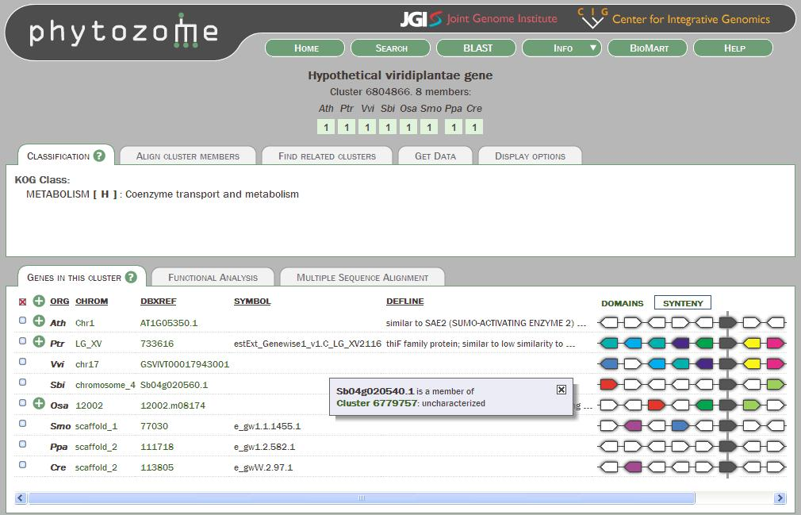
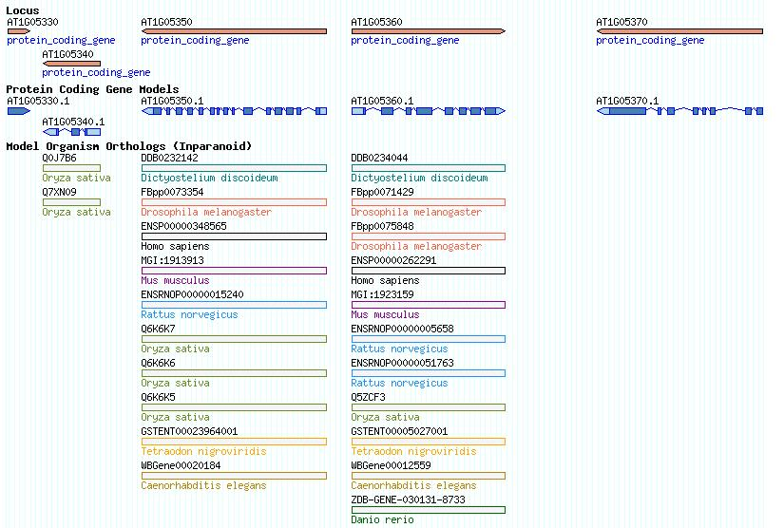
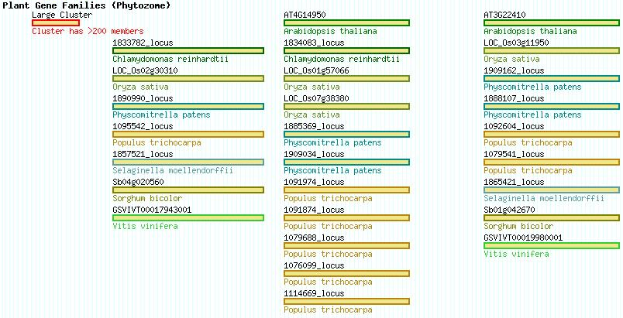
Orthologs and Gene Families

Slide 23
TAIR GBrowse tracks
Gene
DNA
Community annotations
Sequence similarity
Assembly
Proteomics
Analysis (Comparative)
Expression
Orthologs & Gene Families
Variation
Genomic Features
Methylation

Slide 24
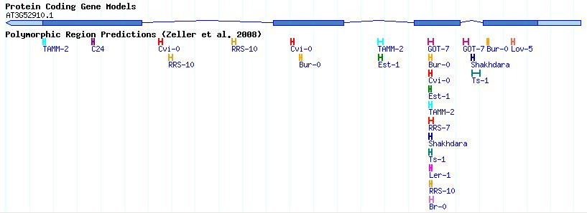
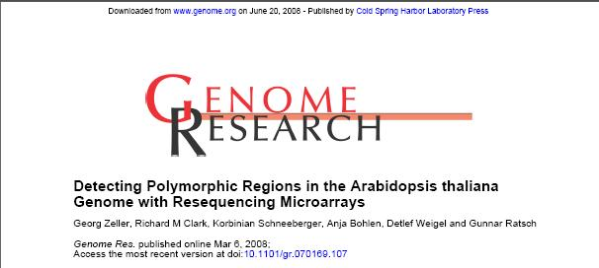
Variation

Slide 25
TAIR GBrowse tracks
Gene
DNA
Community annotations
Sequence similarity
Assembly
Proteomics
Analysis (Comparative)
Expression
Orthologs & Gene Families
Variation
Genomic Features
Methylation

Slide 26
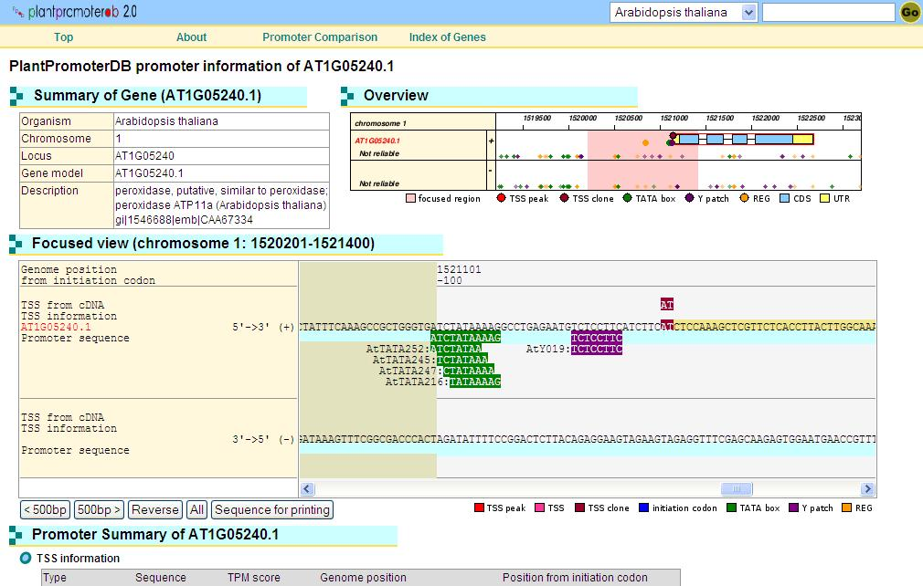
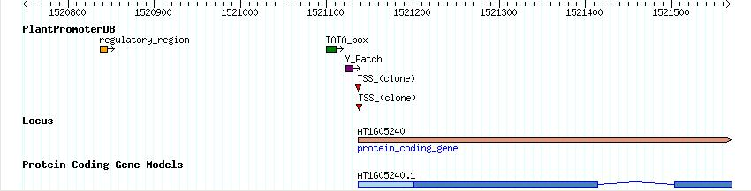
Promoter Elements

Slide 27
TAIR GBrowse tracks
Gene
DNA
Community annotations
Sequence similarity
Assembly
Proteomics
Analysis (Comparative)
Expression
Orthologs & Gene Families
Variation
Genomic Features
Methylation

Slide 28
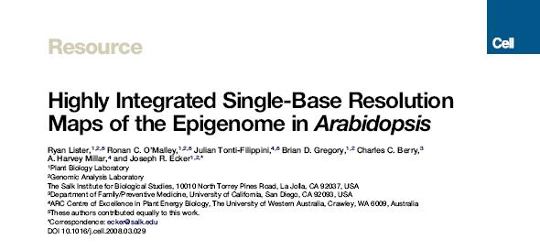
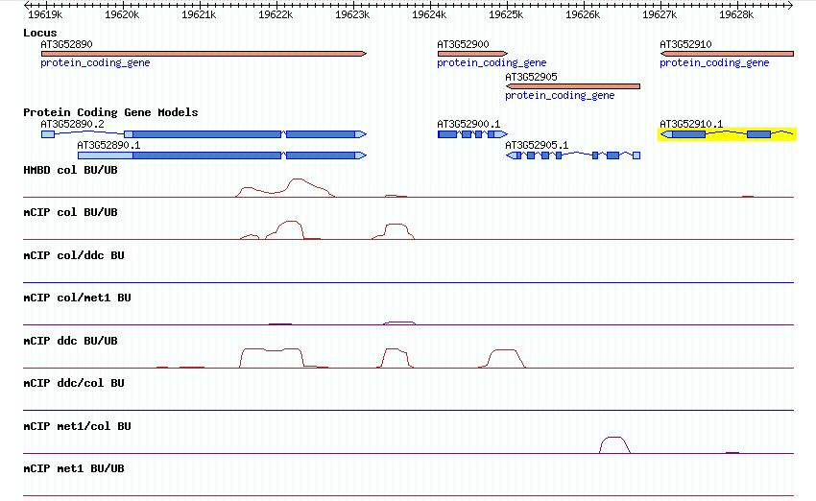
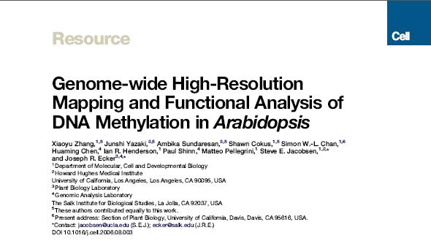
Methylation

Slide 29
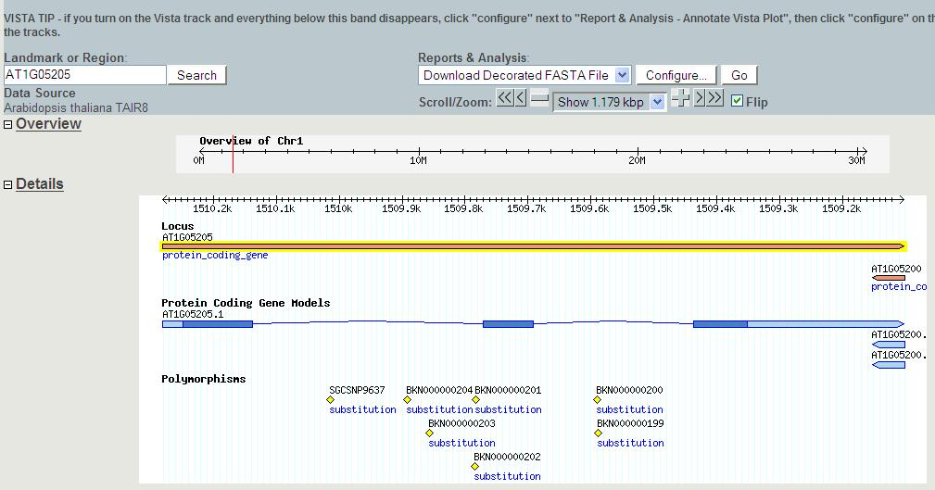
Decorated Fasta file

Slide 30
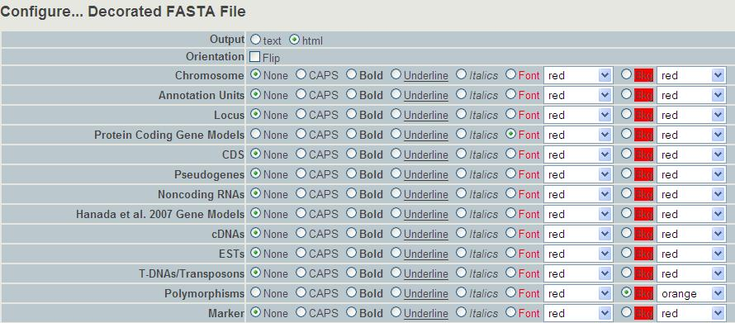
Decorated Fasta file

Slide 31
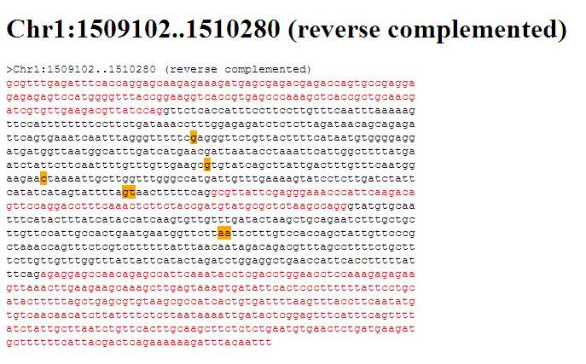
Decorated Fasta file

