Slide 1

Gene Structure Annotation
International Arabidopsis conference
July 23, 2008, Montreal
Philippe Lamesch

Slide 2

TAIR: An overview
Gene
structure
Gene
function
Metabolic
pathways
Philippe
Lamesch
Debbie
Alexander
Kate
Dreher

Slide 3


TAIR: An overview
ESTs, cDNAs
User
submissions
New
release
Computational pipeline
Manual annotation
TAIR web
Internal TAIR projects

Slide 4
Outline
Overview of TAIR8
  Data availability
  Assembly updates
  Transposable elements
Plans for TAIR9
  Gene confidence
  Utilising comparative, proteomic and transcriptome data

Slide 5
TAIR8 Release
33,282 total genes
1291 new genes
50 obsolete genes
Merge 41, Split 33
23% (7380) TAIR7 genes updated
Source of updates
  Submission from community (reviewed by TAIR)
  Manual annotation in-house
  Computational pipeline (PASA)

Slide 6
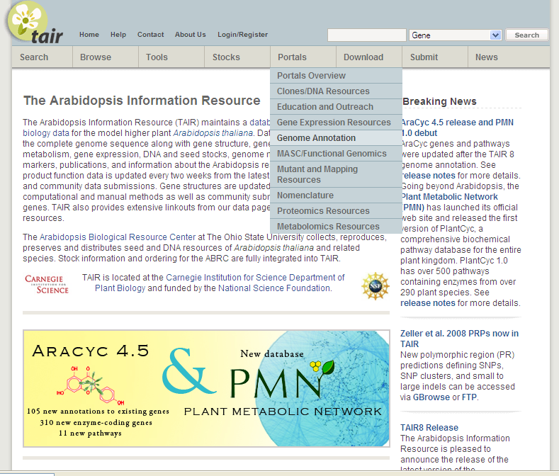
Genome Annotation Portal
http://www.arabidopsis.org/portals/genAnnotation/gene_structural_annotation/annotation_data.jsp

Slide 7
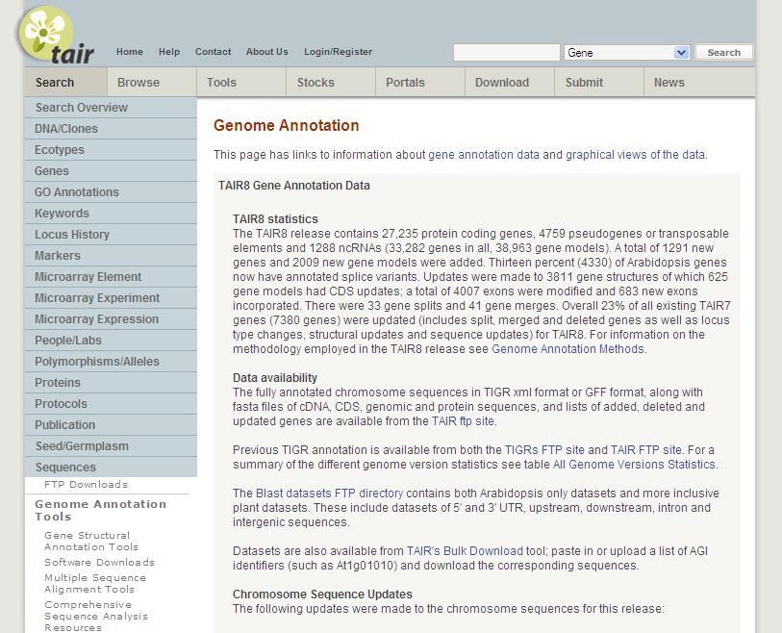
Genome Annotation Portal
http://www.arabidopsis.org/portals/genAnnotation/gene_structural_annotation/annotation_data.jsp

Slide 8
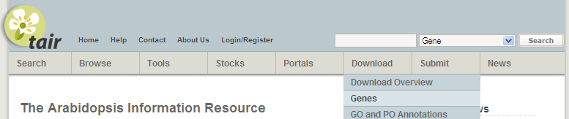
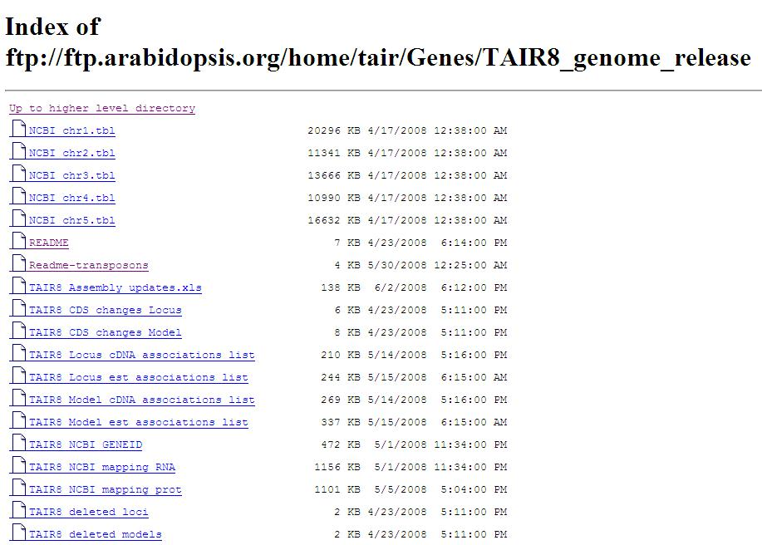
Sequences and information, TAIR FTP
ftp://ftp.arabidopsis.org/home/tair/Genes/TAIR8_genome_release/
Sequences
GFF/XML/NCBI .tbl
Updates
Conversion files
Associations

Slide 9
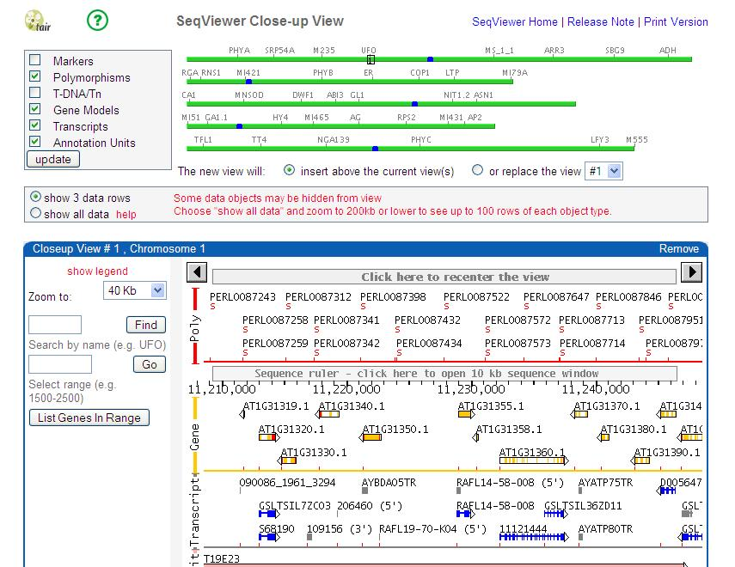
Browse the genome
Seqviewer
Data types

Slide 10
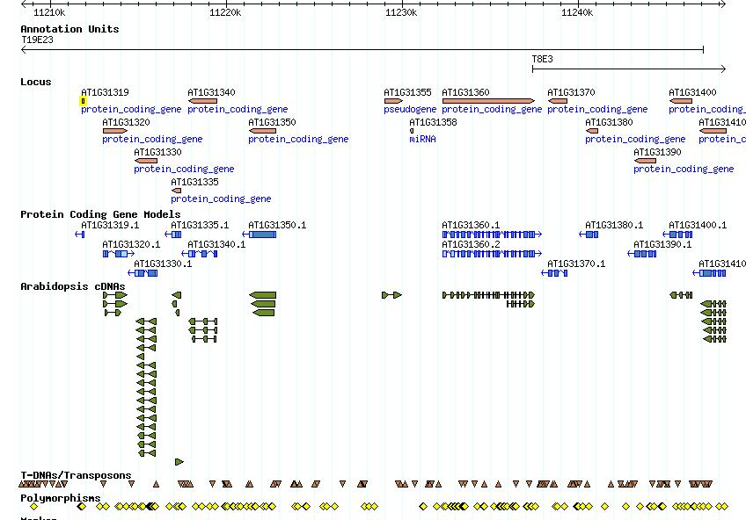
Browse the genome
GBrowse
Data types >50 tracks

Slide 11
Changes made for TAIR8
Assembly updates
  Remove sequence contamination
  Single base pair errors
Addition of Transposable elements

Slide 12
Assembly updates
Genome assembly unchanged since TIGR5 (prior to TAIR8)
Remove sequence contamination
  Vector = NCBI VecScreen, Webcutter 2.0
  Ecoli = Megablast v Ecoli(nr)
  Rice = Community
    Vector/Ecoli = 12 regions
    Rice = 2 regions
    Equivalent #Ns substituted
    8 genes set to obsolete, 2 modified

Slide 13
Assembly updates
Single base pair errors
  Solexa read data (Columbia) supplied by Joe Ecker’s Lab (Salk institute)
    1425 bases changed
      called 2 or greater, % of time consensus base is called is >=75%)
      no minority read support/no ler support
      Confirmed base changes where overlap current annotation

Slide 14
Assembly updates
Single base pair errors
  1425 bases changed
    157 gene model protein sequences updated
    518 had either protein/CDS,mRNA or genomic sequence updated
Notes:
Affected protein seq of 1425 genes

Slide 15
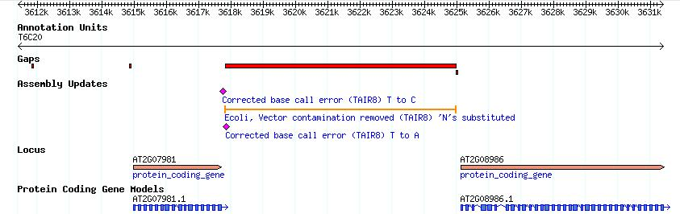
Assembly updates - GBrowse
Gaps

Slide 16
Transposable Elements (TE) & TE-genes
31,060 elements, 339 families, 17 superfamilies Hadi Quesneville Institut Jacques Monod (Buisine et al. Genomics, 2008)
Combines evidence from multiple homology-based predictions
Notes:
Many of these transposons overlap with trans element genes
Many might not know this but as of TAIR7 we did not have any gene type called transposable lement gene
Transposable element genes in TAIR 7 were all classified as pseudogenes
Hence we were faced with the challenge of coming up with criteria of how to define a set of transposable element genes

Slide 17
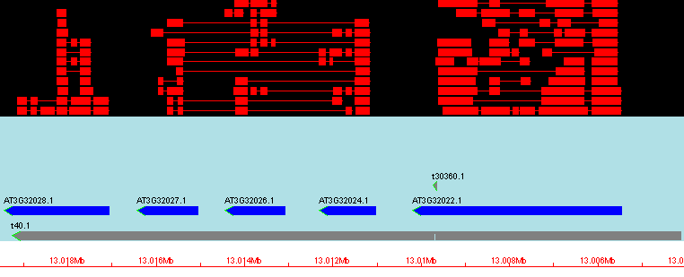
Overlapping TEs
Protein alignments
Unknown pseudogenes
Transposable Element
HELITRON4 family DNA transposon

Slide 18
Overlapping TEs
Protein alignments
Unknown pseudogenes
Transposable Element
HELITRON4 family DNA transposon
In TAIR7
    pseudogenes and transposable elements all part of ‘pseudogene class’
  no defined ‘transposable element’ type
  not all TE-genes have TE descriptions

Slide 19
Identifying TE-genes
Categorization as TE-gene
  By % Overlap with TE (100, >70, >50, below 50)
  Similarity to set of Known TE-proteins
  Manual review
  Additional checks (description, GO terms, publications, transcript evidence)
  3900 AGI genes were reclassified (720 previously classed as protein coding)

Slide 20
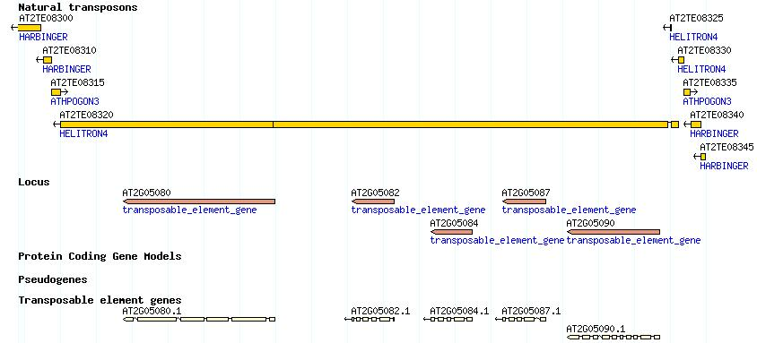
Transposons & TAIR
TE given ID
  AT2TE08320
31,189 TEs, 3900 TE-genes

Slide 21
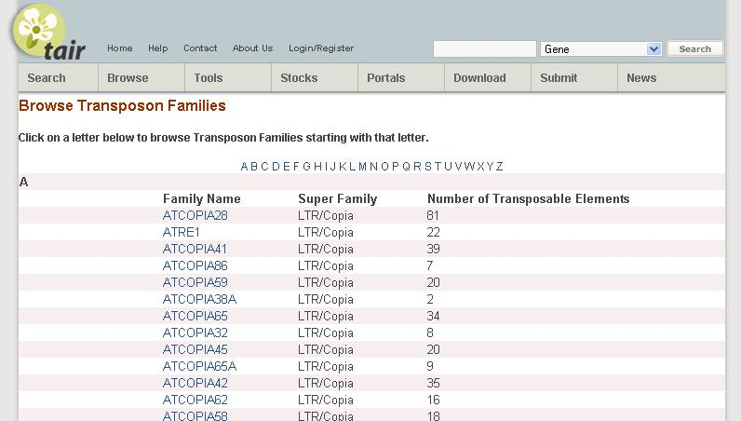
Transposons & TAIR

Slide 22
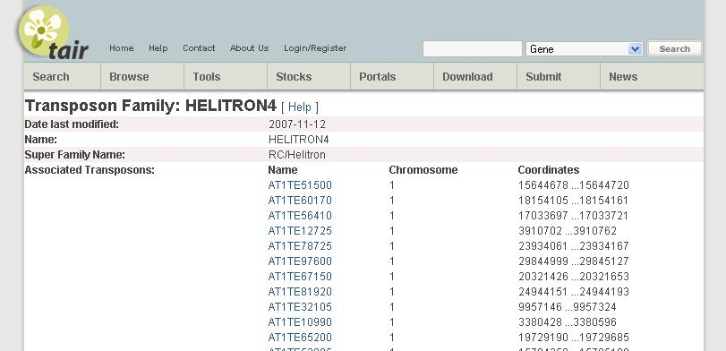
Transposons & TAIR

Slide 23
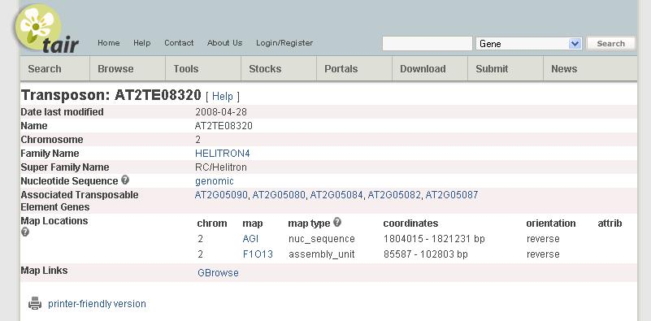
Transposons & TAIR

Slide 24
Plans for TAIR9

Slide 25
Gene confidence score
Why assign a confidence score?
  Differentiates well supported, partially supported and non-supported models
    Allows TAIR users to target particular categories
      For further experimentation
      For use as a reference set
      For computational analysis
    Allows TAIR to target partially supported genes
    Provides a measure with which to monitor improvement
Notes:
Refelcting to what extend a gene structure is covered and confirmed by experimental data

Slide 26
Gene confidence outline
Categories of evidence
  Transcript (cDNA/EST)
  Protein
  Conservation
  Proteomic data
  Transcriptome data (MPSS etc)
Rankings within category
Assign confidence score/rank to model + exons

Slide 27
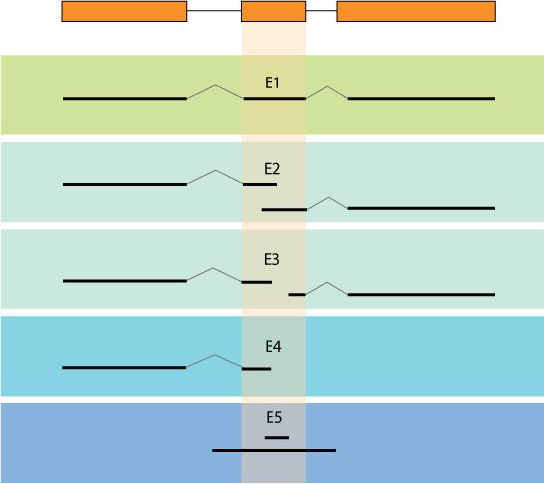
Transcript exon rankings - internal
Splice sites confirmed by transcript
Intermediates
Transcript only overlaps exon

Slide 28
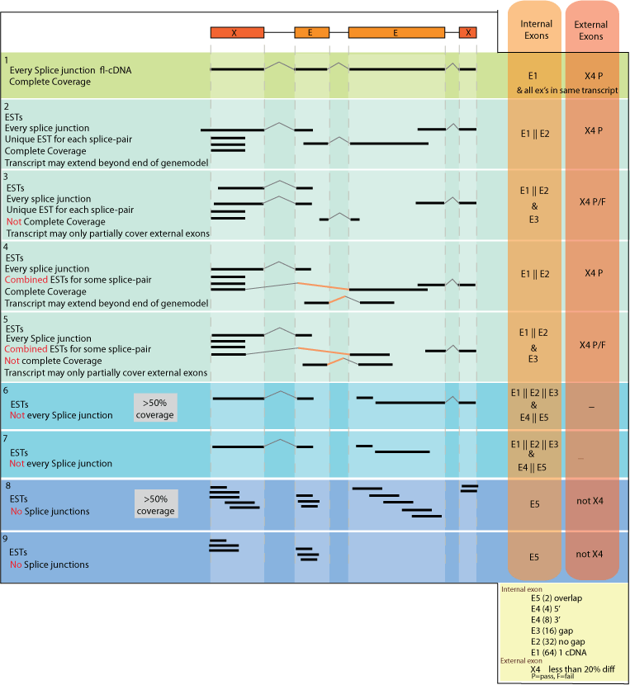
Transcript Model rankings
Intermediates
Intermediates
Notes:
Once scores have been assigned to all exons of a transcript, the score of the transcript itself can be extrapolated from the sum of its exon scores

Slide 29
Gene confidence outline
Rank
Provide evidence ranks on web pages/GFF
  Transcript (cDNA/EST) 7
  Protein 2
  Conservation 2
  Proteomic data 0
  Transcriptome data (MPSS etc) 0
  Include overall rank (incorporating all evidence)
    Associate general description to each overall rank
      e.g. Confirmed, partially confirmed or Platinum, Gold, Silver etc
    Exon ranks included in GFF file

Slide 30
Improving genome annotation: a collective approach
Gene confidence
score
Possible
misannotated
genes
Notes:
Confidence score indicator …

Slide 31
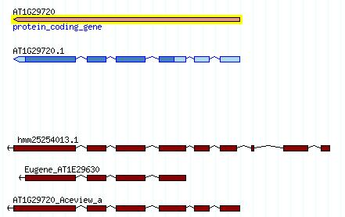
Improving genome annotation: a collective approach
Alternative
gene models:
Gnomon
Aceview
Eugene
Hanada et al
Gene structure updates
Alternative splice variants
Possible
misannotated
genes

Slide 32
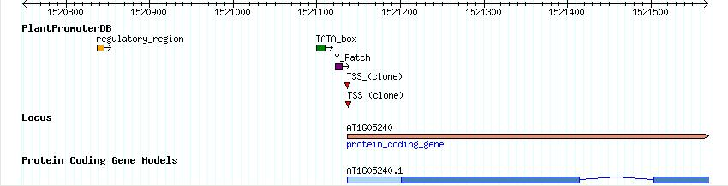
Improving genome annotation: a collective approach
Update TSS
Possible
misannotated
genes
PlantPromoter
elements
Yamamoto et al

Slide 33
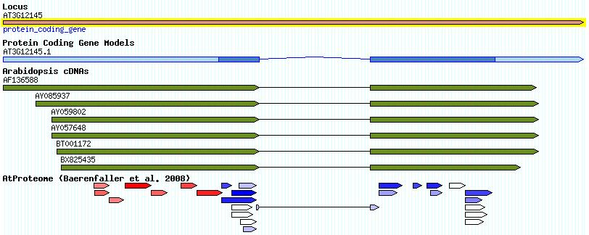
Improving genome annotation: a collective approach
Update gene on translational level
Possible
misannotated
genes
Proteomics data
Incorrect start codon
Baerenfaller et al

Slide 34
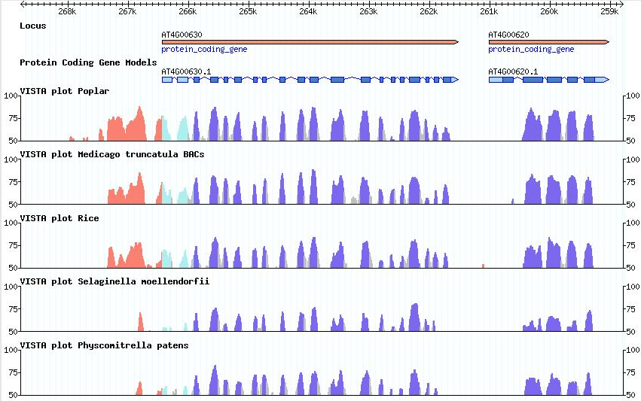
Improving genome annotation: a collective approach
Identify missing exons/genes
Possible
misannotated
genes
Cross-species
sequence
conservation
VISTA plots
(Dubchak Lab)

Slide 35
A collective approach
Gene confidence, identify weakly supported genes
Utilise alt. gene predictions, comparative alignments, transcriptome and proteomic data
Combined manual and computational approach

