Slide 1

Part I: Tips and Techniques from curators
GBrowse at TAIR
David Swarbreck

Slide 2
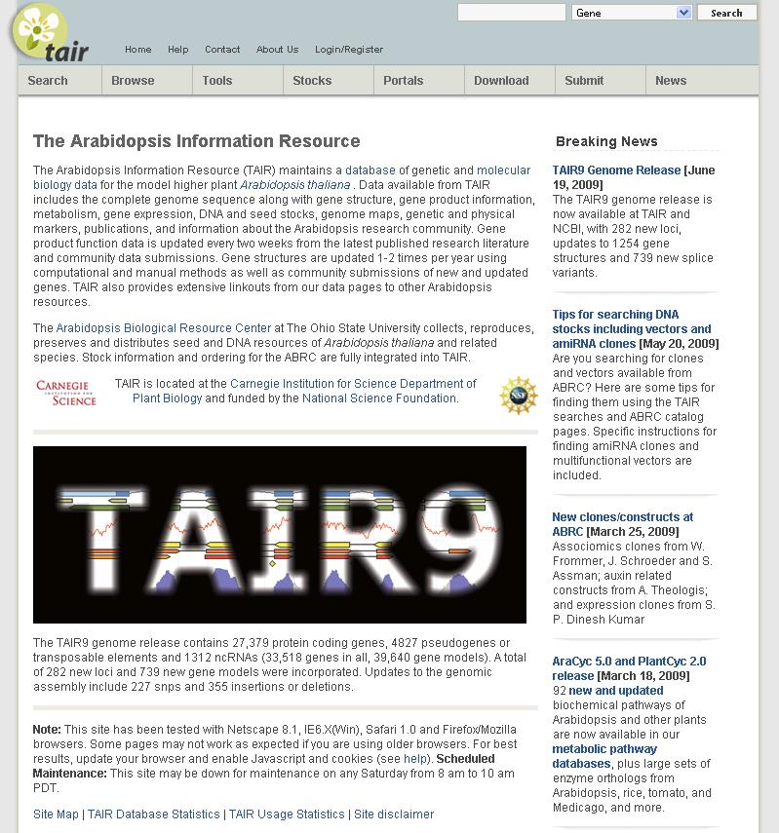
TAIR9 Genome Release

Slide 3
TAIR9 - Sources of data
New cDNA/EST data, x-species alignments
Updates from proteome data
    Baerenfaller et al., 2008 and Castellana et al., 2008
Analysis of pseudopipe annotations
    Mark Gerstein’s lab
Analysis of alternative gene predicitions
    Gnomon - Alexandre Souvorov
    Eugene - Sébastien Aubourg
    Aceview - Jean Thierry-Mieg

Slide 4
TAIR9 Genome release
282 new loci, 739 new gene models
1254 modified models, 774 CDS updates
1144 modified exons, 1056 new exons
Contains: 33518 genes total, 39640 gene models
    27,379 protein coding genes
    4827 pseudogenes/TE genes
    1312 ncRNAs

Slide 5
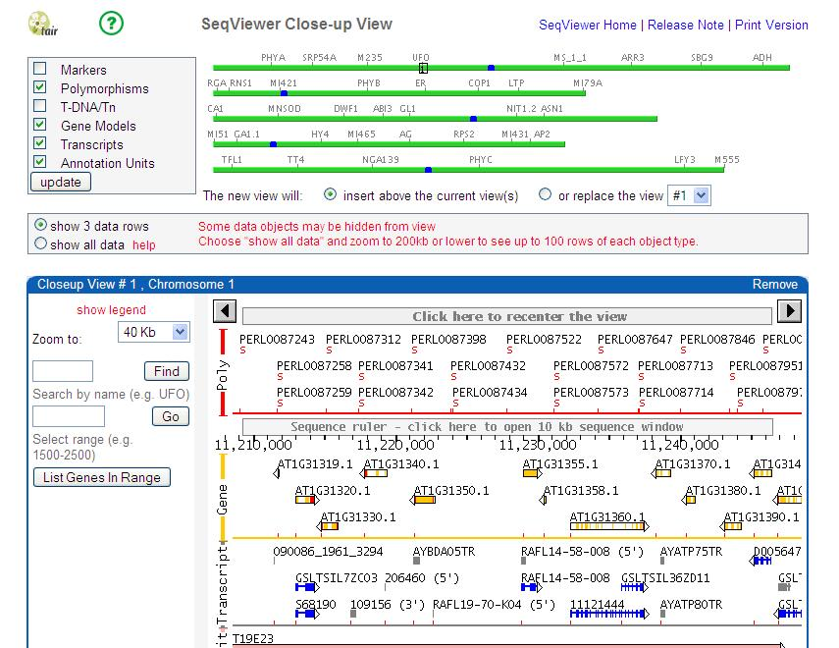
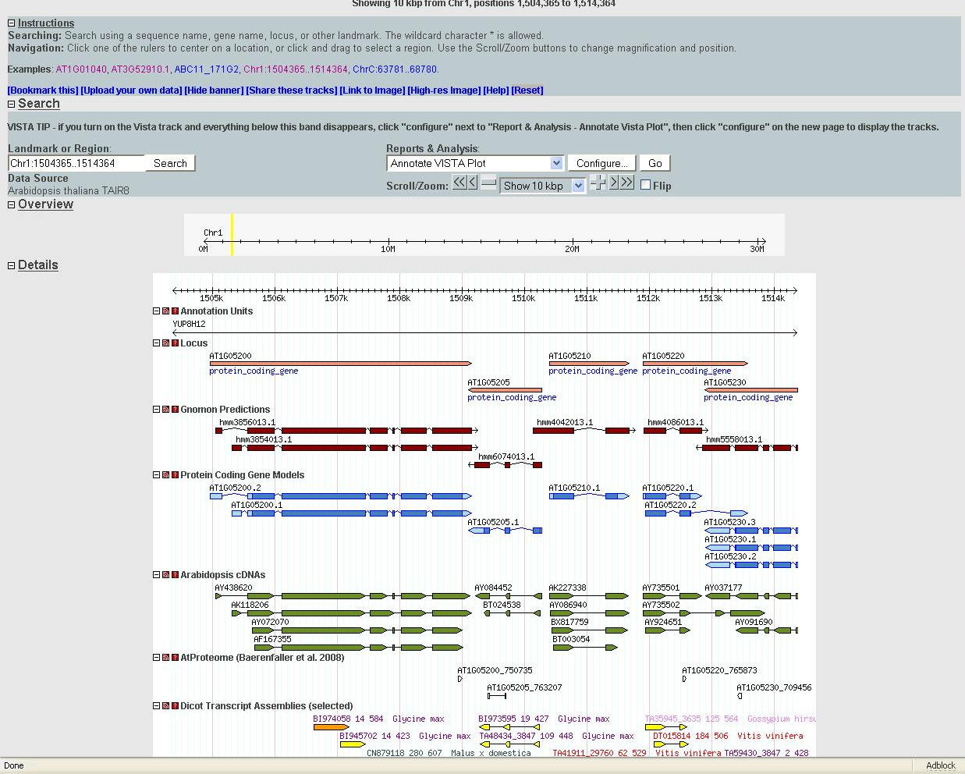
Genome Browsers at TAIR
Two options (Seqviewer & GBrowse)

Slide 6
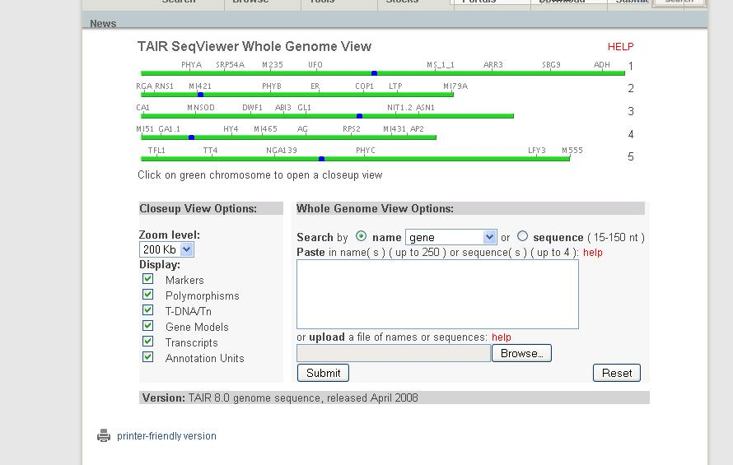
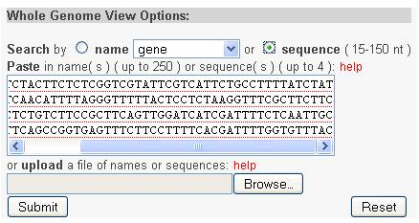
Seqviewer

Slide 7
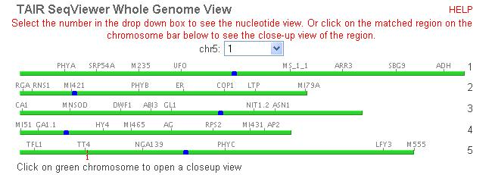
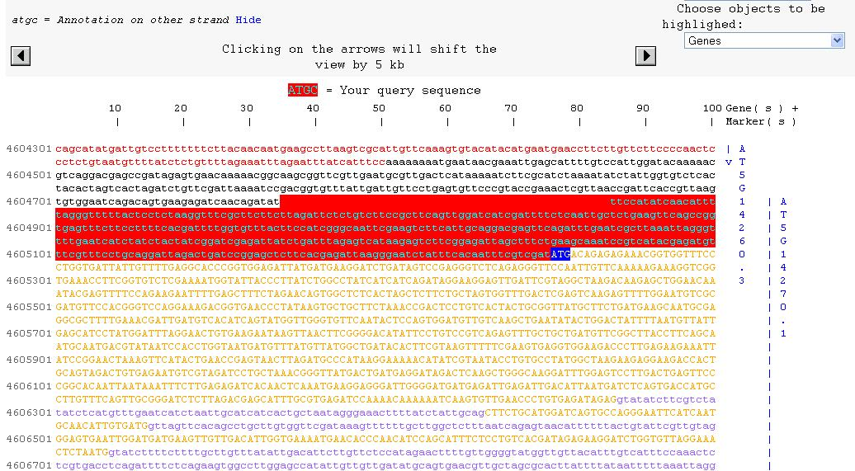
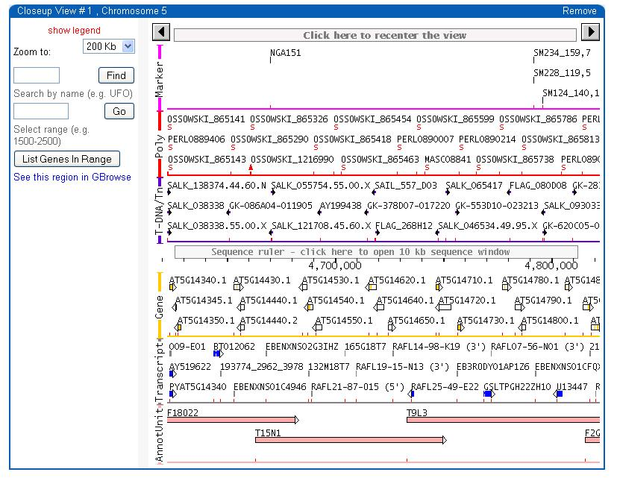
Seqviewer

Slide 8
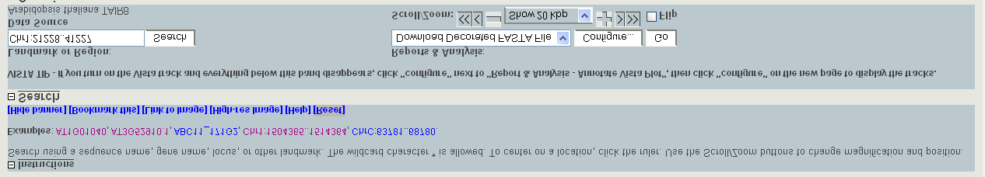
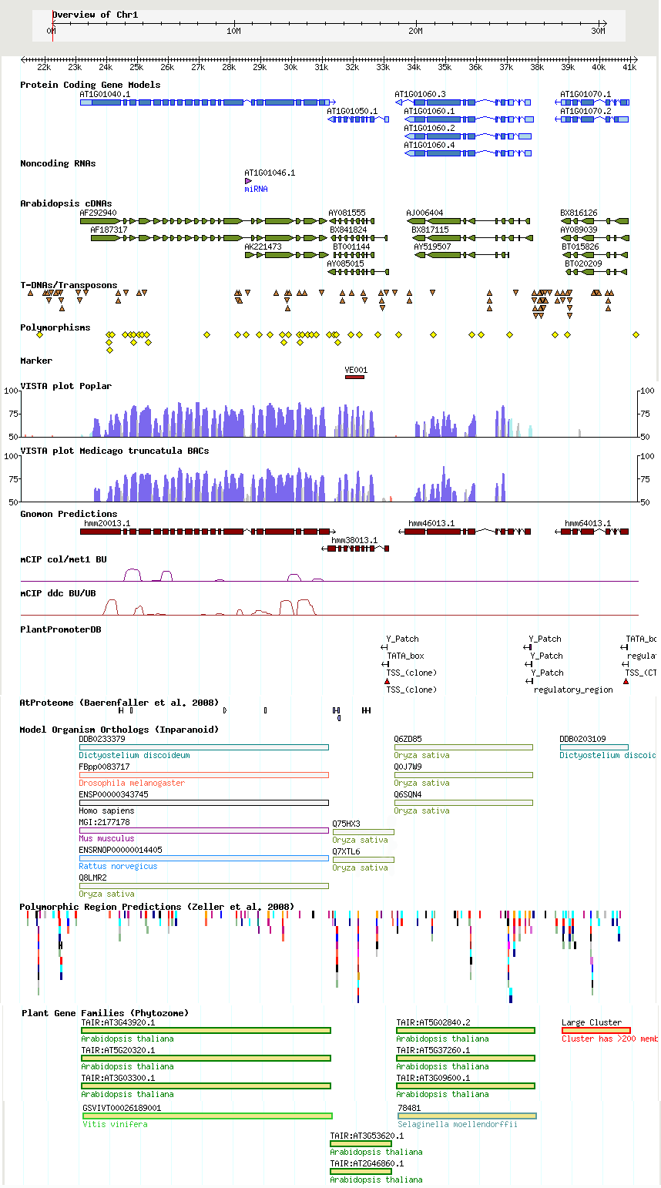
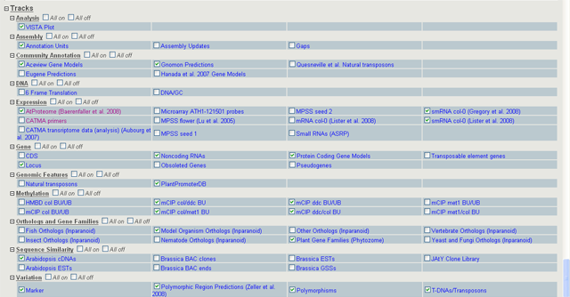
GBrowse
Header
Main Browser Window
Track Menu

Slide 9
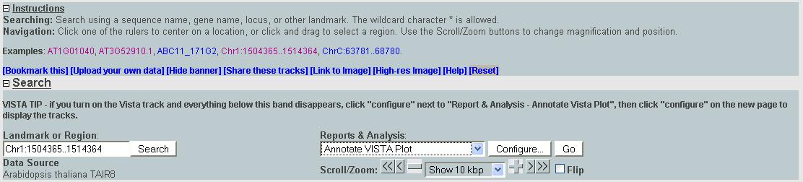
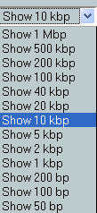
GBrowse - Header
Search by:
Feature Name AT1G01040
AY438620
Position Chr2:100500..102500
Configure Vista plot & fasta download

Slide 10
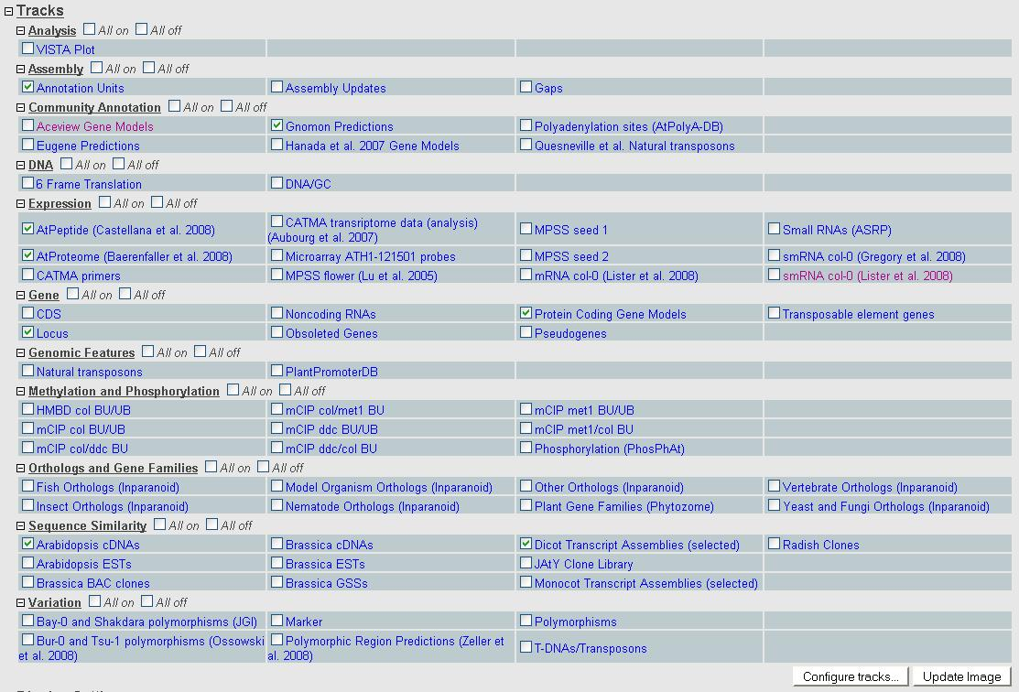
Track menu

Slide 11
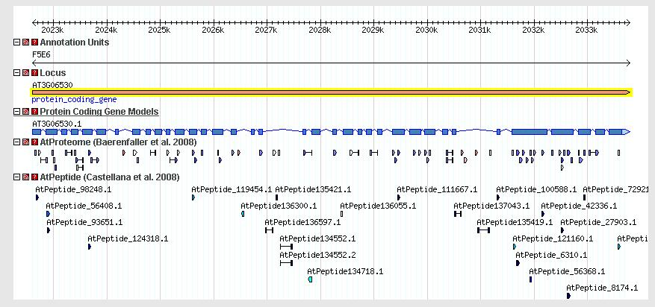
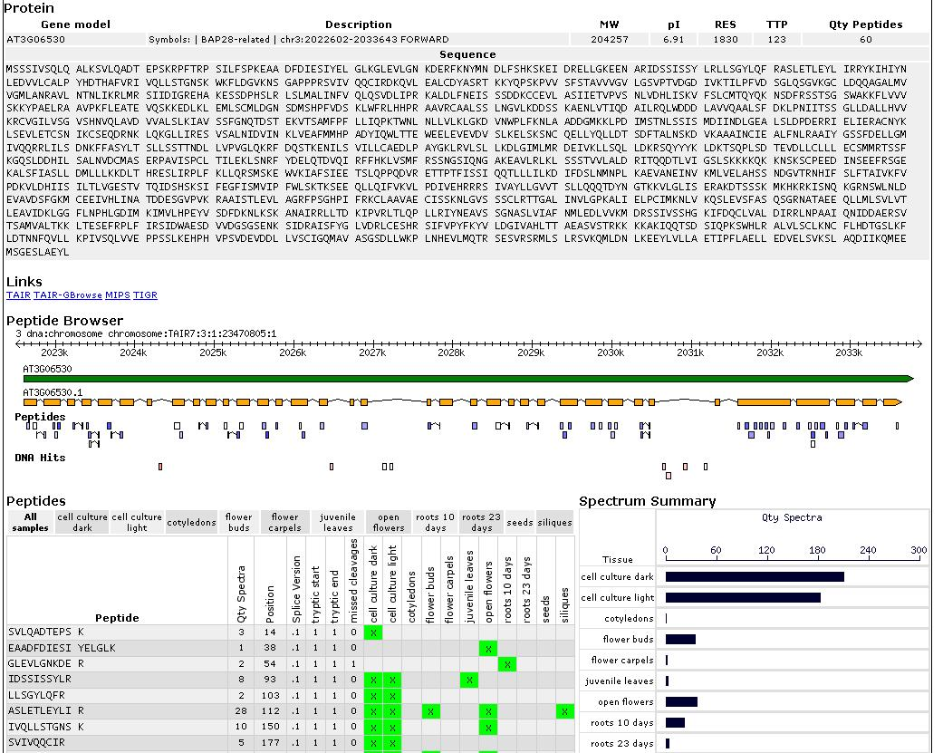
Proteomics Data
Baerenfaller 2008
Castellana et al. 2008

Slide 12
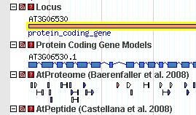
Reposition tracks

Slide 13


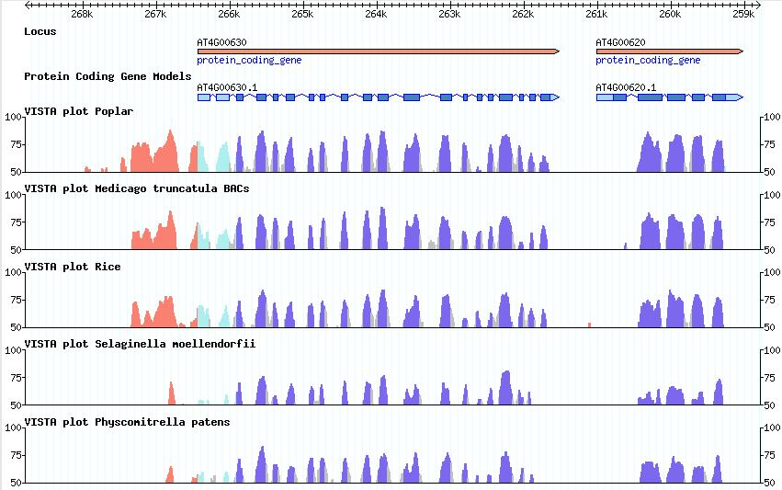
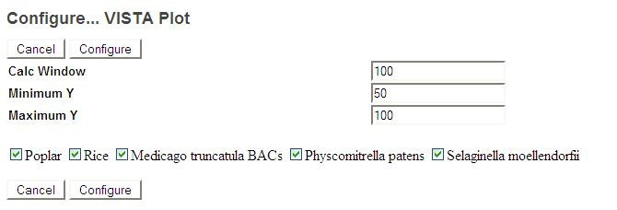
VISTA plot Gbrowse track
Dubchak et al

Slide 14
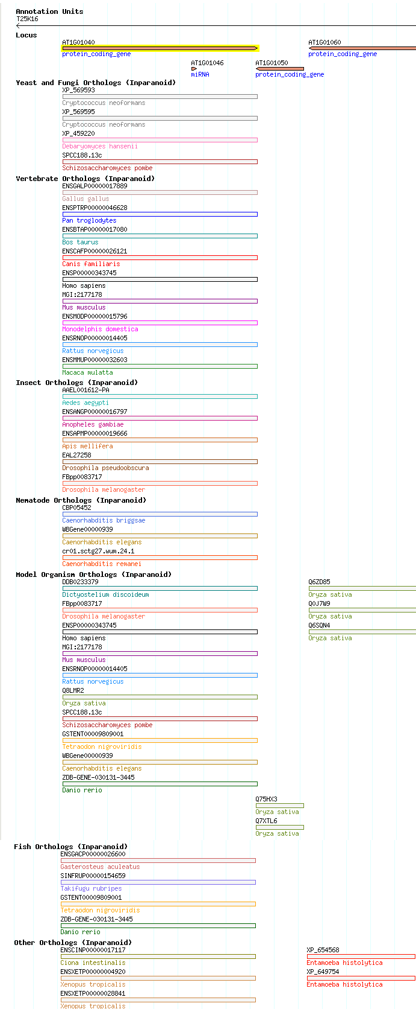
Orthologs and Gene Families
INSECTS
Aedes aegypti (Yellow fever mosquito)
Anopheles gambiae (Malaria mosquito)
Apis mellifera (Western honeybee)
Drosophila melanogster (Fly)
Drosophila pseudoobscura (Fly)
MAMMALS
Bos taurus (Cow)
Canis familiaris (Dog)
Homo sapiens (human)
Mus Musculus (mouse)
Gallus gallus (Chicken)
Macaca mulatta (Rhesus Macaque)
Monodelphis domestica (Opossum)
Pan troglodytes (Chimpanzee)
Rattus norvegicus (Rat)
YEAST
Candida gablata (Haploid yeast)
Cryptococcus neoformans (Yeast-like fungus)
Debaryomyces hansenii (Yeast)
Kluyveromyces lactis (Yeast)
Yarrowia lipolytica (yeast)
Schizosaccharomyces pombe (Fission yeast)
Saccharomyces cerevisiae (Budding yeast)
FISH
Takifugu rubripes (Pufferfish/Fugu)
Tetraodon nigroviridis (Pufferfish/Green-spotted)
Gasterosteus aculeatus (Stickleback)
Danio rerio (Zebrafish)
NEMATODES
Caenorhabditis elegans (Nematode)
Caenorhabditis briggsae (Nematode)
Caenorhabditis remanei (Nematode)
PLANTS
Oryza sative (rice)
OTHER
Xenopus tropicalis (Frog)
Ciona intestinalis (Sea squirt)
Entamoeba histolytica (Amoebozoa)
Dictyostelium discoideum (Slime mold)

Slide 15
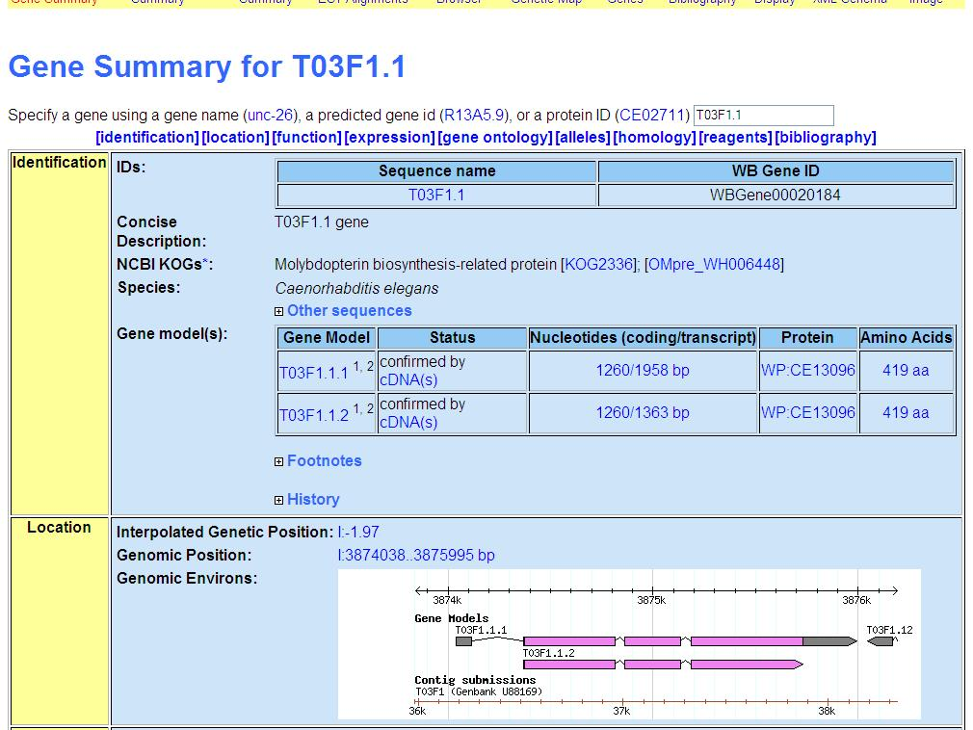
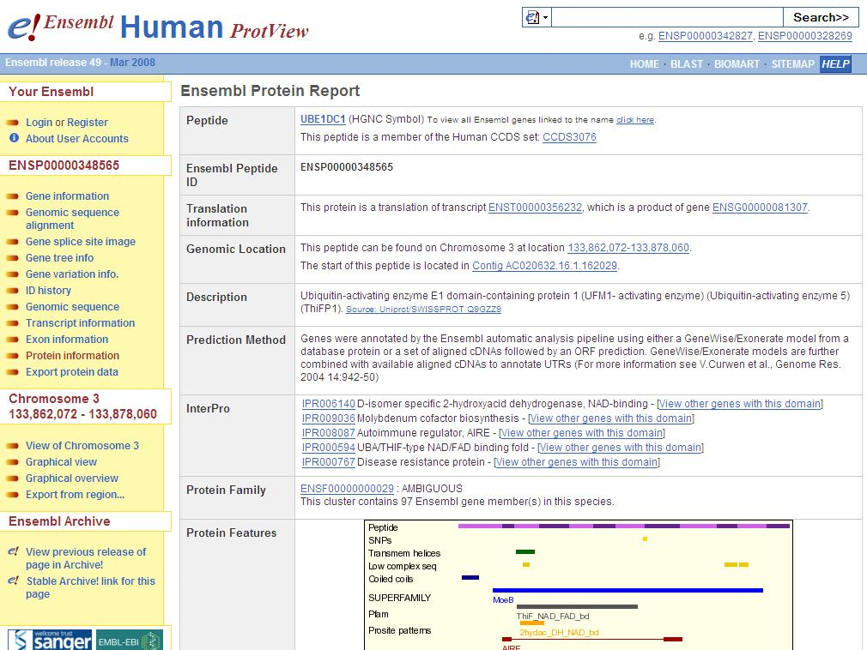
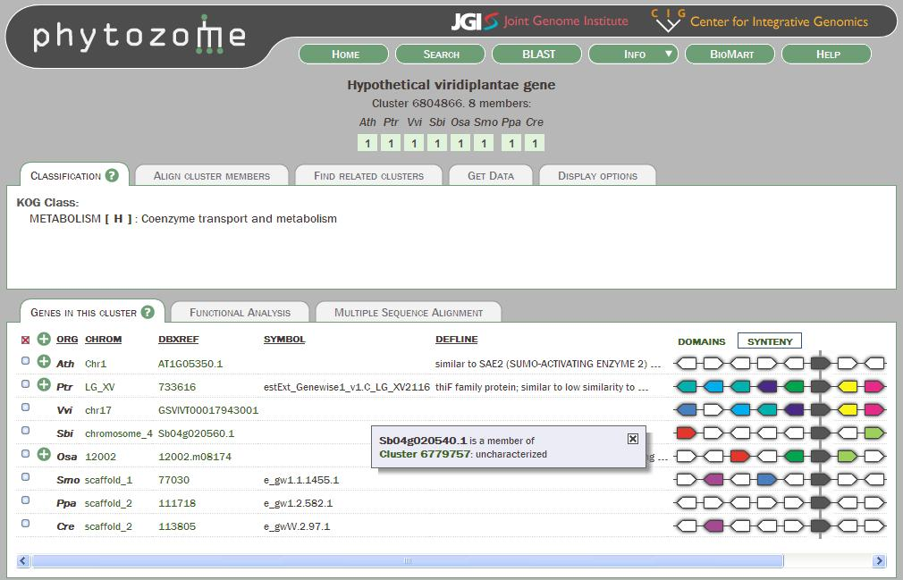
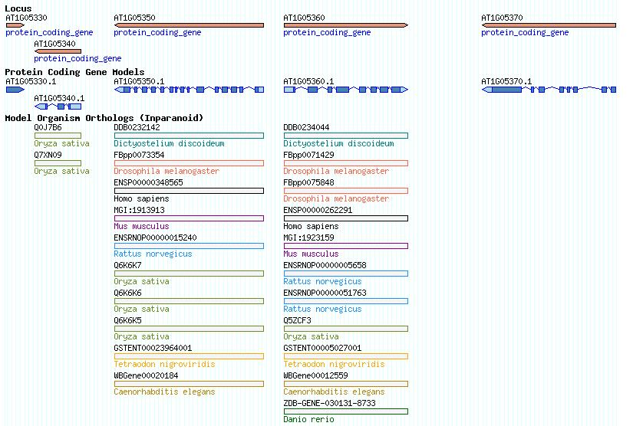
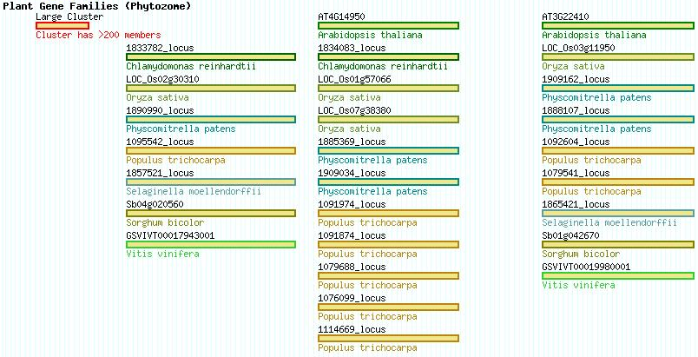
Orthologs and Gene Families

Slide 16
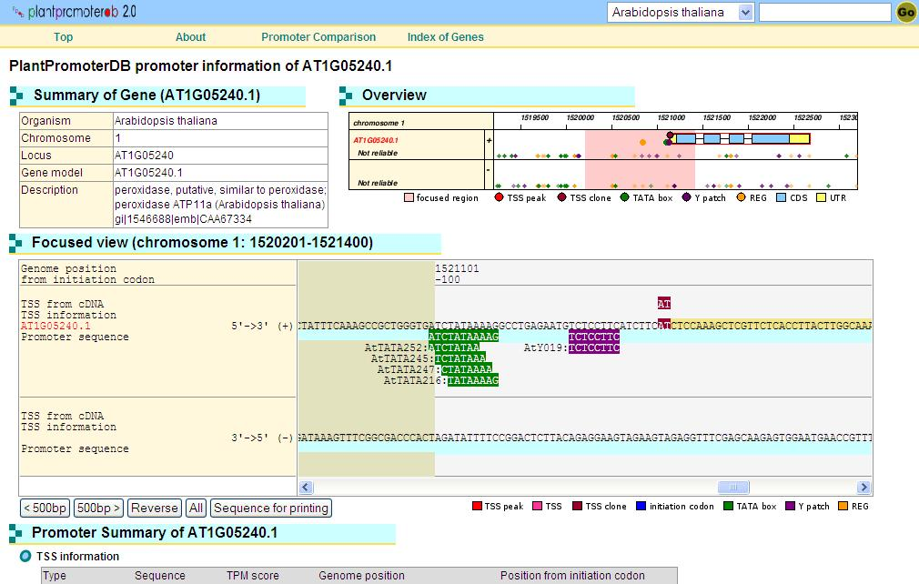
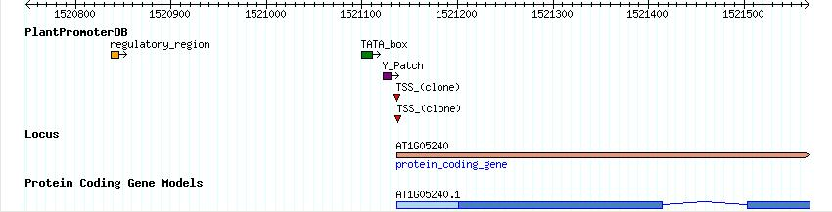
Promoter Elements

Slide 17
Tracks updated regularly

Slide 18
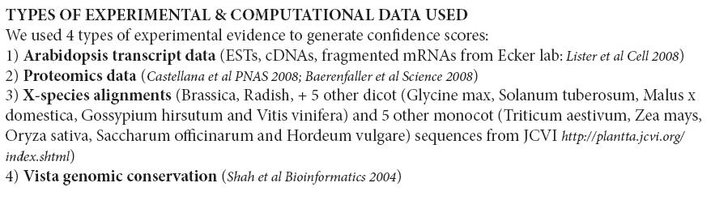
Gene Confidence Rank
Attributes confidence scores to all exons and gene models based on different types of experimental and computational evidence

Slide 19
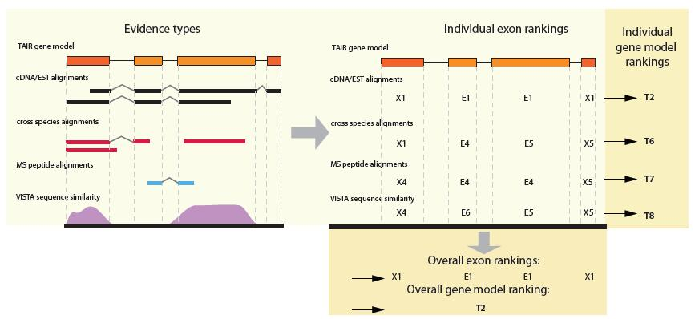
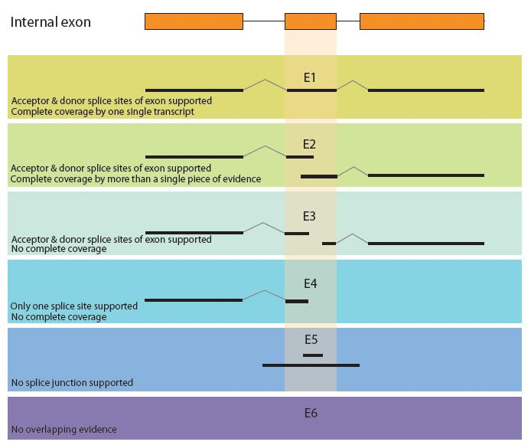
Assigning A Confidence Rank
E1
E4

Slide 20
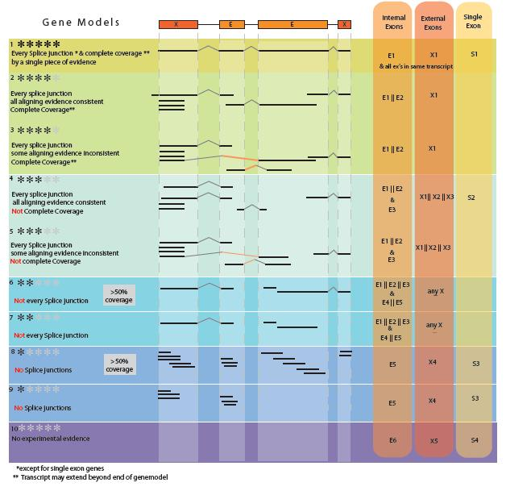

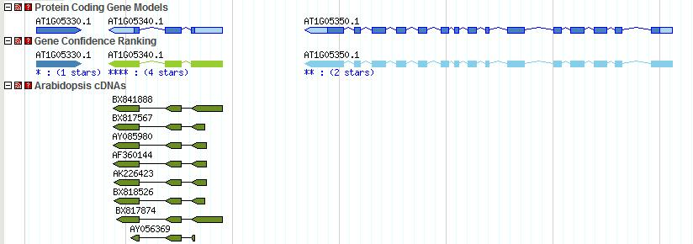
Full support
No support

Slide 21
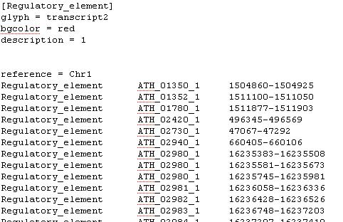
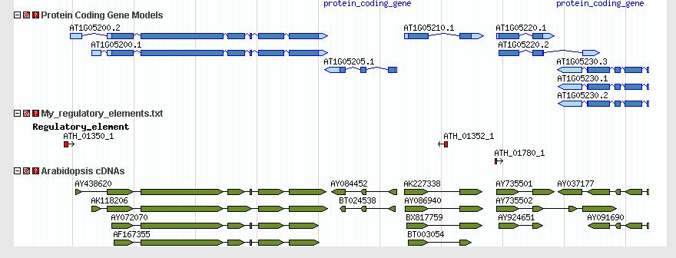
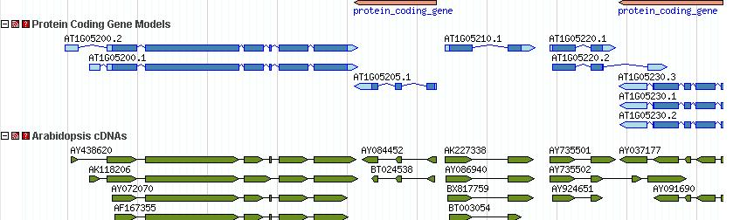
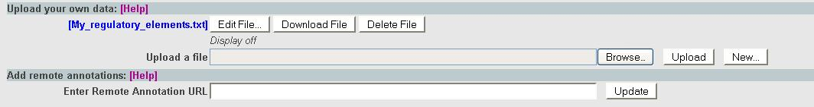
How can I upload my own annotations to GBrowse ?
http://www.arabidopsis.org/cgi-bin/gbrowse/arabidopsis/?help=annotation

Slide 22
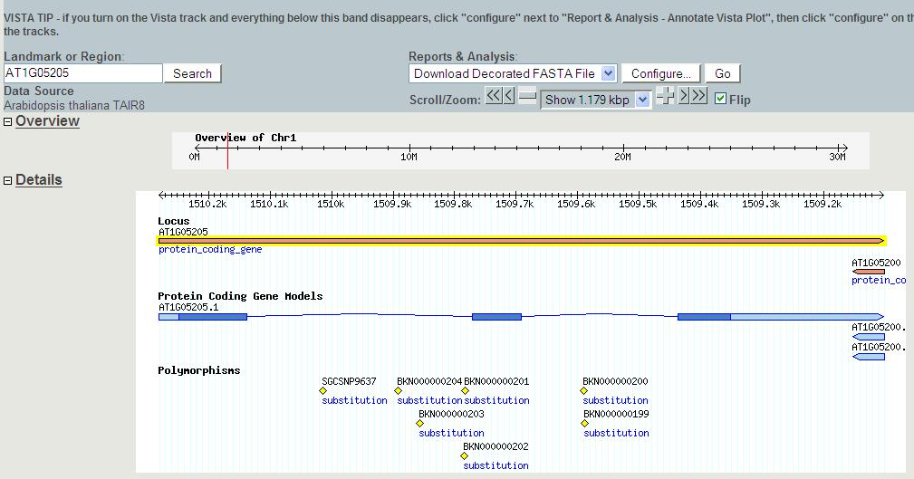
How can I download a marked up FASTA file of a particular region?

Slide 23
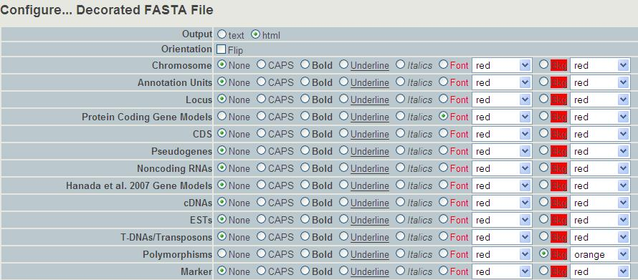
Decorated Fasta file

Slide 24
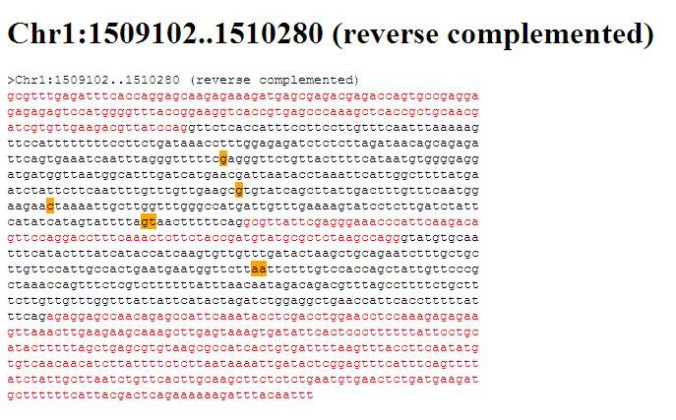
Decorated Fasta file

Slide 25
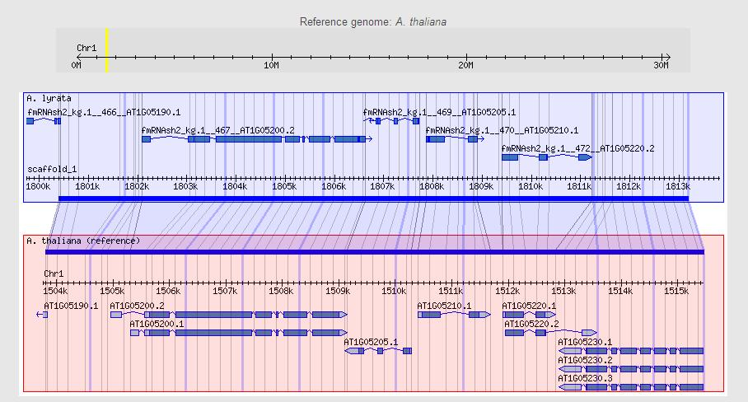
Coming Soon Synteny viewer

