Slide 1
Putting TAIR to work for you
hands-on workshop for beginning and advanced users
http://arabidopsis.org

Slide 2
Today’s topics:
PART 1 – HOW TO:
Find a gene in TAIR and useful information about that gene
  Gene function, expression pattern, protein domains
Use TAIR genome browsers and find out details of the TAIR9 release
Generate, work with and download larger sets of data at TAIR
  List of genes, sequences, annotations, etc
PART 2 – PRACTICE YOUR SKILLS

Slide 3
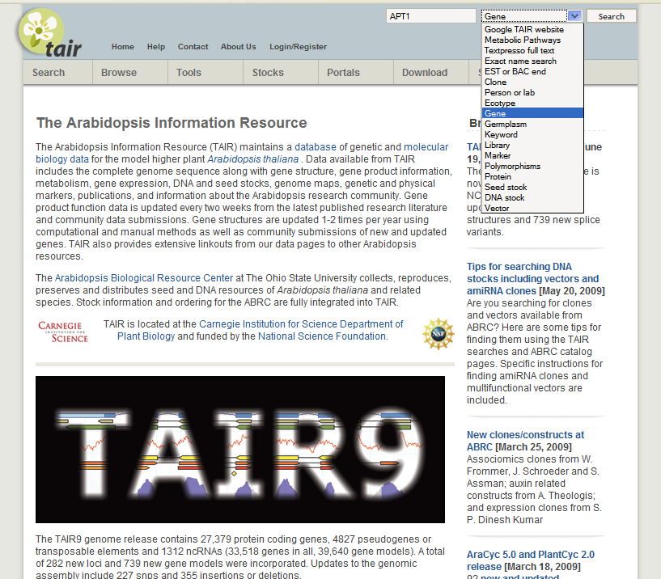
http://arabidopsis.org
Notes:
Simplest and most basic search, default setting is gene. Enter APT1 and click on ‘search’

Slide 4
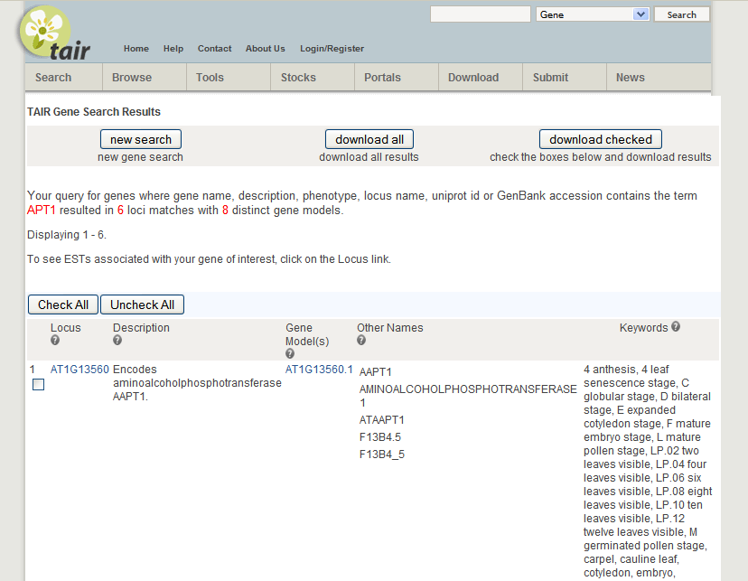
Notes:
Result in this case is 6 genes with 8 distinct gene models (= splice forms). List of fields searched is in the sentence at top.
scroll down to see all 6 results…

Slide 5
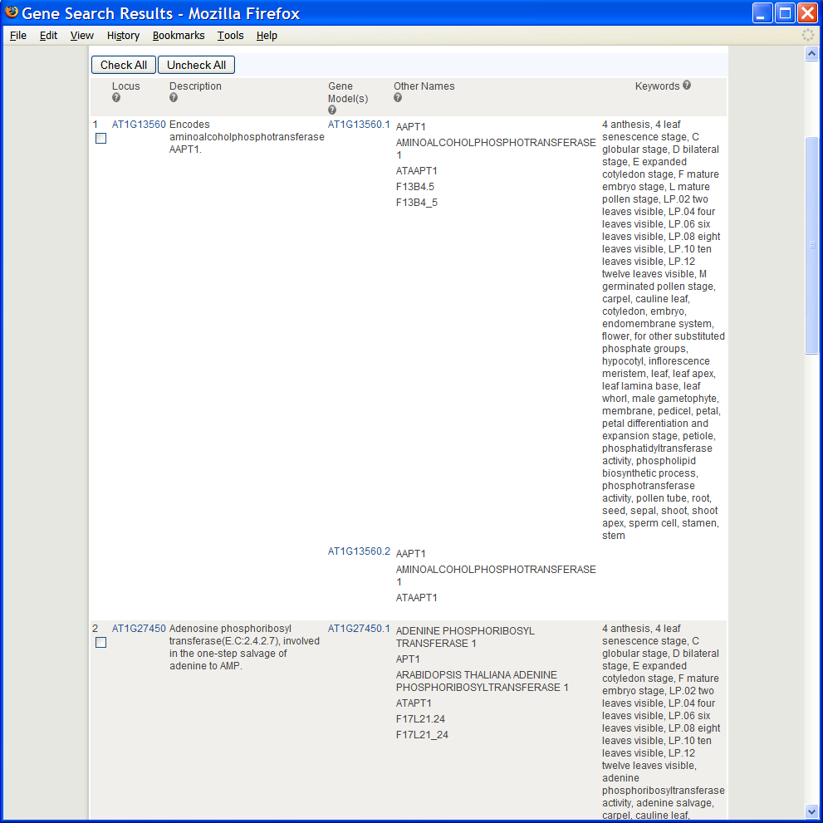
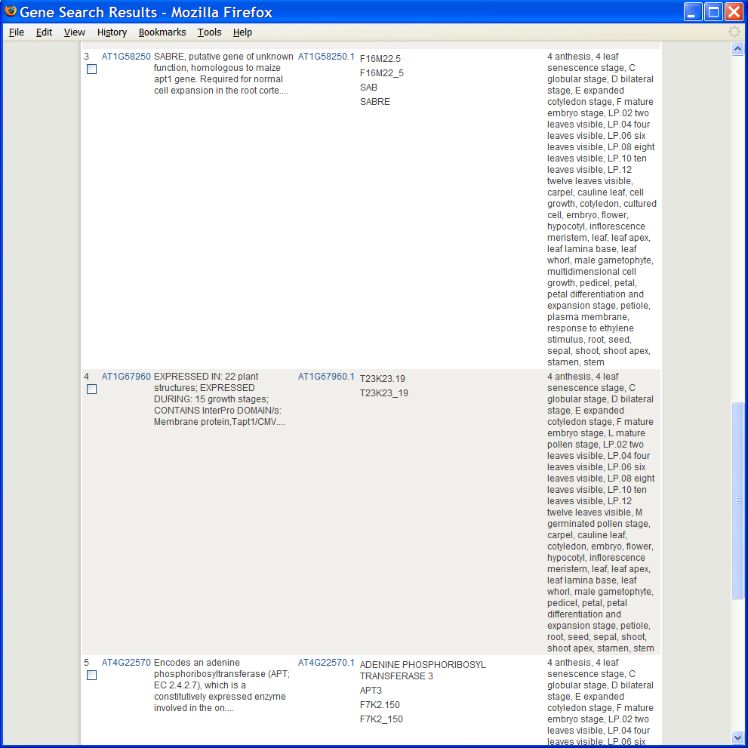
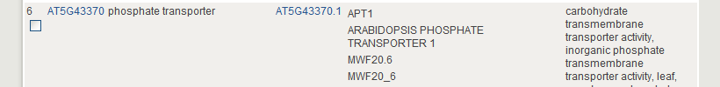
Notes:
Why are there 6 results? 1) people sometimes choose a symbol that’s already in use when naming their genes (Results 2 and 6 for example)
2) This search searches lots of different fields to make sure that some result is returned even if you put in kinase or chloroplast (Result 3 for example)
3) Because it finds any matches for the search term in a larger word (‘contains’ search) (Result 1 for example)

Slide 6
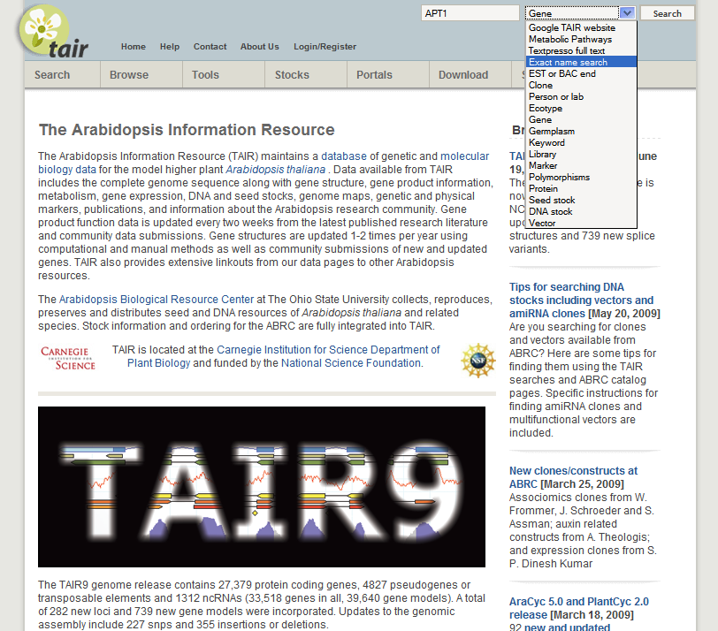
Notes:
If this type of search returns too many results for you, or if you’re not sure if the name you want to search for is a gene or some other type of object, you can try an exact name search instead. This searches only names and synonyms but searches lots of different kinds of objects

Slide 7
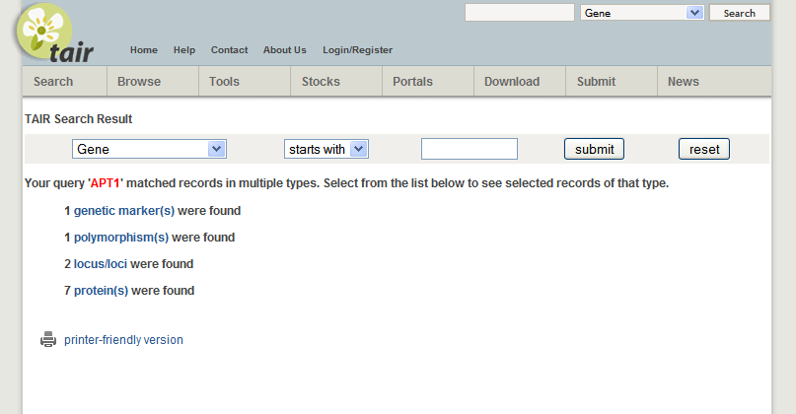
Notes:
In this case matches were found within the list of genetic markers, polymorphisms, genes and proteins. If you click on the loci

Slide 8
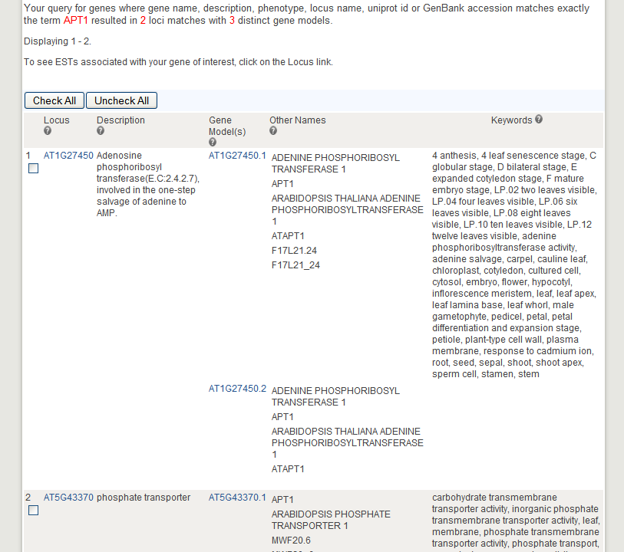
Notes:
You come to a page with only 2 results, the two genes that have apt1 as the exact name or synonym. We’re going to look at the first one… AT1G27450
If you’re following along go ahead and click on the locus link for this gene

Slide 9
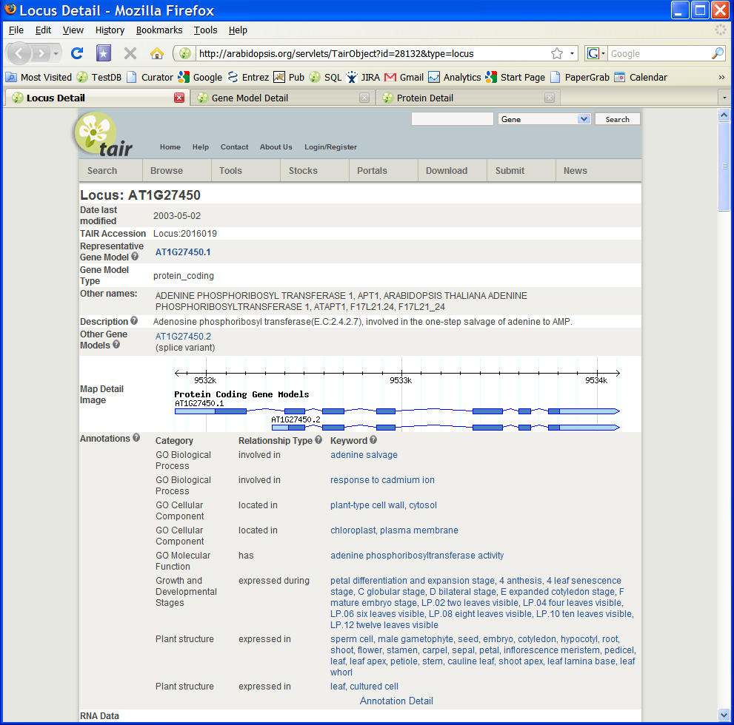
Notes:
This is the locus page where I’m going to be showing you quite a few different kinds of information. If you want to follow any of the links off of this page I suggest you do it in a new tab so you’ll be able to keep coming back to this one as I go through it.
This is not a complete tour of the locus page, but will hit some of the high points, you can find more by exploring by your self later

Slide 10
Notes:
The first thing to notice here is the description of the gene, just below the list of other names. For well studied genes this is a curator’s summary of the most important facts about a gene. For other genes it’s a computationally generated summary.
Next we’ll go down to the annotation section just below the schematic of the two splice forms

Slide 11
Notes:
This section gives you an overview of all the controlled vocabulary annotations made to a gene. GO stands for Gene Ontology. To see more details of these annotations including what research articles or other evidence supports themopen open the ‘Annotation Detail’ page in a new tab of your browser.

Slide 12
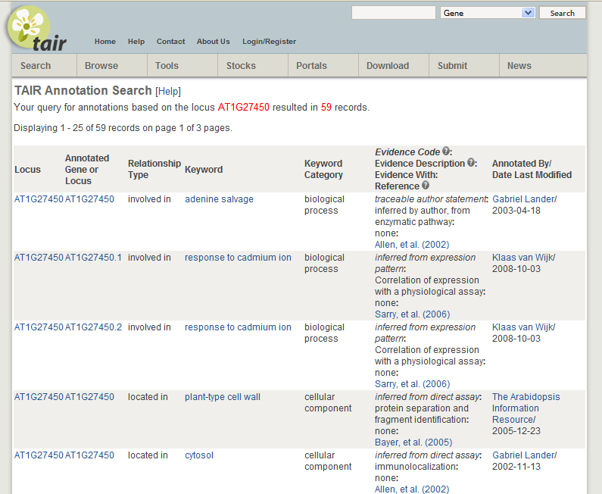
Notes:
Here you can see each annotation along with the type of evidence that supports it and the person who made the annotation. Notice that there are 59 annotations spanning 3 pages

Slide 13
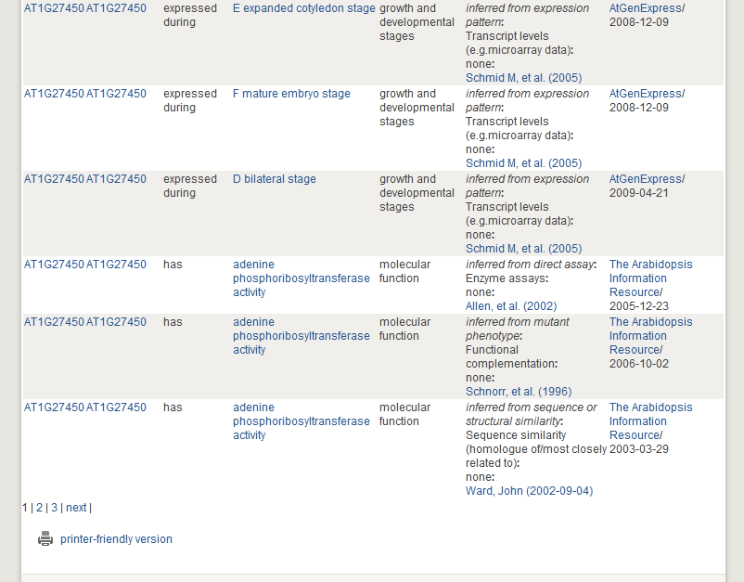
Notes:
The terms themselves are links to more information, if you open one in a new tab

Slide 14
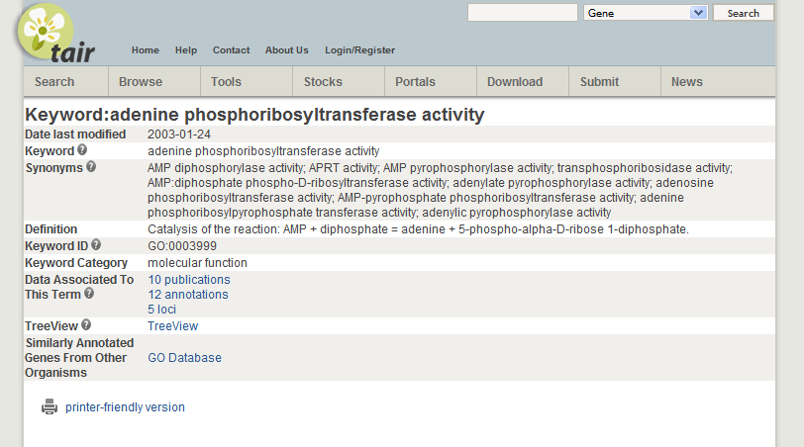
Notes:
You can see the definition of the terms, how many other publications and genes have been associated to this term. To get even more information on the term and lists of genes from other organisms, open a new tab using the GO Database link

Slide 15
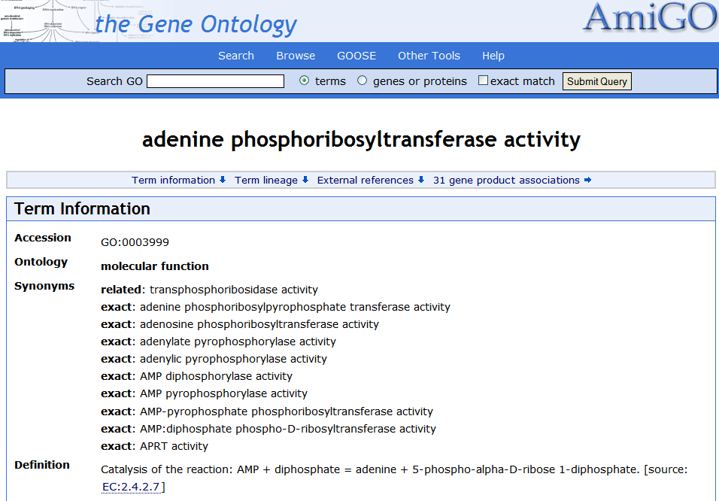
Notes:
Top of page here, scroll down

Slide 16
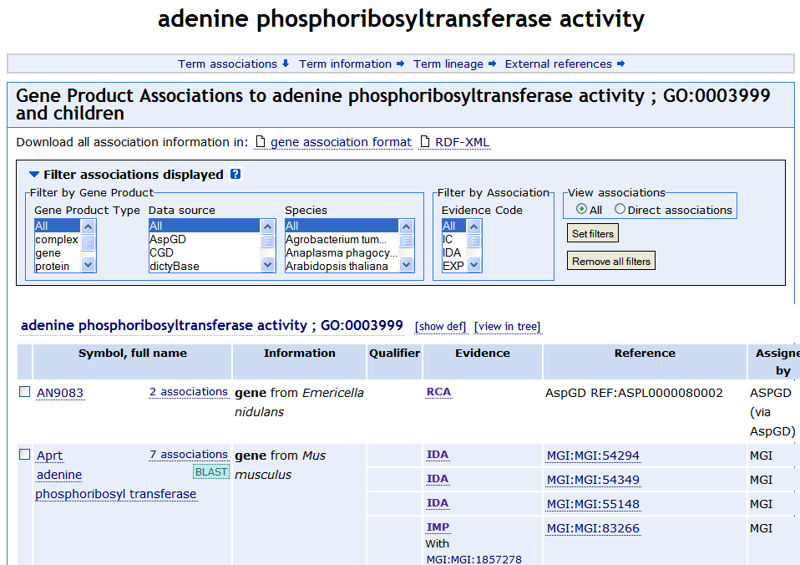
Notes:
You come to the actual genes in the other organisms with links to find out more about those genes.
Now we’re going to return to the locus page where we started

Slide 17
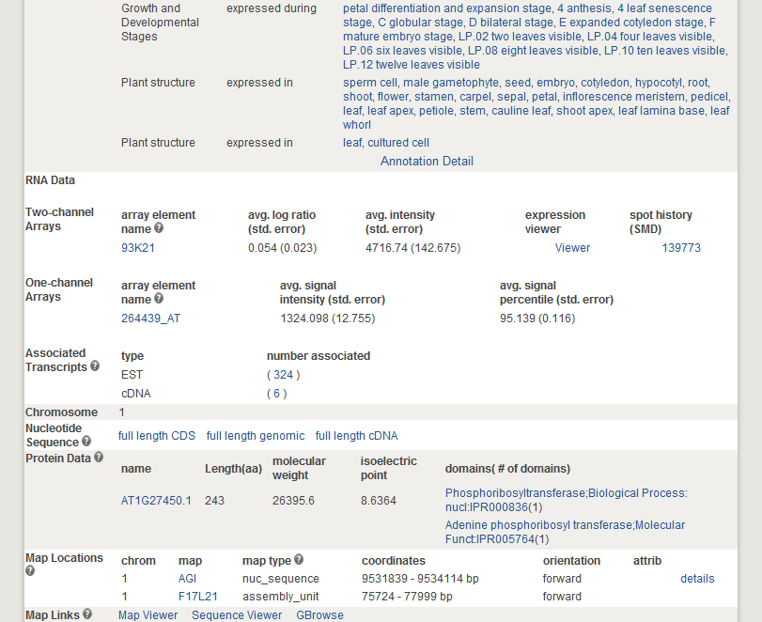
Notes:
and go down the page a bit more until we come to the protein data band

Slide 18
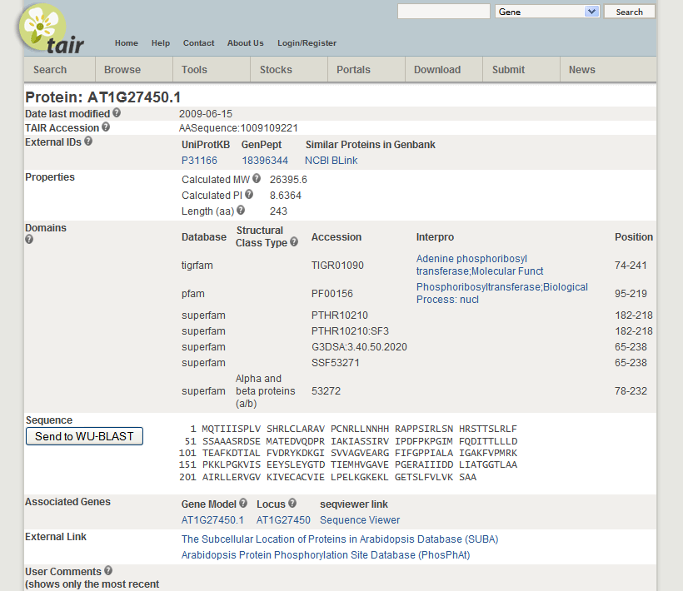
Notes:
In this band you can get a summary of the protein domains found in the product of this gene. You can also click on these to get more information

Slide 19
Notes:
There are some external links specific to proteins here also, including one to SUBA, the Subcelllular Proteomic Database, which will take you to their site:

Slide 20
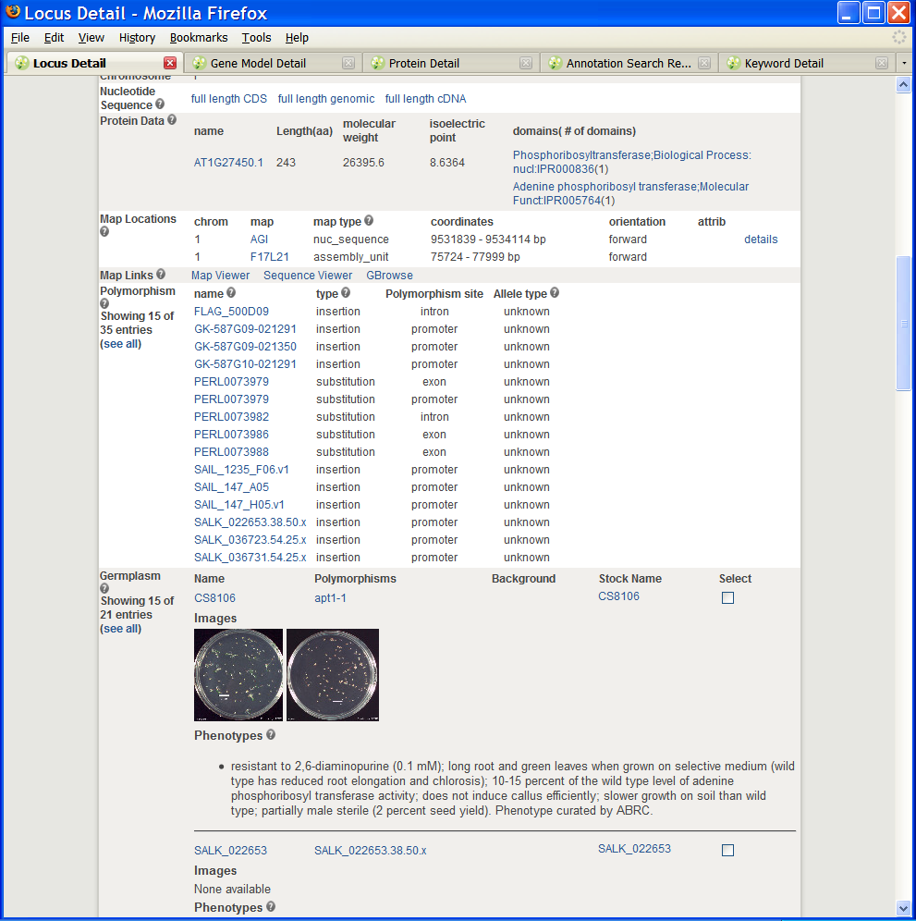
Notes:
Back to the locus page. A couple of bands farther down the page you’ll come to the germplasm band, where you can find information on any phenotypes associated with changes in this gene

Slide 21
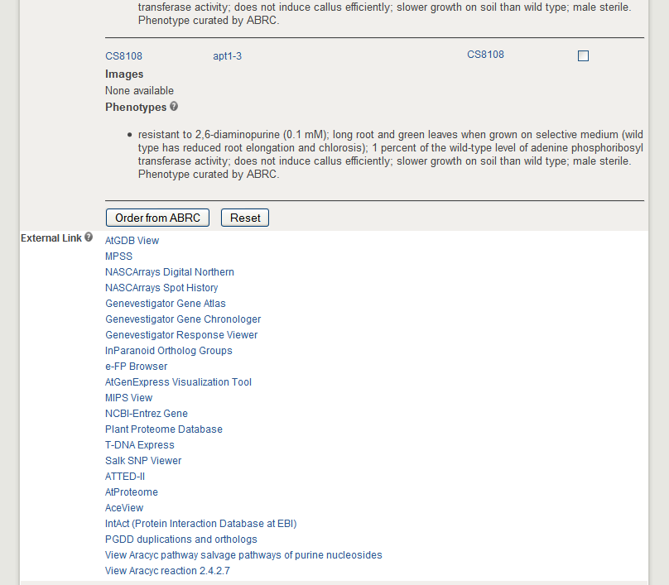
Notes:
Just below the germplasm band is the external links section.

Slide 22
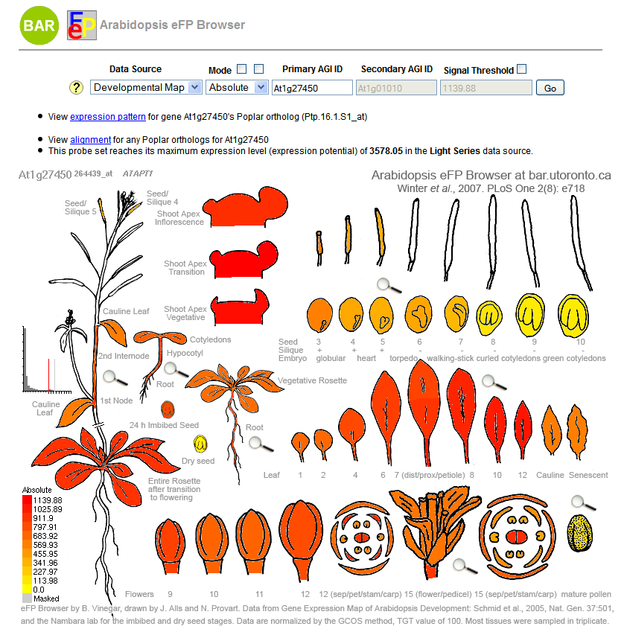
Notes:
The e-FP browser

Slide 23
Notes:
Finally I want to show you the two at the bottom, which lead to metabolic pathway information for this gene product. Clicking on the first link takes you

Slide 24
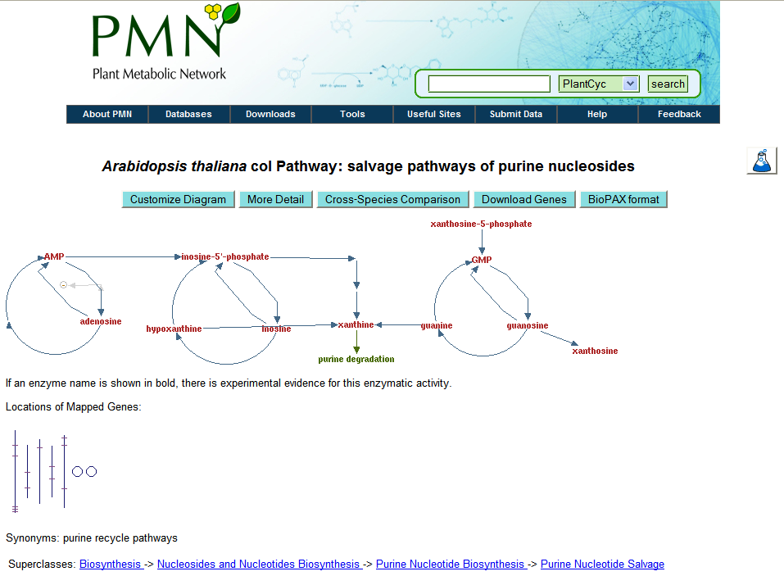
Notes:
To a page showing a diagram of a metabolic pathway that this gene product plays a role in. Clicking on more detail zooms in the view until

Slide 25
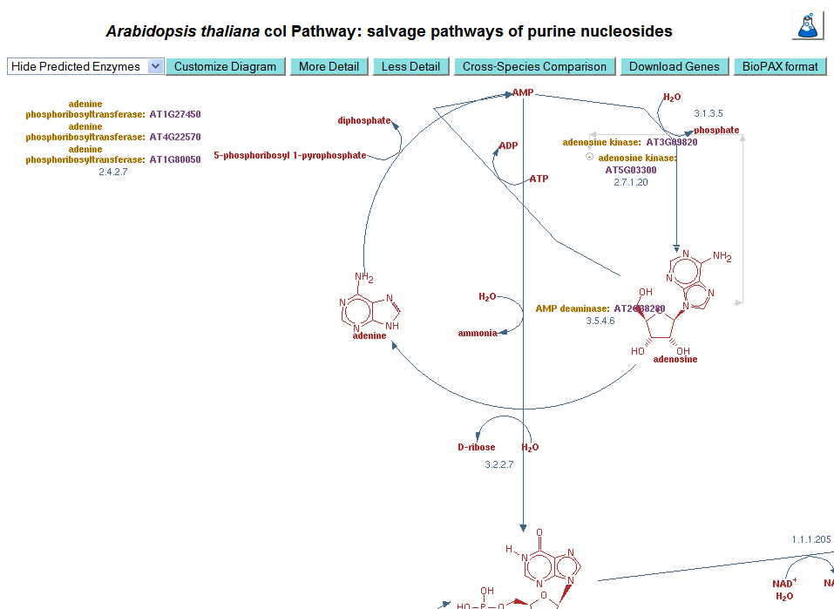
Notes:
Yiu can see the gene we’ve been looking at associated to one of the reactions in this pathway. Now we’re returning to the locus page

Slide 26
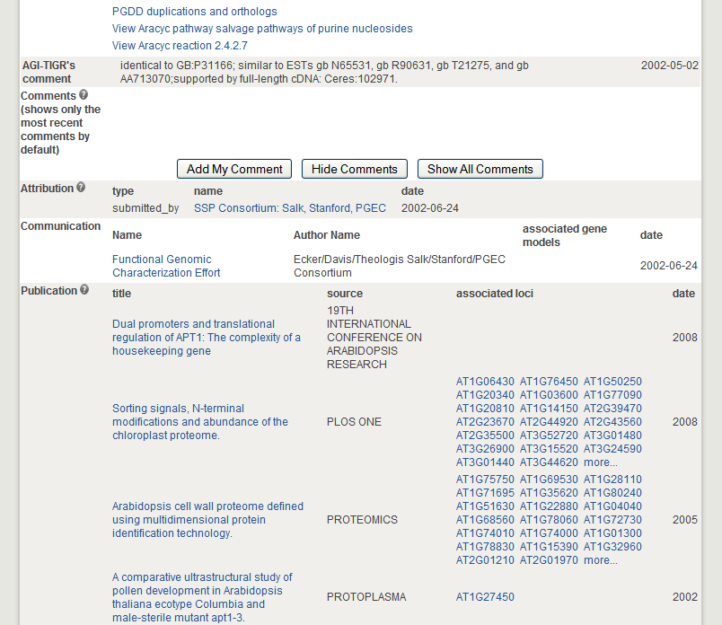
Notes:
Back to the locus page again. Near the bottom of the page below external links is the publication section that shows a list of articles that have information on this gene, along with what other genes appear in the same article.

Slide 27
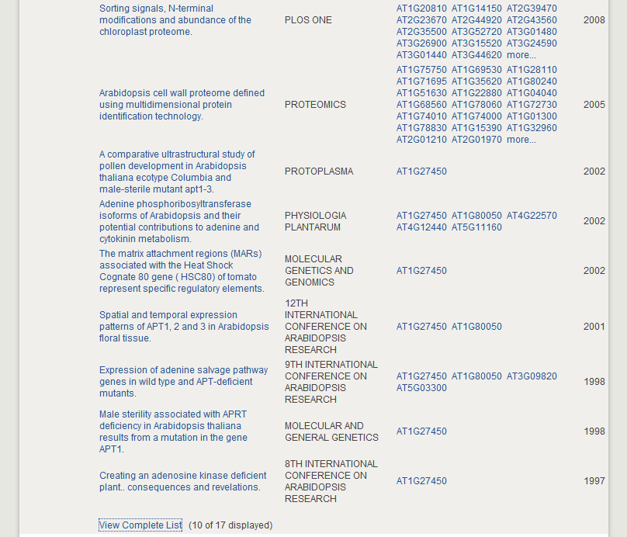
Notes:
Only the most recent 10 are shown but you can see the whole list using the link at the bottom:

Slide 28
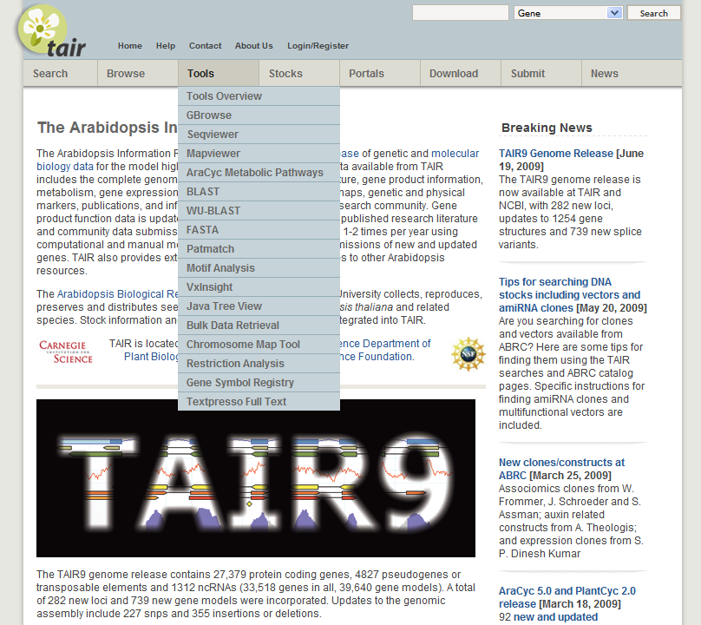
Notes:
That’s it for the highlights of the locus page, I’m only going to show you a couple more things that you can get to from the Tools menu. The first is the Textpresso full text search which allows you to search the full text including figure legends for over 17,000 full text papers held at TAIR. No supplemental results yet though.

Slide 29
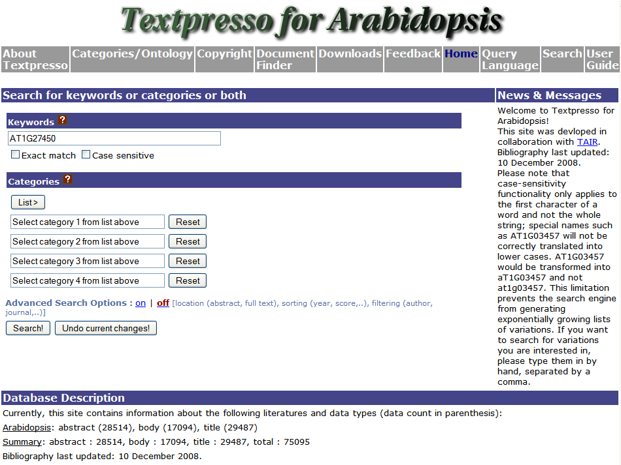
Notes:
To use this search enter the keyword which for most people is a gene name at the top

Slide 30
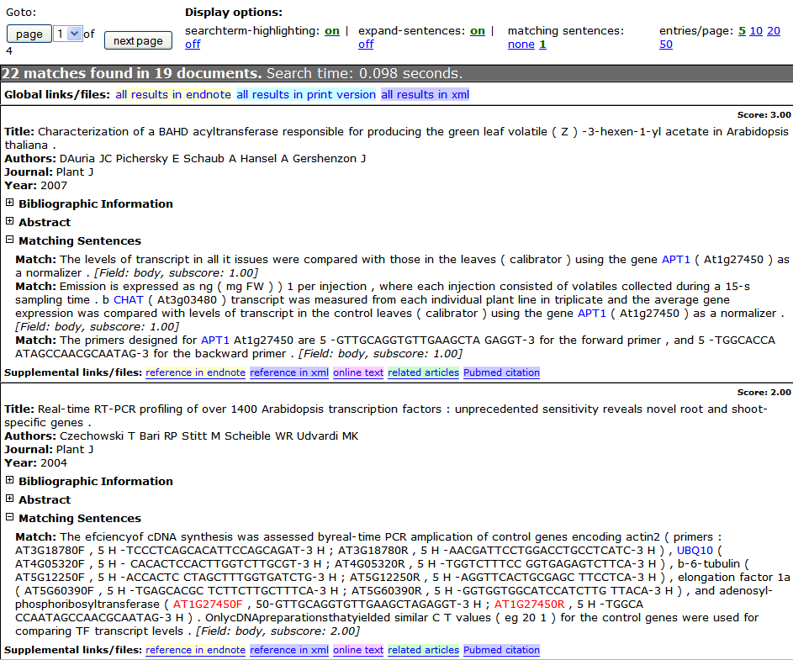
Notes:
This shows the result of searching for that particular agi code. It found 22 matches in 19 documents. The nice thing about this is that you don’t just get the titles of the documents back, you actually get the matching sentences themselves. Has the specificity of the TAIR publication list and the detail of a google search
google scholar 27, textpresso 19, TAIR 17

