Slide 1
Top Four Essential TAIR Resources
Debbie Alexander
Metabolic Pathway Databases for Arabidopsis and Other Plants
Peifen Zhang

Slide 2
Metabolic Pathway Databases for Arabidopsis and Other Plants
Peifen Zhang
The Plant Metabolic Network (PMN)

Slide 3
Outline
Introduction to PMN
Query and retrieve the integrated information about pathways, metabolites, enzymes and genes
Analyze sample gene expression data to identify changes in Arabidopsis metabolic pathways
Behind the scene, how we create and curate a pathway database

Slide 4
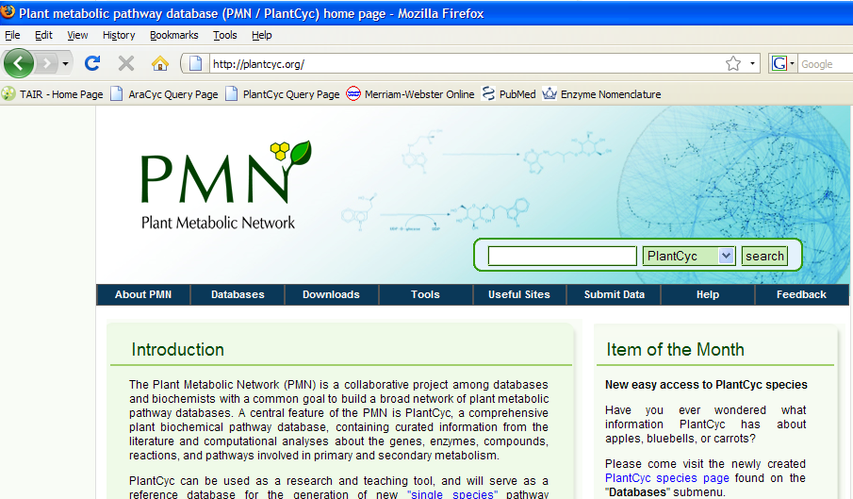
http://plantcyc.org
encyclopedia

Slide 5
PMN is
A network of plant metabolic pathway databases and database curation community
  A plant reference database, PlantCyc
    Pathways, enzymes and genes consolidated from all plant species
  A collection of single-species pathway databases
    Pathway Genome Databases (PGDB)
    Pathways, enzymes and genes in a particular species
  A community for data curation
    Curators at databases (PMN, Gramene, SGN etc)
    Researchers in the plant biochemistry field

Slide 6
Comparison between plantcyc and single-species PGDBs
Plantcyc
  Comprehensive collection of pathways for all plants
  Representative collection of all known enzymes in plants
A PGDB
  Comprehensive collection of pathways in a particular species
  Comprehensive collection of enzymes, known or predicted, in that species

Slide 7
The same underlying software, Pathway Tools
Data creation, storage and exchange
User interface

Slide 8
Major data types in PMN databases
Pathway
  Diagram, summary, evidence, species
Reaction
  Equation, EC number
Compound
  Synonyms, structure
Enzyme
  Assignments to reaction/pathway, evidence, summary, properties (inhibitor, Km etc)
Gene

Slide 9
Currently available PGDBs
PGDB | Species | Host | Status
AraCyc | Arabidopsis | TAIR/PMN | Substantial curation
RiceCyc | Rice | Gramene | Some curation
 | Sorghum | Gramene | No curation
MedicCyc | Medicago | Noble Foundation | some curation
LycoCyc | Tomato | SGN | some curation
 | Potato | SGN | No curation
 | Pepper | SGN | No curation
 | Tobacco | SGN | No curation
 | Petunia | SGN | No curation
 | Coffee | SGN | No curation

Slide 10
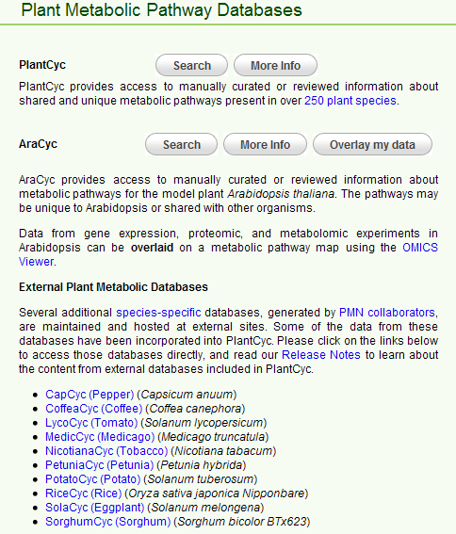

Slide 11
General query use cases
How does a cell make or metabolize XXX?
My gene is predicted to be a XXX, what does the enzyme do?
What are the other genes involved in the same biochemical process as my gene?
What is known and unknown of XXX pathway?

Slide 12
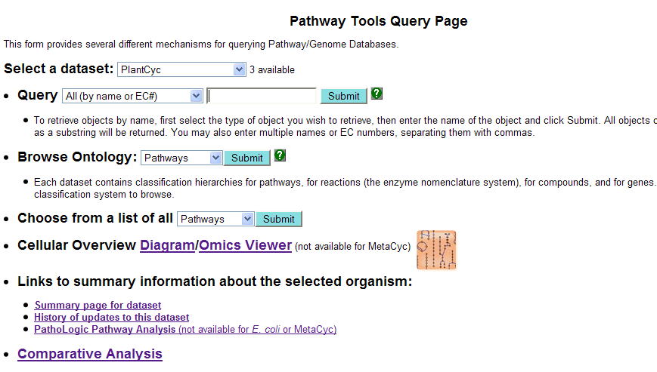
caffeine

Slide 13
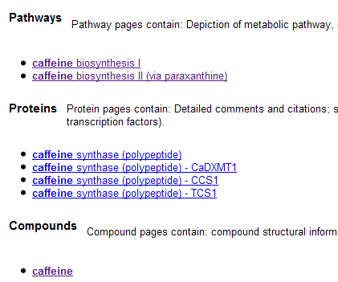
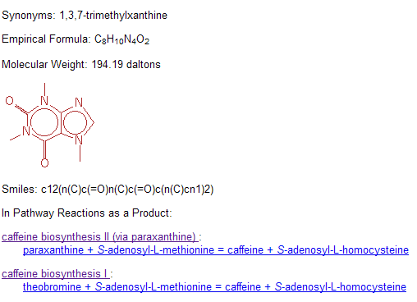

Slide 14
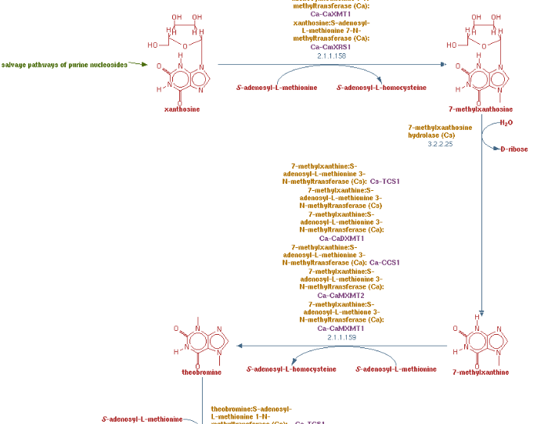
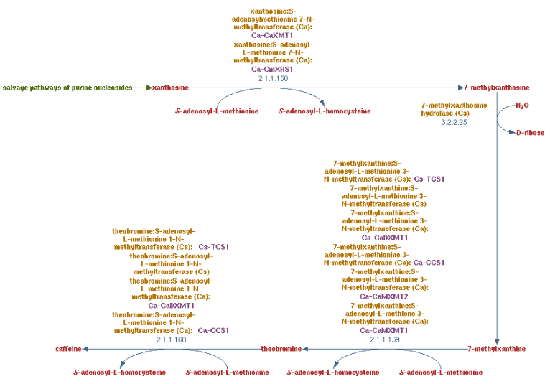

Slide 15
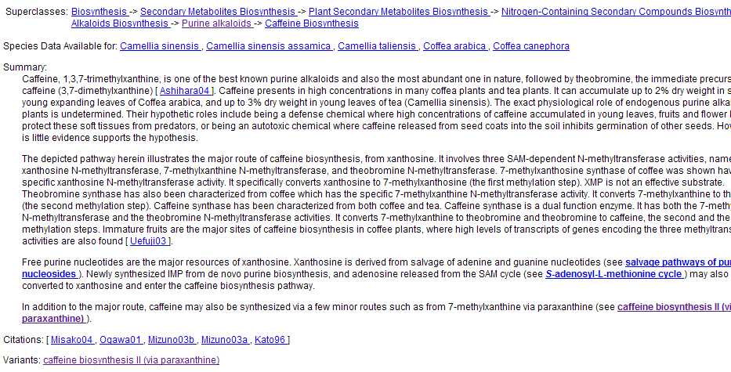
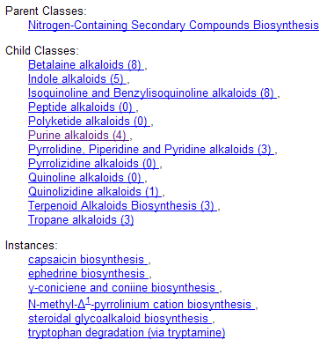

Slide 16
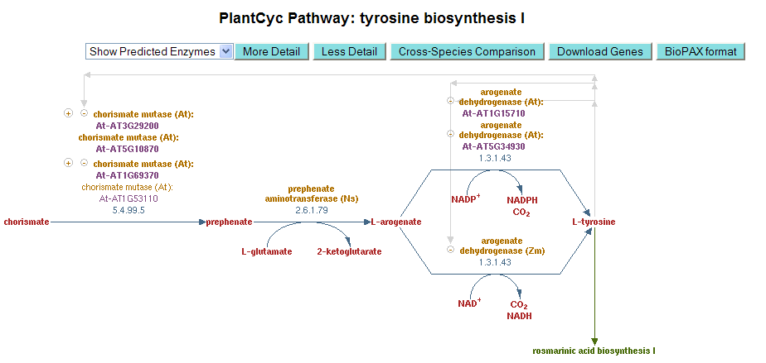

Slide 17
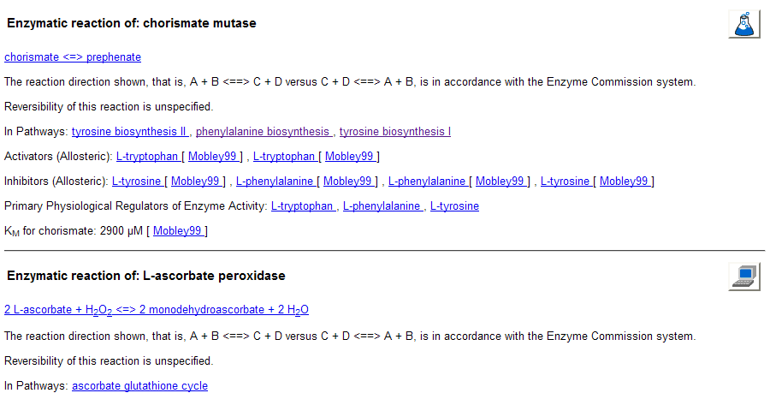
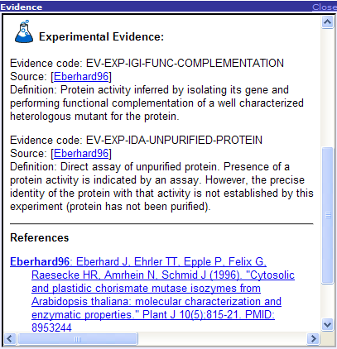

Slide 18
Outline
Introduction to PMN
Query and retrieve the integrated information about pathways, metabolites, enzymes and genes
Analyze sample gene expression data to identify changes in Arabidopsis metabolic pathways
Behind the scene, how we create and curate a pathway database

Slide 19
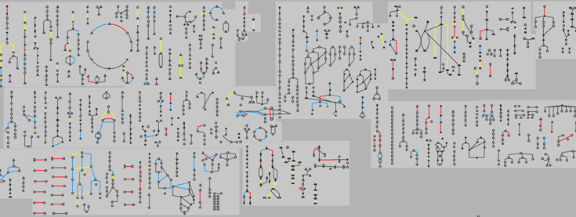
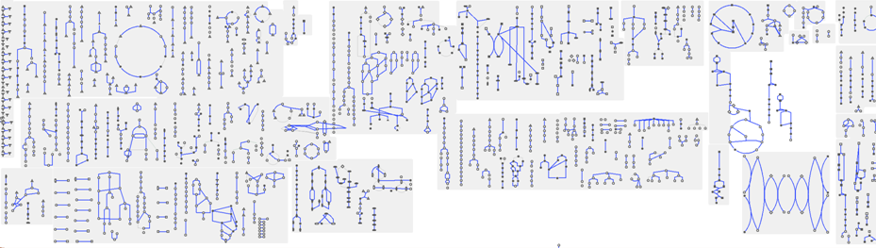
Omics Viewer

Slide 20
Omics Viewer use cases
Visualize and interpret large scale omics data in a metabolism context
  Gene expression data
  Proteomic data
  Metabolic profiling data
  Reaction flux data

Slide 21
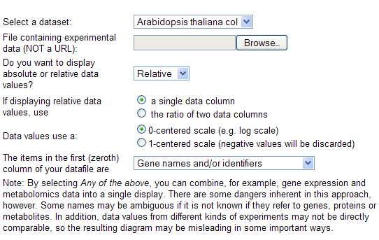
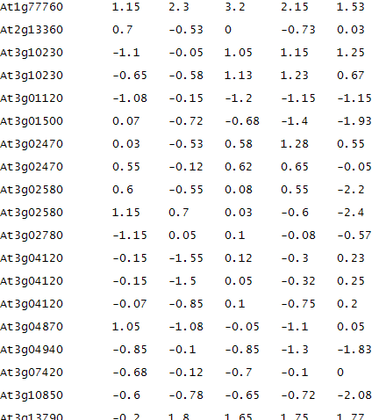
Step one: prepare data input file

Slide 22
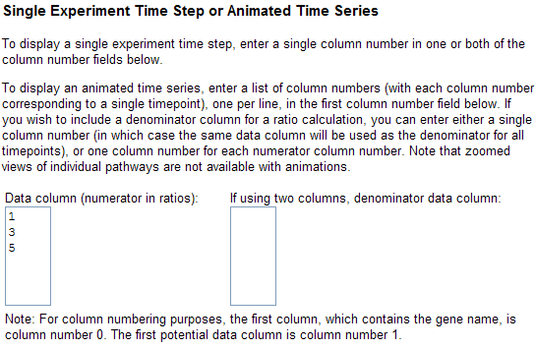
Step two: choose which data to be displayed

Slide 23
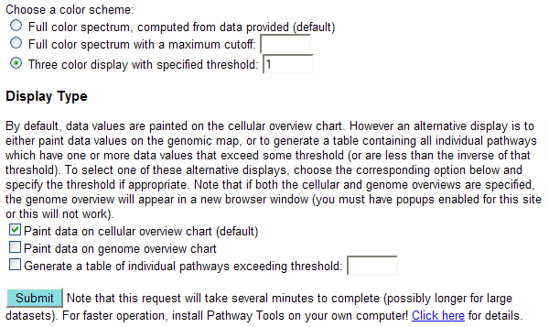
Last, choose color scheme and display type

Slide 24
Red: enhanced expression over my threshold
Yellow: repressed expression over my threshold
Blue: not significant under my threshold

Slide 25
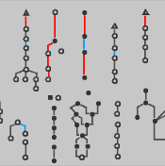
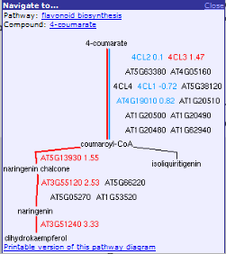
Close-up to a pathway of interest

Slide 26
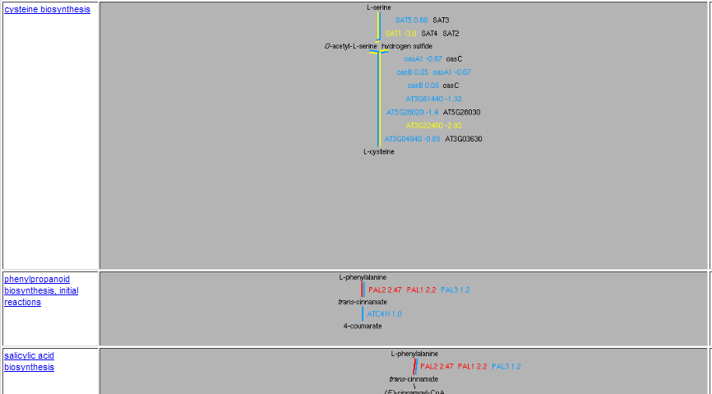
Generate a table of individual pathways exceeding certain threshold

Slide 27
Outline
Introduction to PMN
Query and retrieve the integrated information about pathways, metabolites, enzymes and genes
Analyze sample gene expression data to identify changes in Arabidopsis metabolic pathways
Behind the scene, how we create and curate a PGDB

Slide 28
Create PGDBs, why
Huge sequence data are generated from genome and EST projects
Put individual genes into the context of metabolic network
Use the network to
  discover missing enzymes
  visualize and analyze large experimental data sets
  design metabolic engineering
  conduct comparative and evolutionary studies

Slide 29
Create PGDBs, how
Manual extraction of pathways from the literature, assigning genes/enzymes to pathways
Computational assigning genes/enzymes to reference pathways, manual validation/correction and further curation

Slide 30
Create PGDBs, how
Annotated sequences, molecular function
A reference database (such as MetaCyc and PlantCyc)
PathoLogic (Pathway Tools software)

Slide 31
ANNOTATED GENOME
MetaCyc
DNA sequences
Gene calls
AT1G69370
Gene functions
PathoLogic
chorismate mutase
chorismate mutase
prephenate aminotransferase
arogenate dehydratase
5.4.99.5
2.6.1.79
PGDB
4.2.1.91
chorismate
prephenate
L-arogenate
L-phenylalanine
chorismate mutase
AT1G69370

Slide 32
New PGDB pipeline in PMN
Prioritization
  Available sequences, economic impact
High priority
  Poplar, Soybean, Maize, Wheat
Others
  Cotton, Grape, Sugarcane, Sunflower, Switchgrass…

Slide 33
A quality database requires manual validation and curation

Slide 34
Validation: prune false-positive predictions
Pathways not operating in plants or not in a target species
  glycogen biosynthesis
  C4 photosynthesis
  caffeine biosynthesis
Pathways operating via a different route
  Phenylalanine biosynthesis in bacteria v.s. in plants

Slide 35

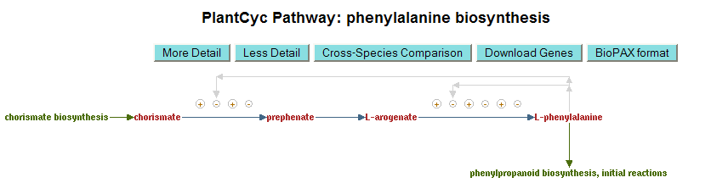

Slide 36
Validation: add evidence and literature support
  Molecular data, enzymes and genes
  Radio tracer experiments
  Expert hypothesis (paper chemistry)
  Pure computational prediction

Slide 37
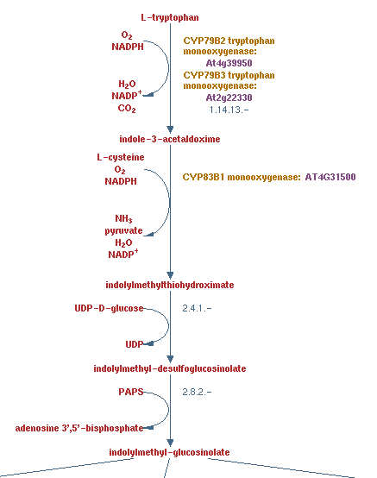
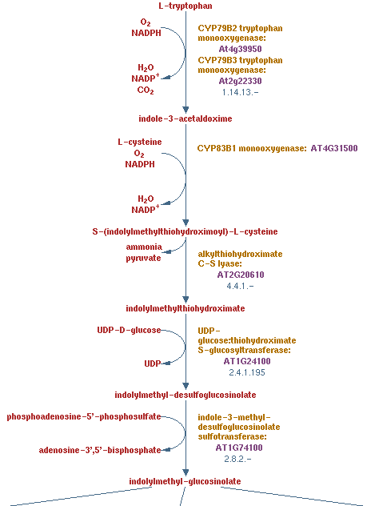
Curation: correct pathway diagrams

Slide 38
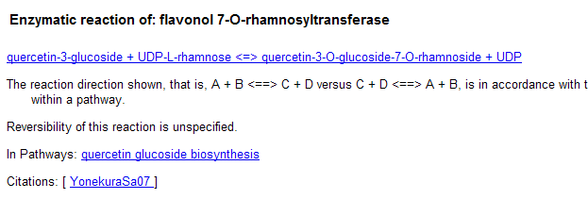
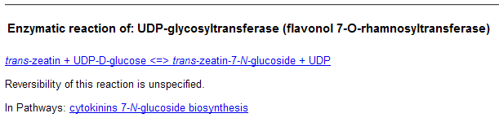
Curation: correct gene/enzyme assignments to reaction/pathway
UGT89C1
Notes:
We extract information from the literature. For pathways….
Evidence code, experimental or computational, along with literature citations were assigned to allow users rapidly assess the reliability of the annotation.

Slide 39
Further curation
Add missing or new pathways
Add missing or new enzymes
Add detailed literature information about a pathway, an enzyme etc

Slide 40
Community curation
Adopt a newly created PGDB by a genome database
Participate as a lab/group
Participate as an individual
Contact us: curator@plantcyc.org

Slide 41
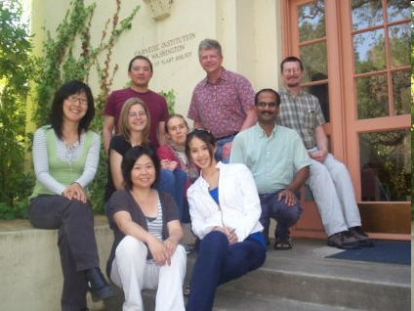
Thank you!

