Slide 1
Qarau
ҚАРАУ · KAZAKH FOR “TO INSPECT”
Computer vision inspection of public infrastructure from photos, with rules you can read.
ICT1103 · QAIRU · Assignment #2 · Computer Vision · 12 November 2026
Tair
Web app and coordination
Dameli
Design system and visuals
Nazar
Restroom model
Amina
Pothole model and data
Alizhan
Serving and performance
Roma
Research, deck and QA
Notes:
Speaker: Tair · budget 0:15 · script 32 words, about 0:15 at 130 words per minute
SCRIPT
Good morning. We are Qarau, Kazakh for “to inspect”. From photos, our app finds potholes and checks restroom door signs, then applies rules you can read. Roma will start with the problem.
Sources: web/lib/brand.ts (BRAND.name, nativeName, meaning, tagline) · web/lib/team.ts (TEAM, COURSE)

Slide 2
THE PROBLEM
Today, roads and door signs are checked by eye
Roads
Restrooms
Inspection is done by eye, so potholes are found late.
We found no place where confusing door signs are reported.
Qarau: a photo goes in, a model finds what matters, and rules a person can read decide what happens next.
Qarau · ICT1103 · QAIRU
02
Notes:
Speaker: Roma · budget 0:35 · script 61 words, about 0:28 at 130 words per minute
SCRIPT
Today, roads and public buildings are inspected by eye, so potholes are found late. Confusing restroom signs are worse off: we found no place where they are reported at all. We wanted one tool for both. A photo goes in, a model finds what matters, and rules that a person can read decide what happens next. Tair will show it live.
OPEN GAP (R-2, #84, Roma): one sourced statistic on road damage, with unit, year, country and source. Not on the slide. Until it is filled, the script uses: “No sentence: say no number; the slide works without it.” When it lands, add the number with its source here and in docs/research/deck-sources.md, then rebuild.
CUES
When R-2 lands: one more line in the Roads card with the number, its unit, year and country, a small source line under it, and one sentence in the script. Its quote, publisher, year, URL and access date go to docs/research/deck-sources.md, section 'Slide 2'.
Sources: no numbers on this slide

Slide 3
LIVE DEMO
One road photo, then one pair of door signs
01
Roads
A road photo → boxes, a severity and the rules that fired
02
Restrooms
Two door signs → their genders, how alike they are, and a verdict
Real, on this laptop: both analyses and the model page. Demo data: the overview tiles and charts, marked with a badge.
Qarau · ICT1103 · QAIRU
03
Notes:
Speaker: Tair · budget 1:30 · script 106 words, about 0:49 at 130 words per minute
SCRIPT
This is Qarau. I open the Roads module and drop a road photo. It runs on our own model, here on this laptop. Here are the potholes it found, the severity, and one rule that fired: [read one rule hit aloud]. Now Restrooms, Compare. I pick a mismatched pair. Here are the two genders, how alike the signs are, and the verdict with the rule that failed. This is the platform overview. These tiles and charts run on demo data. The two analyses you just saw and the model page are real. On the model page are both experiment tables; we come back to these. Alizhan will explain how it works.
CUES
Demo script: docs/PRESENTATION.md 'Demo script' and docs/DEFENSE-RUNBOOK.md. Before the talk: API running with the champion weights (jolscan-e1, `championModelName` in web/data/experiments.json), Settings → Check connection must name it; /health green; demo photo ready; Wi-Fi-off test passed once. Timing: road result by 0:40, restroom verdict by 1:10, overview and model page by 1:30. Compare runs zero-shot CLIP ViT-B/32 (api/restroom.py), not the two-step pipeline. If anything fails: Settings → provider Mock, and continue. If the laptop fails: play the video.
Sources: docs/PRESENTATION.md (demo script, step 5: real against demo) · web/data/experiments.json (championModelName)

Slide 4
HOW IT WORKS
How one photo travels through Qarau and back
mock
demo data
Browser
shows the result
Next.js server
The rules run here
R1–R6 roads
S1–S3 restrooms
same rules for every provider
FastAPI service
/predict
YOLO finds potholes
/restroom
CLIP reads the signs
photo
photo
photo
local
this laptop
result
JSON
cloud
opt-in, not used
JSON
Restroom model (CLIP ViT-B/32) on the laptop CPU: 25.7 ms per image. Pothole latency is not measured yet.
Qarau · ICT1103 · QAIRU
04
Notes:
Speaker: Alizhan · budget 0:40 · script 91 words, about 0:42 at 130 words per minute
SCRIPT
This is the path of one photo. The browser sends it to our Next.js server, which uses the provider chosen in Settings: mock for offline demo data, local for the model on this laptop, or cloud. Local calls our FastAPI service, where YOLO finds potholes and CLIP reads restroom signs. The detections come back, and the rules run in the web server, so every provider is scored by the same rules. Cloud is opt-in, because road photos can show faces and plates. Amina will show what the roads model learned from.
CUES
Providers, said aloud and not on the slide: mock is offline demo data; local is the model on this laptop, photos stay here; cloud is designed and opt-in, photos would leave the device, and it is not used in this demo because S-7 (#31) is not deployed. Routes: /api/analyze and /api/restroom on the Next.js server; /predict, /restroom/compare and /restroom/match on FastAPI. The live site qarau.vercel.app runs the mock provider for analyses: the real models run only on this laptop (web/lib/providers/env.ts reads MODEL_API_URL on the server). The latency is the restroom model the API serves (R1's zero-shot ViT-B/32). ml/results/latency.json (S-15, #28) does not exist yet, so no pothole latency. A drawn version of this diagram with numbered steps is docs/design/architecture-slide.svg (G-66).
Sources: ml/results/restroom/experiments.csv (R1 row, latencyMs (zero-shot CLIP ViT-B/32, the model the API serves)) · docs/ARCHITECTURE.md sections 1 and 3 ('Local and cloud modes', 'Cloud is opt-in') · web/lib/providers/env.ts · api/restroom.py (ARCH default ViT-B/32)

Slide 5
ROADS · DATA AND EXPERIMENT
Roads: a baseline and 7 one-change runs
Run | What changes against E0
E0 | baseline (nano, pretrained)
E1 | small model
E2 | random weights
E3 | frozen backbone
E4 | AdamW
E5 | standard augmentations off
E6 | 960 px input
E7 | extra P2 scale
E8 | = E0 settings
Data
• Kaggle “Annotated Potholes Image Dataset”; ODbL / DbCL metadata; watermarked-photo rights unresolved
• 665 photos, 1,739 boxes, 1 class
• No duplicates found before the split; split by photo, seed 42: 465 / 100 / 100
Selection: validation mAP50; ties within 0.01 use validation recall at 0.40; test does not choose.
Every full run: 40 epochs and seed 42; 640 px input unless the row says 960.
Qarau · ICT1103 · QAIRU
05
Notes:
Speaker: Amina · budget 1:00 · script 127 words, about 0:59 at 130 words per minute
SCRIPT
I prepared and reviewed our pothole data, checked duplicates and XML annotations, corrected one invalid box, and exported the frozen YOLO split. The Kaggle dataset has 665 photos and 1,739 boxes; its metadata lists ODbL and DbCL, but rights to individual watermarked photos remain unresolved and require separate verification. We found no exact or near duplicates before splitting by photo: 465 for training, 100 for validation and 100 for test, with seed 42. My smoke run checked the training pipeline using validation only; Tair performed all full experiment runs. Our comparison changes model settings against baseline E0, keeping frozen data and training budget fixed across runs. Validation chooses settings; test reports performance. The notes explain prior test-photo review and separate evaluation passes. Here is what came out.
CUES
- **My contribution:** D-2 visual review/preparation; D-4 exact/near-duplicate and XML completeness/validity checks; removal of the zero-width object in `img-415.xml` in a separate corrected archive, preserving the image, its other annotations and the original archive; D-3 XML-to-YOLO export and frozen split; D-11 training-only k-means size bands; M-0 selection/E8 policy; successful M-1 validation-only smoke. Evidence: `data/README.md`, `ml/results/pothole_area_clusters.json`, decision 0009, `ml/results/runs/E0-smoke.json` and its CSV, `docs/worklog/amina.md`. Do not present Tair's full E0-E8 training as my work.
- **Dataset and controls:** author Atikur Rahman Chitholian; version `potholes_yolo_v1`; boxes per split 1,198 / 305 / 236. Batch 16, SGD with lr 0.01 and COCO-pretrained weights describe baseline E0, not every variant: E2 removes pretraining, E4 uses AdamW with its specified learning-rate settings, E5 disables standard augmentation, E6 changes input size. Full runs were performed by Tair on the same laptop; source revisions are recorded per run, not claimed identical.
- **Honest limits:** no exact/near-duplicate candidates were found under the documented methods; that is not proof of no possible leakage. The D-2 review sample later proved identical to test (D-20); no test label was changed and the review must not guide model or threshold selection. The full trainer performs separate default-confidence and confidence-0.40 validation/test evaluations after training, and the champion has an additional fixed-threshold operating-point evaluation; do not say the test set was never seen or evaluated only once overall. Smoke excludes test entirely.
- **Licence and provenance:** the displayed licence wording is copied from the D-1 card. These are dataset-level licence metadata, not verified clearance for each image: provenance and usage rights of the watermarked photos remain unresolved, and those photos are not for public display. The team decision to proceed does not verify those rights. No local Kazakhstan dataset was used. K-means bands describe image-relative box area, not physical pothole dimensions or validated severity.
- **Handover:** "Here is what came out." Script time is an estimate; R-22's 0:55-1:05 personal reading criterion is still pending.
Sources: ml/results/experiments.csv (rows whose `changed` is one change: E1, E2, E3, E4, E5, E6, E7) · data/exports/potholes_yolo_v1/split_manifest.json (image_counts, sum of train + val + test; object_counts, sum of train + val + test; image_counts.train; image_counts.val; image_counts.test; seed; object_counts.train; object_counts.val; object_counts.test) · data/exports/potholes_yolo_v1/data.yaml (names (one entry: pothole)) · ml/results/runs/E0.json (params.epochs; params.imgsz; params.seed; params.batch; params.lr0) · ml/export_results.py (TIE (selection rule)) · ml/results/operating_point.json (conf) · data/README.md (dataset-level licence metadata; unresolved photo rights; D-2/D-4 review and correction; YOLO export; D-20 test overlap; training-only clustering) · ml/results/pothole_area_clusters.json (method; split; boxes; area_thresholds) · ml/results/runs/E0-smoke.json and E0-smoke-results.csv (successful validation-only smoke, no test metrics) · docs/decisions/0009-m0-e8-policy.md (personal selection/E8 policy) · ml/train.py (evaluate; smoke_dataset_yaml) · ml/operating_point.py (separate fixed-threshold evaluation) · docs/worklog/amina.md (personal contribution) · docs/ML-EXPERIMENT.md (Selection rule; test-use limits)

Slide 6
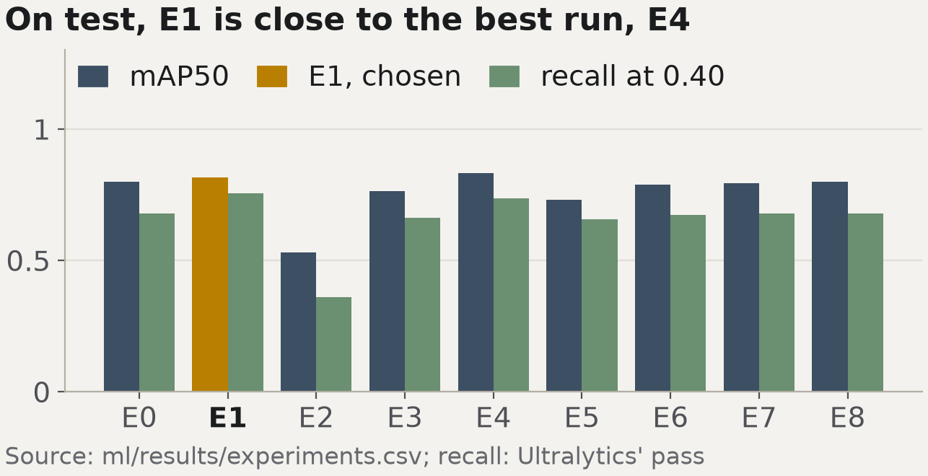
ROADS · RESULTS
Roads: E1 is chosen on validation and finds 176 of 236 test potholes
Run | Val mAP50 | Test mAP50
E0 | 0.8235 | 0.7992
E1 chosen | 0.8237 | 0.8155
E2 | 0.4391 | 0.5302
E3 | 0.7789 | 0.7632
E4 | 0.8276 | 0.8313
E5 | 0.7119 | 0.7299
E6 | 0.8204 | 0.7887
E7 | 0.7890 | 0.7949
E8 | 0.8235 | 0.7992
E1 at confidence 0.40: recall 0.746 (176 of 236), precision 0.854 (176 of 206), 30 false alarms; IoU 0.5.
Reporting policy: no test-gain claims below 0.02; E4 gap 0.016. Not statistical equivalence.
Example A: score 15, critical; project repair guidance 24 h, not an official standard.
Qarau · ICT1103 · QAIRU
06
Notes:
Speaker: Amina · budget 0:45 · script 90 words, about 0:42 at 130 words per minute
SCRIPT
Tair trained the full experiments. E4 leads validation mAP50, but our 0.01 tie band includes E1. E1 wins because its validation recall at 0.40 is highest, 0.738. At the test operating point, E1 finds 176 of 236 potholes, with 30 false alarms and 60 misses. Test never chooses the model. My training-only clustering supplies image-relative size bands; the worked highway example scores 15, critical. Our project policy withholds test-gain claims below 0.02, without claiming statistical equivalence. These are project rules, not an official repair standard. Nazar takes the second module.
CUES
- **Who did what:** Tair performed full E0-E8 training and generated the results being presented. My contribution is data review/preparation and validation, duplicate/XML checks, the invalid-annotation correction and YOLO export, training-only k-means bands, the M-0 selection/E8 policy, and the successful M-1 validation-only smoke. Smoke is a pipeline check, not E0 training or a champion candidate.
- **Champion versus E8:** E4 has the best validation mAP50, 0.8276; E0, E1, E6 and E8 lie within 0.01. E1 has the highest validation recall at 0.40 among those tied candidates, 0.7377, so it wins. E8 construction separately considers only E1/E3/E4/E7 changes exceeding E0 by strictly more than 0.01; none qualified, so E8 used E0 settings. E2/E5 are not combined but remain eligible for the general champion rule. Reproducing E0 in this E8 run does not establish seed-to-seed stability.
- **Operating-point evidence:** `operating_point.json` is for E1, 100 test photos, confidence 0.40 and IoU 0.5: TP 176, FP 30, FN 60; 236 labelled and 206 predicted boxes. Precision is 176/206 = 0.8544, recall is 176/236 = 0.7458, F1 is 0.7964. Each labelled box is matched at most once, highest-confidence prediction first (`ml/operating_point.py`). The chart/CSV's Ultralytics recall pass uses a different matching/reporting protocol; the confusion-matrix counts 178/34/58 are not interchangeable with 176/30/60. See `docs/ML-EXPERIMENT.md` for its IoU 0.45 and F1-best-threshold distinction.
- **Clustering and worked example:** training boxes only; small below 1.15%, large from 7.27% of image area (rounded display thresholds; actual config retains full precision). For example A: small contribution 1; large and medium in lane give 4 x 1.5 + 2 x 1.5 = 9; no cluster bonus; highway gives (1 + 9) x 1.5 = 15, critical. These bands measure apparent box area, not real dimensions or calibrated repair severity. Browser verification of `/app/roads/rules` is still pending; this update starts no QA.
- **Limits and handover:** test is reporting evidence, not a tuning set; preserve the prior D-2/test overlap and multiple evaluation-pass caveats on slide 5. The raw E4-E1 test mAP50 gap is 0.0158, displayed as 0.016; the project reporting policy withholds test-gain claims below 0.02. This cutoff comes from the Selection rule in `docs/ML-EXPERIMENT.md` (introduced in protocol commit `6bc6c07` and indexed by `docs/research/deck-sources.md`); it is not derived here from a statistical test, a confidence interval or a power calculation. It establishes neither statistical equivalence below 0.02 nor statistical significance above it, and is not a universal significance threshold. The separate 0.01 validation tie band is a model-selection policy, not a significance test either. No uncertainty interval or latency is invented. Personal timed reading remains pending. End with "Nazar takes the second module."
Sources: ml/results/operating_point.json (tp; testBoxes; precision; recall; fp; fn; iou; tp + fp; conf) · ml/results/experiments.csv (E0 row, valMap50; E0 row, map50 (test); E1 row, valMap50; E1 row, map50 (test); E2 row, valMap50; E2 row, map50 (test); E3 row, valMap50; E3 row, map50 (test); E4 row, valMap50; E4 row, map50 (test); E5 row, valMap50; E5 row, map50 (test); E6 row, valMap50; E6 row, map50 (test); E7 row, valMap50; E7 row, map50 (test); E8 row, valMap50; E8 row, map50 (test); E4 map50 − E1 map50 = 0.8313 − 0.8155; E4 row, valMap50 (highest); other runs within 0.01 of the best valMap50: E0, E1, E6, E8; E1 row, valRecallAtRulesConf) · docs/ML-EXPERIMENT.md ('Selection rule': differences below 0.02 on test are not claimed) · web/lib/rules/config.ts (worked example A, computed: (4 × 1.5 + 2 × 1.5 + 1) × r5.highway; SEVERITY_BANDS.critical.slaHours) · ml/export_results.py (TIE (selection rule)) · ml/export_results.py (pick_champion: validation-only rule) · docs/RULES.md (part 1, worked example A) · docs/ML-EXPERIMENT.md (0.02 is a project reporting policy, not a statistical equivalence/significance threshold; evaluation limits) · ml/results/operating_point.json (run; images; fn; iou; f1; precision; recall) · ml/operating_point.py (confidence-ordered one-to-one matching) · ml/results/pothole_area_clusters.json (split; area_thresholds; image-relative limitation) · data/README.md (personal dataset/clustering work; D-20) · ml/results/runs/E0-smoke.json and E0-smoke-results.csv (smoke only) · docs/decisions/0009-m0-e8-policy.md (E8 construction versus champion) · docs/worklog/amina.md (personal contribution)

Slide 7
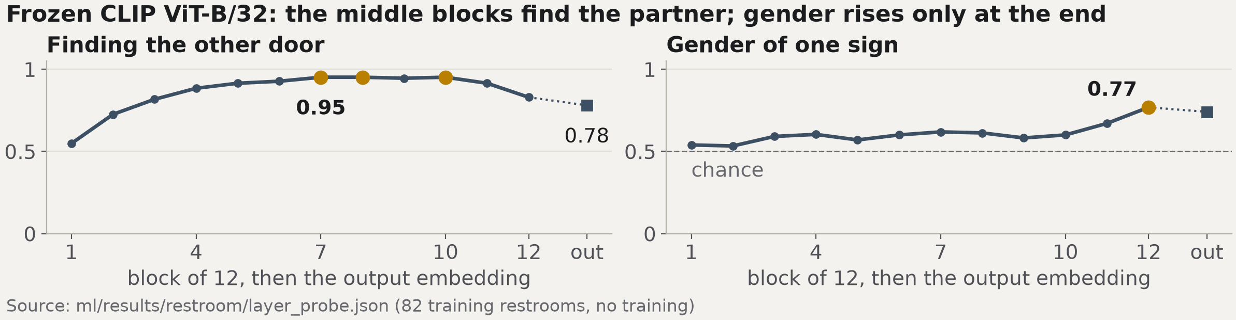
RESTROOMS · DATA AND EXPERIMENT
Restrooms: find the other door
IOAI 2025: given a cropped door sign, find the sign of the opposite gender from the same restroom.
82 training restrooms; 10 validation and 30 test queries; licence CC-BY-4.0.
1 Zero-shot CLIP (R0, R1)
2 Fine-tune the last 1, 3 or 6 blocks (R2–R4)
3 Two-step pipeline, no training (R7)
Qarau · ICT1103 · QAIRU
07
Notes:
Speaker: Nazar · budget 0:50 · script 99 words, about 0:46 at 130 words per minute
SCRIPT
The restroom task comes from the IOAI 2025 olympiad. Given a cropped door sign, the model must find the other door of the same restroom, the opposite gender, in a gallery. The data is small: 82 training restrooms, 10 validation and 30 test queries. We ran three groups. Zero-shot CLIP, which is IOAI's baseline. Our Option A change: fine-tuning the last one, three or six transformer blocks. And a two-step pipeline with no training. The figure shows why depth matters: the middle blocks find the partner best, and gender rises only at the end. Here is what came out.
CUES
Figure values (layer_probe.json): partner found 0.95 at blocks 7, 8 and 10, 0.78 at the output embedding; gender rises to 0.77 only in the last block. The pipeline: SIFT and a pixel check find the crop's original, colour histogram and CLIP find its partner; chosen on 200 training episodes (pipeline.json). R2–R4 use fine-tuned CLIP in both steps; the pipeline (R7) uses SIFT in step 1 and trains nothing. Do not call both 'two-step' without saying which. ResNet50, also in the probe file, is left off the figure: the slide is about CLIP.
Sources: data/README.md (restroom card, 'Training set' (restrooms); restroom card, 'Validation set' (queries); restroom card, 'Test set' (queries)) · ml/results/restroom/experiments.csv (R2 row, `changed` (blocks fine-tuned); R3 row, `changed` (blocks fine-tuned); R4 row, `changed` (blocks fine-tuned)) · ml/results/restroom/layer_probe.json (results.clip[7, 8, 10].pair_top1 (highest); results.clip.final.pair_top1; results.clip.12.gender_acc_cv) · ml/results/restroom/pipeline.json (protocol.train_episodes) · docs/ML-EXPERIMENT-RESTROOM.md ('Task and data', 'Runs')

Slide 8
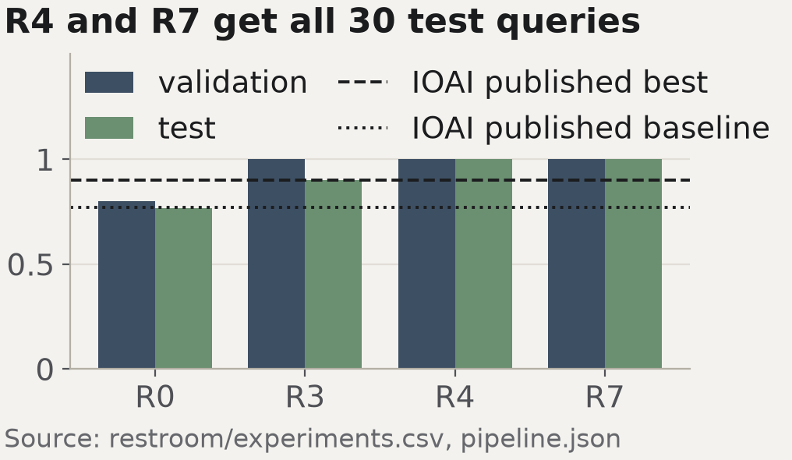
RESTROOMS · RESULTS
Restrooms, 30 test queries: zero-shot 23, fine-tuned 27 (R3) to 30 (R4), pipeline 30
Method | Val | Test
R0 zero-shot CLIP | 8/10 | 23/30 (0.767)
R3 fine-tune 3 blocks | 10/10 | 27/30 (0.900)
R4 fine-tune 6 blocks | 10/10 | 30/30 (1.000)
R7 two-step pipeline | 10/10 | 30/30 (1.000)
IOAI published baseline |  | 0.77
IOAI published best |  | 0.90
One test query is worth 0.033. Gender of one sign, ViT-B/32 (served): prompts 0.756, probe 0.741.
The pipeline uses two facts of this benchmark: each query is cut from a gallery original, and the gallery holds exactly the queries' partners. A real building gives neither.
Qarau · ICT1103 · QAIRU
08
Notes:
Speaker: Nazar · budget 0:50 · script 109 words, about 0:50 at 130 words per minute
SCRIPT
Zero-shot CLIP matches 23 of 30 test queries, the same as IOAI's published baseline of 0.77. Fine-tuning the last three blocks, run R3, gives 27 of 30; R3 is the run our rule picks on validation. The two-step pipeline gets all 30. IOAI's published best is 0.90; those are their numbers, not a contest we took part in. One query is worth 0.033. Thirty test queries cannot separate these runs well. The pipeline also uses two facts of this benchmark that a real building does not give. Gender from one sign is hard: prompts reach 0.756, a trained probe 0.741. Dameli will show how the interface makes this usable.
OPEN GAP (C-20, #201, Nazar): 95 % intervals for 30/30 and 27/30 and the paired test, ml/results/restroom/intervals.json. Not on the slide. Until it is filled, the script uses: “Thirty test queries cannot separate these runs well.” When it lands, add the number with its source here and in docs/research/deck-sources.md, then rebuild.
CUES
Highlighted rows: R3, chosen among the runs on validation (R2–R4 tie at 10/10; gender breaks the tie), and R7, the matching method chosen on training episodes (pipeline.json `champion` = sift_combo_hungarian). Open team decision (R-3 step 4): which one is the headline; Nazar confirms in the chat. R4's 30/30 does not change the run choice: the rule never looks at test. Never say 'we beat the IOAI best'. Gender numbers: R1's zero-shot ViT-B/32, the model the API serves; R0's ViT-B/16 gives other gender numbers, see runs/R0.json; 5-fold cross-validation grouped by restroom. What the app serves today is neither R3 nor R7: `served` is null; Match ranks by zero-shot CLIP ViT-B/32 and the opposite predicted gender (servedNote in web/data/restroom-experiments.json; task C-8). If C-21 (#202) lands, add its one-query-at-a-time number next to 30/30.
Sources: ml/results/restroom/pipeline.json (val.sift_combo_hungarian × 10 queries; test.sift_combo_hungarian × 30 queries; length of predictions.test.sift_combo_hungarian; test.sift_combo_hungarian; computed: 1 / 30 test queries (length of predictions.test.sift_combo_hungarian)) · ml/results/restroom/runs/R0.json (metrics.test_correct; metrics.val_correct) · ml/results/restroom/runs/R3.json (metrics.test_correct; metrics.val_correct) · ml/results/restroom/runs/R4.json (metrics.test_correct; metrics.val_correct) · web/data/restroom-experiments.json (reference.ioaiBaseline (IOAI published); reference.ioaiBest (IOAI published)) · ml/results/restroom/experiments.csv (R0 row, matchTop1Test; R3 row, matchTop1Test; R4 row, matchTop1Test) · ml/results/restroom/runs/R1.json (gender.zero_shot_prompts.accuracy; gender.probe_lr.accuracy) · ml/restroom/pipeline.py (docstring: the benchmark guarantee behind the caveat) · docs/ML-EXPERIMENT-RESTROOM.md ('Two choices, two rules')

Slide 9
DESIGN · THREE OF NIELSEN'S HEURISTICS
Designed for a road dispatcher
Screenshot
09-heuristic-1-status.png
Drive: screenshots/
Screenshot
09-heuristic-2-recover.png
Drive: screenshots/
Screenshot
09-heuristic-3-recognition.png
Drive: screenshots/
Visibility of system status:
provider and connection shown
Error recovery:
the cause, and one click to Mock
Recognition over recall:
six labelled sample images
Charts: bars from zero; severity colours only for severity.
Text on page and card backgrounds: at least 4.98:1 (light) and 5.36:1 (dark); WCAG asks 4.5:1.
Qarau · ICT1103 · QAIRU
09
Notes:
Speaker: Dameli · budget 0:35 · script 77 words, about 0:36 at 130 words per minute
SCRIPT
I designed Qarau for a road dispatcher. Visibility of system status: the app always shows which model answers and whether it is connected. Error recovery: if the model service is down, the message says why and offers one click to the mock provider. Recognition over recall: you pick a sample instead of guessing what to upload. Charts start at zero, and every text colour passes WCAG AA in both themes. Roma now explains how we used AI.
CUES
The three crops are placed in Canva from the Drive folder screenshots/ (docs/design/screenshots.md: screenshots never go into git). Course sources, not on the slide: HCI p14, p19 and p22 for the three heuristics; HCI p37 for WCAG; VizBasics p4, DMViz p28 and p31 for the charts. Also true, for questions: keyboard-only analysis with a visible focus ring; every status has a word and an icon. The contrast audit is preliminary and covers text tokens on --bg and --surface. No screenshot of a seeded dashboard without its 'Demo data' badge. Screenshots not embedded in this build.
Sources: docs/DESIGN-BRIEF.md ('Contrast audit (G-3)', lowest light-theme text ratio (`subtle`); 'Contrast audit (G-3)', lowest dark-theme text ratio (`subtle`); U4 (WCAG text contrast target)) · docs/PRESENTATION.md ('Slide 9, design decisions')

Slide 10
AI USE AND ITS LIMITS
How we used AI, and how we checked it
Claude Code, Codex, GitHub Copilot
• Writing and reviewing code and tests
• Drafting documents, study cards and slide text
• Checking text against the result files
How we checked
• Unit tests and CI on every pull request
• Every number traced to a committed file (docs/research/deck-sources.md)
• Each use logged with its prompt and check: 88 entries in docs/AI-USAGE-LOG.md
Qarau · ICT1103 · QAIRU
10
Notes:
Speaker: Roma · budget 0:35 · script 80 words, about 0:37 at 130 words per minute
SCRIPT
We used AI tools, mainly Claude Code, Codex and Copilot, to write and review code and tests, to draft documents, and to check text against our result files. Every use is logged with its prompt: 88 entries. Whoever used a tool checked its output, with tests and CI, and every number on these slides is traced to a committed file. We planned an audit of two vision-language models; it is not finished, so we show no numbers. Next, the limits.
OPEN GAP (R-6, #85, Roma): R-6 (#85) audit of two vision-language models: count error on screened test photos, docs/research/vlm-evaluation.md is not on main. Not on the slide. Until it is filled, the script uses: “We planned an audit of two vision-language models; it is not finished, so we show no numbers.” When it lands, add the number with its source here and in docs/research/deck-sources.md, then rebuild.
CUES
The entry count is read when the deck is built; rebuild after the 23:00 freeze so it is final. Never quote audit numbers that are not in docs/research/vlm-evaluation.md.
Sources: docs/AI-USAGE-LOG.md (number of '### ' entries under 'Entries' at build time) · docs/AI-USAGE-LOG.md (entries: tool, purpose, verification)

Slide 11
LIMITATIONS AND NEXT STEPS
What our results do not show yet
1
Box area is not physical size
A far pothole looks small. Real size needs camera calibration or depth.
2
82 training restrooms, two classes
Accessible and all-gender signs are not in the data.
3
No local data yet
The road photos are not from Kazakhstan.
Next: an external test set of screened local photos, the two-step pipeline served in the app (C-8), and repeat runs with other seeds.
Qarau · ICT1103 · QAIRU
11
Notes:
Speaker: Roma · budget 0:25 · script 52 words, about 0:24 at 130 words per minute
SCRIPT
Three limits. Box area is not physical size: a far pothole looks small. The restroom data has 82 training restrooms and two classes, so accessible and all-gender signs are missing. And none of our road photos are from Kazakhstan. Next: screened local photos and the two-step pipeline in the app. Tair closes.
CUES
Also true, for questions: a close-up fills the frame; snow and night scenes are untested (docs/ML-EXPERIMENT.md, 'Limits to state').
Sources: data/README.md (restroom card, 'Training set' (restrooms)) · docs/RULES.md ('Known limits') · docs/ML-EXPERIMENT.md ('Limits to state', 'Stretch') · docs/ML-EXPERIMENT-RESTROOM.md ('Limits to state')

Slide 12
QUESTIONS
Where everything is
Repository
github.com/tairqaldy/qarau-ict-final-1st-trimester
Live site
qarau.vercel.app
real model page; analyses there run on demo data
Results
ml/results/experiments.csv
ml/results/restroom/experiments.csv
How we worked
docs/AI-USAGE-LOG.md
docs/CONTRIBUTION-LOG.md
Real: both analyze flows on this laptop and the model page. Demo data: the overview tiles and charts, marked with a badge.
Notes:
Speaker: Tair · budget 0:10 · script 21 words, about 0:10 at 130 words per minute
SCRIPT
Thank you. The code, both results tables and our AI log are in this repository. We are ready for your questions.
CUES
Leave this slide up during questions. docs/research/vlm-evaluation.md is listed automatically once it exists on main (R-20 'Watch out': no path that does not exist). If asked for code, open ml/train.py, then web/lib/rules/, then api/main.py (docs/PRESENTATION.md 'Showing source code').
Sources: README.md ('Live demo') · docs/decisions/0006-public-repository.md · docs/PRESENTATION.md (demo script, step 5)

Slide 13
BACKUP · ROADS
All 9 pothole runs: the columns used in the talk
Run | Val mAP50 | Val R@0.40 | Test mAP50 | Test mAP50-95 | Test P@0.40 | Test R@0.40 | MB
E0 | 0.8235 | 0.6951 | 0.7992 | 0.5173 | 0.8743 | 0.6780 | 5.4
E1 | 0.8237 | 0.7377 | 0.8155 | 0.5475 | 0.8396 | 0.7542 | 20.3
E2 | 0.4391 | 0.2918 | 0.5302 | 0.2472 | 0.7658 | 0.3602 | 5.4
E3 | 0.7789 | 0.6459 | 0.7632 | 0.4843 | 0.8083 | 0.6610 | 5.4
E4 | 0.8276 | 0.7279 | 0.8313 | 0.5629 | 0.8744 | 0.7373 | 5.4
E5 | 0.7119 | 0.6098 | 0.7299 | 0.4667 | 0.8708 | 0.6568 | 5.4
E6 | 0.8204 | 0.7016 | 0.7887 | 0.5383 | 0.8870 | 0.6737 | 5.5
E7 | 0.7890 | 0.6295 | 0.7949 | 0.4493 | 0.8511 | 0.6780 | 5.6
E8 | 0.8235 | 0.6951 | 0.7992 | 0.5173 | 0.8743 | 0.6780 | 5.4
Precision and recall at 0.40 here are Ultralytics' own pass (IoU 0.45); the operating point on slide 6 is ml/operating_point.py (IoU 0.5). Latency: not measured yet (S-15).
Qarau · ICT1103 · QAIRU
B1
Notes:
Speaker: Amina · budget on request · script 3 words, about 0:01 at 130 words per minute
SCRIPT
Only on request.
CUES
What each run changes (experiments.csv `changed`): E0 baseline; E1 model width: small instead of nano; E2 no transfer learning: random weights; E3 frozen backbone: layers 0-10; E4 optimizer: AdamW; E5 standard augmentations off; E6 input resolution 960; E7 architecture: extra P2 small-object scale; E8 best combination: no change qualified, E0 settings.
Sources: ml/results/experiments.csv (number of rows (runs); E0 row, valMap50; E0 row, valRecallAtRulesConf; E0 row, map50; E0 row, map50_95; E0 row, precisionAtRulesConf; E0 row, recallAtRulesConf; E0 row, sizeMb; E1 row, valMap50; E1 row, valRecallAtRulesConf; E1 row, map50; E1 row, map50_95; E1 row, precisionAtRulesConf; E1 row, recallAtRulesConf; E1 row, sizeMb; E2 row, valMap50; E2 row, valRecallAtRulesConf; E2 row, map50; E2 row, map50_95; E2 row, precisionAtRulesConf; E2 row, recallAtRulesConf; E2 row, sizeMb; E3 row, valMap50; E3 row, valRecallAtRulesConf; E3 row, map50; E3 row, map50_95; E3 row, precisionAtRulesConf; E3 row, recallAtRulesConf; E3 row, sizeMb; E4 row, valMap50; E4 row, valRecallAtRulesConf; E4 row, map50; E4 row, map50_95; E4 row, precisionAtRulesConf; E4 row, recallAtRulesConf; E4 row, sizeMb; E5 row, valMap50; E5 row, valRecallAtRulesConf; E5 row, map50; E5 row, map50_95; E5 row, precisionAtRulesConf; E5 row, recallAtRulesConf; E5 row, sizeMb; E6 row, valMap50; E6 row, valRecallAtRulesConf; E6 row, map50; E6 row, map50_95; E6 row, precisionAtRulesConf; E6 row, recallAtRulesConf; E6 row, sizeMb; E7 row, valMap50; E7 row, valRecallAtRulesConf; E7 row, map50; E7 row, map50_95; E7 row, precisionAtRulesConf; E7 row, recallAtRulesConf; E7 row, sizeMb; E8 row, valMap50; E8 row, valRecallAtRulesConf; E8 row, map50; E8 row, map50_95; E8 row, precisionAtRulesConf; E8 row, recallAtRulesConf; E8 row, sizeMb) · docs/ML-EXPERIMENT.md ('What to report')

Slide 14
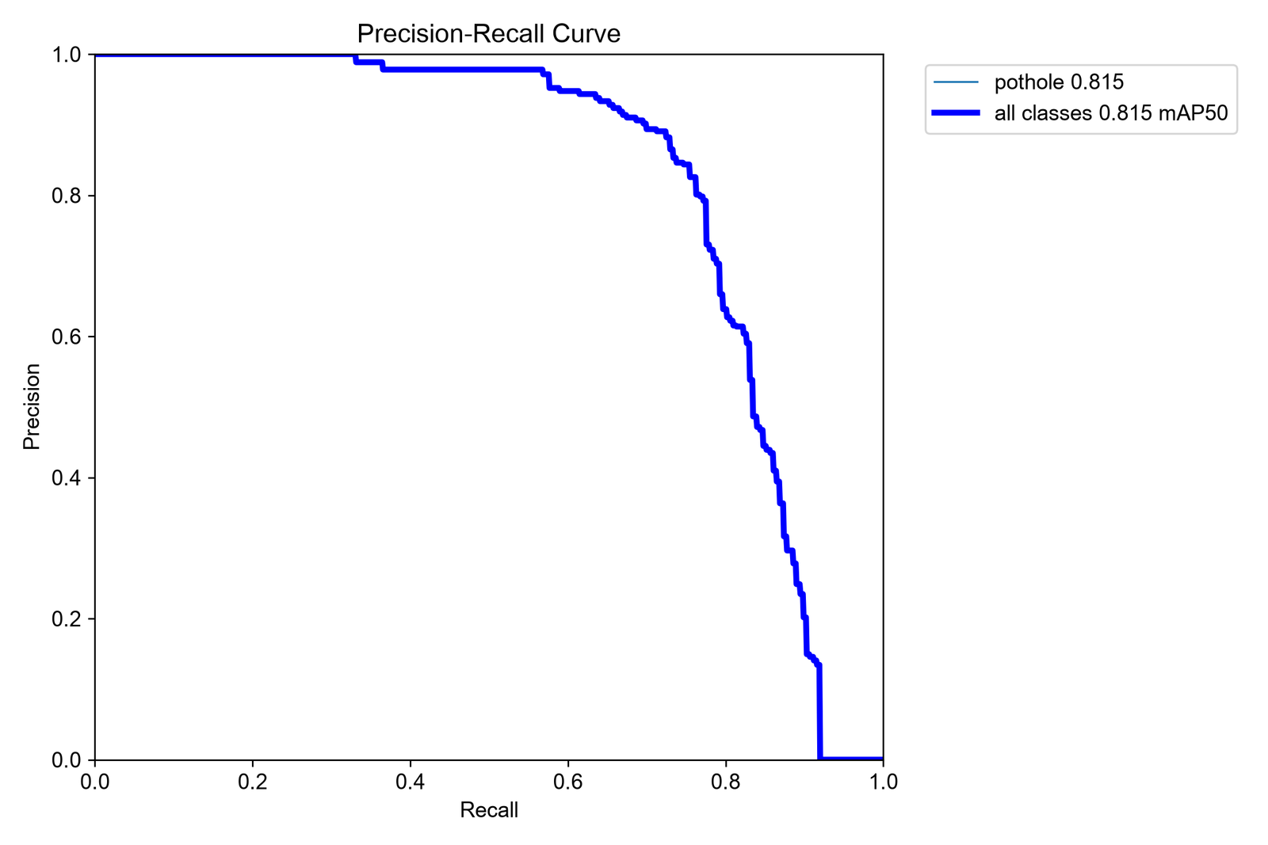
BACKUP · ROADS
E1 at the app's threshold, on the test split
Photos | Potholes | Found (TP) | False alarms | Missed (FN) | Precision | Recall | F1
100 | 236 | 176 | 30 | 60 | 0.854 | 0.746 | 0.796
Confidence 0.40, IoU 0.5, each labelled box matched at most once (ml/operating_point.py). Right: Ultralytics' precision-recall curve for the same model on test; its legend rounds mAP50 to 3 decimals, experiments.csv has 0.8155.
Qarau · ICT1103 · QAIRU
B2
Notes:
Speaker: Amina · budget on request · script 3 words, about 0:01 at 130 words per minute
SCRIPT
Only on request.
CUES
The confusion-matrix figure (ml/results/fig_champion_confusion_at_040.png) counts at IoU 0.45 and so differs slightly from this table; it is left out so the slide gives one answer.
Sources: ml/results/operating_point.json (images; testBoxes; tp; fp; fn; precision; recall; f1; conf; iou) · ml/results/experiments.csv (E1 row, map50 (test)) · docs/ML-EXPERIMENT.md ('Operating point') · ml/README.md ('Deck plots')

Slide 15
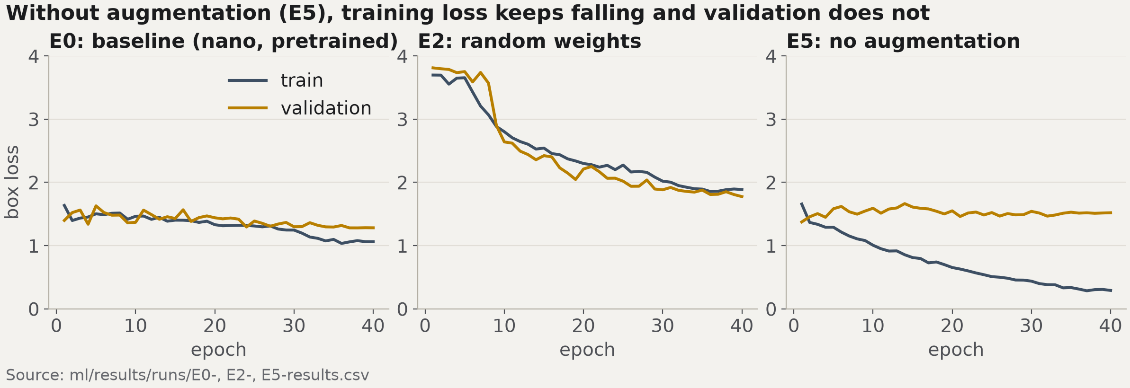
BACKUP · ROADS
Training curves: train against validation box loss
E2 trains from random weights, so it starts high. In E5 the validation loss stays flat: overfitting.
Qarau · ICT1103 · QAIRU
B3
Notes:
Speaker: Amina · budget on request · script 3 words, about 0:01 at 130 words per minute
SCRIPT
Only on request.
Sources: no numbers on this slide

Slide 16
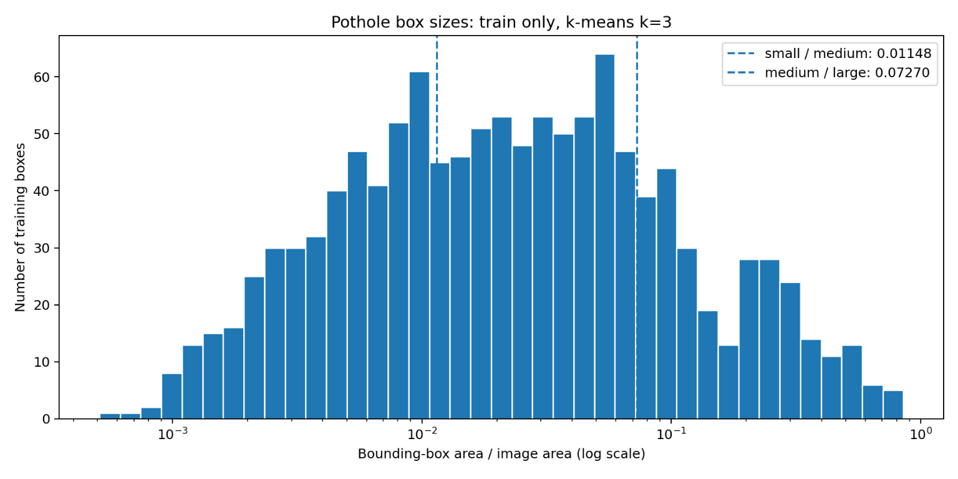
BACKUP · ROADS · RULES
Rules: k-means size bands and one worked example
Worked example (RULES.md, A)
Highway photo: one large and one medium box in the lane, one small box off it.
Points: 4 × 1.5 + 2 × 1.5 + 1 = 10
No cluster bonus (needs 3 medium or large boxes)
Highway × 1.5 → 15
Score 15 → critical: repair within 24 h
k-means (k = 3) on 1,198 training boxes: small below 1.15 %, large from 7.27 % of the image (429 / 499 / 270 boxes). Shares of the image, not physical size.
Qarau · ICT1103 · QAIRU
B4
Notes:
Speaker: Amina · budget on request · script 3 words, about 0:01 at 130 words per minute
SCRIPT
Only on request.
Sources: ml/results/pothole_area_clusters.json (k; boxes; area_thresholds[0] × 100 (% of image); area_thresholds[1] × 100 (% of image); group_counts.small; group_counts.medium; group_counts.large) · web/lib/rules/config.ts (DEFAULT_RULES.r3.multiplier; DEFAULT_RULES.r5.highway; DEFAULT_RULES.r2.large; DEFAULT_RULES.r2.medium; DEFAULT_RULES.r2.small; DEFAULT_RULES.r4.minCount; computed: 4 × 1.5 + 2 × 1.5 + 1; computed: (points + 0) × r5.highway; SEVERITY_BANDS.critical.slaHours) · data/README.md ('Box-size clustering for R2') · docs/RULES.md (part 1, example A)

Slide 17
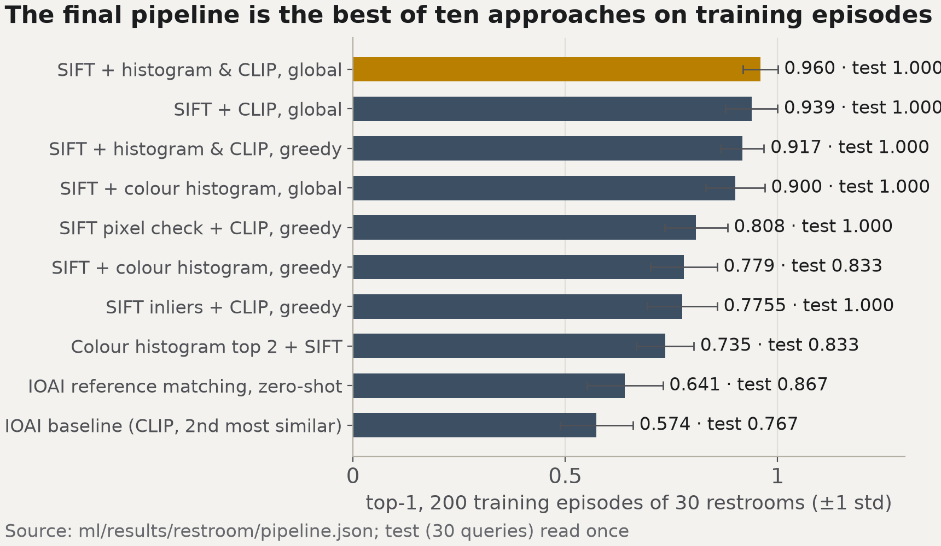
BACKUP · RESTROOMS
Restrooms: from the IOAI baseline to the pipeline
Chosen on training episodes, then validation; test read once.
Champion: SIFT + pixel check, then 0.3 × colour histogram + 0.7 × CLIP (z-scored), one global assignment.
Training episodes: 0.960 ± 0.041.
Qarau · ICT1103 · QAIRU
B5
Notes:
Speaker: Nazar · budget on request · script 3 words, about 0:01 at 130 words per minute
SCRIPT
Only on request.
Sources: ml/results/restroom/pipeline.json (histogram_weight; computed: 1 − histogram_weight; train_episodes.sift_combo_hungarian.top1.mean; train_episodes.sift_combo_hungarian.top1.std) · docs/ML-EXPERIMENT-RESTROOM.md ('The final pipeline')

