Slide 1

Data Science Questions
What is the relationship between a healthy lifestyle and a chronic disease?
What impact do lifestyle factors have the risk of diabetes?
What is the relationship between diabetes and other health problems?

Slide 2
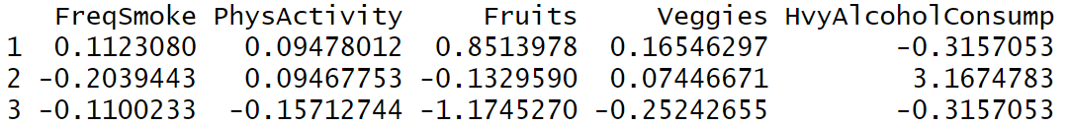
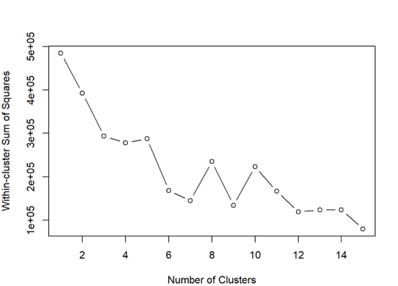
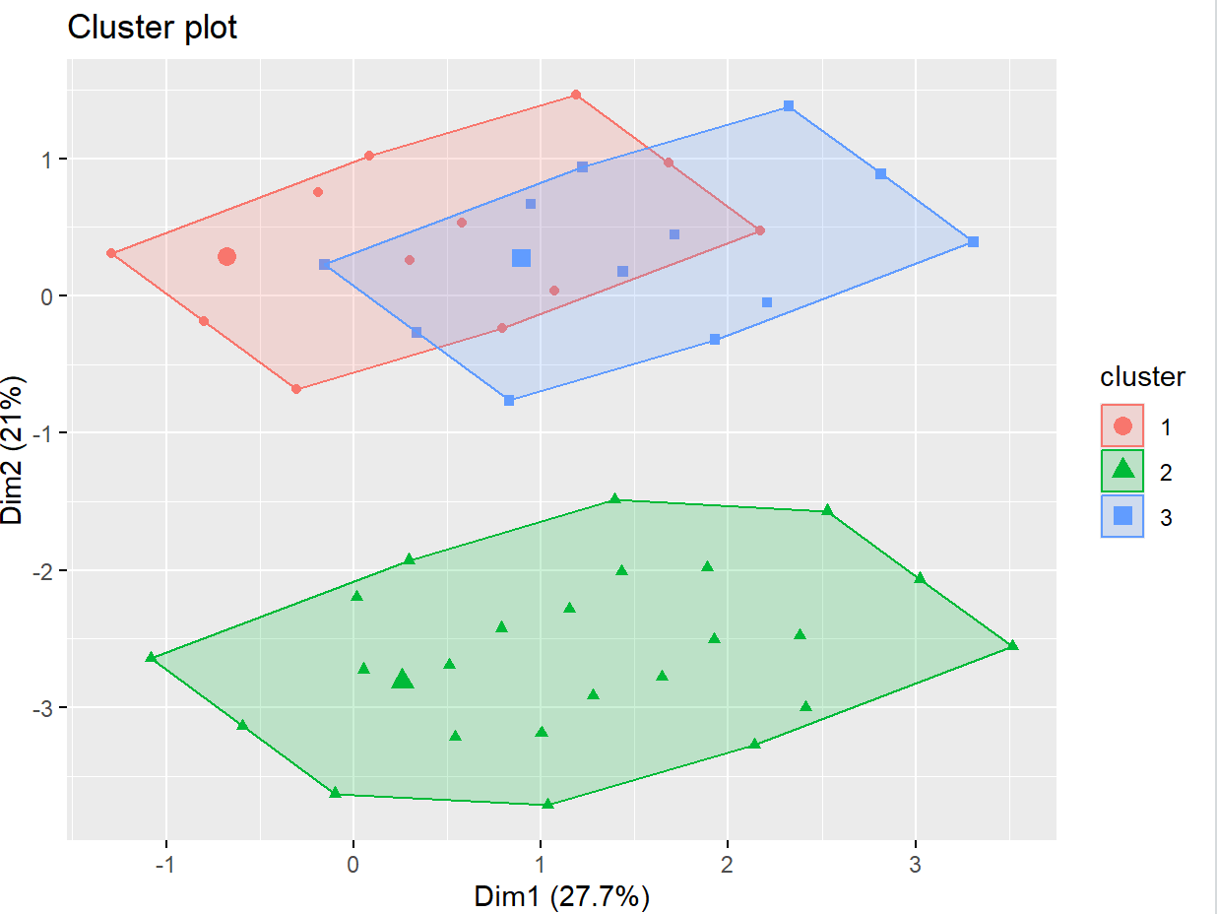
What is the relationship between a healthy lifestyle and a chronic disease?
Method : K-means
Cluster centers:

Slide 3

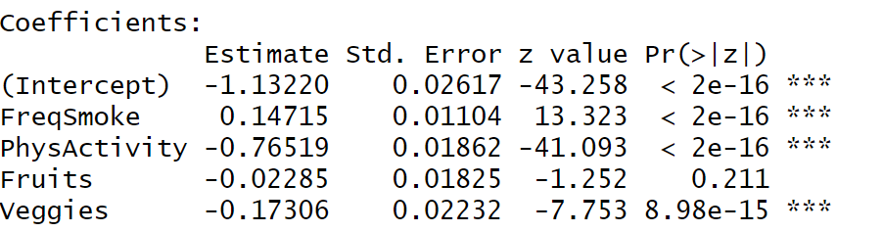
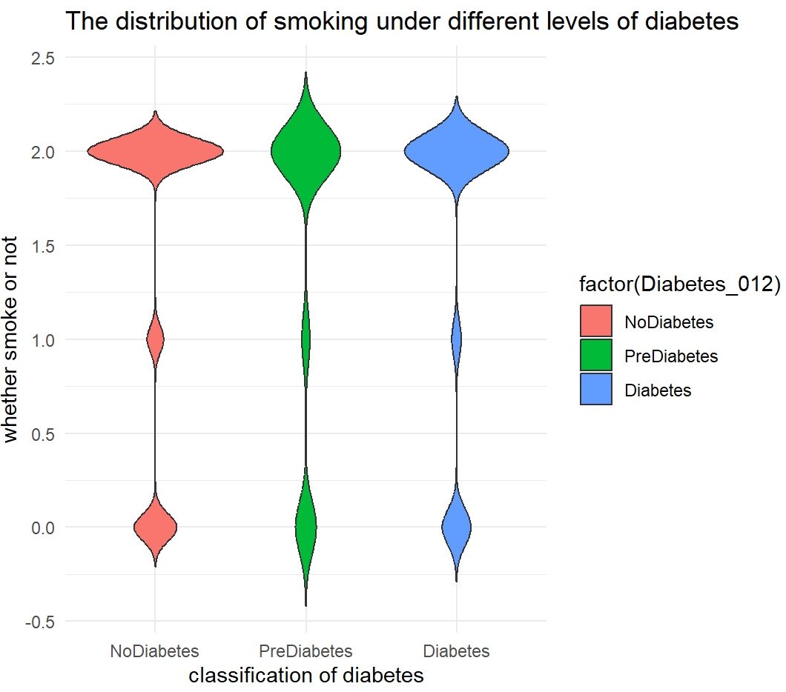
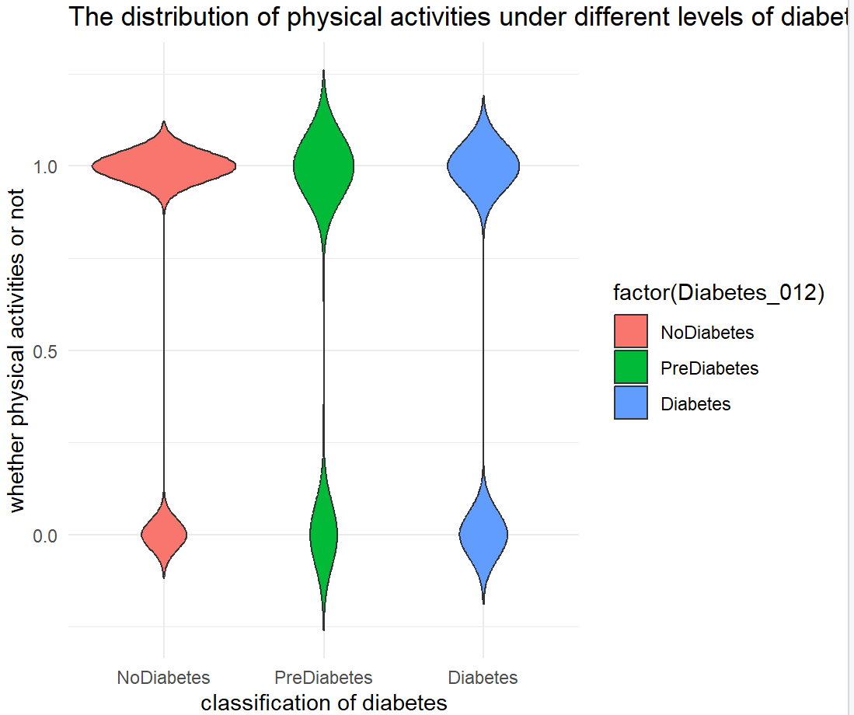
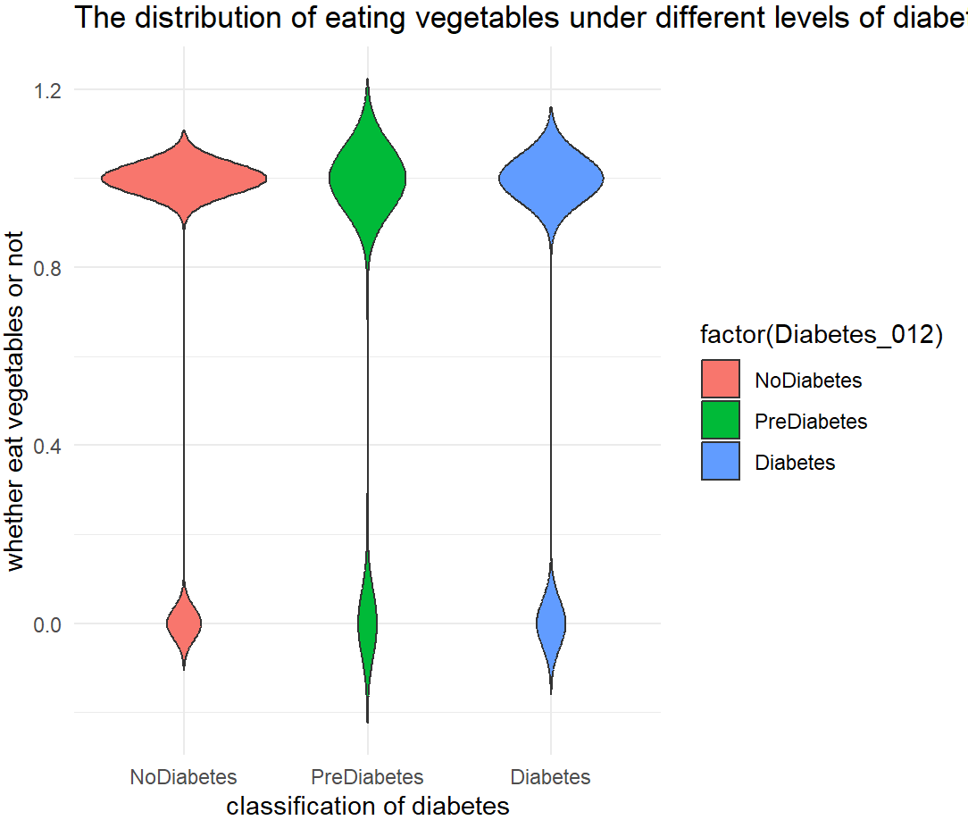
What impact do lifestyle factors have the risk of diabetes?
01
Method : Logistic regression
02
Smoking frequency ↑ → diabetes risk ↑
Physical activity ↑ → diabetes risk ↓
Vegetable intake ↑ → diabetes risk ↓

Slide 4

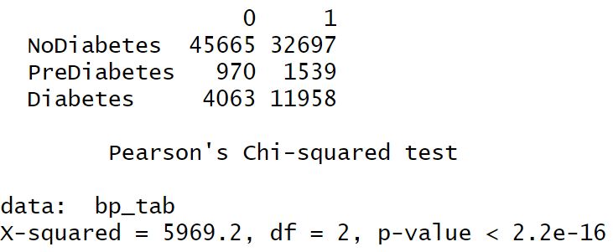
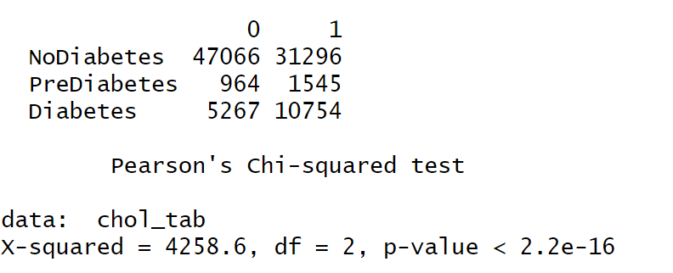
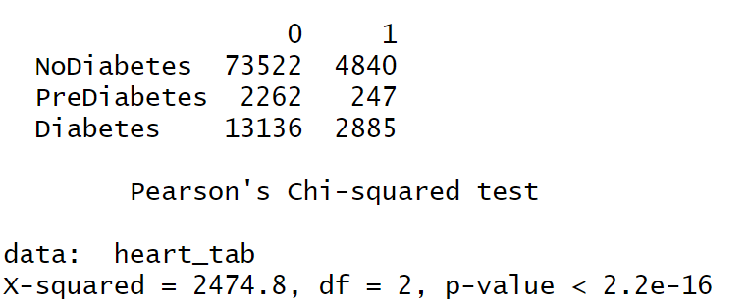
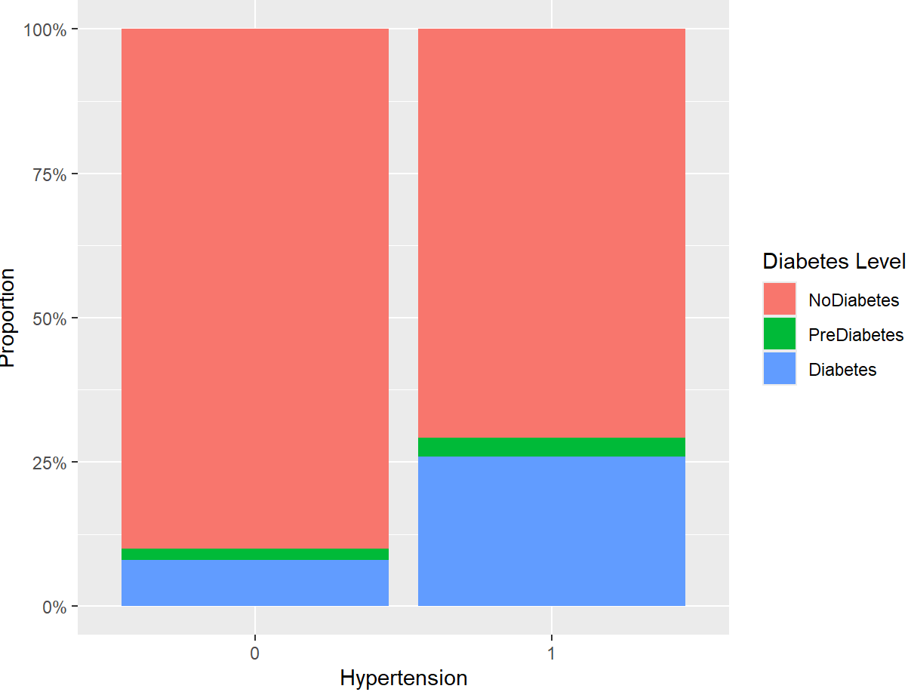
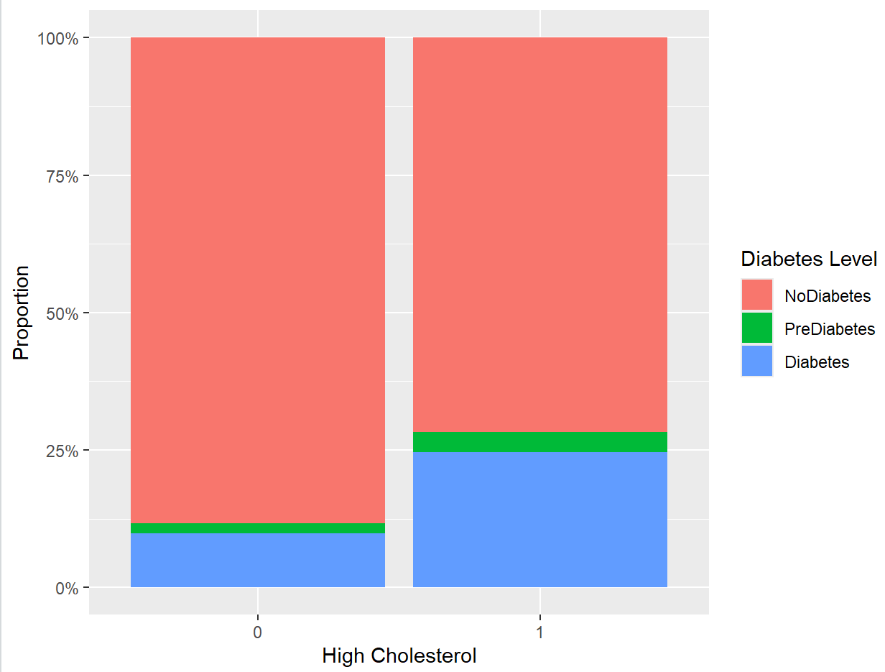
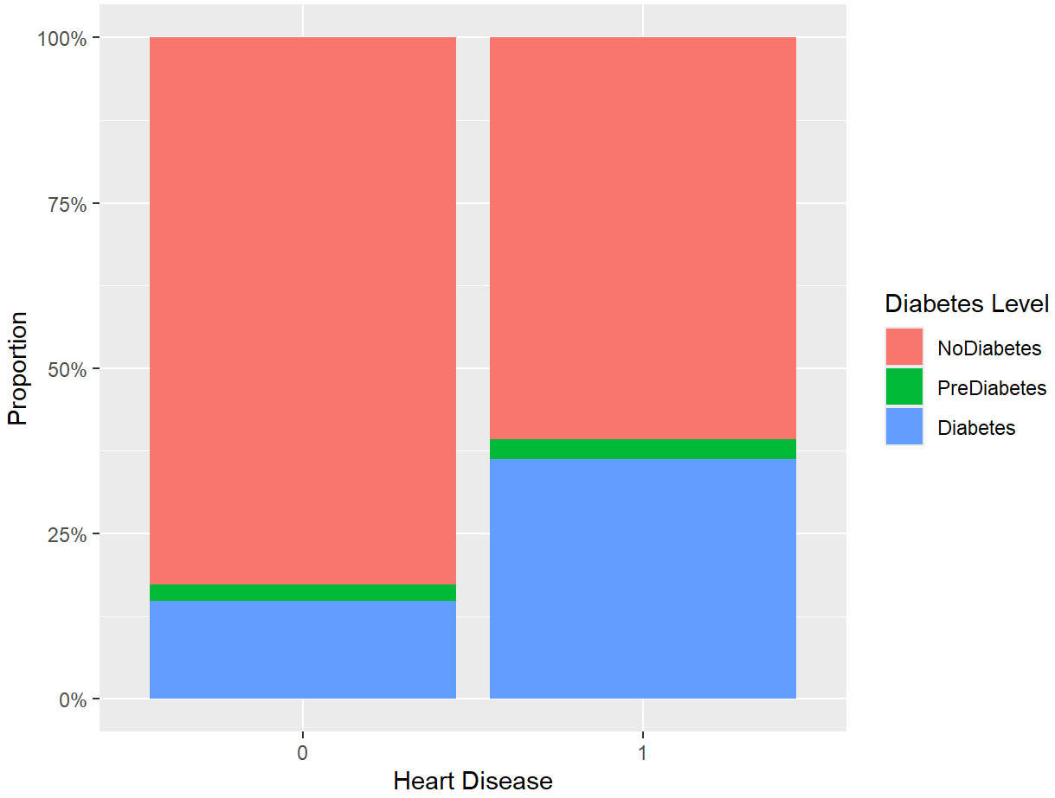
Relationship between diabetes and other health problems?
Method :Chi-squared test
Use Contingency table and look p values
Bar chart showing the relationship between hypertension, high cholesterol, heart disease and the diabetes level

Slide 5

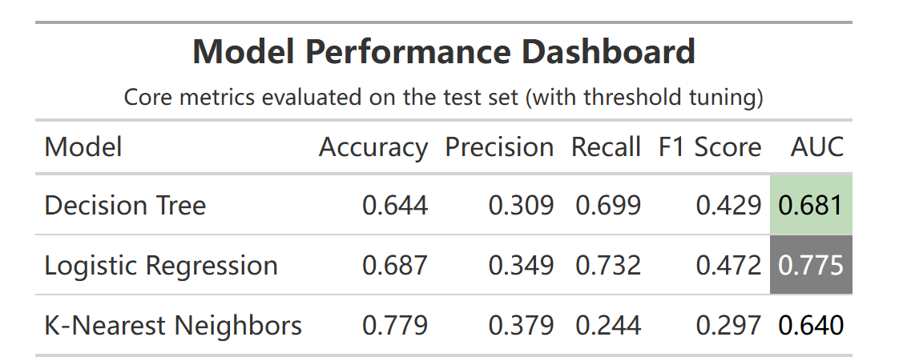
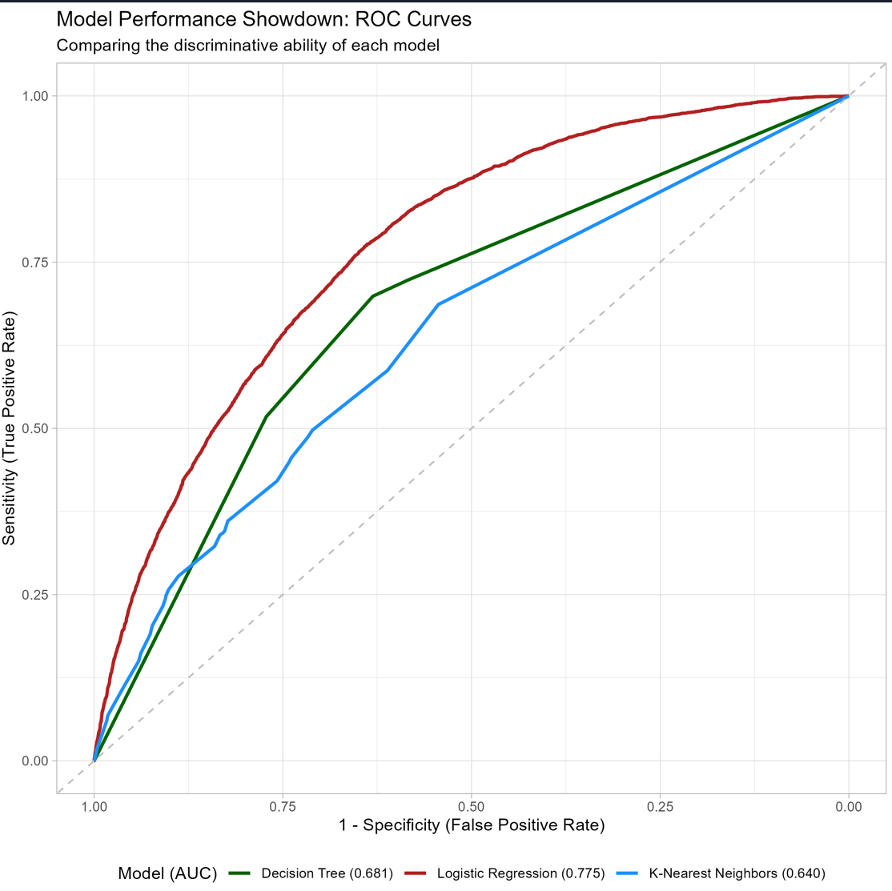



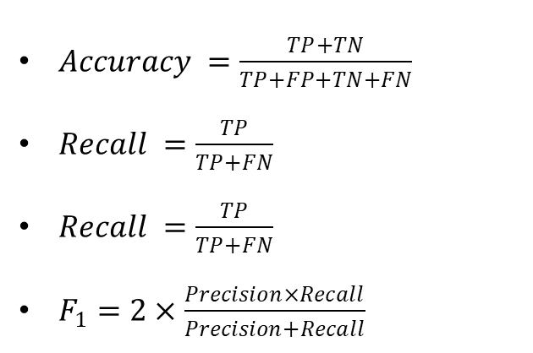
Model Evaluation
Evaluation metrics
$Accuracy =\frac{TP+TN}{TP+FP+TN+FN}$​
$Recall =\frac{TP}{TP+FN}$
$Recall =\frac{TP}{TP+FN}$
$F_{1}=2×\frac{Precision×Recall}{Precision+Recall}$
The red curve (Logistic Regression) is at the top, indicating that it has the best performance and the highest AUC value
The green curve (Decision Tree) comes next
The blue curve (K-Nearest Neighbors) is at the bottom, with relatively the poorest performance.

Slide 6
Next actions
Diabetes Risk Level Notification
Low Risk
Moderate Risk
High Risk
Health Recommendations
Increase physical activity
control diet
have regular medical check-ups
Personalized Intervention Plan
Provide tailored intervention recommendations based on specific characteristics, such as high blood pressure, high cholesterol, and heart disease.

