Slide 1
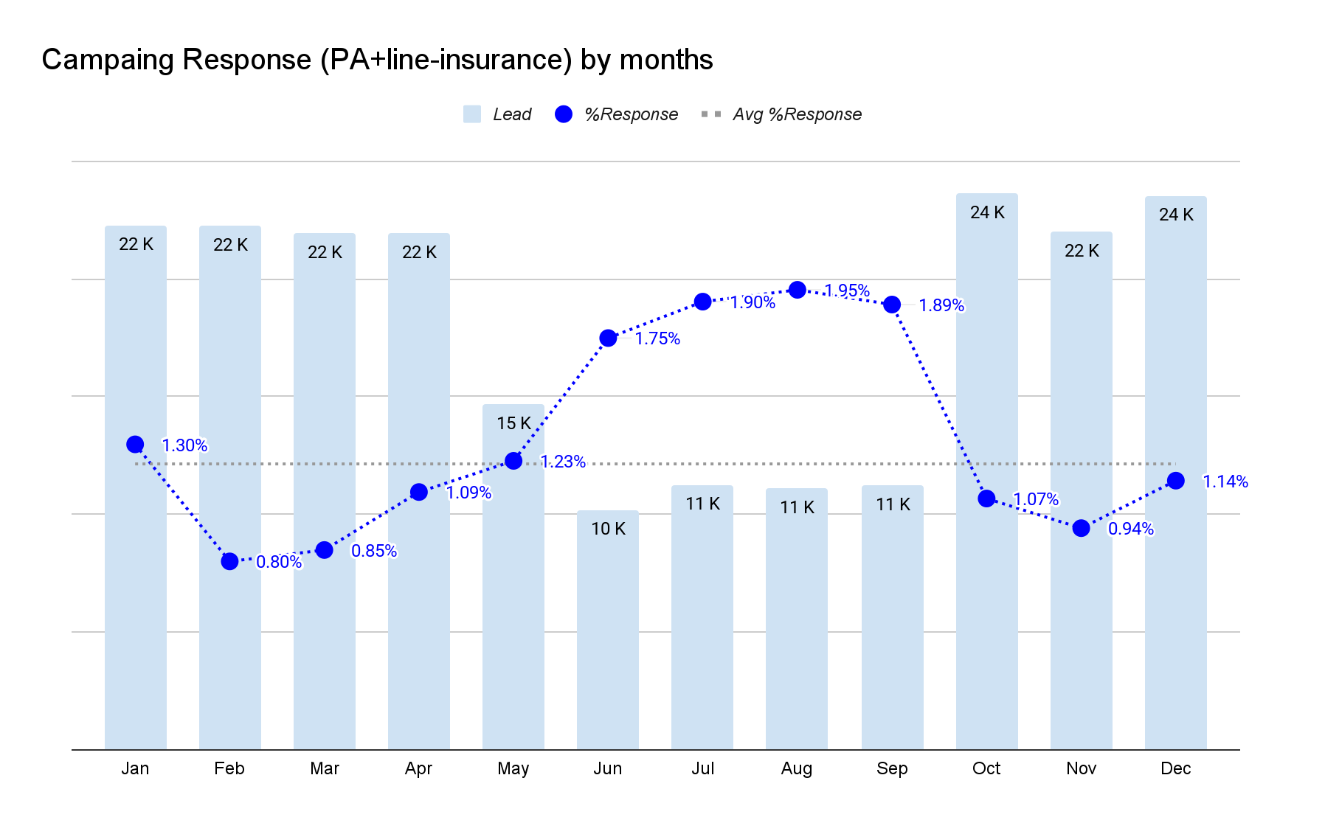
The problem
📉 The current campaign has low response rate (avg response ~1.2%) due to broad targeting.
🔍 Using a preditcive model to identify customer who have propensity to buy insurance.

Slide 2
Who likely to buy Insurance
◆ High propensity customers are younger, more likely single, with moderate income and saving habits, and stronger relationships (payroll, Credit card, Planet).
◆ Low propensity group tends to be older, with lower financial engagement, and more mixed status and occupations.
Average ( P50)
Persona | High Propensity (BIN 10) | Low Propensity (BIN 1)
Age | 32 years ( 28 years) | 44 years ( 43 years)
Income | 15K (12K) | 11K (6.5K)
Avg saving balance 30 days | 2.4K (1.1k) | 0.9K (0.0K)
Payroll / CC / Planet | 25% / 5% / 1% | 9%/ 1% / 0%
Occupation | 45% SA, 20% SE, 21% STU | 38% SA, 25% SE, 10% FRL
Customer Segment | 60% L-Mass, 37% Mass, 3% U-Mass | 47% L-Mass, 35%-Mass, 2% U-Mass
Status Single | 82% | 50%

Slide 3
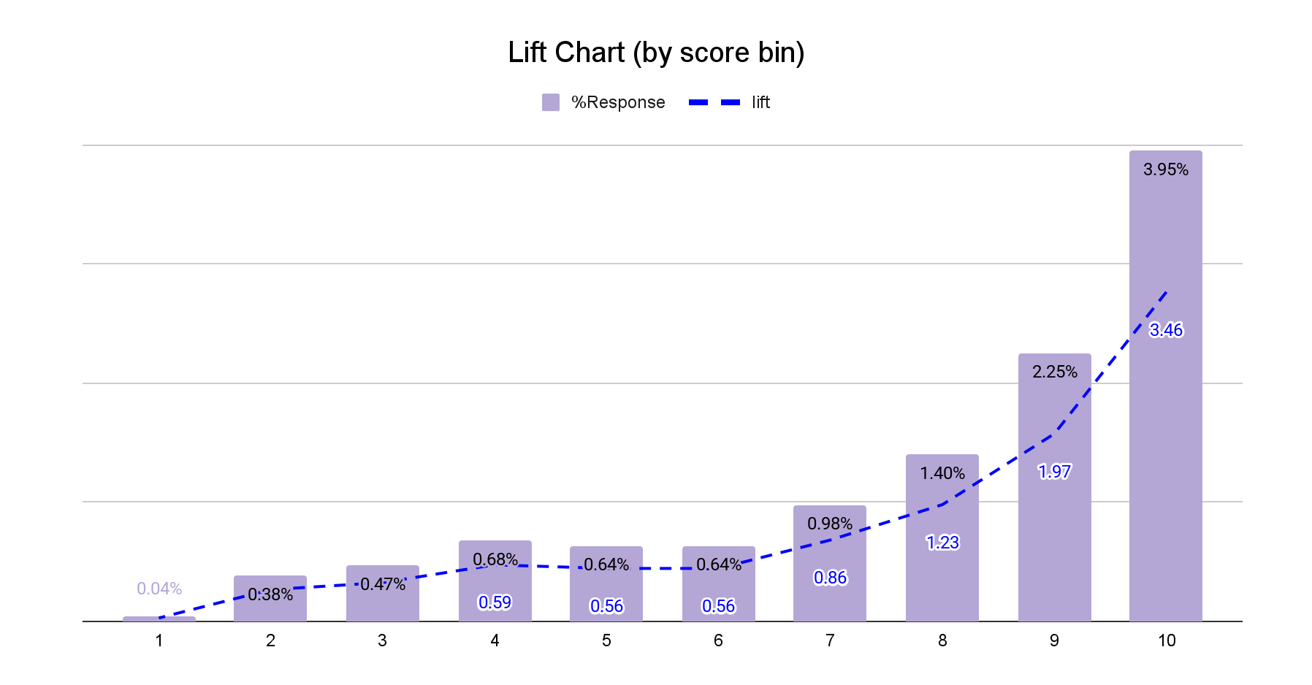
Predictive Model: Propensity to Buy
Overall Model Quality
The model demonstrates good discriminatory power, with ROC/AUC ranging from ~68% to 74%, depending on the test set.
Model's Gini is above 35% in all test sets, which is very acceptable for marketing targeting use cases.
Stability
Out-of-time (OOT) performance in December actually improves slightly to 74% AUC, suggesting the model generalizes well across time.
The slight drop in test-in-time vs. training (from 73% → 68%) is expected, especially due to target imbalance and undersampling. No signs of overfitting.
Target : Customer who buy PA or Life insurance
Base Model : LightGBM (Binary classification)
Input feature & Selected :
Model Performance and Lift chart
Data set | period | %Target | ROC/AUC | Gini coefficient
Training* | Jan - Nov | 5.0% | 73.0% | 45.9%
Test-in-time | Jan - Nov | 1.2% | 68.2% | 36.5%
Out-of-Time | Dec | 1.1% | 74.0% | 48.0%
Feature group | Input | Selected | %Importance
Demographics | 14 (32%) | 14 (44%) | 27%
Product Holding | 8 (18%) | 7 (22%) | 20%
Segment | 3 (7%) | 2 (6%) | 0%
Balance & Transaction | 19 (43%) | 9 (28%) | 53%
Total | 44 (100%) | 32 (100%) | 100%
Note : Training data set have undersampling for change %target from 1.2% to 5.0%
Top key features:
Demographics : Age, Income, female
Product Holding : mob, Bank Product, Saving
Segment : Upper Mass
Balance & Transaction : Avg Saving Balance 30 day, Easy Payment last 30 days, Saving stability
All feature definitions : link

Slide 4
Actionable Recommendations
Propensity score Level | Action | Tactic | Goal
High Propensity (BIN10, BIN9) | Assign to Telemarketing team for direct contact | Customize sales pitch to match customer life stage: Working adults → Promote tax-saving plans Families → Focus on children's health insurance Young adults → Offer accident coverage | Improve conversion with need-based product matching
Medium Propensity (BIN4 – BIN8) | Use digital channels (email, line, bank application) for soft promotion | Trigger-Based Follow-Up: Send to Tele team when key events occur: Salary bonus received Flight ticket purchased Medical expense/payment detected | Combine awareness and timely outreach to drive purchase intent
Low Propensity (BIN1 – BIN3) | Hold off on mass communication | Monitor with Event Triggers: Only engage when a relevant life event suggests potential need (e.g. travel, illness, saving spike) | Optimize resource usage while still detecting emerging interest
🧪Test & Learn Strategy
Run A/B Testing: Compare model targeting vs. traditional campaign to measure lift in response rate
Goal: Validate model impact and refine targeting strategy
🔄Model Maintenance
Frequent Retraining: Re-train model monthly or use daily updated data to reflect latest customer behavior
Goal: Keep predictions relevant and improve ongoing performance

