Slide 1

How do annual member and casual riders use Cyclistic bikes differently?

Slide 2
Summary
Usage Frequency: Casual users ride significantly less often than members across months, weekdays, and hours of the day.
Ride Duration: Casual users take longer, more variable rides, while members have consistently shorter and more stable ride durations across all time frames.
Popular Routes: Top routes are not always dominated by members; on some, casual users are the majority. Even where members lead, casual users still use those routes in notable numbers.
Bike Preference: Both groups prefer electric bikes the most, followed by classic bikes. Electric scooters, though less used overall, are more popular with casual users than with members.

Slide 3
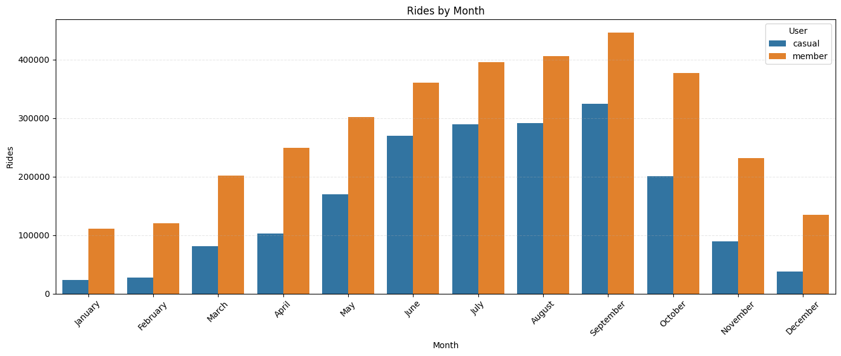
Usage Frequency
Monthly trends in ride frequency show that both member and casual users exhibit similar patterns: a gradual increase from March, reaching a peak in September, followed by a steady decline. Between December and February, usage remains consistently low with minimal variation compared to the rest of the year.

Slide 4
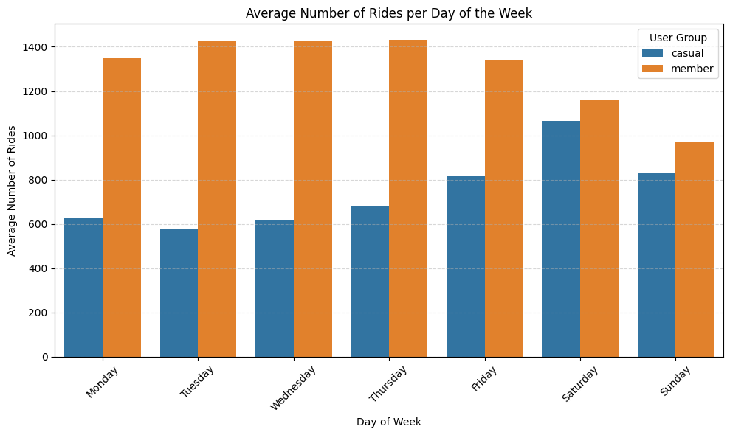
Usage Frequency
Members ride more on weekdays (Monday to Friday) and less on weekends
Casual users ride less on weekdays (Monday to Thursday) but more on weekends, especially from Friday to Sunday.

Slide 5
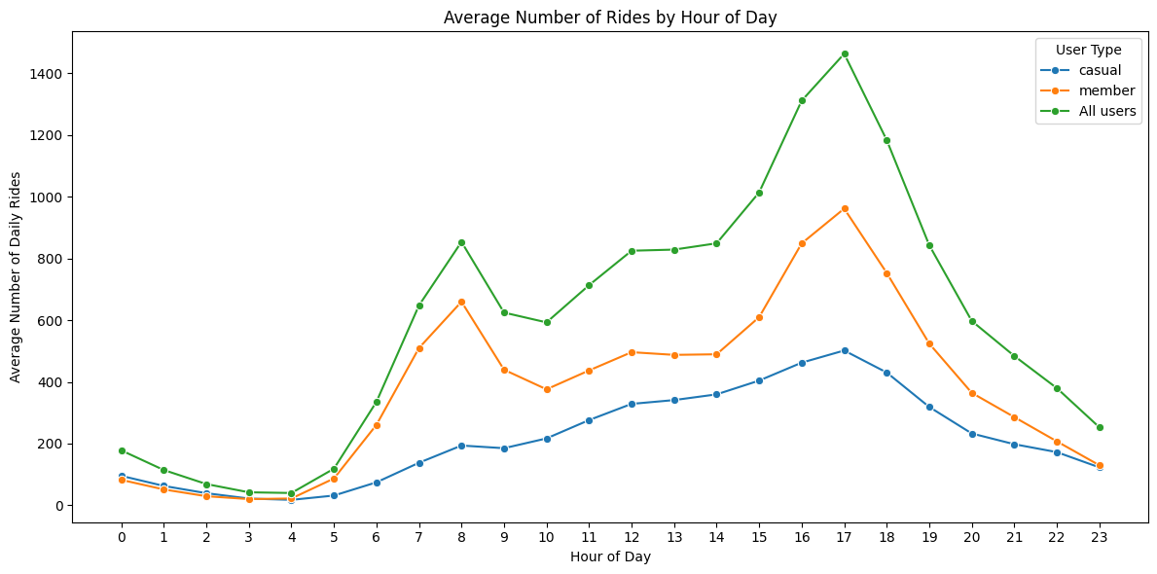
Usage Frequency
The ride frequency of casual users is relatively stable throughout the day, peaking only once at 17:00.
In contrast, member usage fluctuates more sharply, with rapid changes around peak commuting hours. Their ride volume peaks at both 8:00 and 17:00.
Additionally, between 0:00 and 3:00, casual users slightly outnumber members in ride count, though the difference is minimal.

Slide 6
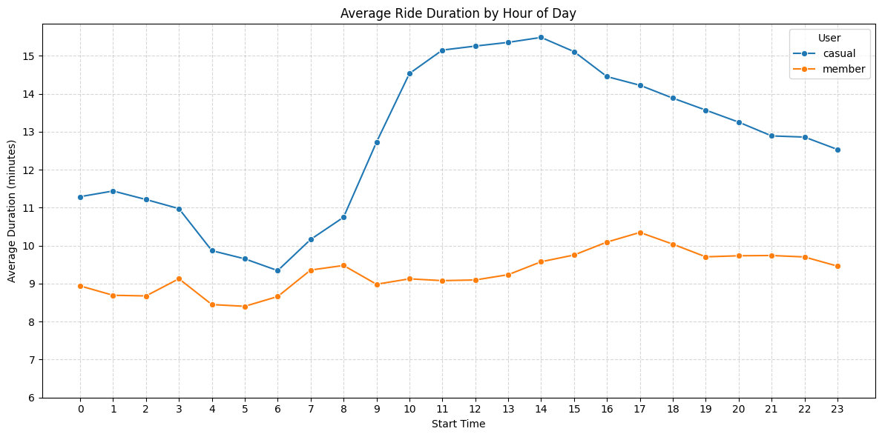
Usage Frequency
About Average Ride Duration by hour of the day:
Members show relatively low variation, with durations ranging from just over 8 minutes to a peak of 10.34 minutes at 5 PM.
Casual users, on the other hand, consistently record longer trip durations than members at every hour of the day. Their durations vary significantly, from a low of 9.34 minutes to a high of 15.48 minutes.

Slide 7
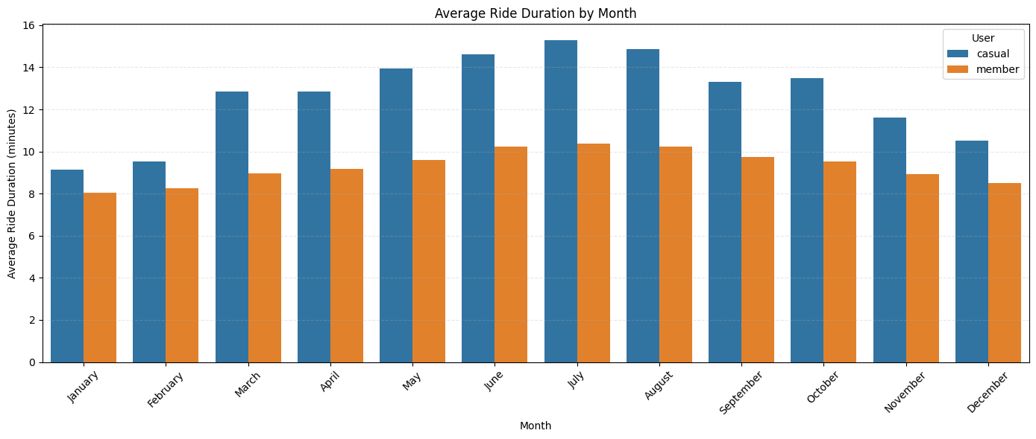
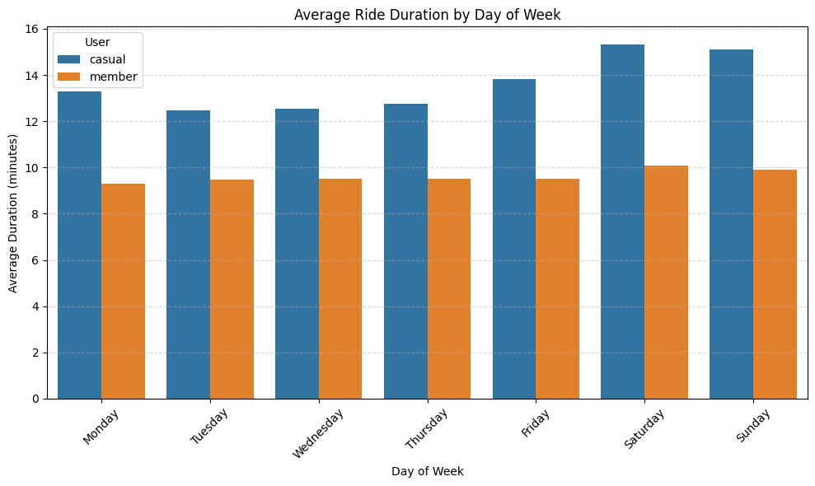
Ride Duration
In terms of average ride duration, casual users consistently take longer rides than members.
By month: casual users average between 9 and 15 minutes, while members average between 8 and 10 minutes.
By day of the week: casual users average 12 to 15 minutes, compared to 9 to 10 minutes for members.

Slide 8
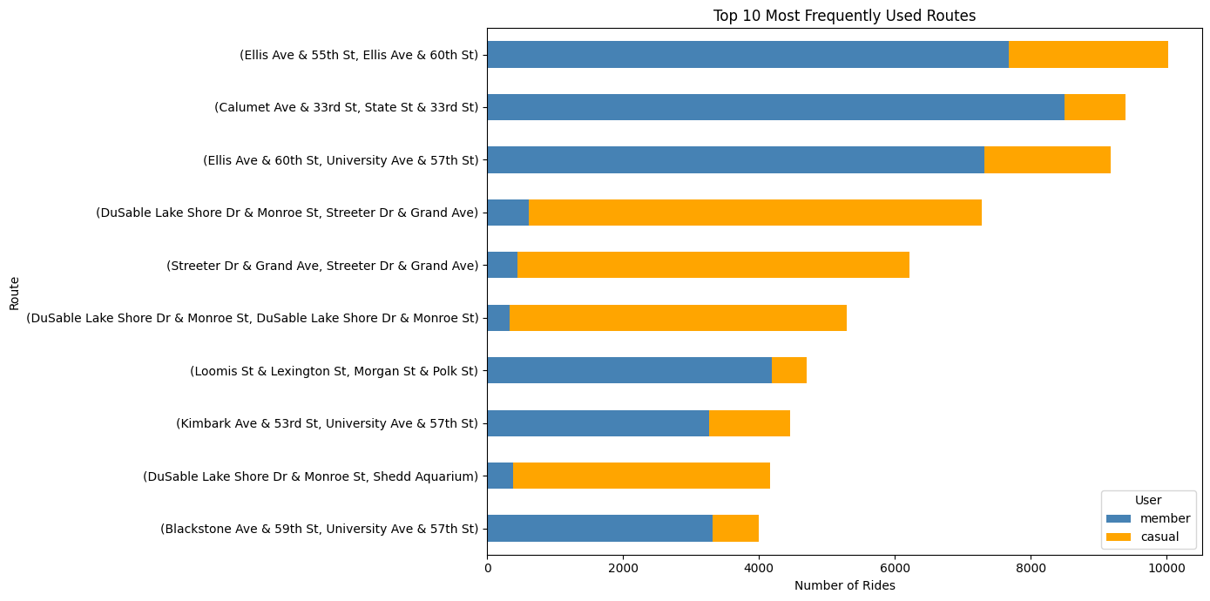
Popular Routes
In the top busiest routes, member users are not always the dominant group. Certain routes see casual users taking significantly more rides. Even on routes where members outnumber casuals, the number of casual riders remains noteworthy.

Slide 9
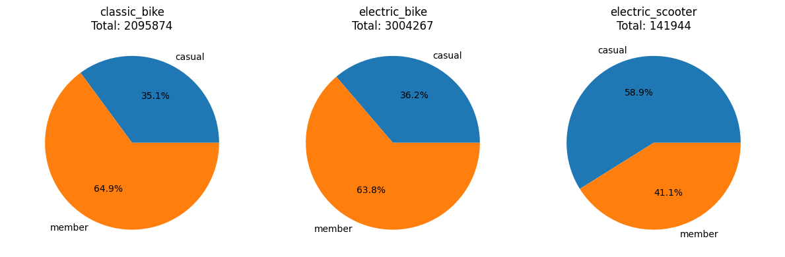
Bike Preference
Both members and casual users share the same preference order for the three types of vehicles, from most to least used: electric bike > classic bike > electric scooter.
While members have higher usage frequency for electric bikes and classic bikes, casual users slightly outnumber members in the use of electric scooters.

Slide 10
Project Goal and Guiding Questions
Goal
Design marketing strategies aimed at converting casual riders into annual members.
Guiding Questions
How do annual member and casual riders use Cyclistic bikes differently?
Why would casual riders buy Cyclistic annual memberships?
How can Cyclistic use digital media to influence casual riders to become members?

Slide 11
Recommendations
Based on the above findings, here are three marketing strategy recommendations to encourage casual riders to become members:
Question 2: Why would casual riders buy Cyclistic annual memberships?
-> Recommendation 1: Focus on casual riders with short weekday trips during peak hours
These users show commuting patterns similar to members, with rides around 8 AM and 5 PM under 11 minutes. Offer memberships as a more affordable and efficient choice for their routine travel.
Question 3: How can Cyclistic use digital media to influence casual riders to become members?
-> Recommendation 2: Use digital ads targeted by time and behavior
Deliver personalized ads through in-app channels and social media during peak usage times. Tailor messages to highlight membership benefits for daily commuters.
Additional Support for Overall Marketing Strategy
-> Recommendation 3: Personalize promotions based on top routes and bike type preferences Identify casual riders who often use routes popular with members or prefer electric bikes. Craft messages that reflect their habits and show how membership enhances their typical experience.

