Slide 1
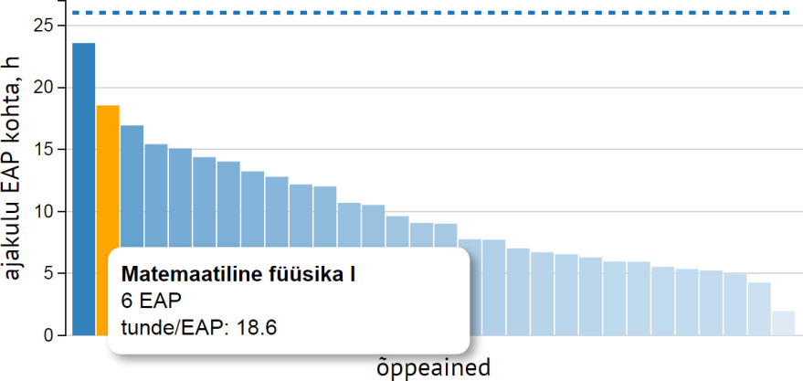
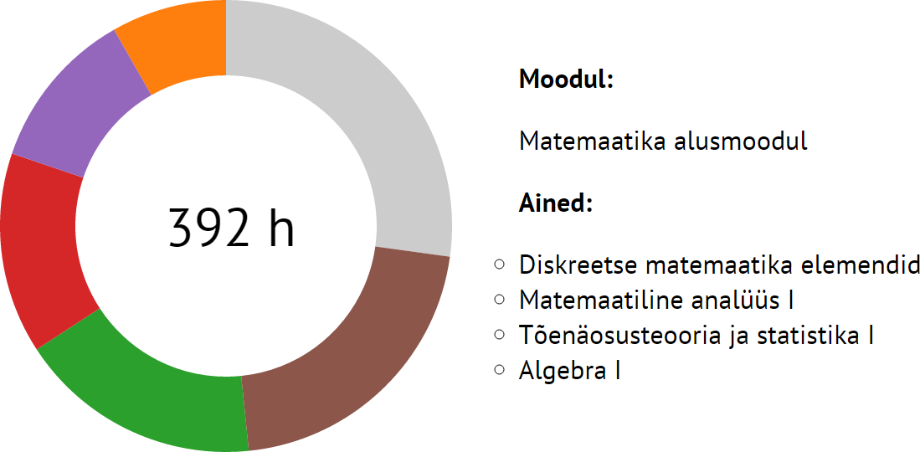
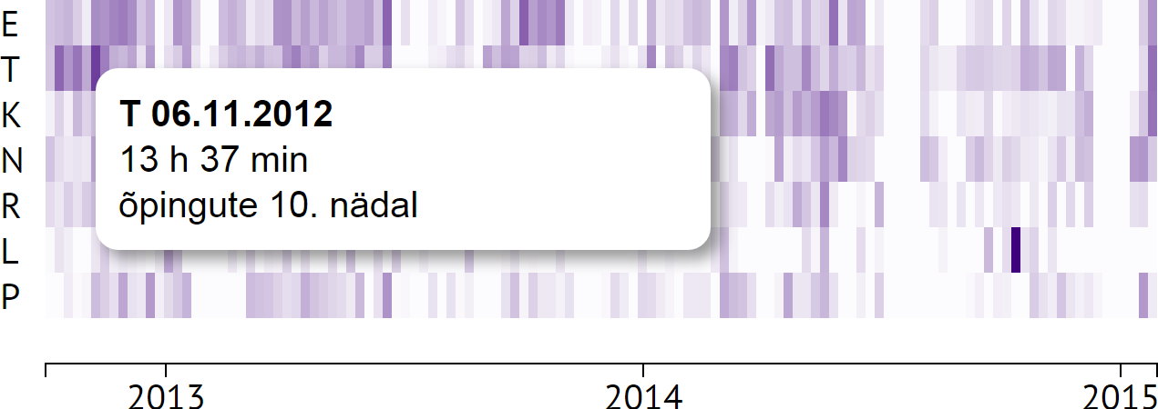
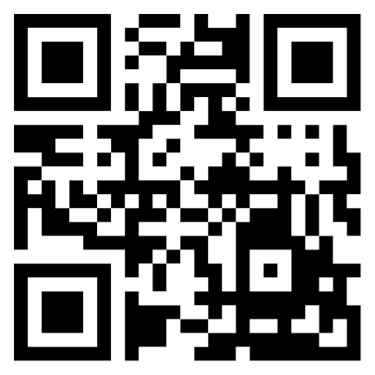

What if you could see every aspect of your study habits?
If you have data, you can now. And the best part? The graphs are so pretty you’ll never get tired of looking at them.
bar chart
pie chart
heatmap
The interactive graphs were created using Javascript and D3.js.
Live demo: ut.ee/~tpungas/studyvis
Source: github.com/taivop/studyvis
Taivo Pungas
Uni. Tartu | Institute of Computer Science| Computer Science BSc curriculum

