Slide 1
CyberBoyAI: Next-Gen Threat Detection & Orchestration
Status: Production-Ready (Vercel Frontend, Dockerized FastAPI Backend on Render)
▪ Subtitle: A 9-Layer Multi-Agent Shield Combining ML, OSINT, and AI Sandboxed Forensics
Notes:
Welcome. Today I present CyberBoyAI, a production-grade multi-agent cybersecurity platform. We leverage overlapping layers of machine learning and sandboxed visual AI to protect fintech users in real time.

Slide 2
The Core Problem: Why Blacklists Fail
Key Focus: The Vulnerability of Static Defense
▪ Points:
▪ Zero-Day Attacks: Hackers buy and register cheap domains minutes before an attack.
▪ Database Delays: Global blacklists take hours or days to synchronize.
▪ The CyberBoyAI Philosophy: Assume the database is always outdated. Analyze the live site's physical DNA and behavior instead.
Notes:
Static blacklists are always one step behind because hackers rotate fresh domains in minutes. CyberBoyAI operates on a zero-trust model: we don't just look up the link; we inspect its physical structure and live behavior.

Slide 3
Tech Stack & Production Architecture
Key Focus: Production-Grade High-Performance Stack
▪ Points:
▪ Frontend UI: Next.js 14, TypeScript, Tailwind CSS (Live on Vercel).
▪ API Backend: Dockerized FastAPI running asynchronous pipelines (Live on Render).
▪ Data Tier: Supabase PostgreSQL for daily cron threat feeds and user cache.
▪ ML Engine: Scikit-Learn (Random Forest multi-class URL classification models).
▪ AI Sandbox: Playwright headless Chromium & OpenAI visual DOM analysis.
Notes:
Our architecture is split into a modern Next.js client and a containerized FastAPI backend. We query databases, extract ML features, and visit pages in a secure sandbox—all in parallel in under 3 seconds.

Slide 4
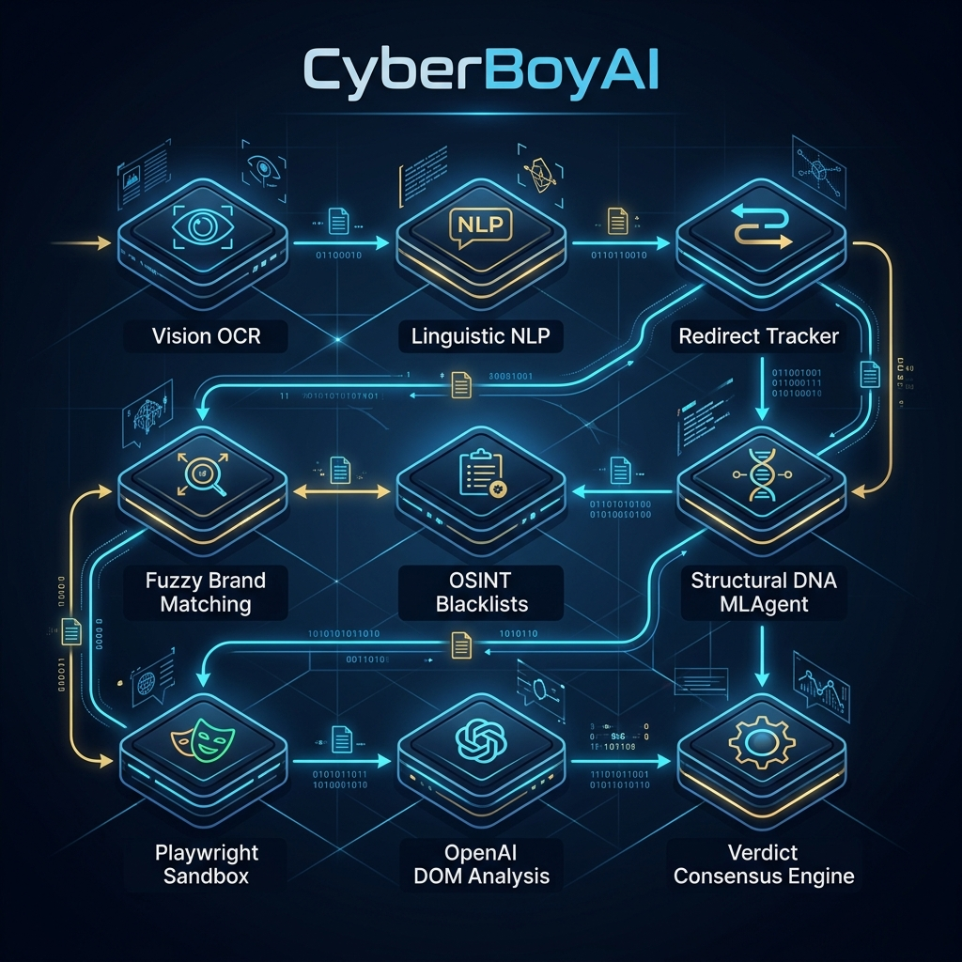
High-Level View: 9-Layer Defense Pipeline
Key Focus: Defense-in-Depth Security
▪ Points:
▪ Layer 1-3 (Input Analysis): Vision OCR, QR Decoding, and Redirect Unshortening.
▪ Layer 4-6 (Static Analysis): Fuzzy Brand Matching, OSINT Feeds, and URL Structural ML.
▪ Layer 7-9 (Dynamic Analysis): Sandboxed Browser Scraping, OpenAI DOM Audit, and Path-Aware Whitelisting.
Notes:
We route every threat through a 9-layer gauntlet. We decrypt QR codes, unmask redirect hops, check databases, run local ML, visit the page in a sandbox, and perform visual audits. No single bypass can slip through.

Slide 5
Layers 1 to 3: Multimodal Vision & Redirect Tracking
Key Focus: Defeating Entry-Level Obfuscation
▪ Points:
▪ Vision OCR & Qishing: GPT-4o-Vision scans screenshots and decodes visual QR codes.
▪ Redirect Tracker: Recursively follows HTTP redirect chains (up to 10 hops) to unmask hidden endpoints.
▪ Email Preprocessing: Extracts, decodes, and sanitizes plain-text MIME email payloads.
Notes:
Scammers hide behind QR codes ('Qishing') and redirect shorteners like bit.ly. CyberBoyAI unmasks redirect hops recursively and uses computer vision to extract links from screenshots instantly.

Slide 6
The Mathematical Engine: High-Level Algorithms
Key Focus: Heuristics and Core Math Models
▪ Points:
▪ Shannon Entropy: Measures domain randomness to detect auto-generated malicious domains.
▪ Levenshtein Distance: Calculates string edits to detect visual homoglyphs and typosquatting (e.g. `netfl1x`).
▪ TF-IDF Vectorization: Converts raw emails into numerical threat matrices for linguistic classification.
▪ Gini Impurity: Optimizes machine learning splits during Random Forest training.
▪ Consensus Fusion: Adjusts scoring weights dynamically when security agents disagree.
Notes:
Our algorithms are transparent and explainable. We use Shannon Entropy to spot random domains, Levenshtein edit distance to block brand typosquatting, and TF-IDF to encode text. These five math models guarantee our decisions are audit-ready.

Slide 7
Training the ML Models: Datasets & Specs
Key Focus: Clean, High-Fidelity Training Pipelines
▪ Points:
▪ URL DNA Model Dataset: Trained on the Kaggle `malicious-urls-dataset` (300k+ records).
▪ Multi-Class URL Classifier: Classifies links into four categories: Benign, Phishing, Malware, or Defacement.
▪ Email/SMS NLP Model Dataset: Unified deduplicated corpus combining Apache SpamAssassin and Zenodo datasets.
▪ URL Preprocessing: Uses parallel CPU processing to chunk and extract features at extreme speed.
Notes:
We trained our URL classifier on 300,000 Kaggle records mapping to four distinct threat classes. Our email NLP engine is trained on a custom-deduplicated corpus of SpamAssassin and Zenodo records. Both models utilize parallel CPU multiprocessing for maximum preprocessing speed.

Slide 8
Random Forest URL Classifier Specifications
Key Focus: URL Lexical and Technical DNA
▪ Points:
▪ Model Configuration: Random Forest Classifier with 200 trees and a maximum depth limit of 15.
▪ URL Features (20 Core Keys):
▪ Lexical:* URL length, subdomain depth, path depth, hyphen counts, symbol entropy.
▪ Technical:* HTTPS presence, TLD risk rating, leet-speak substitutions, non-standard ports.
Notes:
Our URL classifier scans 20 core structural keys—ranging from character entropy to leet-speak substitutions. By using 200 decision trees capped at a depth of 15, we prevent training overfitting while maintaining high detection speed.

Slide 9
Sandboxed Scraping & AI Visual Forensics
Key Focus: Safely Analyzing Live Threats
▪ Points:
▪ Playwright Browser Sandbox: Spawns headless Chromium with JavaScript disabled to block drive-by malware.
▪ OpenAI Visual DOM Scraper: GPT-4o-mini reviews parsed text structures for credential-harvesting patterns.
▪ Jailbreak Defense: Wraps DOM text in randomized UUID boundary keys to fully isolate and neutralize hacker injection code.
Notes:
We visit suspicious sites safely using a headless browser with JavaScript completely disabled. We extract the page structure and feed it to our visual AI agent, protected by dynamic UUID boundaries to prevent hackers from jailbreaking the AI.

Slide 10
Layer 9: Path-Aware Whitelisting (Cloud Abuse)
Key Focus: Preventing Trusted Domain Exploits
▪ Points:
▪ The Threat: Scammers host phishing forms on trusted cloud systems like Google Forms or Notion.
▪ Standard Filters: Blindly trust the base domain and allow the attack.
▪ CyberBoyAI Solution: Path-Aware Whitelisting. Fast-paths are blocked for deep paths (e.g. `docs.google.com/forms`), forcing a full sandbox visual audit.
Notes:
Hackers abuse trusted platforms like Google Forms because standard security engines blindly whitelist Google. CyberBoyAI implements path-aware whitelisting, forcing a deep sandbox audit the moment a deep user form path is detected.

Slide 11
The Verdict Engine: Consensus Conflict Resolution
Key Focus: Intelligent Agent Score Aggregation
▪ Points:
▪ Weighted Fused Score: Merges database feeds (35%), ML URL DNA (30%), visual AI audits (20%), and behaviors (15%).
▪ Consensus Stalemate: Detects when agents disagree and dynamically shifts weights.
▪ AI Visual Override: If ML says a domain is safe, but visual AI catches an active login form, weights shift instantly to boost the AI to 40% and override the ML.
Notes:
Our central Verdict Engine acts like a courtroom. It aggregates database, ML, AI, and behavioral inputs. If they disagree, the engine dynamically shifts weights, allowing visual proof of a phishing form to override a clean URL structure.

Slide 12
Score Translation: Local ML vs. Global Confidence
Key Focus: Demystifying Conflicting Dashboard Scores
▪ Points:
▪ Local ML Risk (The Physics): Probability that the URL string matches the physical structure of a typical phishing link.
▪ Global Confidence (The Consensus): System-wide confidence that the final consolidated verdict is correct.
▪ Reducing False Positives: Safe URL shorteners (like `bit.ly`) score high ML Risk (random structure) but low Global Threat, resulting in a balanced "Suspicious (50% Confidence)" verdict.
Notes:
You may see 98% ML Risk but only 50% Global Confidence. This is our consensus engine at work. A URL shortener looks suspicious structurally, but since it is a safe service, the engine resolves the stalemate by showing 'Suspicious' instead of blocking it.

Slide 13
Future Work: Enterprise Scaling Roadmap
Key Focus: Scaling to Enterprise Market Needs
▪ Points:
▪ Rotating Residential Proxies: Bypasses attacker IP blocklists by routing scrapers through home residential internet connections.
▪ Active Learning Loops: Automates monthly ML model retraining using live community threat feedback reports.
▪ CAPTCHA Solvers: Integrates automated visual solvers to scan malicious pages hidden behind Cloudflare verification gates.
Notes:
To scale CyberBoyAI to an enterprise level, we will integrate rotating residential proxies to defeat adversary blocking, implement monthly active learning loops to prevent model drift, and deploy CAPTCHA solvers to bypass security gates.

Slide 14
Summary of Core Achievements
Key Focus: Live, Operational Cybersecurity Platform
▪ Points:
▪ Live End-to-End Production: Dockerized FastAPI on Render, React dashboard on Vercel, Supabase Cloud tier.
▪ 9-Layer Security Pipeline: Complete OSINT, Random Forest ML, and Sandboxed AI forensics.
▪ Zero-Day Guard: Visual OCR extraction, redirect unmasking, and active jailbreak boundaries.
▪ High-Speed Caching: 10-minute API cache for instant history retrieval and optimized frontend load speeds.
Notes:
In summary, we have deployed a live, multi-agent threat sentry. It is fast, mathematically robust, and highly explainable. CyberBoyAI is fully online and ready to protect fintech users. Thank you, and I am open to your questions.

