Slide 1


NEXORA FINTECH:
Unlocking Global Leadership Through Data & AI
BY:
Taiwo ADEYEMI
Email: adetwins2005@gmail.com
Image: StockCake-Intelligence Meets Data_1750151333

Slide 2

GLOBAL TRENDS & KEY OPPORTUNITIES IN DATA & AI
Trends | Key Opportunites for Nexora
📈 Rise of Embedded AI in Digital Payments | Automate fraud detection, credit scoring, and customer verification
🌍 Financial Inclusion through AI | Design inclusive credit algorithms for underserved populations
⚖️ AI Regulation & Ethics | Lead with transparent, bias-free AI systems to build trust in emerging markets
📡 Real-time Data Pipelines | Deploy streaming data systems for instant loan approvals and user insights
🤖 Generative AI in Customer Support | Deploy AI agents for 24/7 multilingual support across continents
Visual Source: adapted from common strategic analysis models.

Slide 3
SWOT Analysis: Nexora's Internal Readiness for Data & AI Leadership
Strengths | Weaknesses (Gaps)
✅ Agile and tech-savvy teams with fintech experience | ⚠️ Limited in-house AI/ML expertise and data engineering capability
✅ Solid digital infrastructure from lending and payments systems | ⚠️ Siloed data with no centralized data platform
✅ Strong executive commitment to innovation | ⚠️ Lack of formal processes for AI model development, deployment, and governance
✅ Culture of speed and experimentation | ⚠️ Insufficient focus on long-term AI ethics, fairness, and auditability
✅ Strong Regional Presence: Established footprint in high-growth markets (Asia, Africa, Middle East). | ⚠️Potential Data Silos: Fragmented data infrastructure across diverse operations.
✅ Investment in Data & AI: Explicit strategic focus and capital allocation. | ⚠️Data Literacy Across Organization: Uneven understanding of advanced data and AI concepts
✅ Innovation-Driven Culture: Openness to new technologies | ⚠️Emerging AI Capabilities: Currently not yet a global leader in AI sophistication
Sources: https://www.cedar-rose.com/blog/ai-driving-smarter-faster-credit-risk-decisions-for-banks

Slide 4
SWOT Analysis: Nexora's Internal Readiness for Data & AI Leadership
Opportunities | Threats (Risks)
🚀 Leverage existing financial data to build predictive AI models | ⛔ Regulatory changes in data privacy and AI ethics across regions
🚀 Build a regional AI Center of Excellence to close talent and skills gaps | ⛔ Talent drain or over-reliance on external consultants
🚀 Become a leader in ethical AI for underserved markets | ⛔ Model bias or inaccuracies affecting trust and credit decisions
🚀 Partner with universities/startups for AI R&D | ⛔ Execution risk due to simultaneous strategic transformations
 | ⛔Aggressive Competition: Established tech giants and agile startups investing heavily in FinTech AI.
 | ⛔ROI Justification: Difficulty in demonstrating tangible returns from AI investments if not properly tracked
Sources: https://www.cedar-rose.com/blog/ai-driving-smarter-faster-credit-risk-decisions-for-banks

Slide 5
Strategic Roadmap (Key Initiatives & Timeline)
(Three Years Strategic Roadmaps: 2025 – 2027)
Phase 1: Foundation & Governance (Year: 2025)
Data & AI Ecosystem:
  Comprehensive data audit & cloud data fabric design.
  Establish Global Data Governance Council & implement automated data quality.
AI Product Development:
  Launch AI Innovation Lab & rapid prototyping of high-impact MVPs (e.g., initial personalized lending model, enhanced fraud detection).
Talent:
  Skills gap analysis & launch of "Nexora AI Academy" internal training and partner with universities.
  Recruit core senior AI leadership team.
Responsible AI:
  Develop "Responsible AI Policy" & mandatory ethics training.

Slide 6
Strategic Roadmap (Key Initiatives & Timeline)
(Three Years Strategic Roadmaps: 2025 – 2027)
Phase 2: Productization & Scaling (Year: 2026)
Data & AI Ecosystem:
  Productize high-value data assets.
  Implement self-service data platform.
AI Product Development:
  Integrate successful AI MVPs into core products (e.g., hyper-personalized CX, dynamic pricing).
  Establish MLOps framework for industrializing AI.
Talent:
  Global recruitment pipeline for niche AI roles.
  Develop AI career progression frameworks.
Responsible AI:
  Integrate bias detection/mitigation tools.
  Implement Explainable AI (XAI) techniques.

Slide 7
Strategic Roadmap (Key Initiatives & Timeline)
(Three Years Strategic Roadmaps: 2025 – 2027)
Phase 3: Global Leadership & Continuous Innovation (Year: 2027)
Data & AI Ecosystem:
  Continuous optimization of data fabric for performance & scalability.
AI Product Development:
  Foster "AI experimentation" culture across all product teams.
  Launch new AI-native products disrupting traditional financial services.
Talent:
  Position Nexora as a global employer of choice for AI professionals.
  Sponsor external research/hackathons.
Responsible AI:
  Regular AI system audits for fairness & compliance.
  Lead industry discussions on ethical AI in fintech.

Slide 8
Success Metrics & Recommendations
Key Performance Indicators (KPIs):
Customer Lifetime Value (CLV) Growth: Target +30%
Operational Cost Reduction: Target -15% (e.g., reduced manual processing, fewer fraud incidents)
Fraud Detection Rate Improvement: Target +50%
Time-to-Market for New AI Features: (e.g., reduce by 20%)
Data Quality Index: (e.g., target 95% data accuracy)
AI Model Performance: (e.g., specific accuracy/precision/recall targets per model)
Talent Retention Rate (Data & AI Teams): (e.g., >90%)
AI Ethical Compliance Score: (Internal audit score)

Slide 9
Success Metrics & Recommendations
Key Performance Indicators (KPIs):
Customer Lifetime Value (CLV) Growth: Target +30%
Operational Cost Reduction: Target -15% (e.g., reduced manual processing, fewer fraud incidents)
Fraud Detection Rate Improvement: Target +50%
Time-to-Market for New AI Features: (e.g., reduce by 20%)
Data Quality Index: (e.g., target 95% data accuracy)
AI Model Performance: (e.g., specific accuracy/precision/recall targets per model)
Talent Retention Rate (Data & AI Teams): (e.g., >90%)
AI Ethical Compliance Score: (Internal audit score)

Slide 10
Recommendations for Success:
Establish a Chief Data and AI Officer Role and launch a Global AI Center of Excellence
Executive Buy-in & Sponsorship: CEO and executive team must champion Data & AI as a core strategic imperative.
Cross-Functional Collaboration: Foster deep collaboration between Data & AI, Product, Engineering, and Risk teams.
Continuous Investment: Allocate consistent resources for technology, talent, and infrastructure.
Agile & Iterative Approach: Embrace experimentation, learn from failures, and rapidly adapt.
Prioritize Responsible AI: Build trust by integrating ethical considerations from first day.
Global-Local Balance: Centralized strategy with flexible regional implementation to address local nuances.
Build a foundational AI capability by investing in data infrastructure, AI talent, and responsible AI governance, to transform Nexora into a trusted AI-first fintech for emerging markets.
Accelerate your AI fraud protection with DataDome: As AI-powered threats continue to evolve, businesses need sophisticated protection that can adapt to emerging fraud tactics.

Slide 11
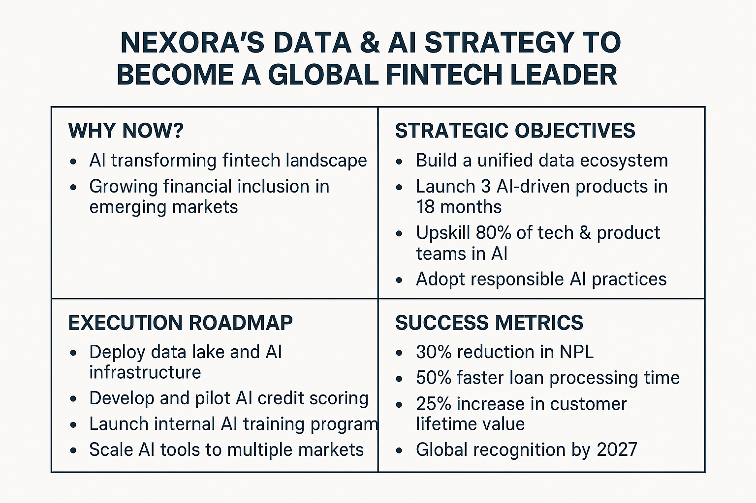

Slide 12
Conclusion
Nexora has the momentum and market data to become a global AI leader in fintech. Strategic focus on inclusive, ethical, and scalable AI adoption will distinguish Nexora across Asia, Africa, and the Middle East. Bold leadership, practical execution and commitment are critical to this journey.
Let’s make it happen!

Slide 13
|THANK YOU!

