Slide 1


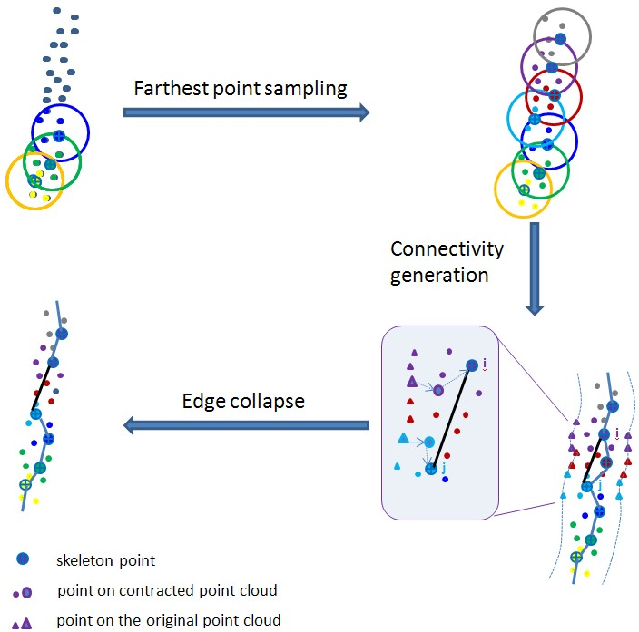
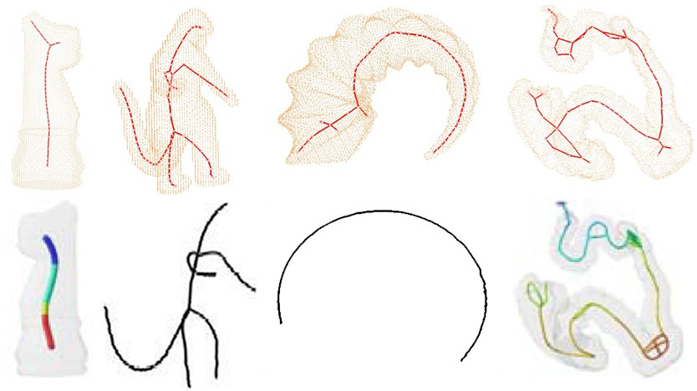
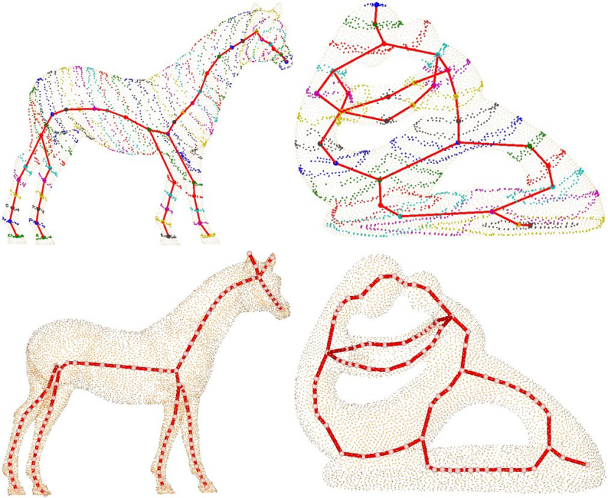
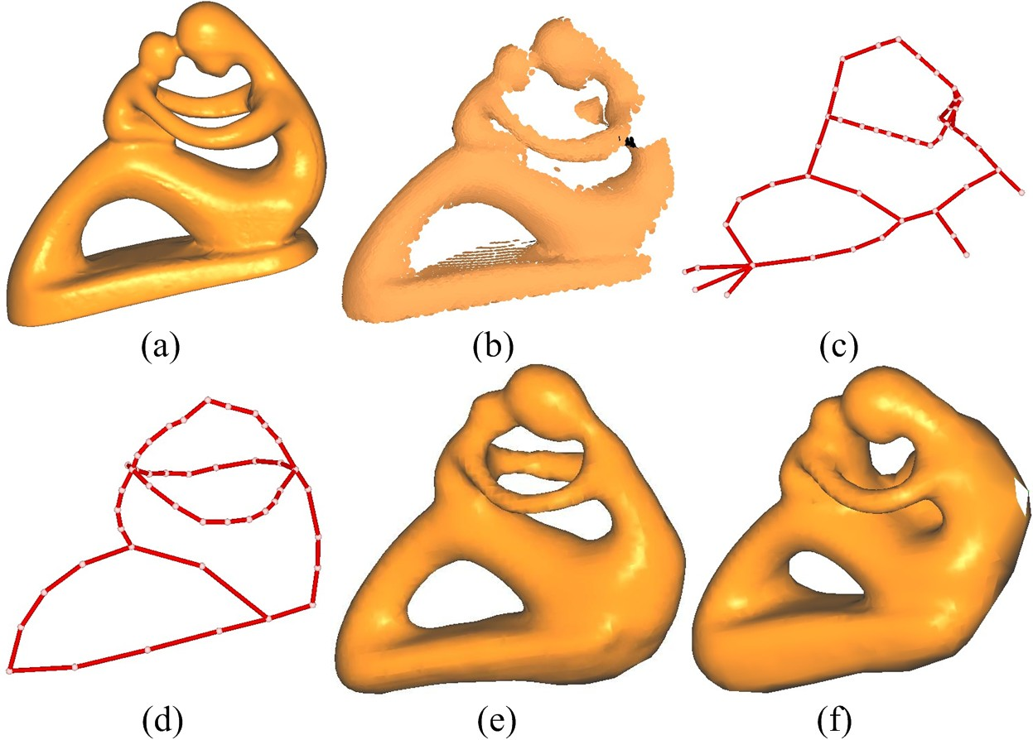
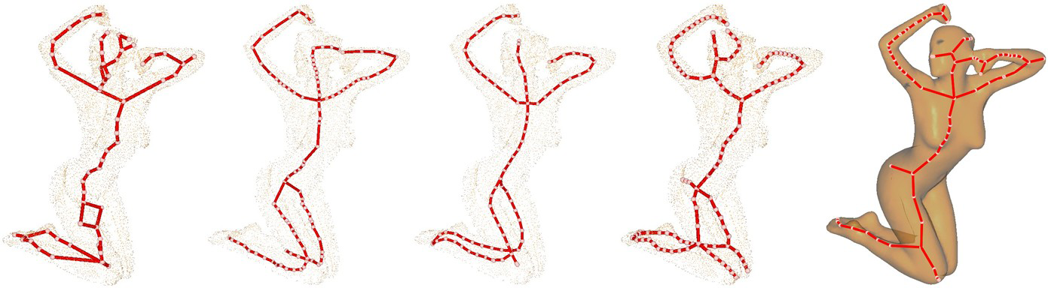
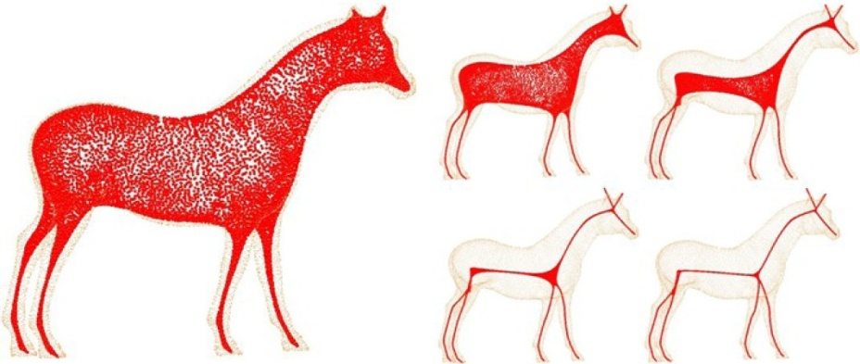
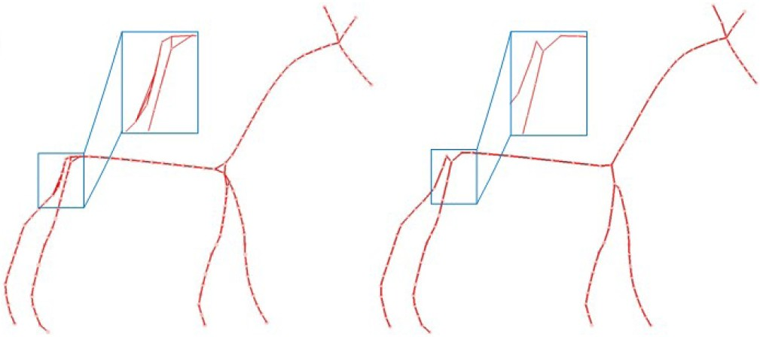
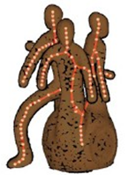
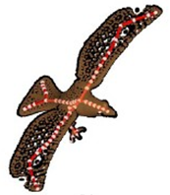
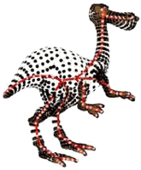
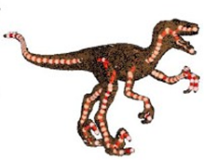
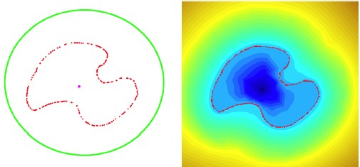
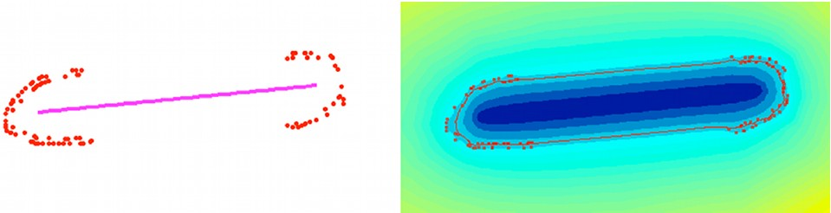

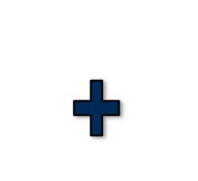

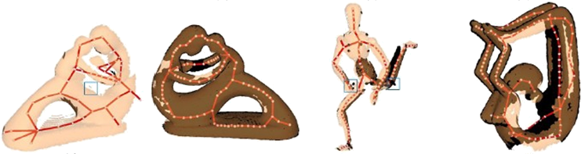
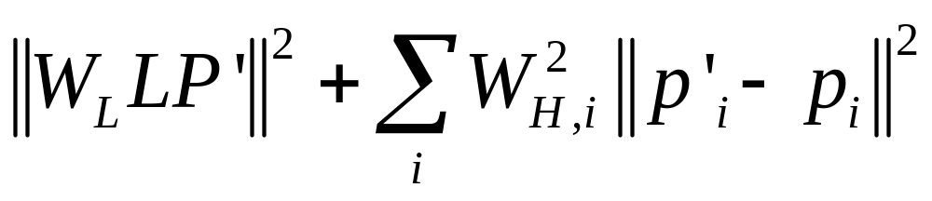
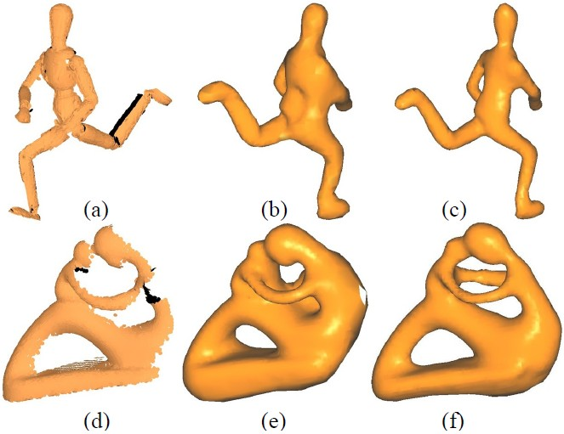
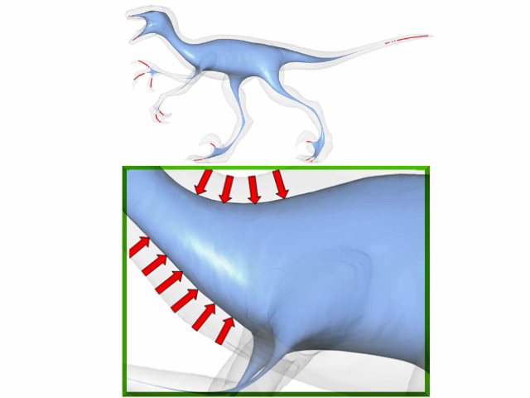

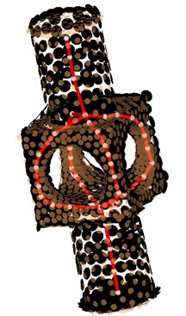
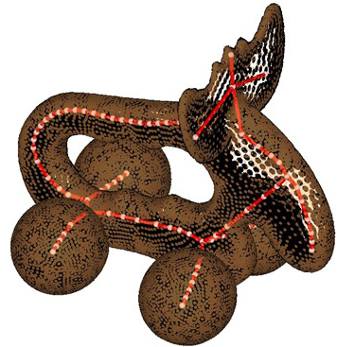
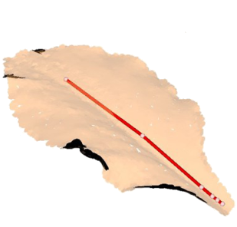
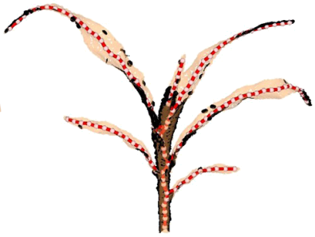
Point Cloud Skeletons via Laplacian-Based Contraction
School of Mathematical Sciences, Dalian University of Technology, Dalian, China
School of Computing Science, Simon Fraser University, Vancouver, Canada
MOTIVATION
TOPOLOGY THINNING
COMPARISON
Extract curve skeleton directly from point clouds.
Repair topology of acquired point clouds in the presence of large amounts of missing data via skeleton.
Figure 5 Comparison with Potential Field method
Figure 6 Comparison with Reeb Graph method
Figure 1. Point cloud skeleton and skeleton-assisted topology repair and surface reconstruction. Original model. (b) Input point cloud with missing data. (c) Curve skeleton extracted, while descriptive, contains topological errors. After simple user operations to repair the skeleton (d), topologically correct surface reconstruction is obtained (e), compared to the result of Poisson reconstruction (f) from (b).
Figure 7 Comparison of Reeb Graph, Deformable blob, ROSA, our method, and Mesh contraction method.
OUTLINE
THE RESULTS
SKELETON DRIVEN POINT CLOUD RECONSTRUCTION
Give a point cloud and a refined curve skeleton, we can compute the signed distance field of the shape, and extract its zero-level-set iso-surface as the reconstructed surface.
Figure 2 Skeletonization of models with spherical, sheet-like region and close-by structure.
GEOMETRY CONTRACTION
Figure 8 Reconstruction on a skeleton cross-section (left) and reconstruction along a skeleton branch.
Contraction constraint
Attraction constraint
Figure 3 Skeletonization of models with missing data.
b
c
d
Figure 4 Skeletonization of models with holes and boundaries.
Figure 8 Reconstruction from sparse data. Left: The input point clouds. Middle: Reconstruction achieved by straightforward Poisson reconstruction is under-constrained in under-sampled regions. Right: The skeleton provides topological and geometrical hints that guides reconstruction toward a more suitable solution.

