Slide 1



3
Data Science for Design
Communicate with the data
TiTi
Vicky
Ning Ren

Slide 2



1 Context
2 Data
3 Audience
4 Demo

Slide 3

Context
Source
Datashare Project
Data topic
Scottish Young People Survey(SYPS) conducted in 1985
Data content
Family background,Experience of education,Employment Situation,Furthur expectation
Important and Interesting
Social aspect: a good reference and reflection to get insight on the young people nowadays
Personal aspect: a recall of their young time

Slide 4
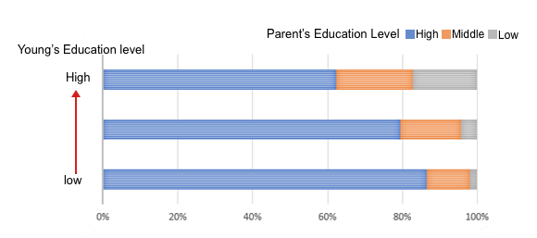
Data
Data Type: questionnaire coded with number
8076 sample, 80% respond rate
Interesting relationship:
The relationship between parent and children’s education level

Slide 5

Audience
Memory album-pop up book
Scottish Families with 2 generations, who were young people in 1985 and who are young people right now
Parents can recall and share their memory
Children may learn experience and have reflection to make their own life choices

Slide 6
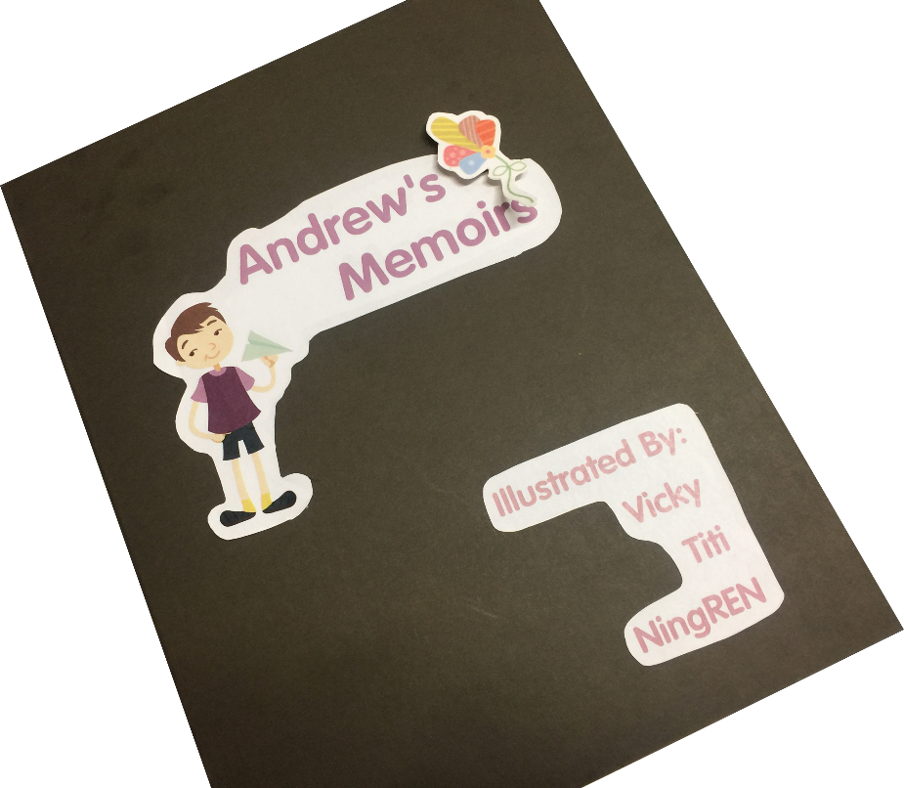
Demo

Slide 7
Thanks

