Slide 1



3
Data Science for Design
Communicate with the data
TiTi
Vicky
Ning Ren

Slide 2


Context
Source: Data Share Website
Project topic: Scottish Young People Survey(SYPS) conducted in 1980s
Data content: Family background, Experience of education, Employment Situation, Future expectation
Important and Interesting:
Social aspect: a good reference and reflection to get insights on the young people nowadays
Personal aspect: a recall of their young time

Slide 3
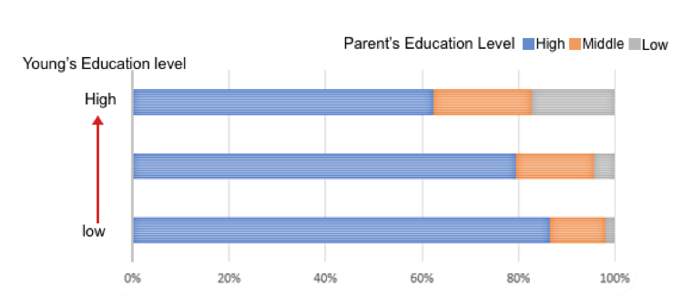
Data
Questionnaire coded with number
8076 samples, 80% respond rate
Interesting relationship:
Eg, The relationship between parent and children’s education level

Slide 4

Audience
Audience
Scottish Families with 2 generations
Elder generation is the scottish people living in the 1980s
Young generation is their offsprings
Artefact:
Pop-up book
Recall and share elder generation’s memory
Young ones learn experience and have reflection to make their own life choices

Slide 5
Thanks

