Slide 1



3
Data Science for Design
Communicate with the data
TiTi
Vicky
Ning Ren

Slide 2



1 Context
2 Data
3 Audience
4 Demo

Slide 3

Context
Source
Datashare Project
Data topic
Scottish Young People Survey(SYPS) conducted in 1985
Data content
Family background,Experience of education,Employment Situation,Furthur expectation
Important and Interesting
Social aspect: a good reference and reflection to get insight on the young people nowadays
Personal aspect: a recall of their young time

Slide 4
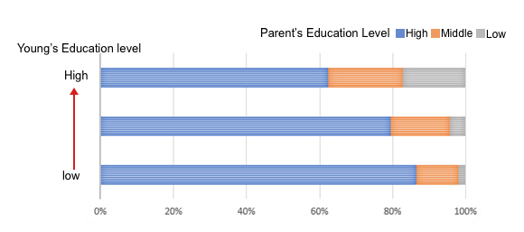
Data
Data Type: questionnaire coded with number
8076 sample, 80% respond rate
Interesting relationship:
The relationship between parent and children’s education level

Slide 5

Audience
Scottish Family-2 Generations
Memory album-pop up book

Slide 6
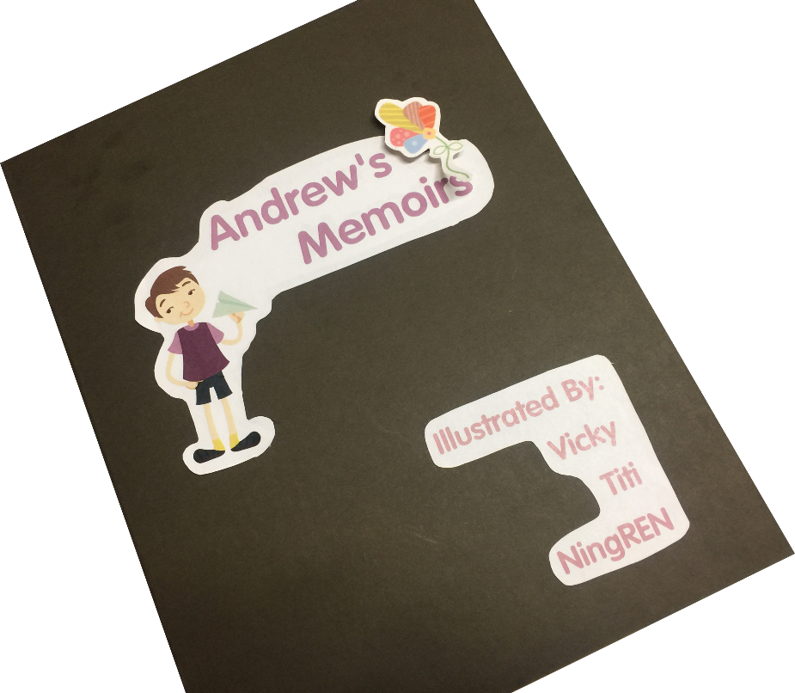
Demo

Slide 7
Thanks

