Slide 1
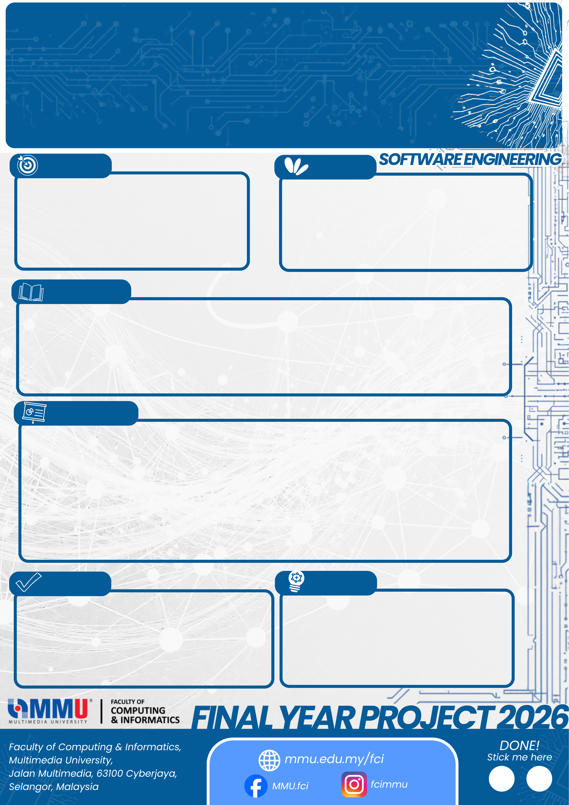
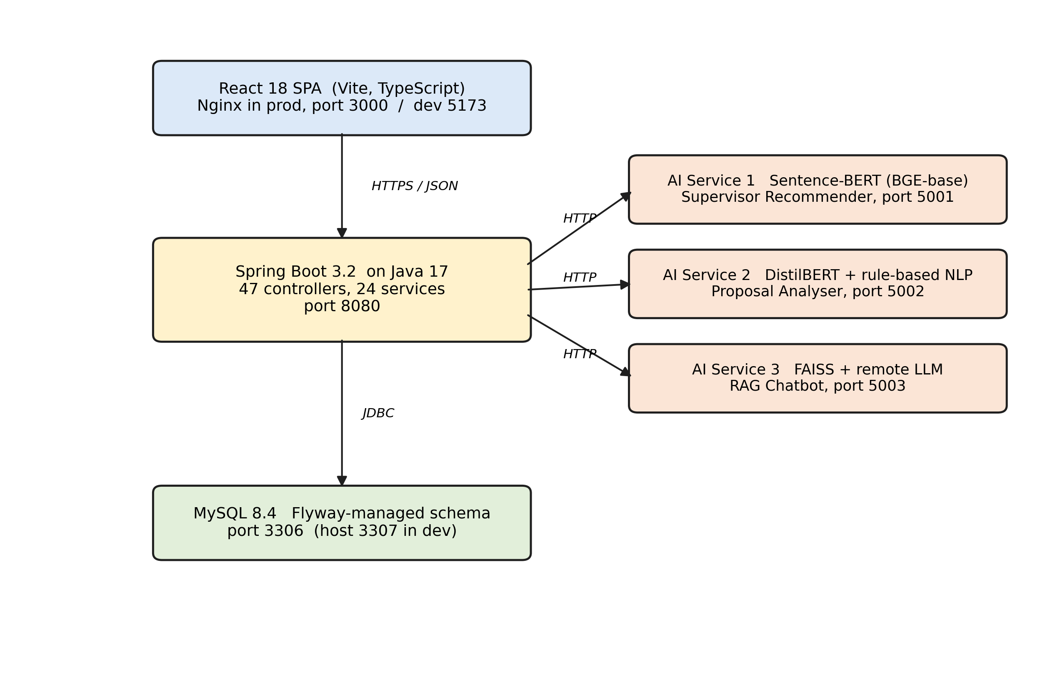
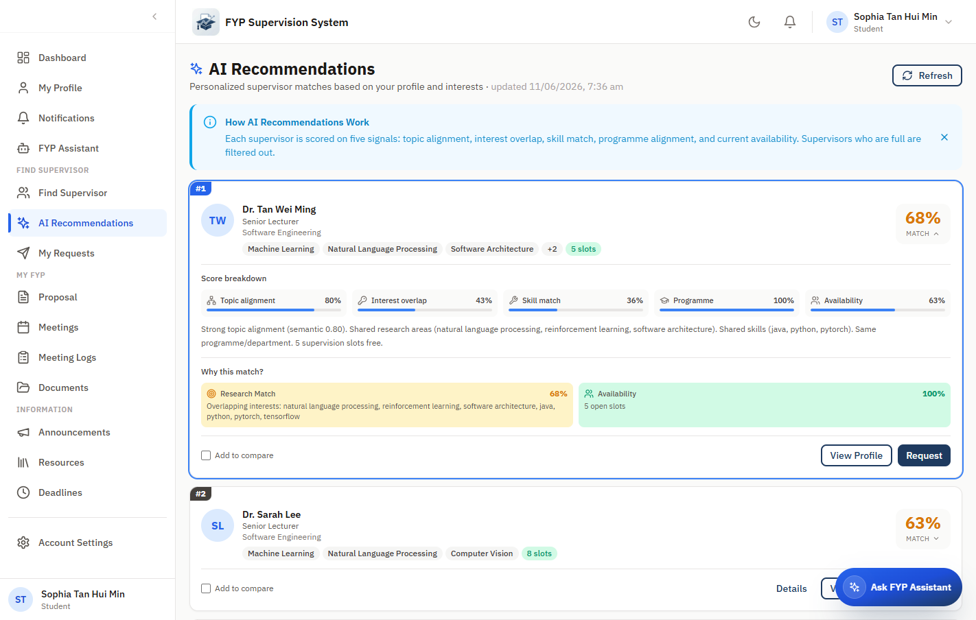
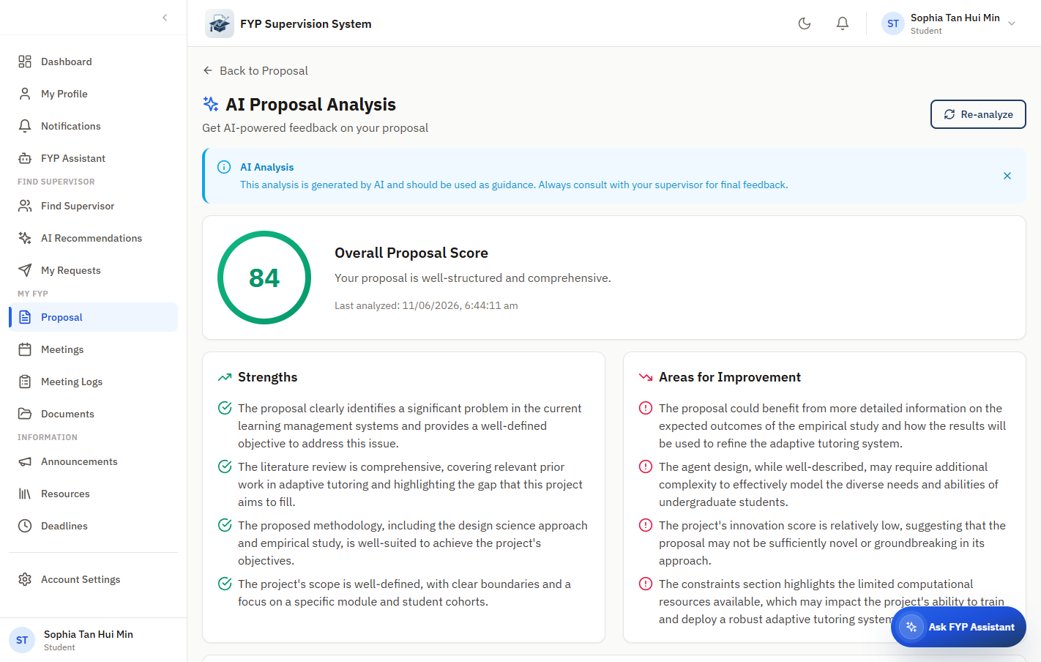
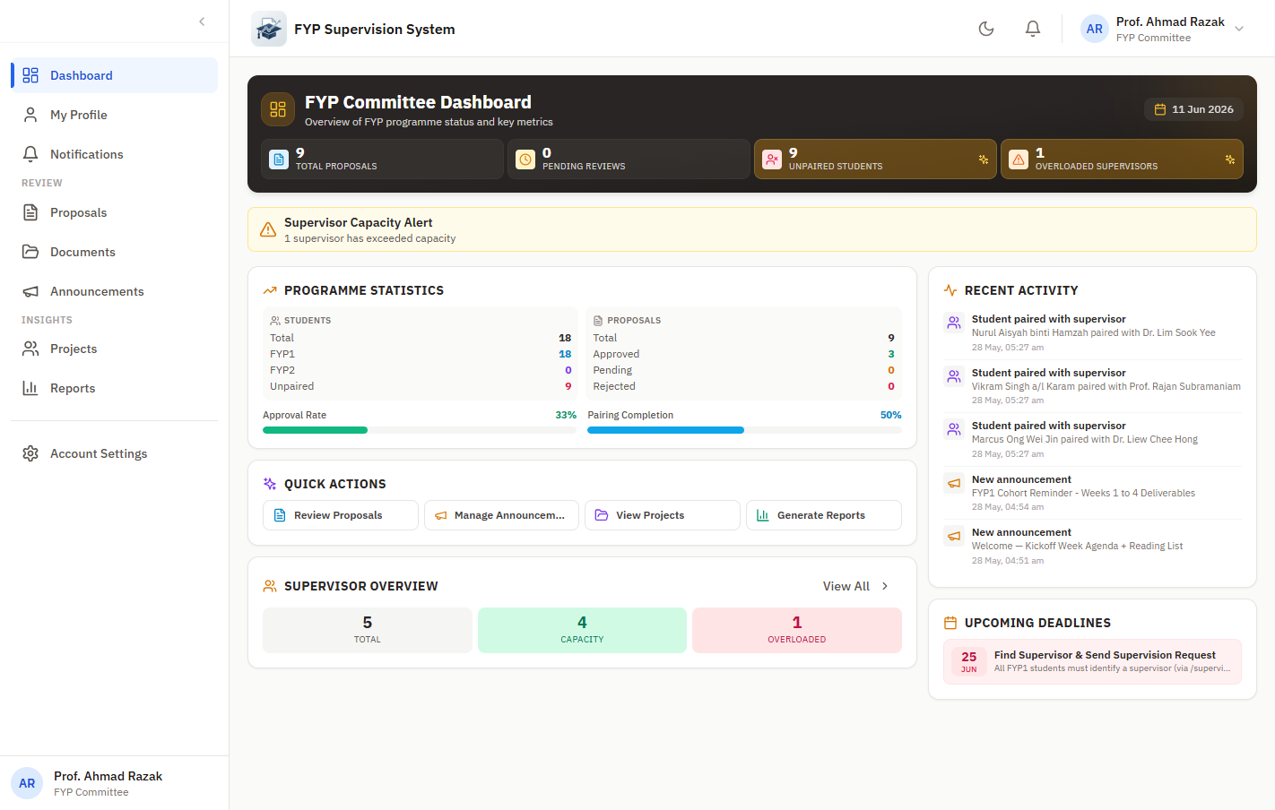
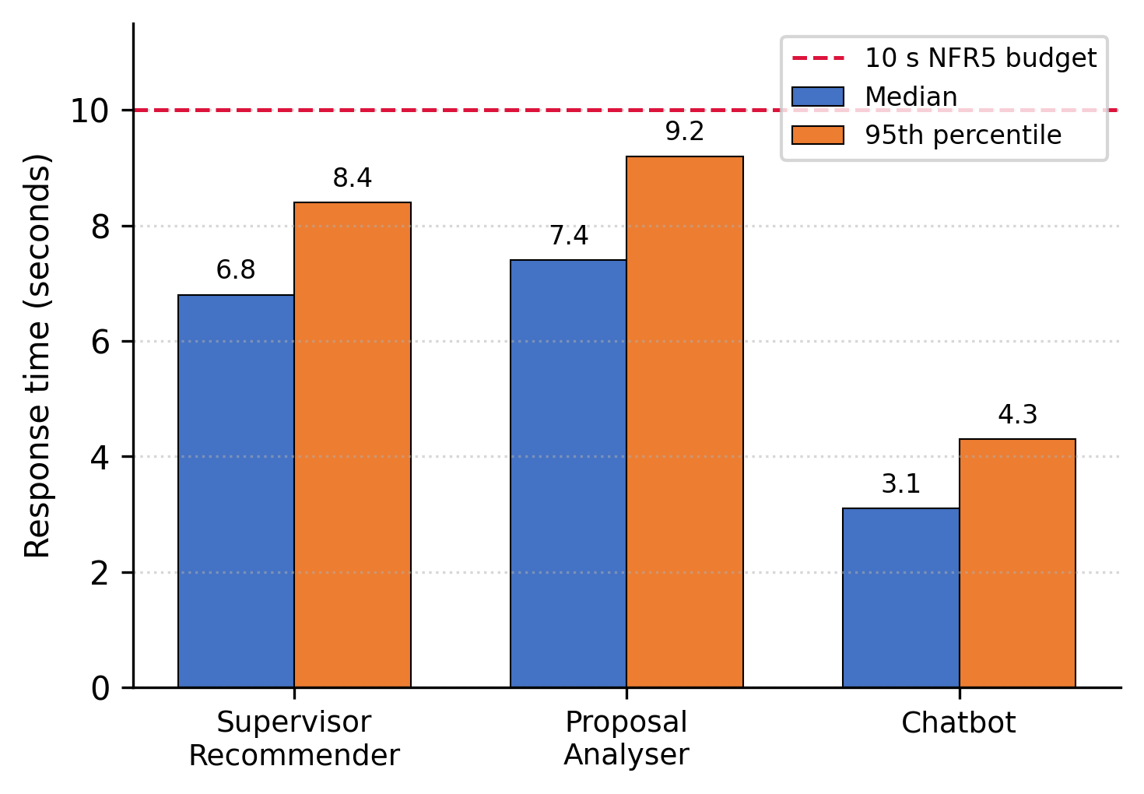
FYP Supervision System
An AI-Assisted Supervision Platform with Signed Meeting Logs
FYP02-SE-T2610-0001
Student Name:
Tai Zhi Xuan
1211109038
Student ID:
Supervisor:
Moderator:
Dr. Yeoh Eng Thiam
Mr. Chan Ming Man
Introduction
Objectives
Every MMU FCI student must complete a Final Year Project, yet supervision still runs across disconnected tools like email, Teams and spreadsheets, leaving its history fragmented and prone to last-minute rushes near submission.
◆ Feedback is verbal or buried in email threads, so required revisions get missed
◆ Meeting outcomes are remembered rather than recorded, weakening accountability
◆ Proposal reviews go to structure and formatting instead of the research content
1. Study current FCI supervision practice and capture system requirements.
2. Design a secure, role-based web platform for four user groups.
3. Build the core supervision workflow end to end.
4. Integrate three AI features: recommender, proposal checker, chatbot.
5. Test and evaluate whether it improves the FCI workflow.
Key Features
AI Supervisor Recommender
Sentence-BERT match on skills, interests and remaining quota.
AI Proposal Analyzer
DistilBERT plus NLP checks structure and readability pre-submission.
RAG FYP Chatbot
24/7 procedural help from a curated FAISS knowledge base.
Signed Meeting Logs
SHA-256 signatures in DOCX logs with 6-log FCI compliance.
Role-Based Access & Auth
Four roles with JWT, login throttling and password reset.
Supervisor Workspace
Supervisee, availability, feedback and document review.
Announcements & Filter
Programme, phase and student-targeted broadcasts.
Committee Oversight
Progress scoring, risk flags and CSV cohort reports.
Admin Console & Audit
Roster import, system parameters and a full action trail.
Architecture & Demo
AI Recommendations
Proposal Analyzer
Committee Dashboard
Three-tier: React SPA, Spring Boot API (JWT/RBAC), MySQL and 3 Flask AI microservices
React 18 · Spring Boot 3.2 · MySQL 8 · Flask · Docker · Sentence-BERT · DistilBERT · FAISS
Methodology
Results
Structured SDLC split across two phases: FYP1 (background, requirements, design) then FYP2 (build, integrate, test, evaluate).
Requirements › Design › Build › Test › Evaluate
◆ Role-based access enforced from day one across four actor modules
◆ Requirements grounded in a 45-student survey (Nov 2025)
60 test cases, 100% passed
52 JUnit methods, 7 services
6 integration journeys + panel
45 survey users, all 3+ tools
AI service response times
All five objectives met and pilot-ready. Next: MMU SSO, mobile app, scale test, committee analytics.

