Slide 1

Final Project bank customer data
Mia curtopelle
Kirsten Fischl
Tajahnei williams

Slide 2
About the dataset
Dataset from a German bank regarding customers applying for a loan
N = 1,000
20 attributes (numerical and qualitative)
Status of existing checking account, duration of checking account life, credit history, purpose of application, credit amount, savings account/bonds, employment, installment rate in percentage of disposable income, personal status and sex, other debtors, present resident since, property, age, other installment plans, housing, existing credits at this bank, job, number of people liable to provide maintenance for, telephone, and foreign worker
Two outcome classes (good or bad customer)

Slide 3
approach
Supervised
Binary classification
Three tested models
Support vector model (linear)
Logistic regression
Random forest

Slide 4

sampling
Model performance
Weaker
Stronger
Support Vector Model | Logistic Regression | Random Forest
 | Original Dataset | Training Dataset (imblearn.over_sampling)
Bad customers (0) | 300 | 527
Good customers (1) | 700 | 523

Slide 5
Support vector model
Classification Report
GridSearch Optimization
 | Precision | Recall | F1-score | Support
Bad | 0.69 | 0.76 | 0.72 | 173
Good | 0.74 | 0.67 | 0.70 | 177
Accuracy |  |  | 0.71 | 350
Macro Avg | 0.72 | 0.71 | 0.71 | 350
Weighted Avg | 0.72 | 0.71 | 0.71 | 350
Tested Parameters
C | 1 | 5 | 10 | 50
gamma | 0.0001 | 0.005 | 0.001 | 0.005
Best Parameters
C | 1
gamma | 0.0001
Improved Accuracy
73.5%

Slide 6
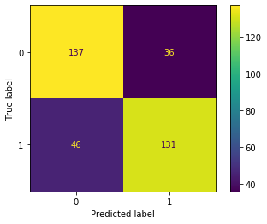
Svm confusion matrix

Slide 7
CLASSIFICATION REPORTS
Logistic regression
Grid search
optimization
 | Precision | Recall | F1-score | Support
Bad | 0.71 | 0.74 | 0.72 | 173
Good | 0.73 | 0.70 | 0.72 | 177
Accuracy |  |  | 0.71 | 350
Macro Avg | 0.72 | 0.72 | 0.72 | 350
Weighted Avg | 0.72 | 0.72 | 0.72 | 350
 | Precision | Recall | F1-score | Support
Bad | 0.72 | 0.75 | 0.73 | 173
Good | 0.75 | 0.71 | 0.73 | 177
Accuracy |  |  | 0.73 | 350
Macro Avg | 0.73 | 0.73 | 0.73 | 350
Weighted Avg | 0.73 | 0.73 | 0.73 | 350

Slide 8
CLASSIFICATION REPORTS WITH DUMMY ENCODED DATA
Logistic regression
Logistic regression
Grid search
optimization
 | Precision | Recall | F1-score | Support
Bad | 0.72 | 0.76 | 0.74 | 173
Good | 0.75 | 0.72 | 0.73 | 177
Accuracy |  |  | 0.74 | 350
Macro Avg | 0.74 | 0.74 | 0.74 | 350
Weighted Avg | 0.74 | 0.74 | 0.74 | 350
 | Precision | Recall | F1-score | Support
Bad | 0.69 | 0.77 | 0.73 | 173
Good | 0.75 | 0.66 | 0.70 | 177
Accuracy |  |  | 0.71 | 350
Macro Avg | 0.72 | 0.71 | 0.71 | 350
Weighted Avg | 0.72 | 0.71 | 0.71 | 350

Slide 9
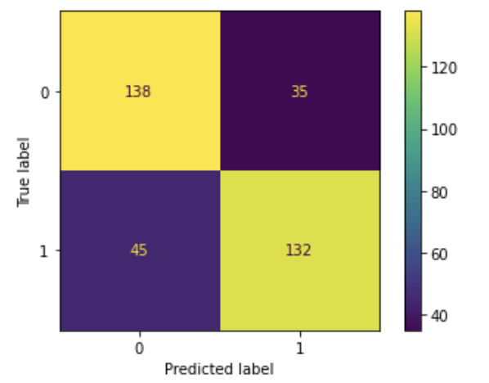
Confusion matrix according to the cost matrix associated with this dataset It is worse to class a customer as good when they are bad, than it is to class a customer as bad when they are good .

Slide 10
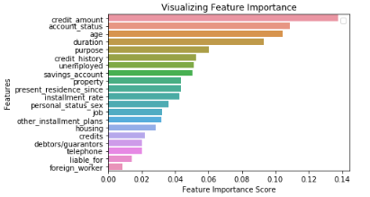
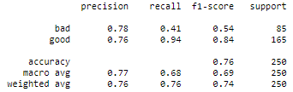
Random Forest classification
The first model was trained using 1,000 decision trees on scaled, but imbalanced data. It reached an accuracy score of 76%.
To improve the model, we compared the importance of the features to find out which ones could be dropped.

Slide 11
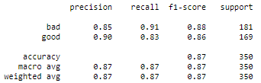
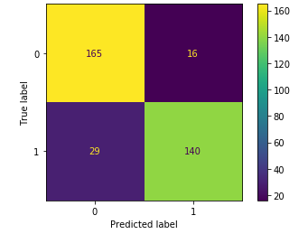
The least significant columns were dropped and by using the RandomOverSampler method, the data was balanced.
The second model trained with 3,000 decision trees, balanced data, and less features reached an accuracy score of 87%.

Slide 12
Bias in artificial intelligence
While it may be a significant improvement on making decisions through pure human subjectivity, banks still need to be concerned with the prevention of bias on the part of the programmer that may be intentional or unintentional
Steps like omitting unnecessary attributes like sex and foreign worker status can possibly prevent the algorithm from making a biased decision
A human review should be conducted of the predictions made by the machine learning algorithm to ensure fairness and protection against bias decisions.

