Slide 1
Interactive Story Space Ship Crisis
Fahim Ahmed (lead)(HTML/CSS)
Zaheer Tajani (HTML/CSS)
Aris Yusprov (HTML/CSS)

Slide 2
Description/Background
For this project we wanted to turn the Interactive Hiking story into a Interactive Story.
The story starts with a Space Ship crashing, and the different obstacles that a person or a crew goes through to survive the crisis.
Many different obstacles pose threats as the story goes giving a suspenseful background thinking you are the victim of the accident and stranded on a random planet with not many supplies and communications are not working.

Slide 3
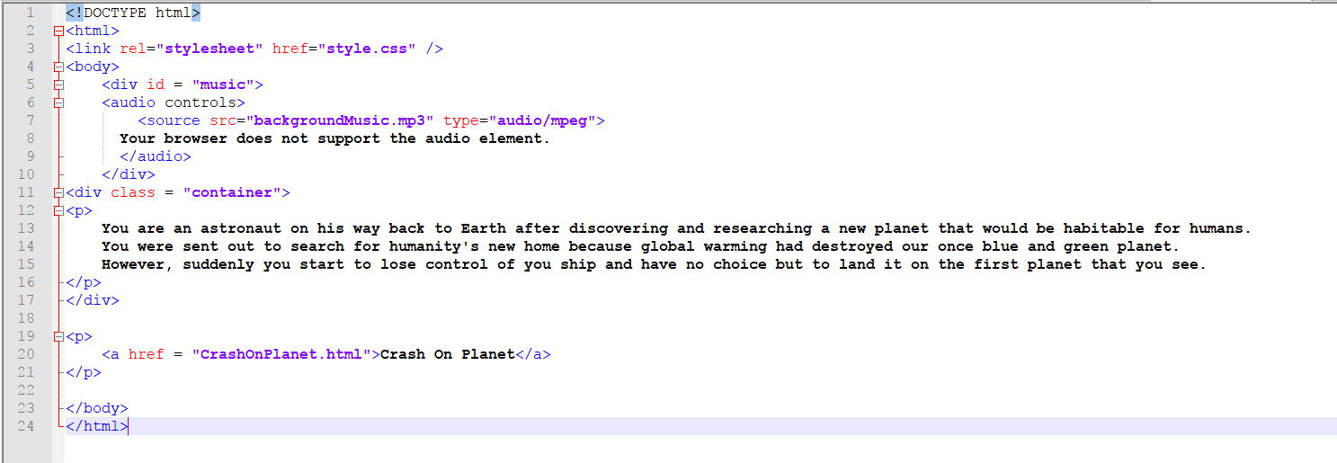
Code Snippets
SpaceShipCrisis.html
Starts the story

Slide 4
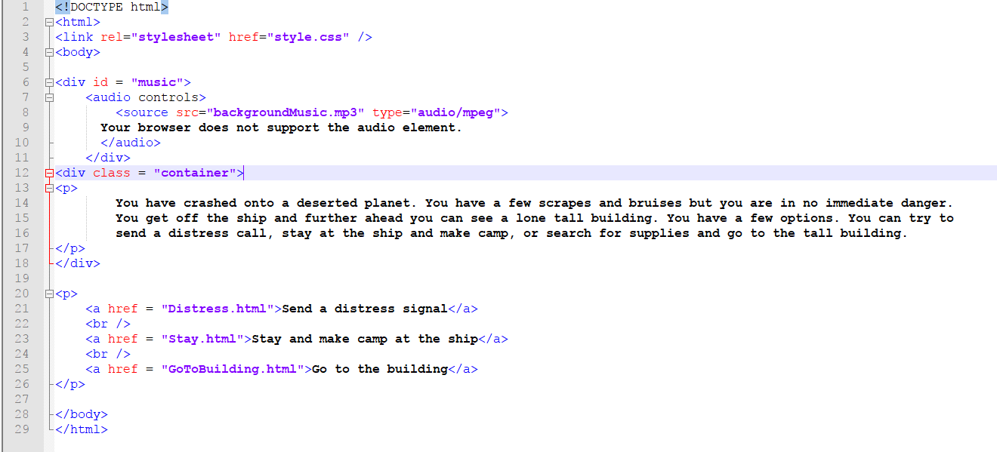
Crash on planet
Once you crash on the planet you have 3 options.
Distress signal, make a camp or go to the building you see.

Slide 5
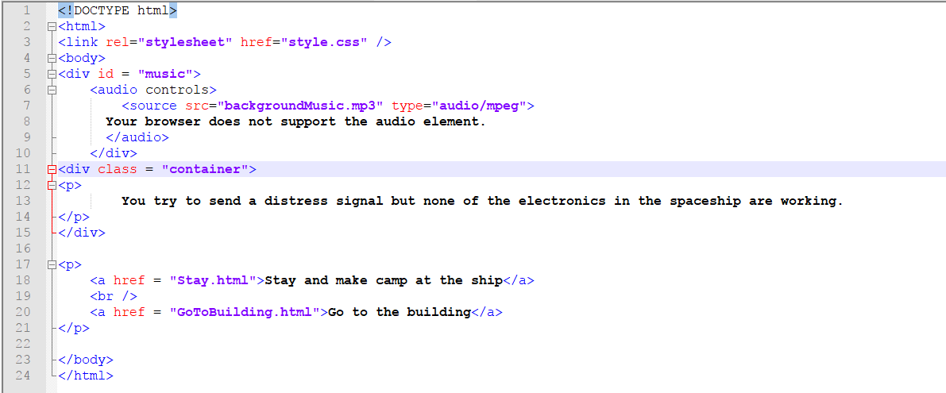
Distress signal
Two options are provided here
Stay and make a camp
Go to the building

Slide 6
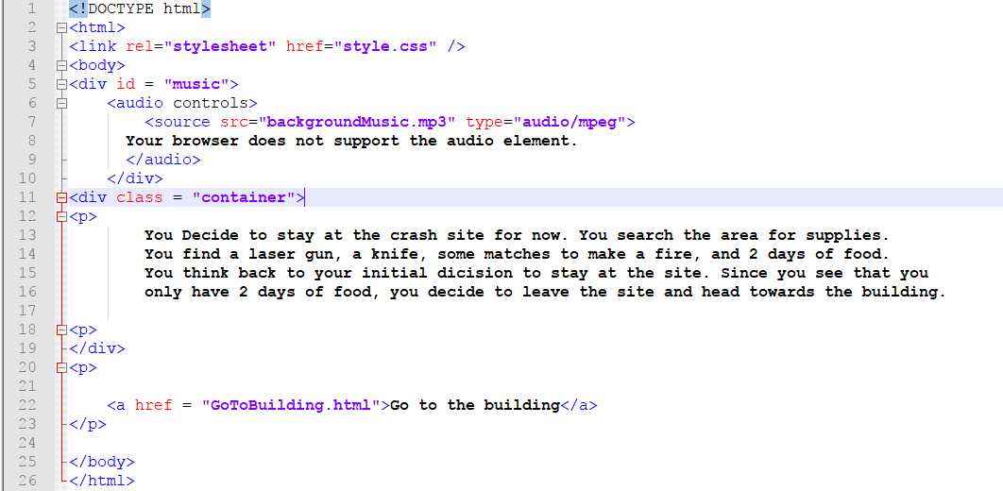
STAY
One option provided here
Go to the Building.

Slide 7
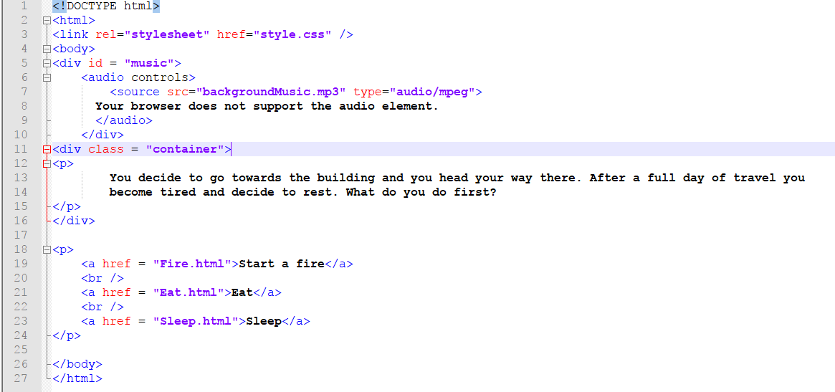
Go To The Building
Three Options
Start a fire
Eat
Sleep

Slide 8
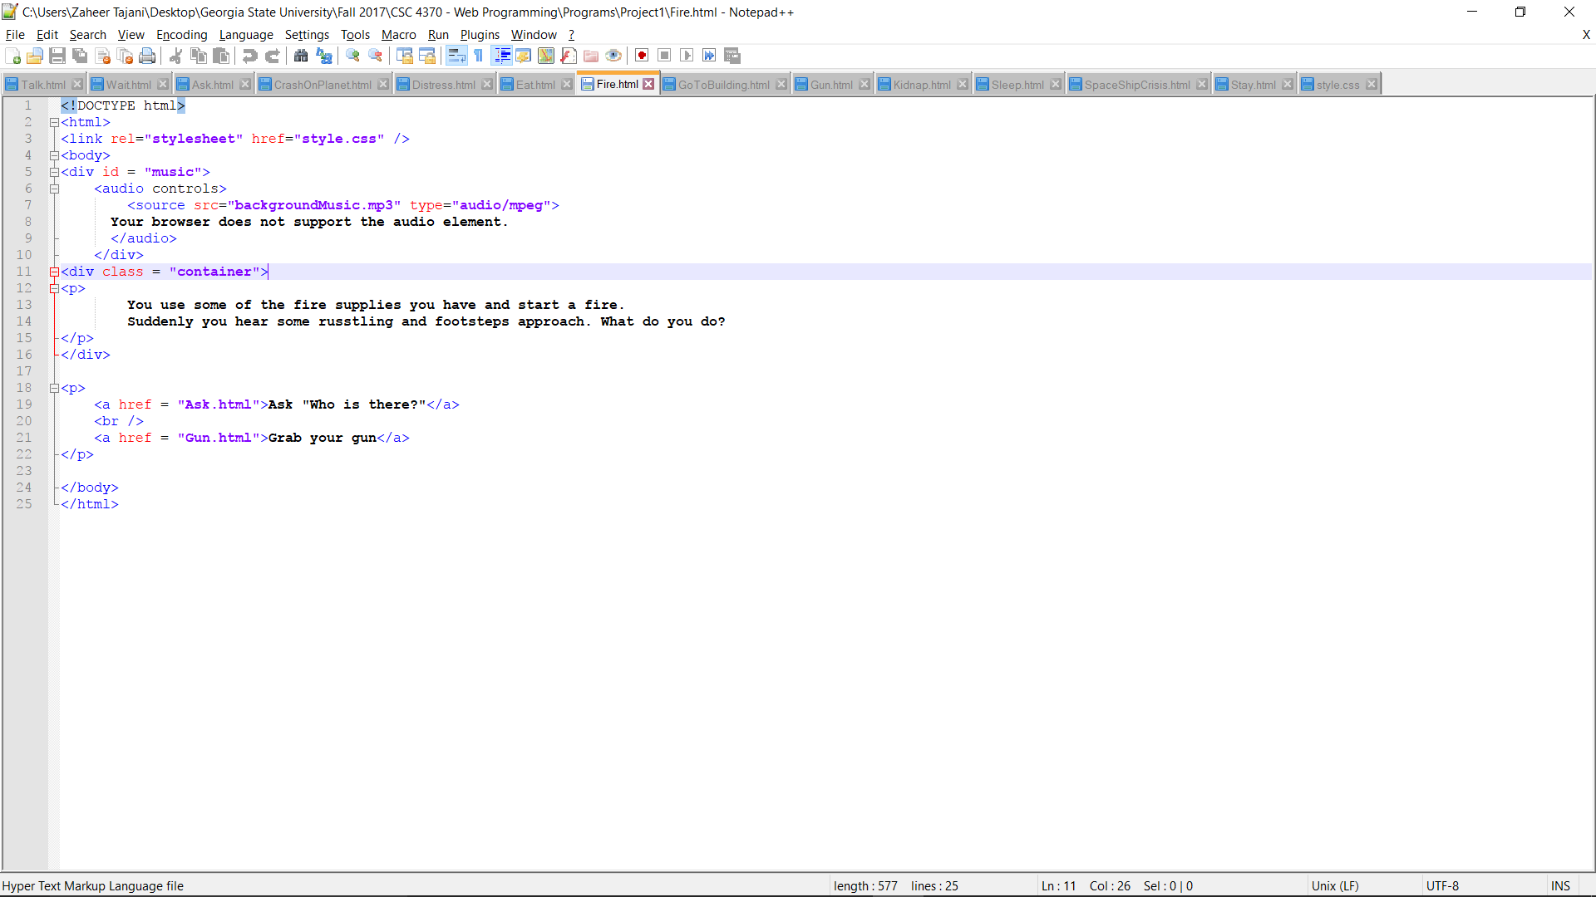
Build a Fire
Two Options
Ask who the people are
Attack the random people by shooting them

Slide 9
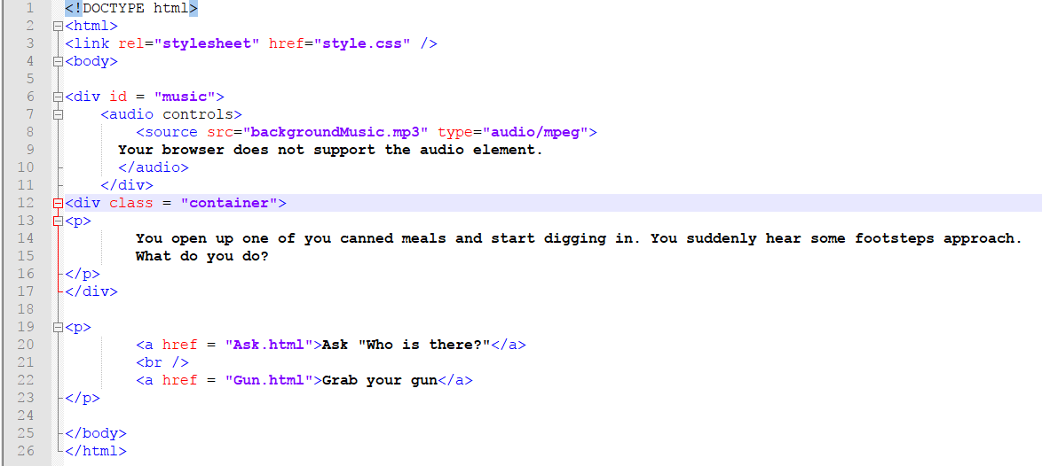
EAT
Two Options
Attack
Talk/Ask

Slide 10
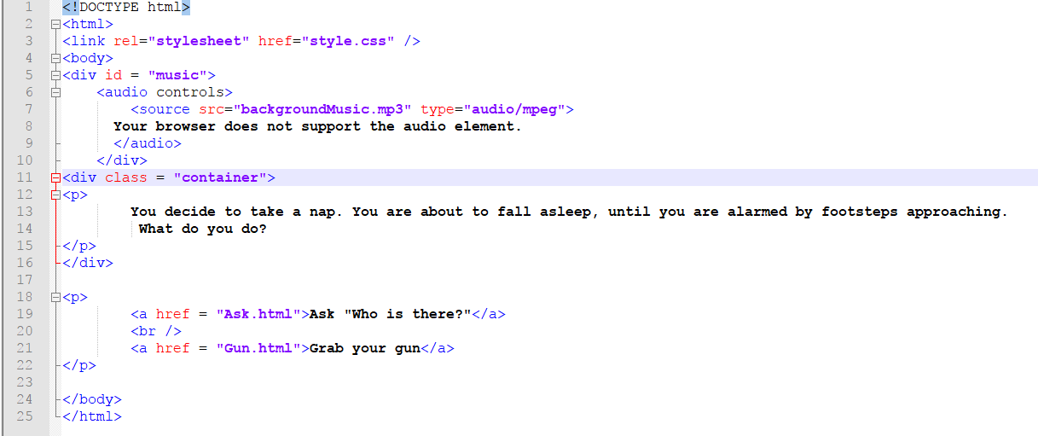
Sleep
Two Options
Ask who is there
Attack whoever/whatever is there

Slide 11
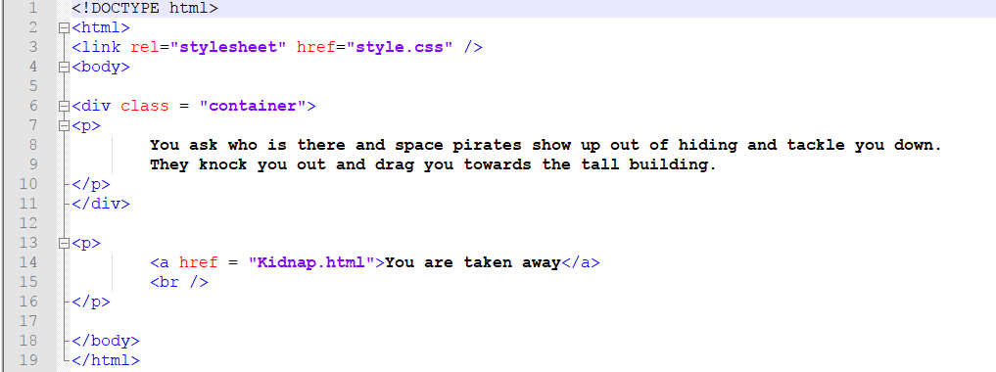
ask
One option
Get Kidnapped

Slide 12
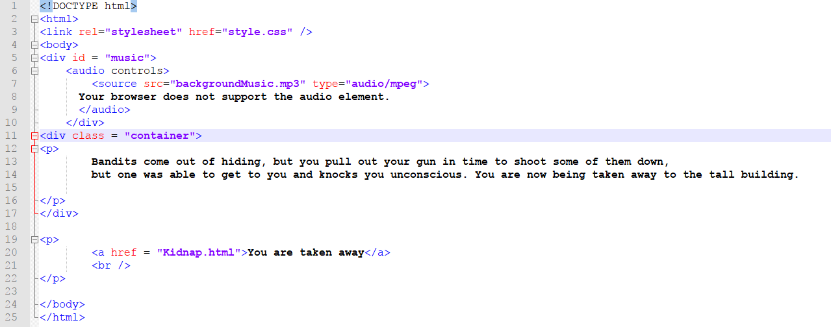
gun
One option
Get kidnapped

Slide 13
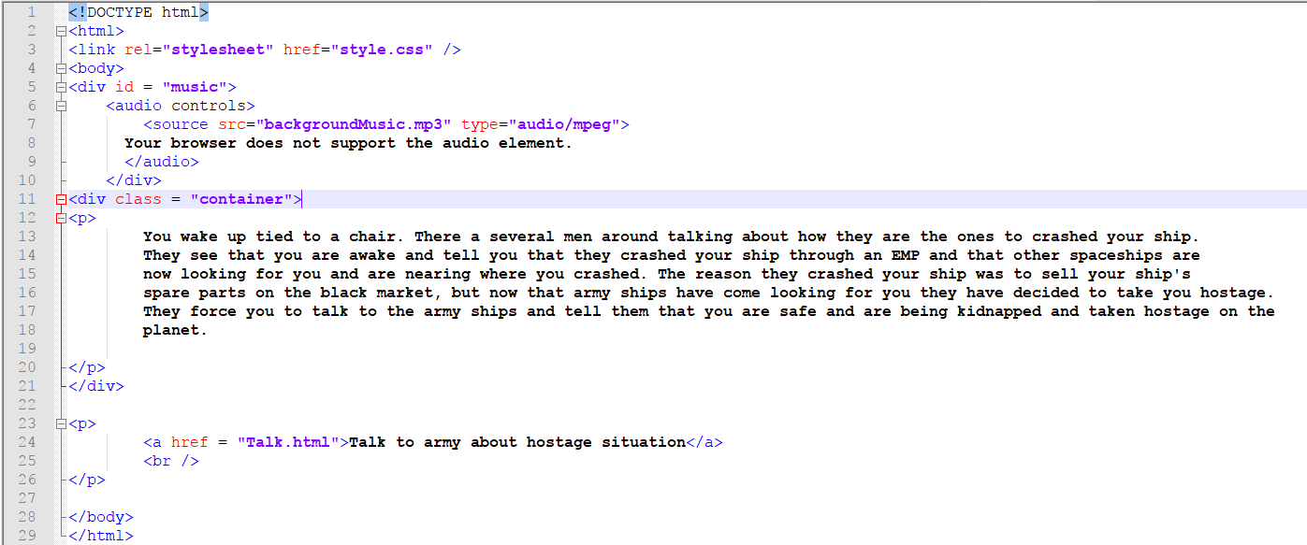
kidnap
Only option is to talk to your kidnappers and negotiate with them.

Slide 14
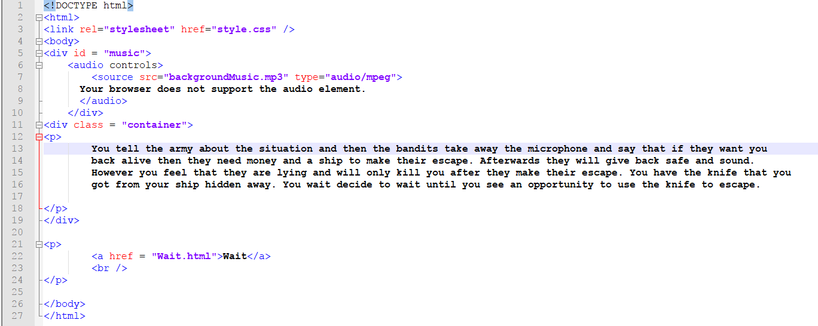
Talk
You try to reason with your Army guys and the kidnappers and help make a joint decision about kidnapping you.
You realize you have the knife to cut the ropes and wait for the right time to use it.

Slide 15
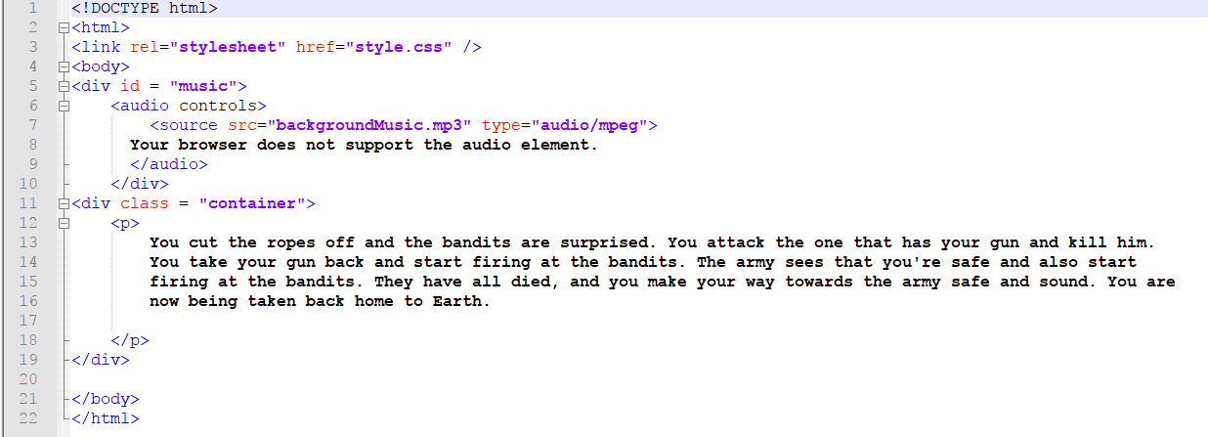
wait
The negotiations do not go well so you cut the ropes with your knife and beat the rest of the kidnappers and rush to safety where the Army takes you home back to Earth.

Slide 16
The end

