Slide 1

Aleya Chowdhury Susan carrera Ricky barnwell

Slide 2


Fly with us

Slide 3
Aleya Chowdhury Design and style CSS, HTML, javaScript, Jquery Powerpoint | Ricky Barnwell Team Leader Php , Date base, CSS, HTML Collaborate and Finalize code | Susan Carrera Data base MySQL

Slide 4
Goals
Travel booking to anywhere to visit a destination Book flights
Select rental car
Pre-pay for the parking

Slide 5
Languages
HTML
CSS
JAVASCRIPT
PHP
JQUERY
MYSQL

Slide 6
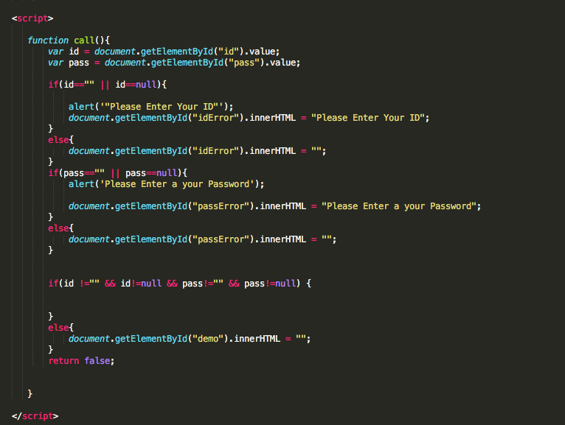
HOMEPAGE

Slide 7
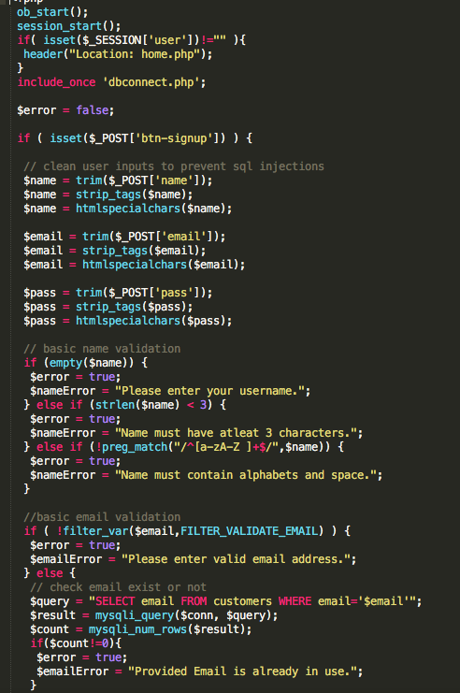
Register

Slide 8
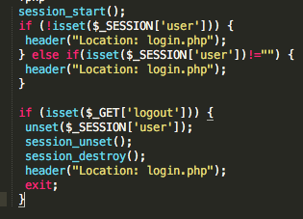
LOGOUT

Slide 9
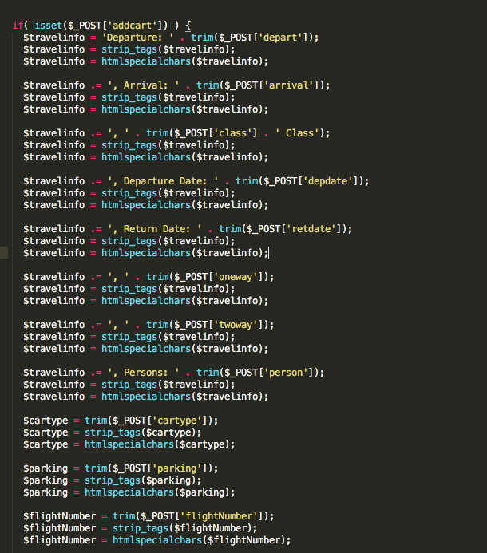
Booking

Slide 10
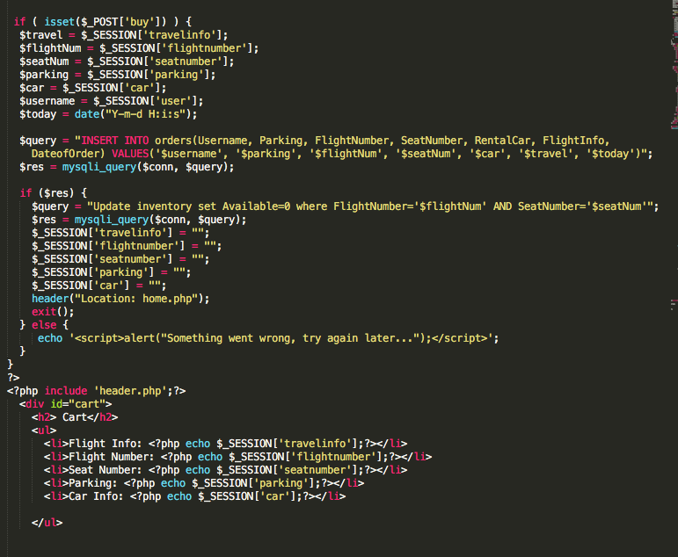
Shopping cart

Slide 11
Demo

Slide 12
