Slide 1
Game of Life
Members
Fahim ahmed
Mohammad Salman Mesia
Zaheer tajani

Slide 2
Game Rules
1. Any live cell with fewer than two live neighbors dies, as if caused by under population.
2. Any live cell with more than three live neighbors dies, as if by overcrowding.
3. Any live cell with two or three live neighbors’ lives on to the next generation.
4. Any dead cell with exactly three live neighbors becomes a live cell.

Slide 3
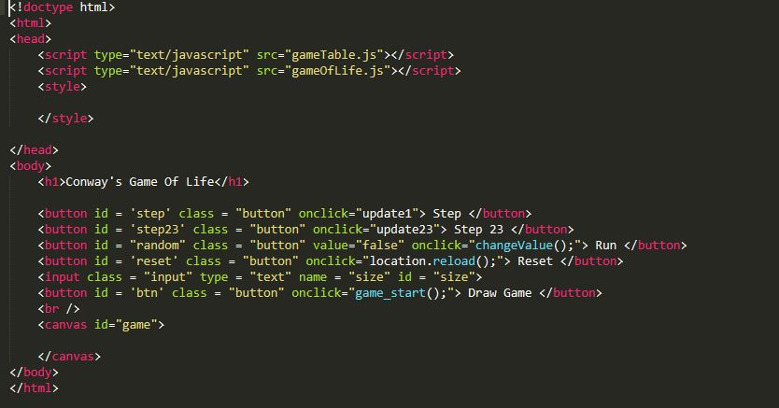
Code snippets

Slide 4
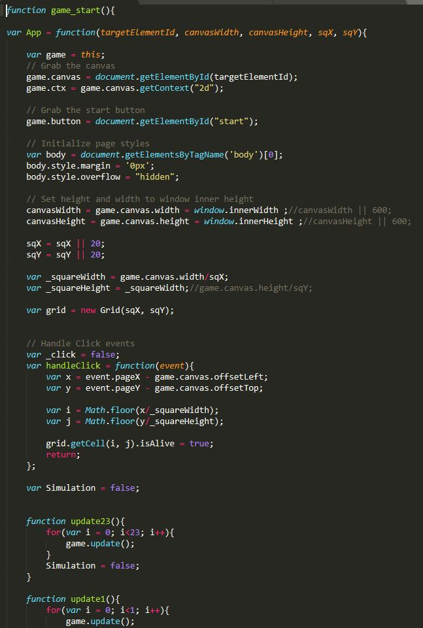
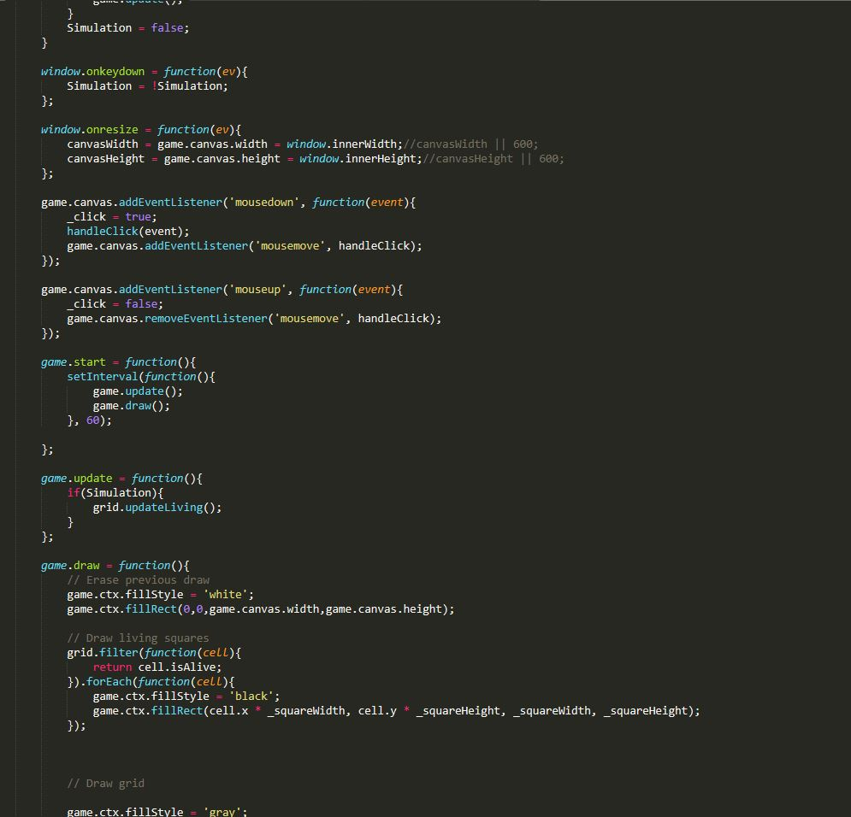
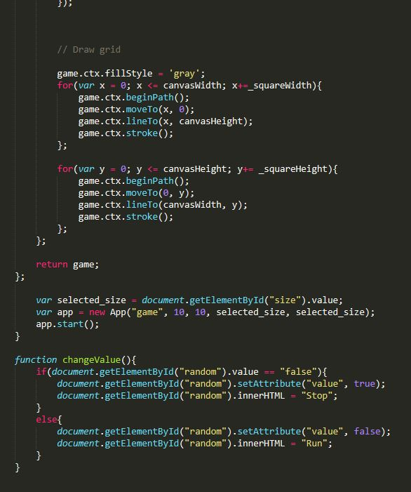
Code snippets cont.

Slide 5
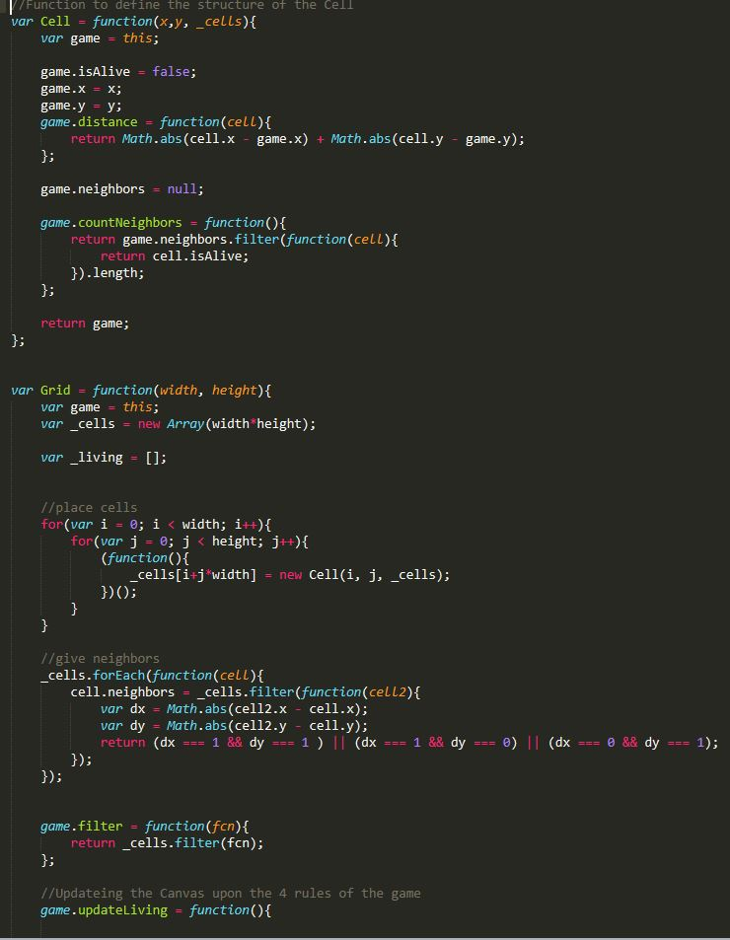
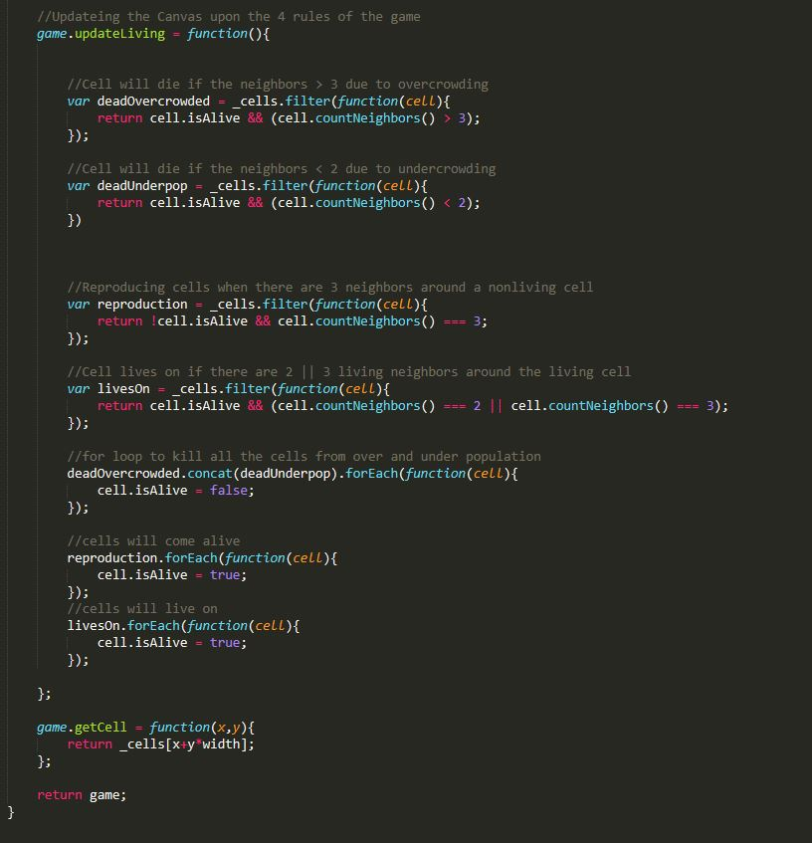
Code Snippets cont.

Slide 6
DEMO TIME!

